Slide 1
CCNA 200-301, Volume I
Chapter 1
Introduction to TCP/IP Networking

Slide 2
Objectives
Perspective on Networking
TCP/IP Networking Model
Data Encapsulation Terminology

Slide 3
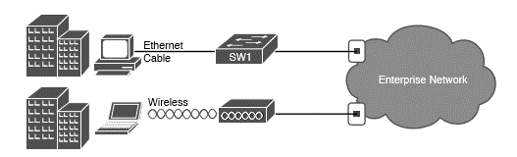
Two Major Branches of Networking
Enterprise Network

Slide 4
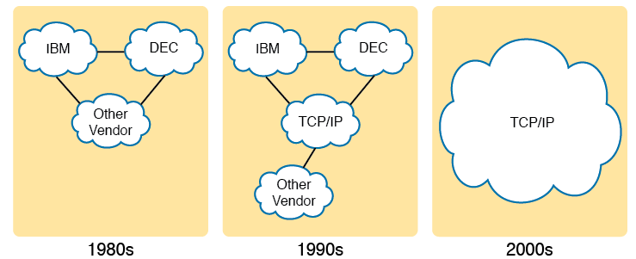
TCP/IP Networking Model
Historical Progression: Proprietary Models to Open TCP/IP

Slide 5
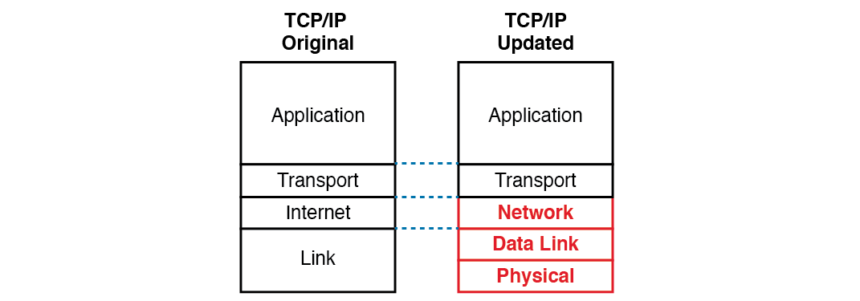
The Two TCP/IP Networking Models

Slide 6
TCP/IP Architectural Model and Example Protocols
TCP/IP Architecture Layer | Example Protocols
Application | HTTP, POP 3, SMTP
Transport | TCP,UDP
Internet | IP, ICMP
Data Link & Physical | Ethernet, 802.11 (Wi-Fi) TCP/IP

Slide 7
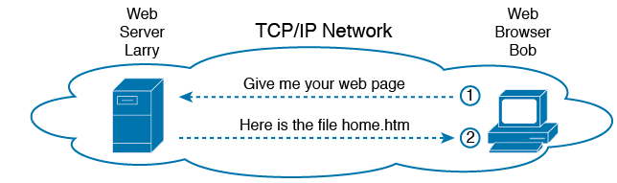
HTTP
Basic Application Logic to Get a Web Page

Slide 8
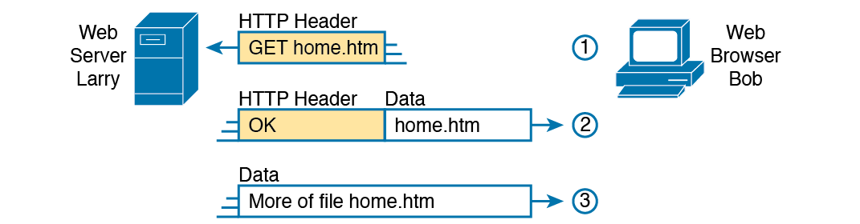
HTTP (continued)
HTTP Get Request, HTTP Reply, and one Data-Only Message

Slide 9
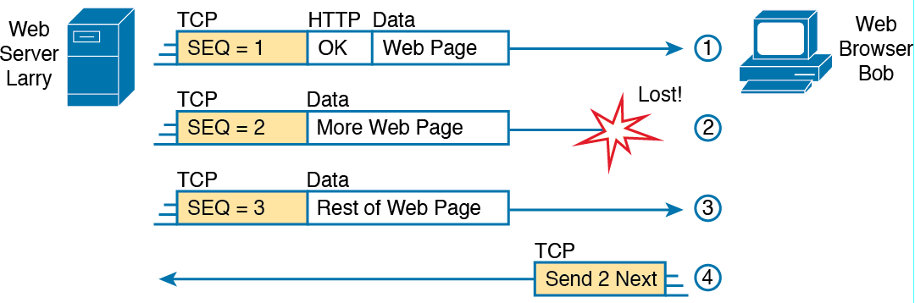
TCP/IP Transport Layer
TCP Error-Recovery Services as Provided to HTTP

Slide 10
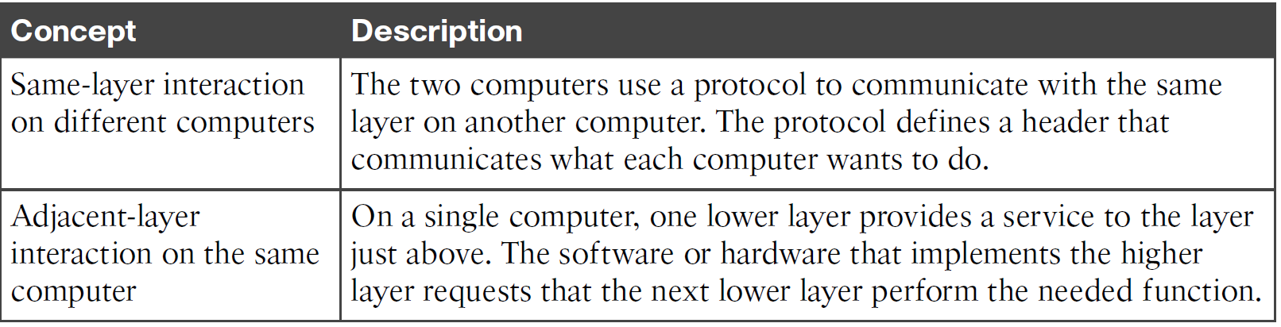
Same-Layer and Adjacent-Layer Interaction

Slide 11
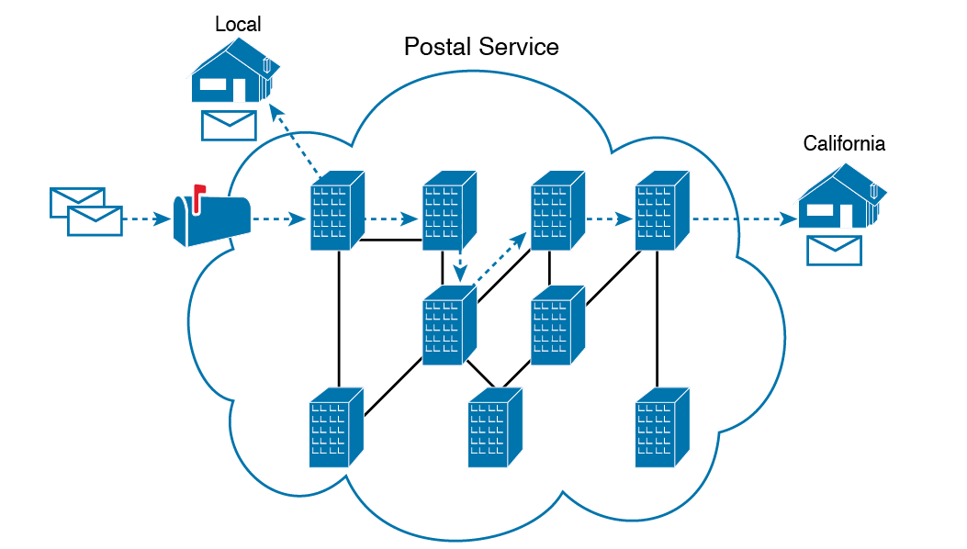
Postal Service Forwarding (Routing) Letters

Slide 12
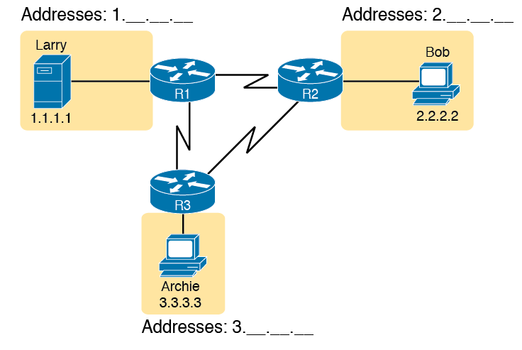
Simple TCP/IP Network

Slide 13
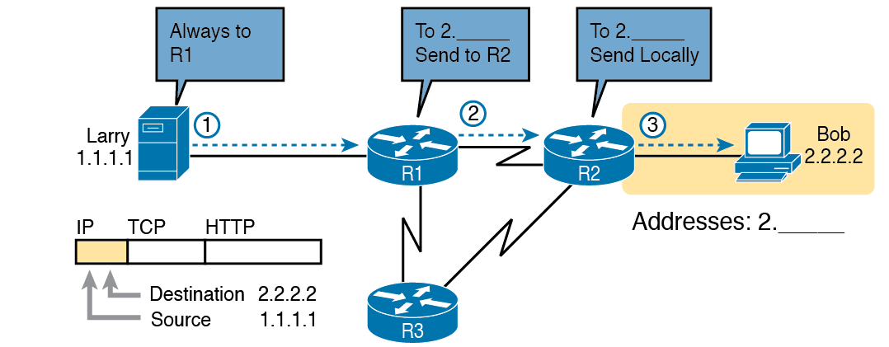
Basic Routing Example

Slide 14
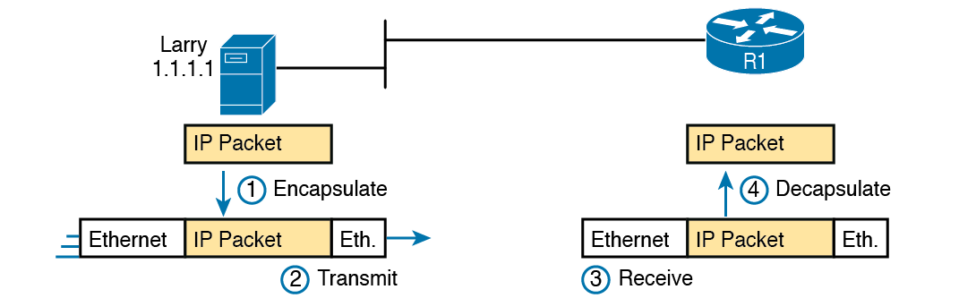
Ethernet
Larry Using Ethernet to Forward an IP Packet to Router R1

Slide 15
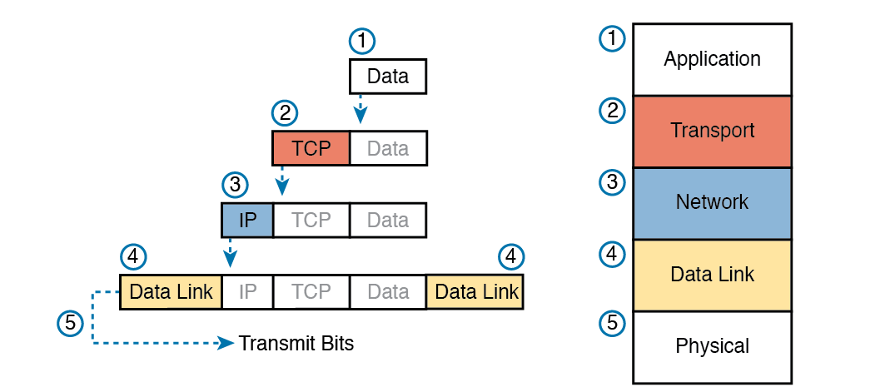
Five Steps of Data Encapsulation: TCP/IP

Slide 16

Perspective on Encapsulation and “Data”
The letters LH and LT stand for link header and link trailer, respectively, and refer to the data link layer header and trailer.
The letters LH and LT stand for link header and link trailer, respectively, and refer to the data link layer header and trailer.
The letters LH and LT stand for link header and link trailer, respectively, and refer to the data link layer header and trailer.

Slide 17
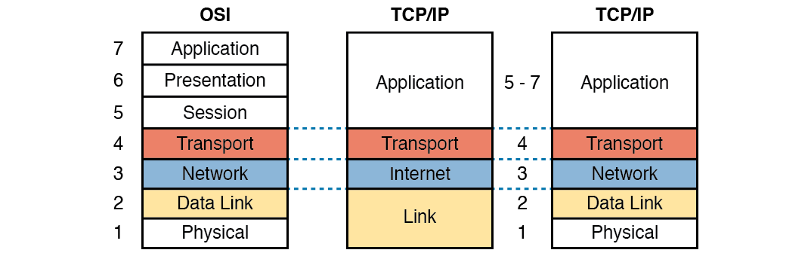
OSI Networking Model
OSI Model Compared to the Two TCP/IP Models

Slide 18
OSI Reference Model Layer Definitions
Layer | Functional Description
7 All | Application layer. This layer provides an interface between the communications software and any applications that need to communicate outside the computer on which the application resides. It also defines processes for user authentication.
6 People | Presentation layer. This layer’s main purpose is to define and negotiate data formats, such as ASCII text, EBCDIC text, binary, BCD, and JPEG. Encryption is also defined by OSI as a presentation layer service
5 Seem | Session layer. This layer defines how to start, control, and end conversations (called sessions). This includes the control and management of multiple bidirectional messages so that the application can be notified if only some of a series of messages are completed. This allows the presentation layer to have a seamless view of an incoming stream of data.
4 To | Transport layer. This layer’s protocols provide a large number of services, as described in Chapter 5, “Fundamentals of TCP/IP Transport and Applications.” Although OSI Layers 5 through 7 focus on issues related to the application, Layer 4 focuses on issues related to data delivery to another computer (for instance, error recovery and flow control).

Slide 19
OSI Reference Model Layer Definitions (Continued
Layer | Functional Description
3 Need | Network layer. This layer defines three main features: logical addressing, routing (forwarding), and path determination. Routing defines how devices (typically routers) forward packets to their final destination. Logical addressing defines how each device can have an address that can be used by the routing process. Path determination refers to the work done by routing protocols to learn all possible routes, and choose the best route.
2 Data | Data link layer. This layer defines the rules that determine when a device can send data over a particular medium. Data link protocols also define the format of a header and trailer that allows devices attached to the medium to successfully send and receive data
1 Processing | Physical layer. This layer typically refers to standards from other organizations. These standards deal with the physical characteristics of the transmission medium, including connectors, pins, use of pins, electrical currents, encoding, light modulation, and the rules for how to activate and deactivate the use of the physical medium.

Slide 20
OSI Reference Model Example Devices and Protocols
Layer Name | Protocols and Specifications | Devices
Application, presentation, session (Layers 5–7) | Telnet, HTTP, FTP, SMTP, POP3, VoIP, SNMP | Hosts, firewalls
Transport (Layer 4) | TCP, UDP | Hosts, firewalls
Network (Layer 3) | IP | Router
Data link (Layer 2) | Ethernet (IEEE 802.3), HDLC | LAN switch, wireless access point, cable modem, DSL modem
Physical (Layer 1) | RJ-45, Ethernet (IEEE 802.3) | LAN hub, LAN repeater, cables

Slide 21
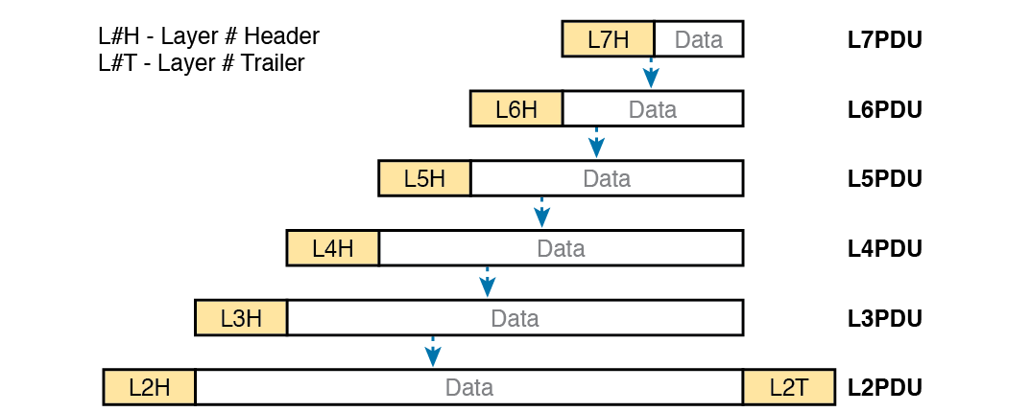
OSI Encapsulation and Protocol Data Units

