Slide 1
CCNA 200-301, Volume I
Chapter 10
RSTP and EtherChannel Configuration

Slide 2
Objectives
Understanding RSTP Through Configuration
Implementing EtherChannel

Slide 3
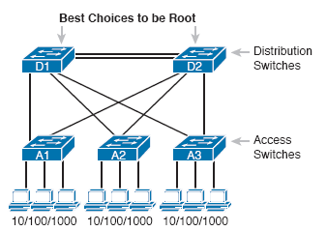
Typical Configuration Choice: Making Distribution Switch Be Root
For instance: In a typical LAN design model, with two distribution layer switches connecting to multiple access layer switches; most network engineers would make the one of the distribution switches the STP root switch.

Slide 4
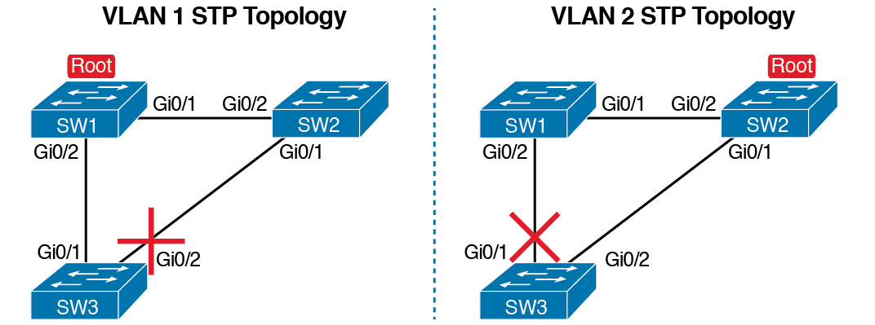
Load Balancing with One Tree for VLAN 1 and Another for VLAN 2

Slide 5
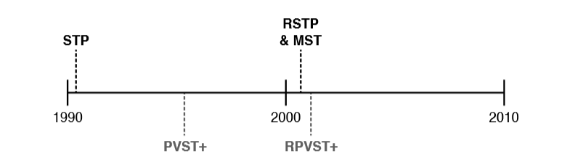
Timeline of Per-VLAN and Multiple STP Features

Slide 6
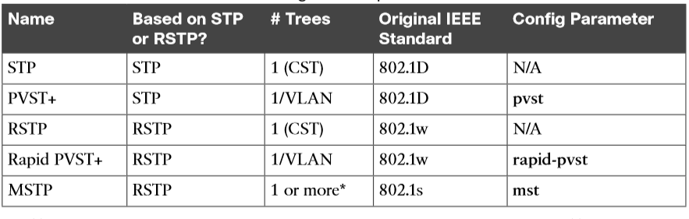
STP Standards and Configuration Options

Slide 7
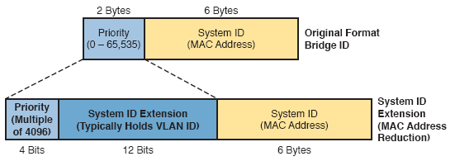
STP System ID Extension

Slide 8
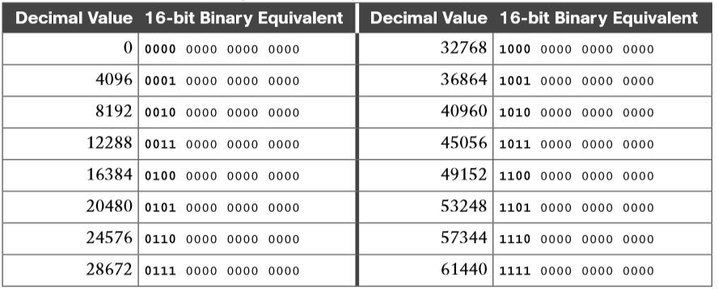
STP/RSTP Configurable Priority Values

Slide 9
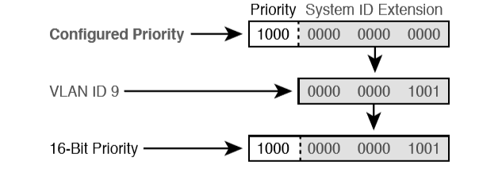
Configured Priority (16-Bit) and System ID Extension (12-Bit) Added

Slide 10

Configuring a Manual EtherChannel
Step 1. Add the channel-group number mode on command in interface configuration mode under each physical interface that should be in the channel to add it to the channel.
Step 2. Use the same number for all commands on the same switch, but the channel-group number on the neighboring switch can differ.

Slide 11
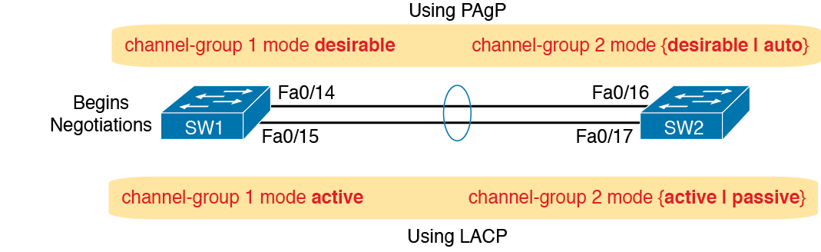
Configuring Dynamic EtherChannels
Two different protocols support switch negotiation of EtherChannel links: PagP and LACP
The switch can use the protocol to send messages to/from the neighboring switch and discover if their configuration settings pass all checks
If a given physical link passes, the link is added to the EtherChannel and used

Slide 12
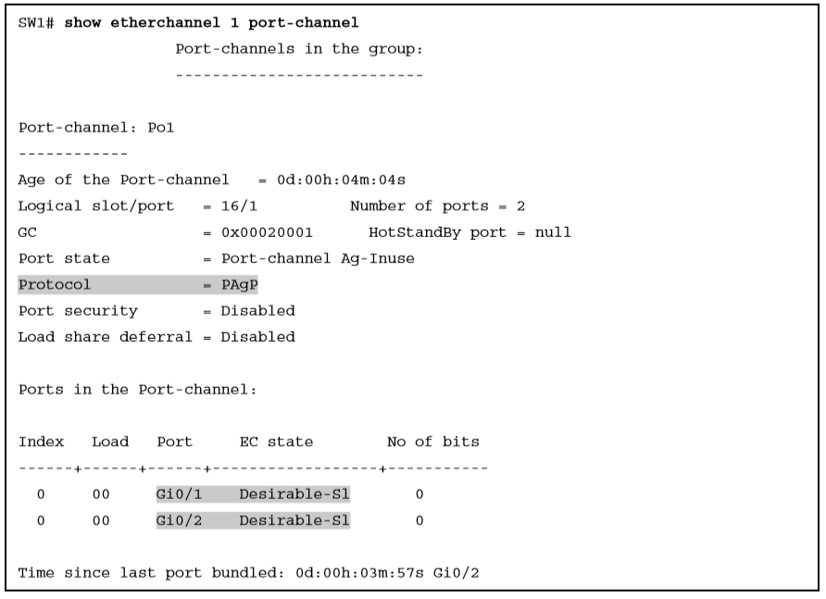
EtherChannel Verification: PAgP Desirable Mode

Slide 13
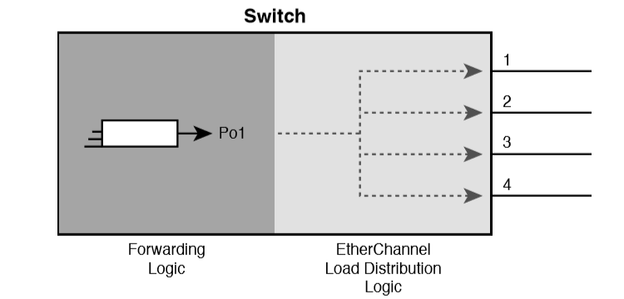
Correct EtherChannel Configuration Combinations

Slide 14
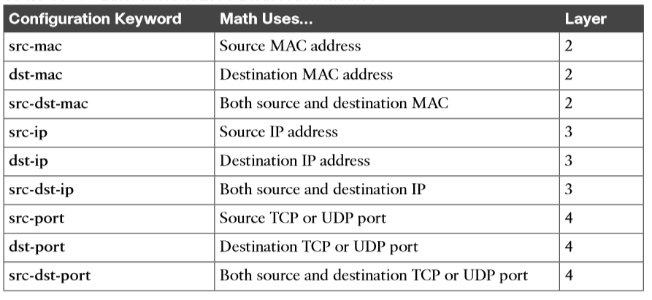
EtherChannel Load Distribution Methods

Slide 15
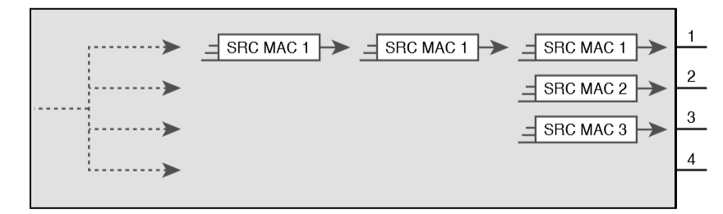
Distributing All Frames with Same Mac Out Same Interface

Slide 16
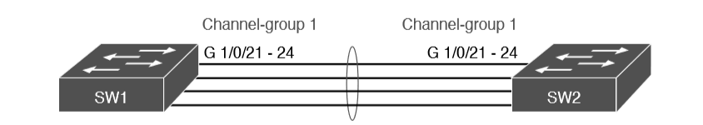
Four-Link EtherChannel

Slide 17
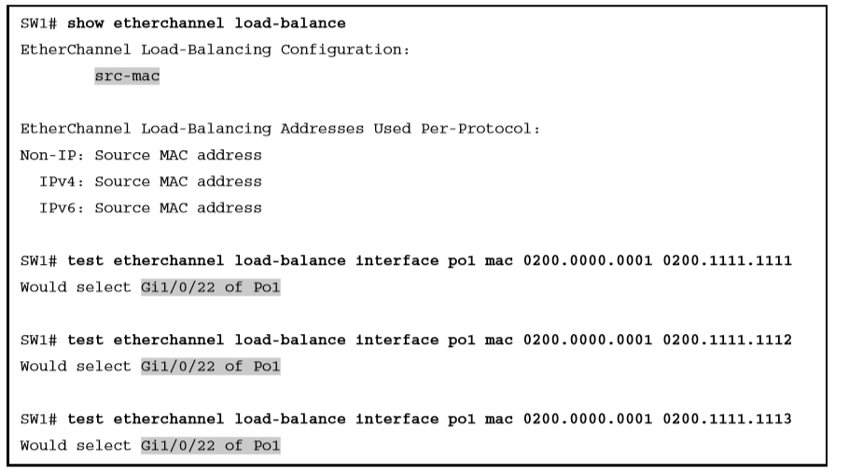
Testing with Identical Source MACs When Using src-mac Balancing

Slide 18
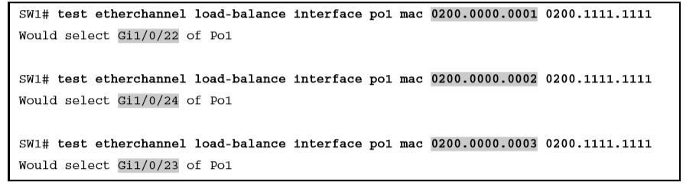
Testing with Source MACs with Low-Order Bit Differences

Slide 19
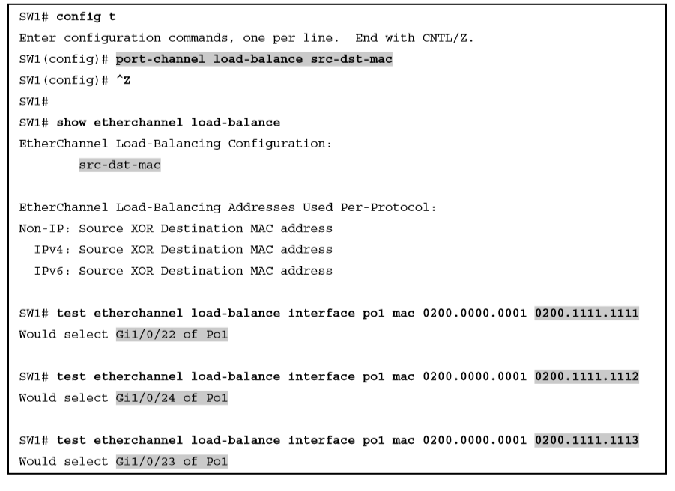
Evidence of Source and Destination MAC Load Distribution

