Slide 1
CCNA 200-301, Volume I
Chapter 11
Perspectives on IPv4 Subnetting

Slide 2
Objectives
Analyze Requirements
Make Design Choices

Slide 3
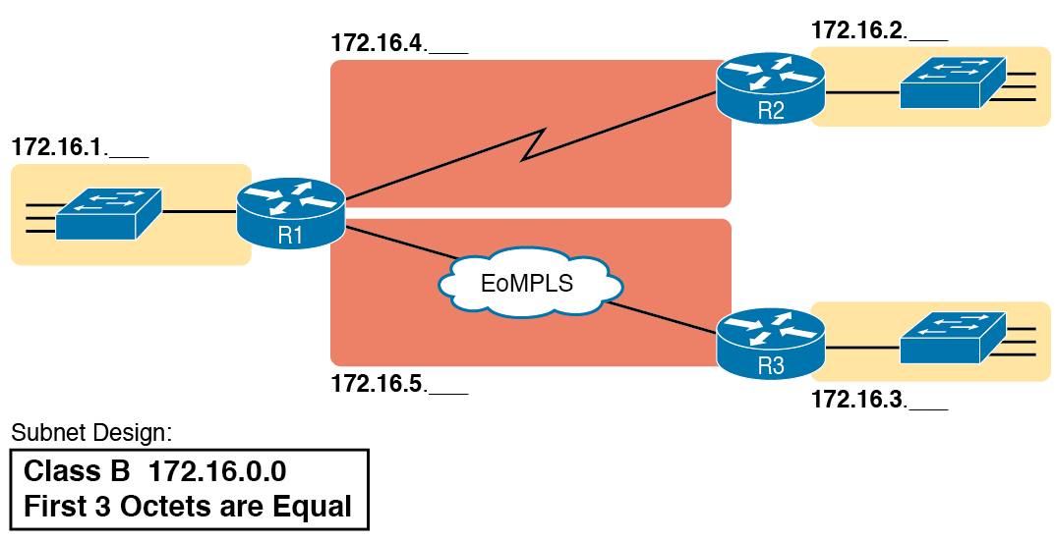
Example Subnet Plan Document

Slide 4
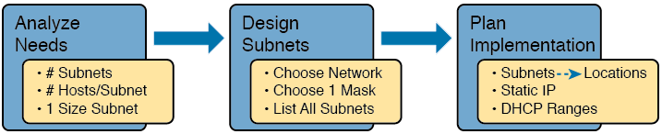
Subnet Planning, Design, and Implementation Tasks

Slide 5
Analyze Subnetting and Addressing Needs
Which hosts should be grouped together into a subnet?
How many subnets does this network require?
How many host IP addresses does each subnet require?
Will we use a single subnet size for simplicity, or not?

Slide 6
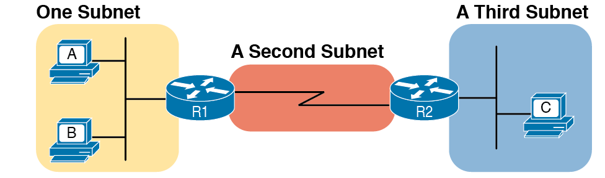
PC A and B in One Subnet, PC C in a Different Subnet

Slide 7
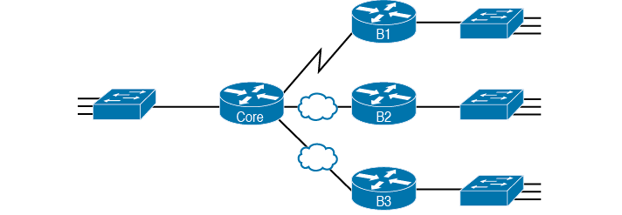
Four Site Internetwork with Small Central Site

Slide 8
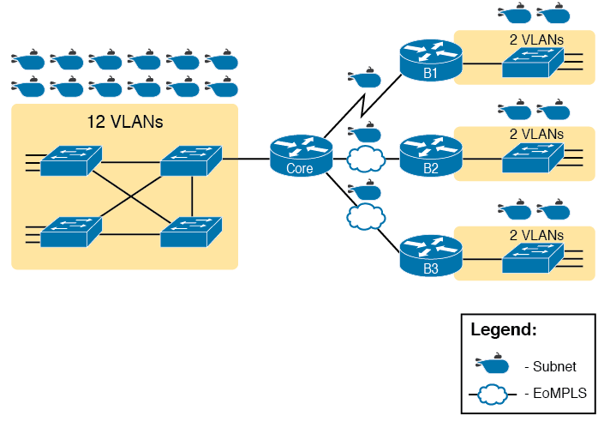
Four-Site Internetwork with Larger Central Site

Slide 9
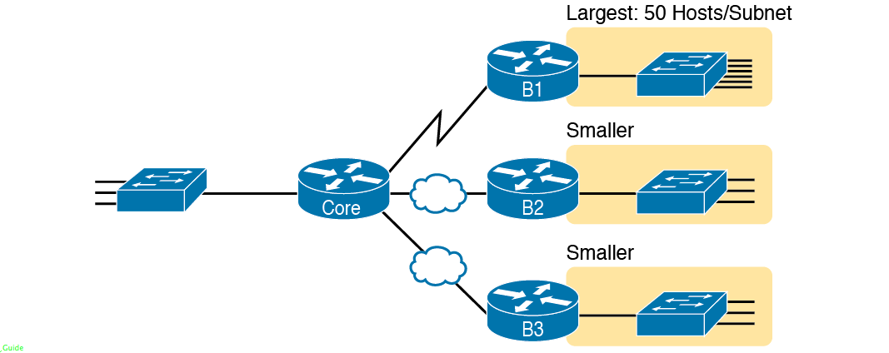
Large Branch B1 with 50 Hosts/Subnet

Slide 10

Subnet Size Concepts

Slide 11
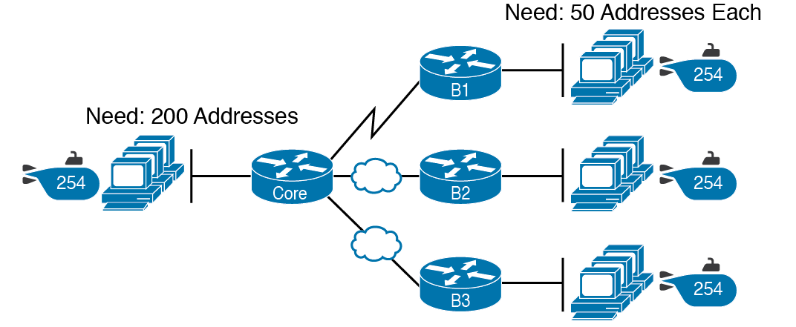
Network Using One Subnet Size

Slide 12
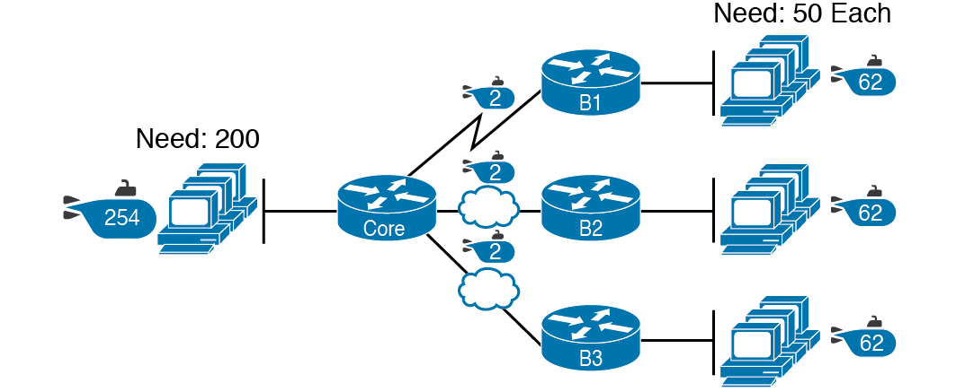
Three Masks, Three Subnet Sizes

Slide 13
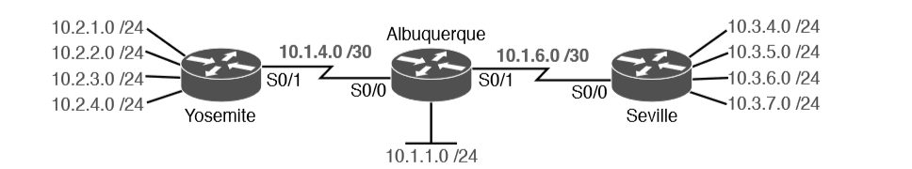
Internetwork with VLSM: Network 10.0.0.0, >1 Mask

Slide 14

Input to the Design Phase, and Design Questions to Answer

Slide 15
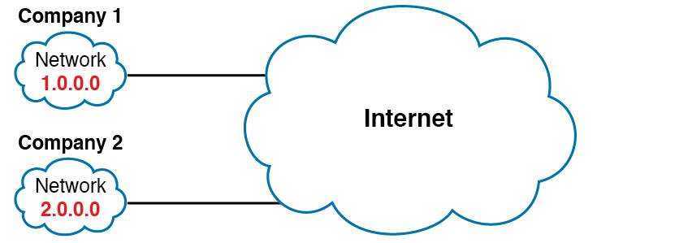
Two Companies with Unique Public IP Networks

Slide 16
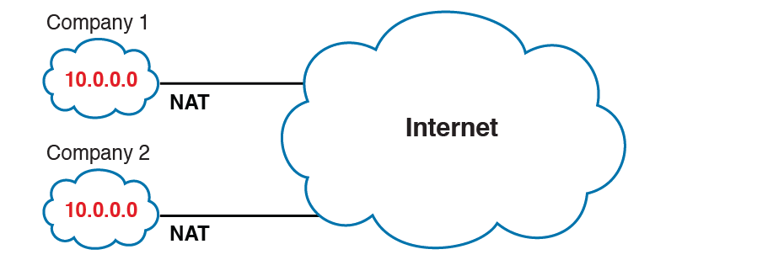
Reusing the Same Private Network 10.0.0.0 with NAT

Slide 17
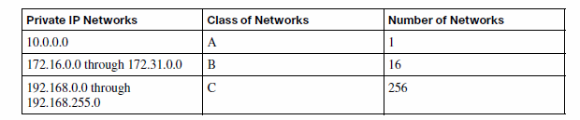
RFC 1918 Private Address Space

Slide 18
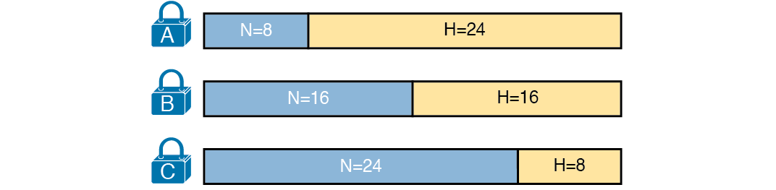
Format of Unsubnetted Class A, B, and C Networks

Slide 19
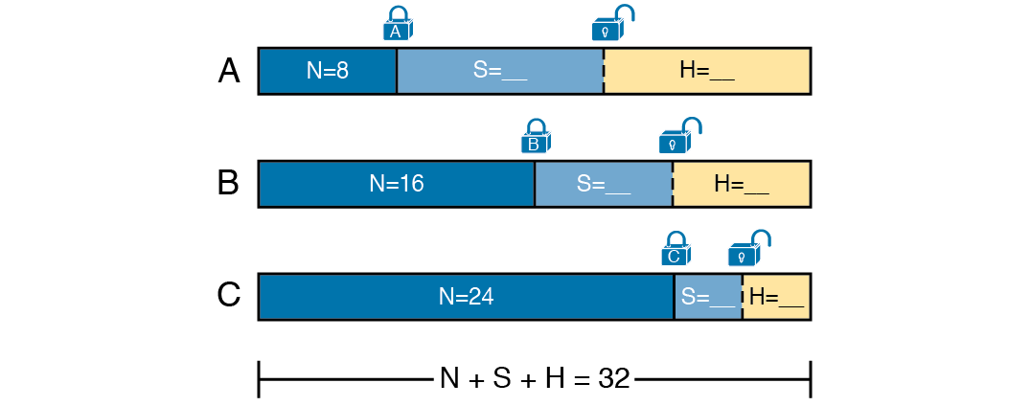
Concept of Borrowing Host Bits

Slide 20
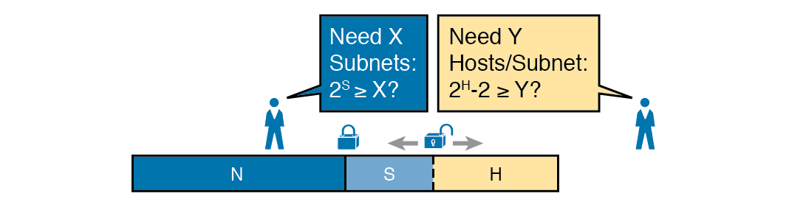
Borrowing Enough Subnet and Host Bits

Slide 21
Powers of 2 Reference for Designing Masks
Number of Bits | 2^{X} | 2^{X} – 2
1 | 2 | 0
2 | 4 | 2
3 | 8 | 6
4 | 16 | 14
5 | 32 | 30
6 | 64 | 62
7 | 128 | 126
8 | 256 | 254
9 | 512 | 510
10 | 1024 | 1022
11 | 2048 | 2046
12 | 4096 | 4094

Slide 22
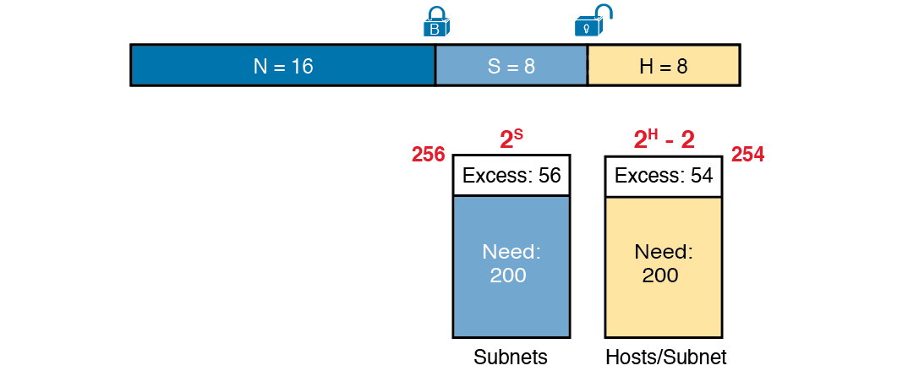
Example Mask Choice, N = 16, S = 8, H = 8

Slide 23

Creating the Subnet Mask—Binary—Class B Network

Slide 24
First Ten Subnets, Plus the Last Few, from 172.16.0.0, 255.255.255.0
Subnet Number | IP Addresses | Broadcast Address
172.16.0.0 | 172.16.0.1 – 172.16.0.254 | 172.16.0.255
172.16.1.0 | 172.16.1.1 – 172.16.1.254 | 172.16.1.255
172.16.2.0 | 172.16.2.1 – 172.16.2.254 | 172.16.2.255
172.16.3.0 | 172.16.3.1 – 172.16.3.254 | 172.16.3.255
172.16.4.0 | 172.16.4.1 – 172.16.4.254 | 172.16.4.255
172.16.5.0 | 172.16.5.1 – 172.16.5.254 | 172.16.5.255
172.16.6.0 | 172.16.6.1 – 172.16.6.254 | 172.16.6.255
172.16.7.0 | 172.16.7.1 – 172.16.7.254 | 172.16.7.255
172.16.8.0 | 172.16.8.1 – 172.16.8.254 | 172.16.8.255
172.16.9.0 | 172.16.9.1 – 172.16.9.254 | 172.16.9.255
------------Skipping many ------------------------
172.16.254.0 | 172.16.254.1 – 172.16.254.254 | 172.16.254.255
172.16.255.0 | 172.16.255.1 – 172.16.255.254 | 172.16.255.255

Slide 25
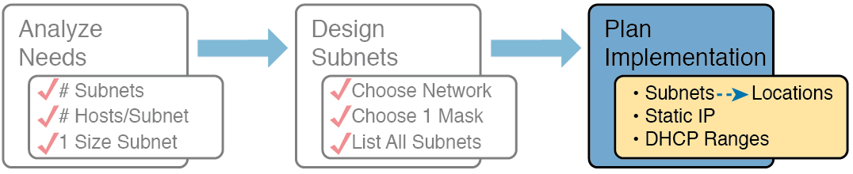
Facts Supplied to the Plan Implementation Step

Slide 26
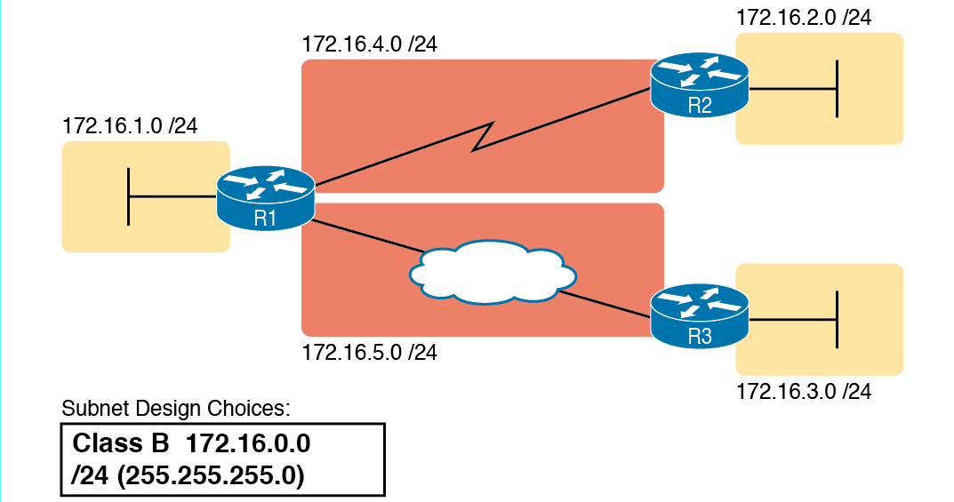
Example of Subnets Assigned to Different Locations

Slide 27
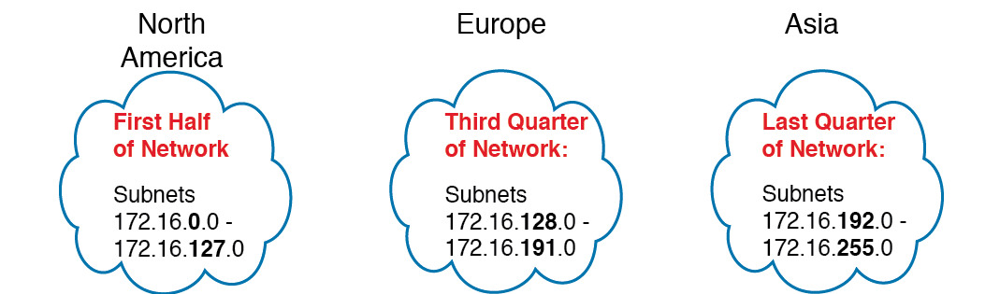
Reserving 50% of Subnets for North America and 25% Each for Europe and Asia

Slide 28
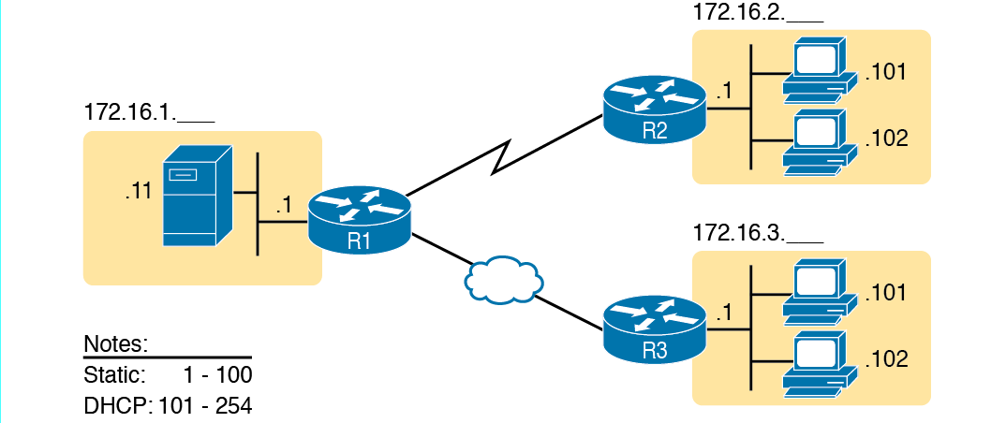
Static from the Low End and DHCP from the High End

