Slide 1
CCNA 200-301, Volume I
Chapter 12
Analyzing Classful IPv4 Networks

Slide 2
Objectives
Classful Network Concepts

Slide 3
Classful Network Concepts
This chapter examines how to begin with a single IP address and then determine the following facts:
  Class (A, B, or C)
  Default mask
  Number of network octets/bits
  Number of host octets/bits
  Number of host addresses in the network
  Network ID
  Network broadcast address
  First and last usable address in the network

Slide 4
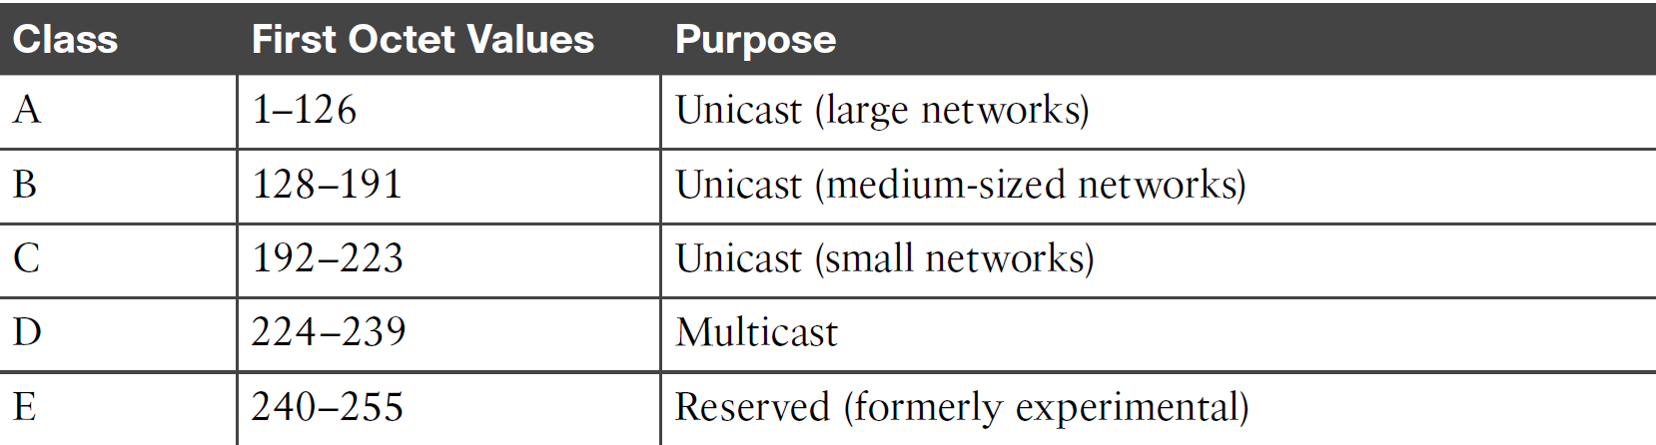
  IPv4 Address Classes Based on First Octet Values

Slide 5
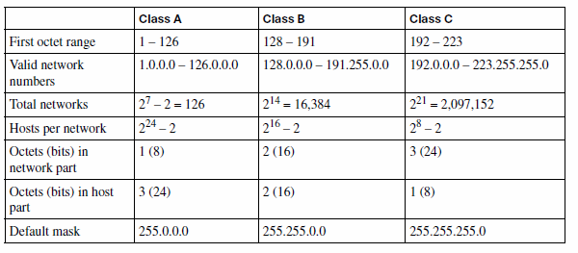
Key Facts for Classes A, B, and C

Slide 6
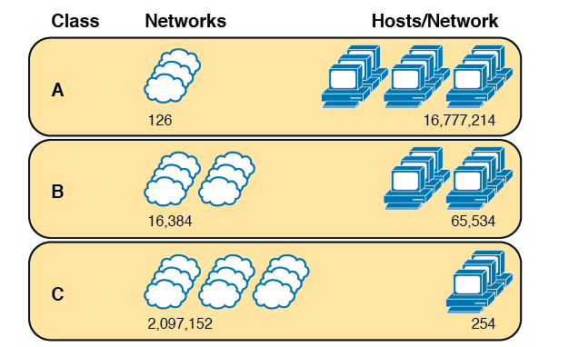
Numbers and Sizes of Class A, B, and C Networks

Slide 7
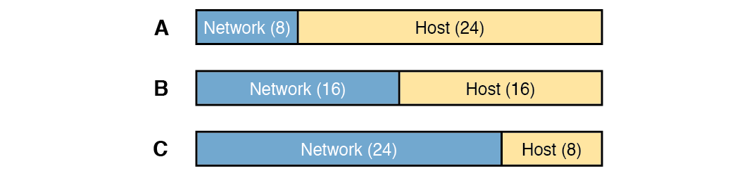
Sizes (Bits) of the Network and Host Parts of Unsubnetted Classful Networks

Slide 8
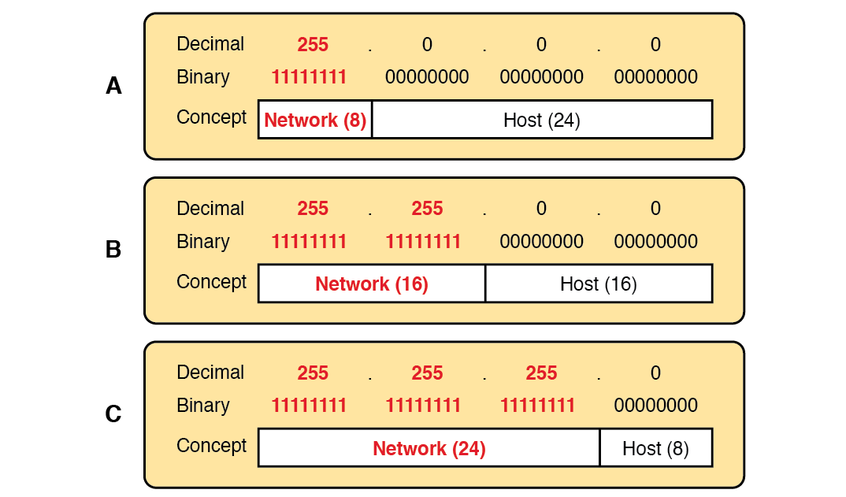
Default Masks for Classes A, B, and C

Slide 9
Deriving the Network ID and Related Numbers
Each classful network has four key numbers that describe the network.
  Network number
  First (numerically lowest) usable address
  Last (numerically highest) usable address
  Network broadcast address

Slide 10
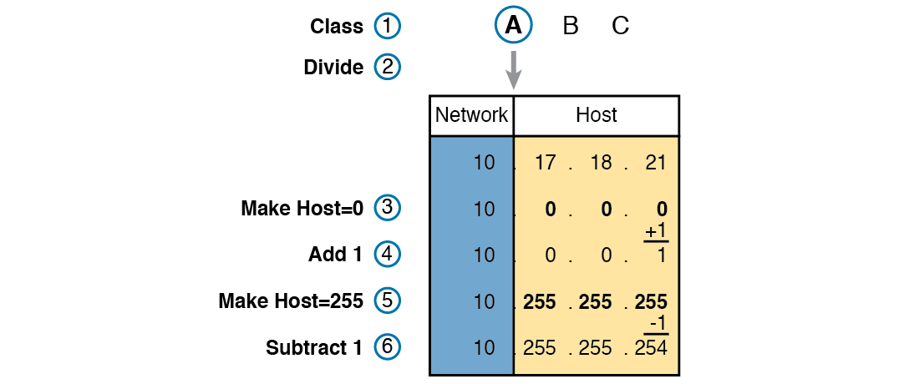
Example of Deriving the Network ID and Other Values from 10.17.18.21

Slide 11
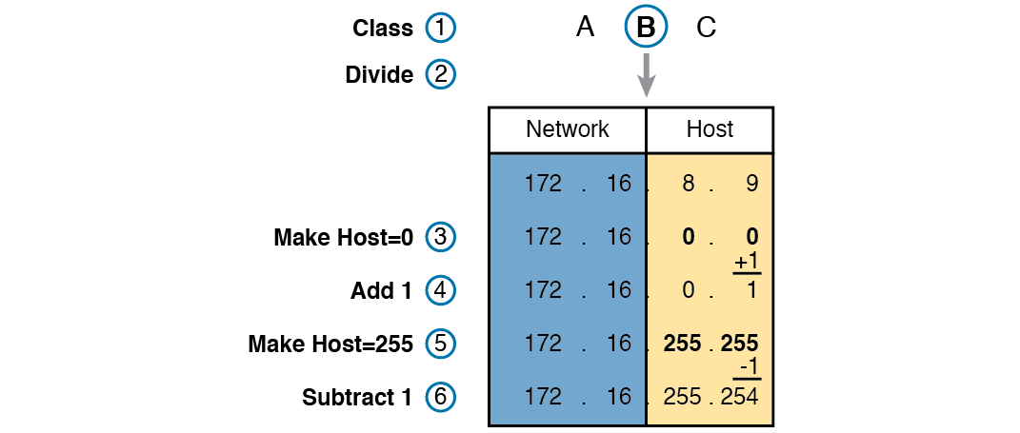
Example Deriving the Network ID and Other Values from 172.16.8.9

Slide 12
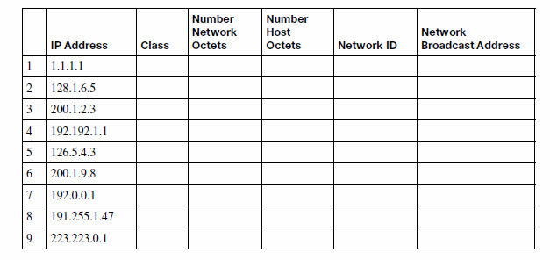
Practice Deriving Key Facts Based on an IP Address

Slide 13
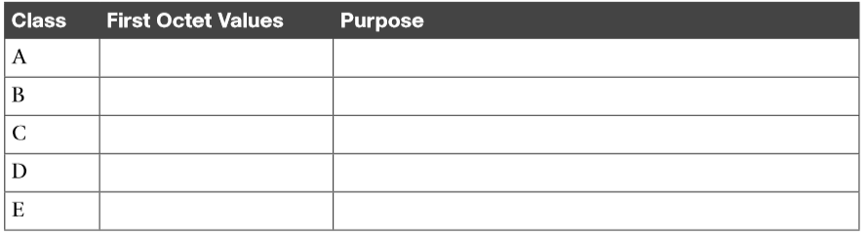
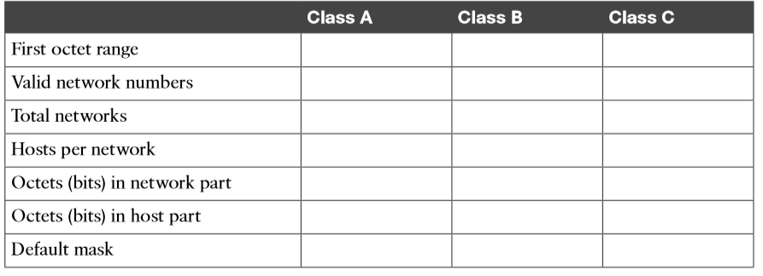
Practice Remembering the Details of Address Classes

