Slide 1
CCNA 200-301, Volume I
Chapter 13
Analyzing Subnet Masks

Slide 2
Objectives
Subnet Mask Conversion
Defining the Format of IPv4 Addresses

Slide 3
Three Mask Formats
32-bit binary numbers
  11111111 00000000 00000000 00000000
  11111111 11111111 11111111 00000000
Dotted Decimal Notation (DDN)
  255.0.0.0
  255.255.255.0
Prefix (also called CIDR)
  /8
  /24

Slide 4
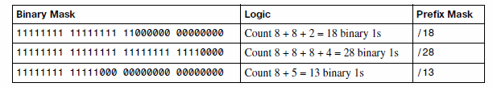
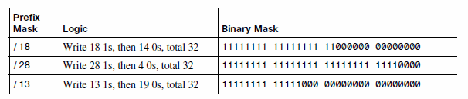
Converting Between Binary and Prefix Masks

Slide 5
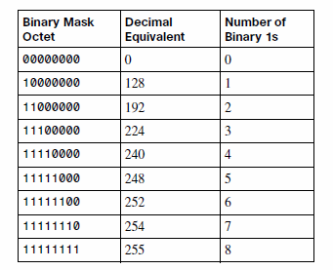
Converting Between Binary and DDN Masks

Slide 6
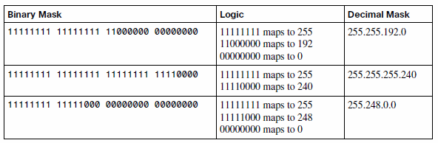
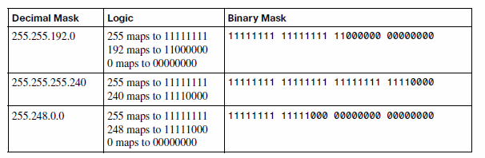
Example Conversions

Slide 7
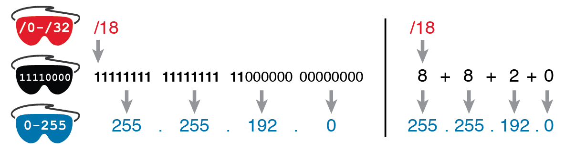
Conversion from Prefix to Decimal: Full Binary Versus Shorthand

Slide 8
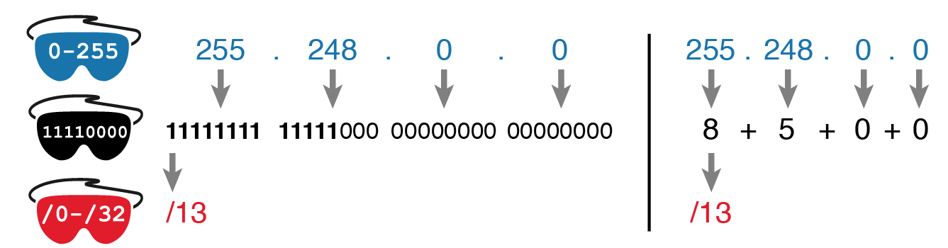
Conversion from Decimal to Prefix: Full Binary Versus Shorthand

Slide 9
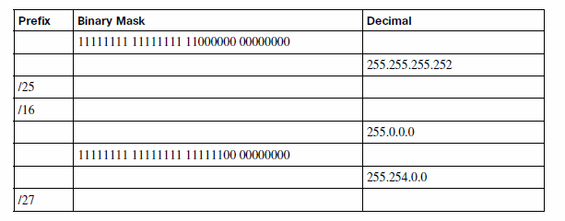
Practice Converting Subnet Masks

Slide 10
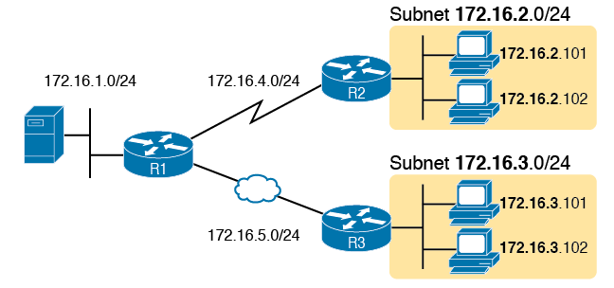
Simple Subnet Design, with Mask /24

Slide 11

Prefix (Subnet) and Host Parts Defined by Mask 1s and 0s

Slide 12

Mask 255.255.255.0: P=24, H=8

Slide 13

Class Concepts Applied to Create Three Parts

Slide 14

Subnet 10.1.1.0, Mask 255.255.255.0: N=8, S=16, H=8

Slide 15
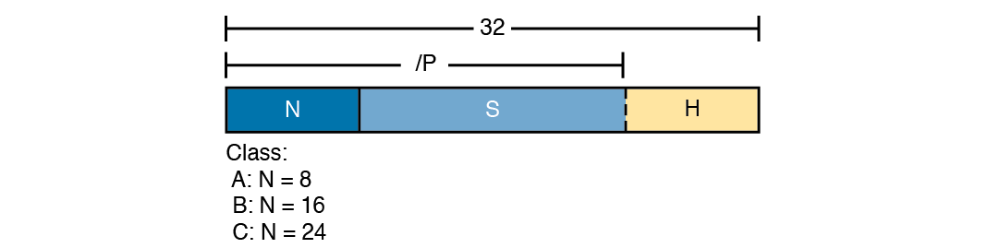
Relationship Between /P, N, S, and H

Slide 16

Visual Representation of Problem: 8.1.4.5, 255.255.0.0

Slide 17
Example – 200.1.1.1 255.255.255.252
Step 1 255.255.255.252 = /30, so P=30.
Step 2 200.1.1.1 is in the range 192–223 in the first octet, so it is Class C; so N=24.
Step 3 S = P - N = 30 - 24 = 6.
Step 4 H = 32 - P = 32 – 30 = 2.
Step 5 2² - 2 = 2 hosts/subnet
Step 6 2⁶ = 64 subnets.

