Slide 1
CCNA 200-301, Volume I
Chapter 14
Analyzing Existing Subnets

Slide 2
Objectives
Defining a Subnet
Analyzing Existing Subnets: Binary
Analyzing Existing Subnets: Decimal

Slide 3
Defining a Subnet
An IP subnet is a subset of a classful network, created by choice of some network engineer. However, that engineer cannot pick just any arbitrary subset of addresses; instead, the engineer must follow certain rules, such as the following:
  The subnet contains a set of consecutive numbers.
  The subnet holds 2H numbers, where H is the number of host bits defined by the subnet mask.
  Two special numbers in the range cannot be used as IP addresses:
  The first (lowest) number acts as an identifier for the subnet (subnet ID).
  The last (highest) number acts as a subnet broadcast address.
  The remaining addresses, whose values sit between the subnet ID and subnet broadcast address, are used as unicast IP addresses.
This section reviews and expands the basic concepts of the subnet ID, subnet broadcast address, and range of addresses in a subnet.

Slide 4

Address Structure: Class B Network, /18 Mask

Slide 5
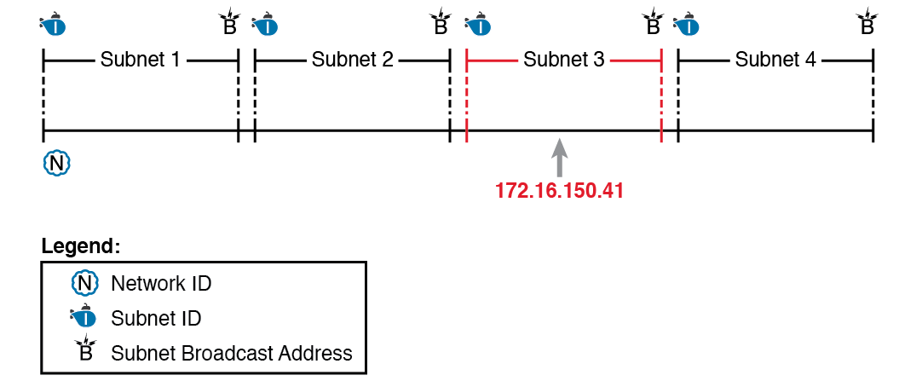
Network 172.16.0.0, Divided into Four Equal Subnets

Slide 6
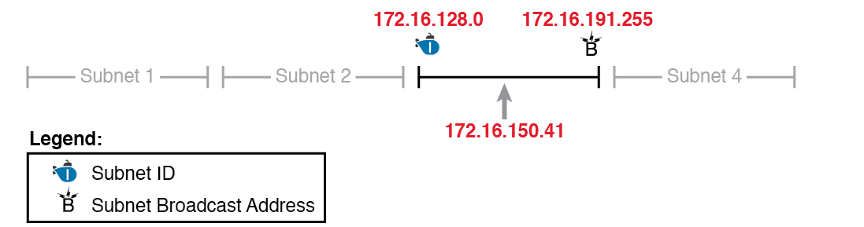
Resident Subnet for 172.16.150.41, 255.255.192.0

Slide 7
Summary of Subnet ID Key Facts
Definition | Number that represents the subnet
Numeric Value | First (smallest) number in the subnet
Literal Synonyms | Subnet number, subnet address, prefix, resident subnet
Common-Use Synonyms | Network, network ID, network number, network address
Typically Seen In… | Routing tables, documentation

Slide 8
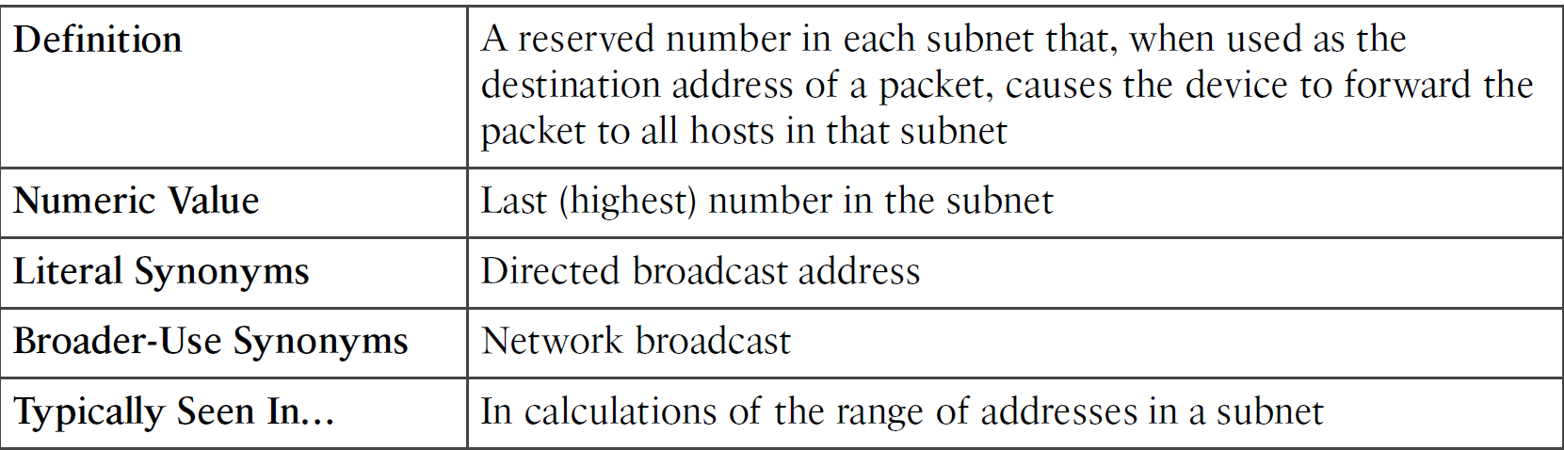
Summary of Subnet Broadcast Address Key Facts

Slide 9
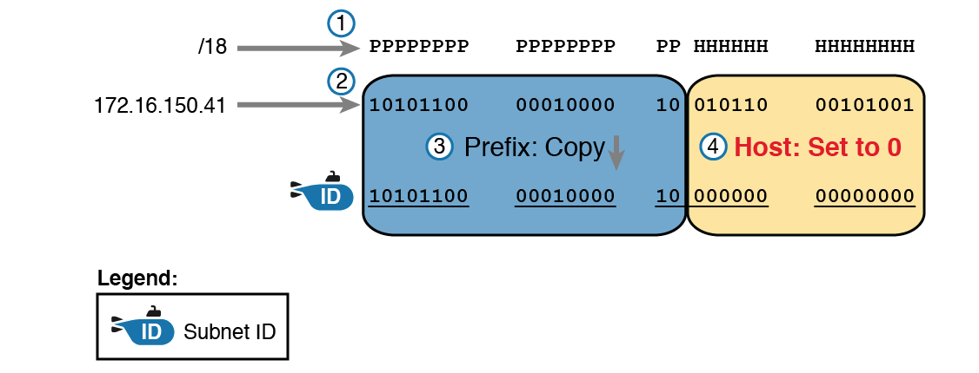
Binary Concept: Convert the IP Address to the Subnet ID

Slide 10
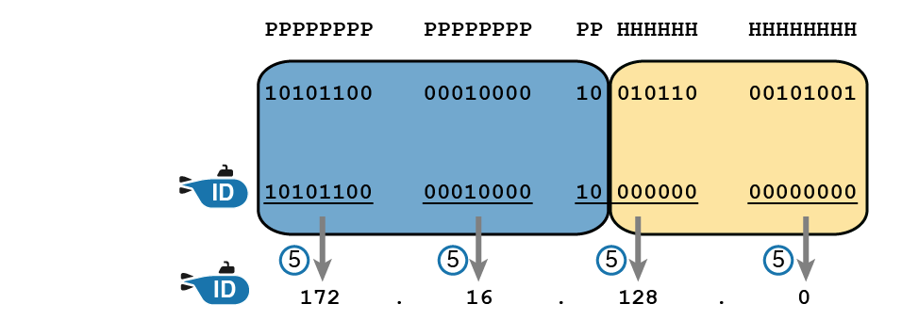
Converting the Subnet ID from Binary to DDN

Slide 11
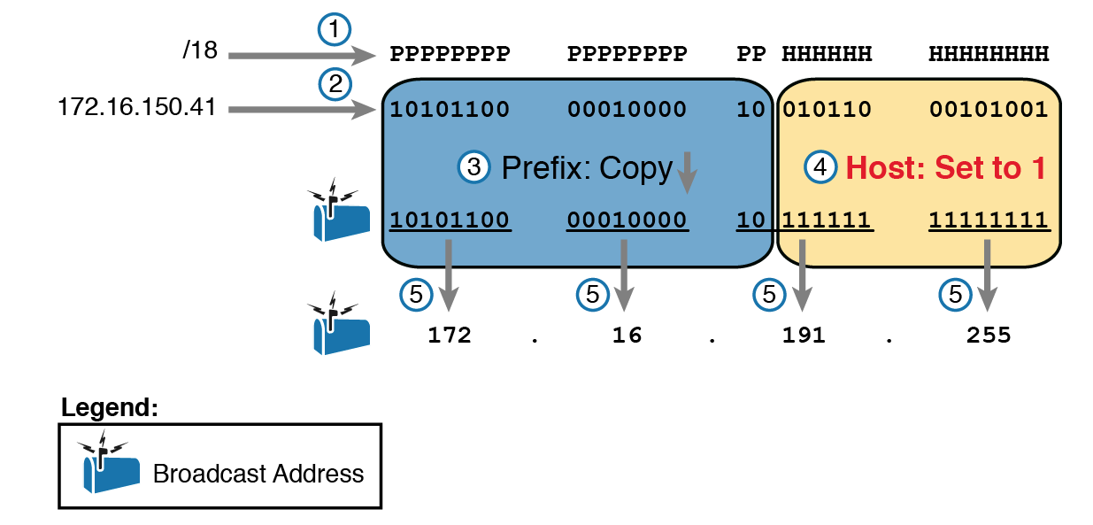
Finding a Subnet Broadcast Address: Binary

Slide 12
Subnet Analysis for Address 8.1.4.5, Mask 255.255.0.0
Prefix Length | /16 | 11111111 11111111 00000000 00000000
Address | 8.1.4.5 | 00001000 00000001 00000100 00000101
Subnet ID | 8.1.0.0 | 00001000 00000001 00000000 00000000
Broadcast Address | 8.1.255.255 | 00001000 00000001 11111111 11111111

Slide 13
Subnet Analysis for Subnet with Address 130.4.102.1, Mask 255.255.255.0
Prefix Length | /24 | 11111111 11111111 11111111 00000000
Address | 130.4.102.1 | 10000010 00000100 01100110 00000001
Subnet ID | 130.4.100.0 | 10000010 00000100 01100100 00000000
Broadcast Address | 130.4.102.255 | 10000010 00000100 01100110 11111111

Slide 14
Subnet Analysis for Subnet with Address 199.1.1.100, Mask 255.255.255.0
Prefix Length | /24 | 11111111 11111111 11111111 00000000
Address | 199.1.1.100 | 11000111 00000001 00000001 01100100
Subnet ID | 199.1.1.0 | 11000111 00000001 00000001 00000000
Broadcast Address | 199.1.1.255 | 11000111 00000001 00000001 11111111

Slide 15
Subnet Analysis for Subnet with Address 130.4.102.1, Mask 255.255.252.0
Prefix Length | /22 | 11111111 11111111 11111100 00000000
Address | 130.4.102.1 | 10000010 00000100 01100110 00000001
Subnet ID | 130.4.100.0 | 10000010 00000100 01100100 00000000
Broadcast Address | 130.4.103.255 | 10000010 00000100 01100111 11111111

Slide 16
Subnet Analysis for Subnet with Address 199.1.1.100, Mask 255.255.255.224
Prefix Length | /27 | 11111111 11111111 11111111 11100000
Address | 199.1.1.100 | 11000111 00000001 00000001 01100100
Subnet ID | 199.1.1.96 | 11000111 00000001 00000001 01100000
Broadcast Address | 199.1.1.127 | 11000111 00000001 00000001 01111111

Slide 17
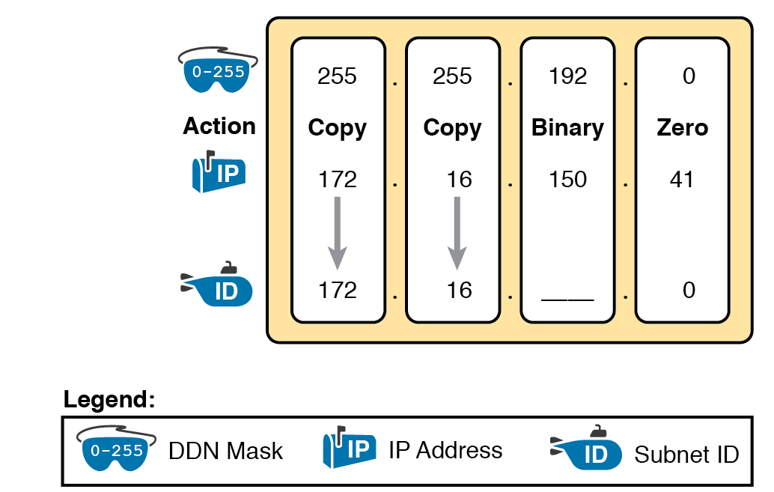
Binary Shortcut Example

Slide 18
Practice Problems: Find Subnet ID and Broadcast, Easy Masks
 | IP Address | Mask | Subnet ID | Broadcast Address
1 | 10.77.55.3 | 255.255.255.0
2 | 172.30.99.4 | 255.255.255.0
3 | 192.168.6.54 | 255.255.255.0
4 | 10.77.3.14 | 255.255.0.0
5 | 172.22.55.77 | 255.255.0.0
6 | 1.99.53.76 | 255.0.0.0

Slide 19
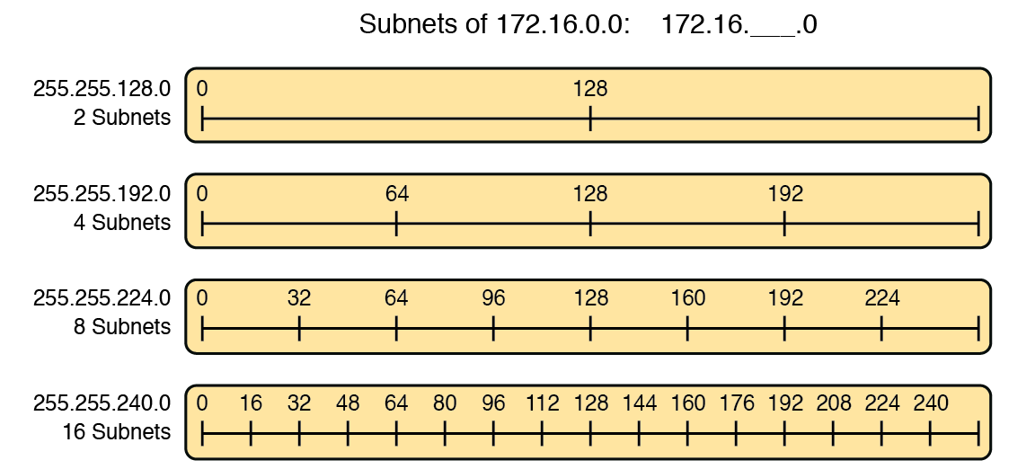
Numeric Patterns in the Interesting Octet

Slide 20
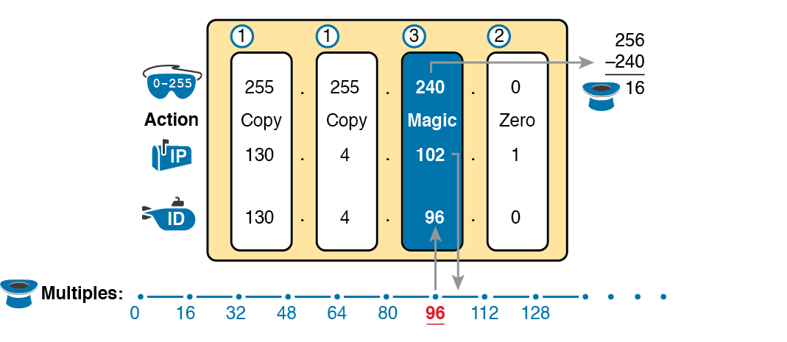
Find the Subnet ID: 130.4.102.1, 255.255.240.0

Slide 21
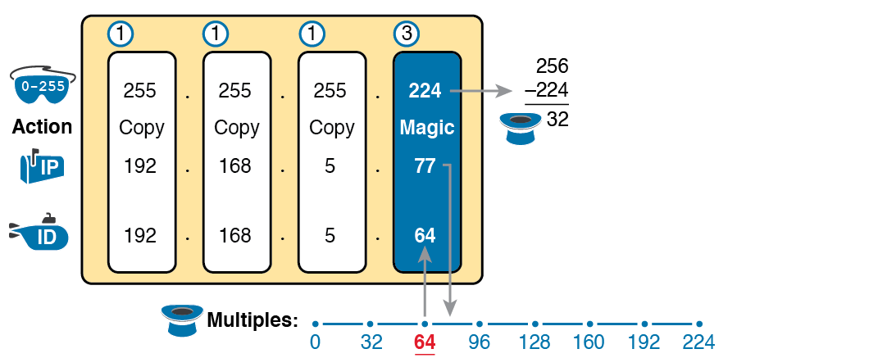
Resident Subnet for 192.168.5.77, 255.255.255.224

Slide 22
Practice Problems: Find Subnet ID, Difficult Masks
 | IP Address | Mask | Subnet ID
1 | 10.77.55.3 | 255.248.0.0
2 | 172.30.99.4 | 255.255.192.0
3 | 192.168.6.54 | 255.255.255.252
4 | 10.77.3.14 | 255.255.128.0
5 | 172.22.55.77 | 255.255.254.0
6 | 1.99.53.76 | 255.255.255.248

Slide 23
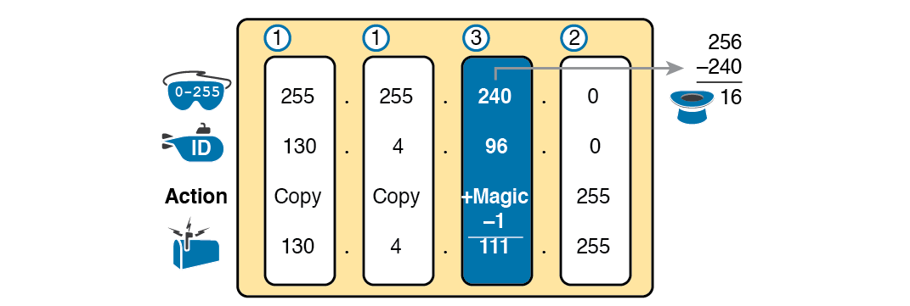
Find the Subnet Broadcast: 130.4.96.0, 255.255.240.0

Slide 24
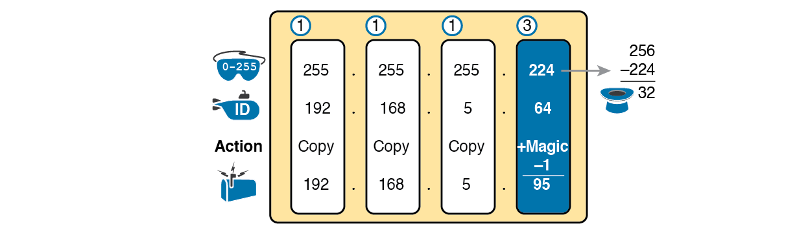
Find the Subnet Broadcast: 192.168.5.64, 255.255.255.224

Slide 25
DDN Mask Values, Binary Equivalent, Magic Numbers, and Prefixes
Prefix, interesting octet 2 | /9 | /10 | /11 | /12 | /13 | /14 | /15 | /16
Prefix, interesting octet 3 | /17 | /18 | /19 | /20 | /21 | /22 | /23 | /24
Prefix, interesting octet 4 | /25 | /26 | /27 | /28 | /29 | /30
Magic number | 128 | 64 | 32 | 16 | 8 | 4 | 2 | 1
DDN mask in the interesting octet | 128 | 192 | 224 | 240 | 248 | 252 | 254 | 255

