Slide 1
CCNA 200-301, Volume I
Chapter 2
Fundamentals of Ethernet LANs

Slide 2
Objectives
An Overview of LANs
Building Physical Ethernet LANSs with UTP
Building Physical Ethernet LANs with Fiber
Sending Data in Ethernet Networks

Slide 3
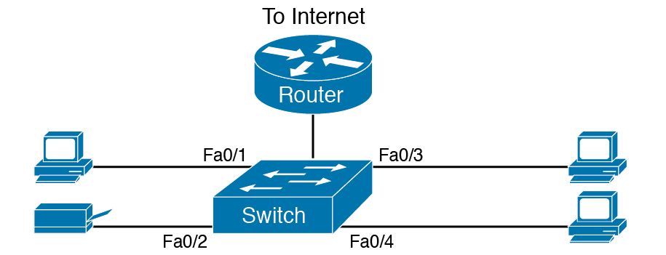
SOHO LAN

Slide 4
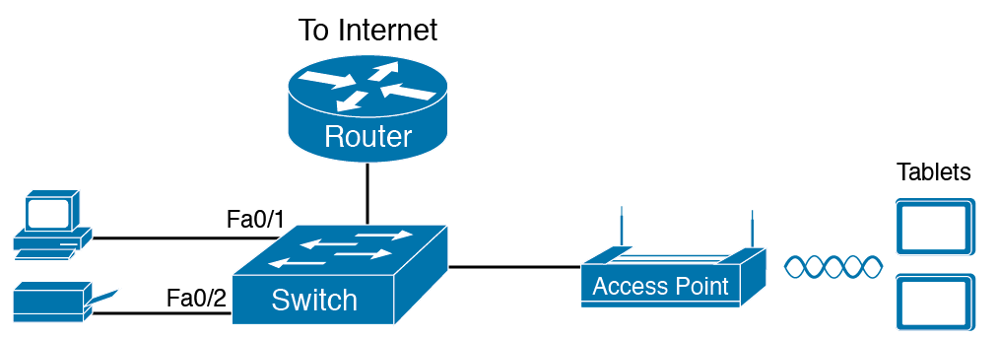
Small Wired and Wireless SOHO LAN

Slide 5
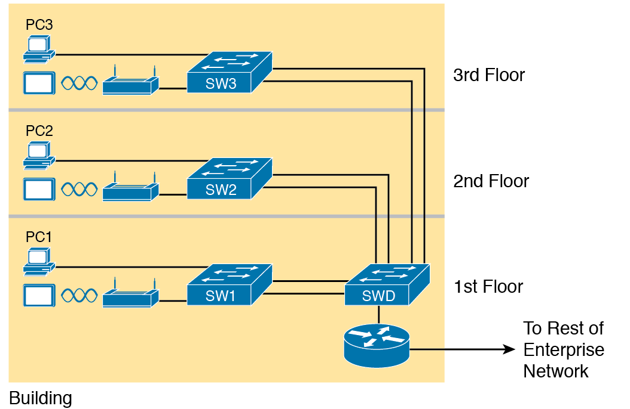
Single-Building Enterprise Wired and Wireless LAN

Slide 6
Types of Ethernet
Speed | Common Name | Informal IEEE Standard Name | Formal IEEE Standard Name | Cable Type, Maximum Length
10 Mbps | Ethernet | 10BASE-T | 802.3 | Copper, 100m
100 Mbps | Fast Ethernet | 100BASE-T | 802.3u | Copper, 100m
1000 Mbps | Gigabit Ethernet | 1000BASE-LX | 802.3z | Fiber, 5000 m
1000 Mbps | Gigabit Ethernet | 1000BASE-T | 802.3ab | Copper, 100 m
10 Gbps | 10 Gig Ethernet | 10GBASE-T | 802.3an | Copper, 100 m

Slide 7
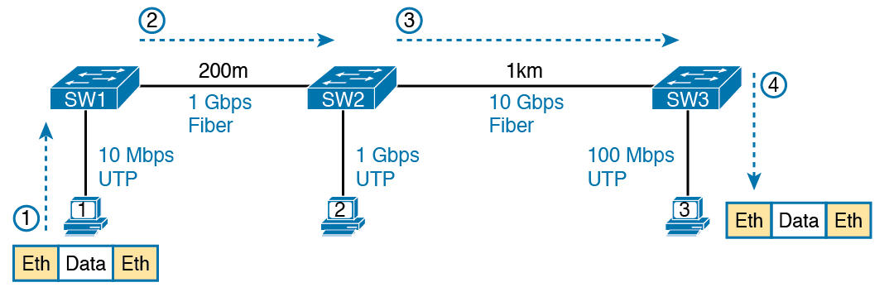
Ethernet LAN Forwards a Data Link Frame Over Many Types of Links

Slide 8
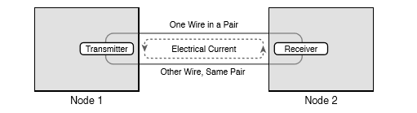
Creating One Electrical Circuit over One Pair to Send in One Direction

Slide 9
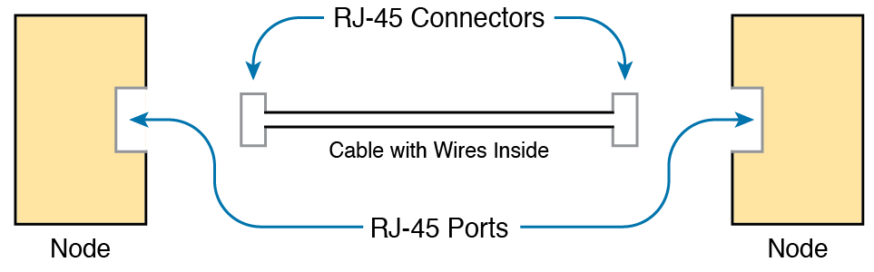
Basic Components of an Ethernet Link

Slide 10
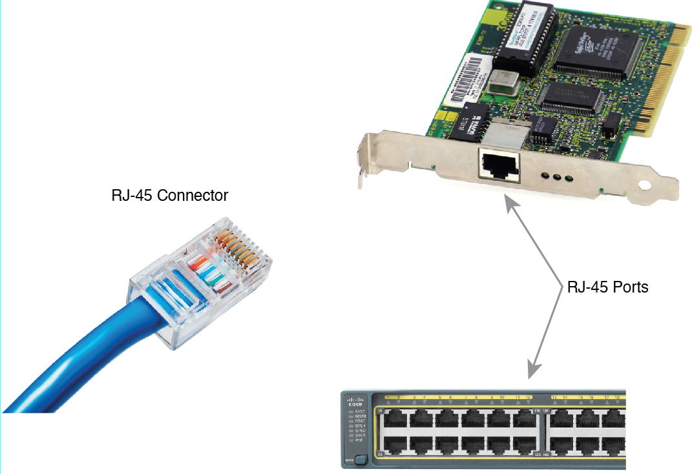
RJ-45 Connectors and Ports

Slide 11
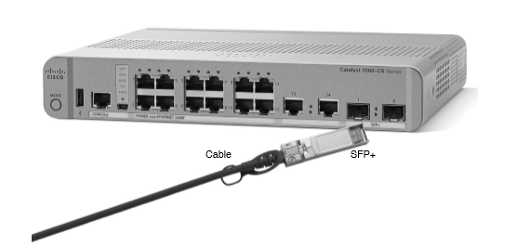
10-Gbps SFP+ with Cable Sitting Just Outside a Catalyst 3560CX Switch

Slide 12
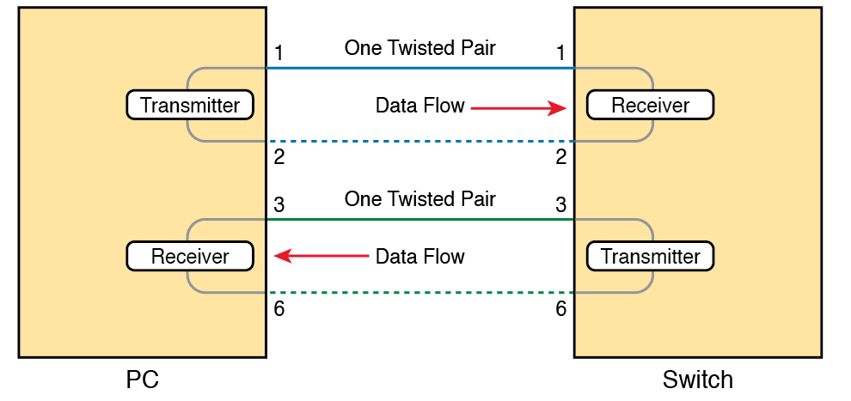
Using one Pair for Each Transmission Direction with 10- and 100-Mbps Ethernet

Slide 13
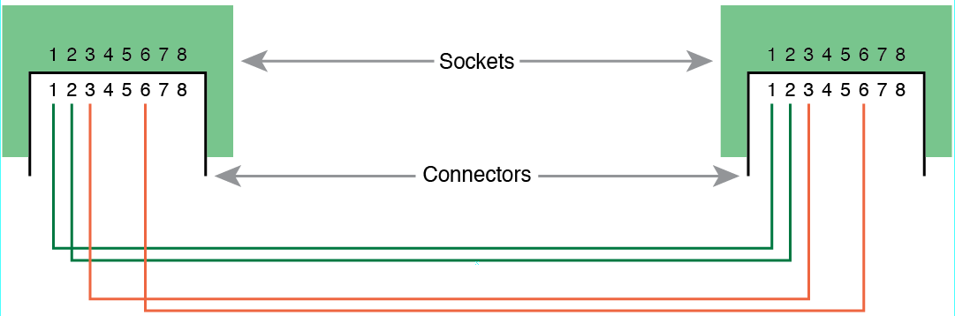
10Base-T and 100Base-T Straight-Through Cable Pinout

Slide 14
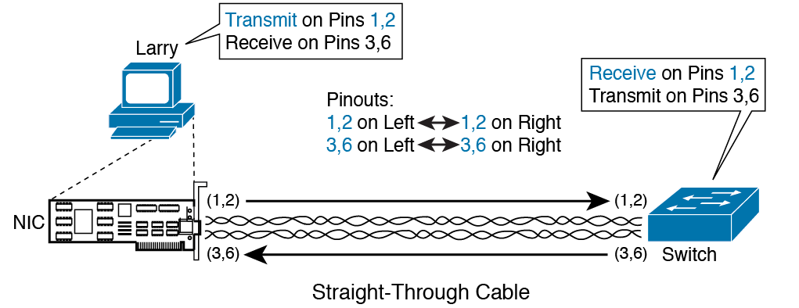
Ethernet Straight-Through Cable Concept

Slide 15
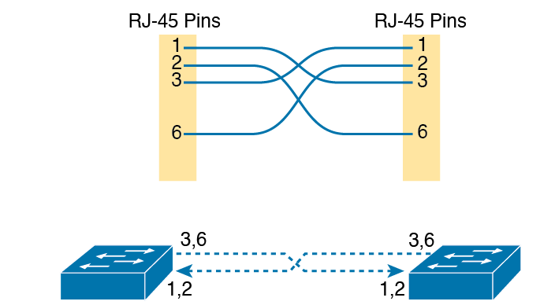
Crossover Ethernet Cable

Slide 16
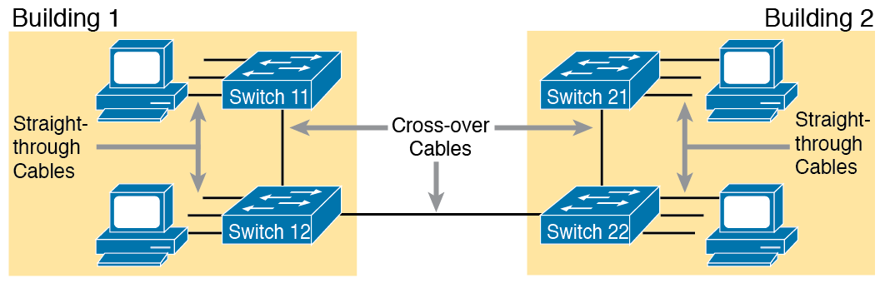
Typical Uses for Straight-Through and Crossover Ethernet Cables

Slide 17
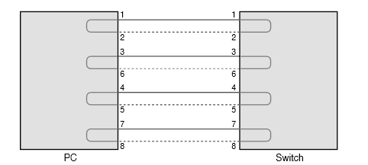
Four-Pair Straight-Through Cable to 1000BASE-T

Slide 18
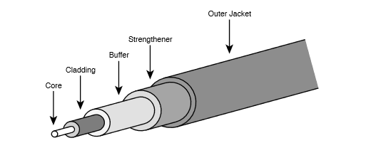
Components of a Fiber-Optic Cable

Slide 19
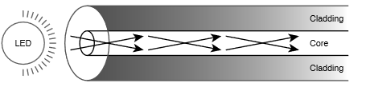
Transmission on Multimode Fiber with Internal Reflection

Slide 20
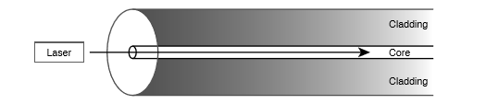
Transmission on Single-Mode Fiber with Laser Transmitter

Slide 21

Two Fiber Cables with Tx Connected to Rx on Each Cable

Slide 22
A Sampling of IEEE 802.3 10-Gbps Fiber Standards
Standard | Cable Type | Max Distance*
10GBASE-S | MM | 400m
10GBASE-LX4 | MM | 300m
10GBASE-LR | SM | 10km
10GBASE-E | SM | 30km
* The maximum distances are based on the IEEE standards with no repeaters.

Slide 23
Comparisons Between UTP, MM, and SM Ethernet Cabling
Criteria | UTP | Multimode | Single-mode
Relative Cost of Cabling | Low | Medium | Medium
Relative Cost of a Switch Port | Low | Medium | High
Approximate Max Distance | 100m | 500m | 40km
Relative Susceptibility to Interference | Some | None | None
Relative Risk of Copying from Cable Emissions | Some | None | None

Slide 24
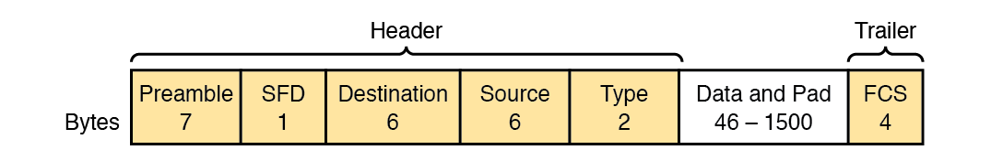
Commonly Used Ethernet Frame Format

Slide 25
IEEE 802.3 Ethernet Header and Trailer Fields
Field | Field Length in Bytes | Description
Preamble | 7 | Synchronization
Start Frame Delimiter (SFD) | 1 | Signifies that the next byte begins the Destination MAC Address field.
Destination MAC address | 6 | Identifies the intended recipient of this frame.
Source MAC address | 6 | Identifies the sender of this frame.
Type | 2 | Defines the type of protocol listed inside the frame; today, most likely identifies IP Version 4 (IPv4) or IP Version 6 (IPv6).
Data and Pad | 46-1500 | Holds data from a higher layer, typically an L3PDU (usually an IPv4 or IPv6 packet). The sender adds padding to meet the minimum length requirement for this field (46 bytes).
Frame Check Sequence (FCS) | 4 | Provides a method for the receiving NIC to determine if the frame experienced transmission errors

Slide 26
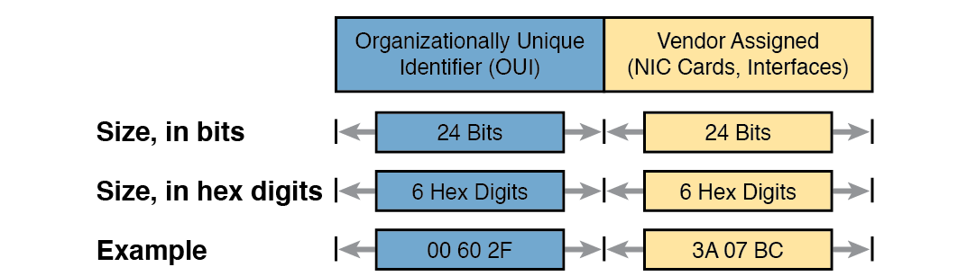
Structure of Unicast Ethernet Addresses

Slide 27
LAN MAC Address Terminology and Features
LAN Addressing Term or Feature | Description
MAC | Media Access Control. 802.3 (Ethernet) defines the MAC sublayer of IEEE Ethernet.
Ethernet address, NIC address, LAN address | Other names often used instead of MAC address. These terms describe the 6-byte address of the LAN interface card.
Burned-in address | The 6-byte address assigned by the vendor making the card.
Unicast address | A term for a MAC that represents a single LAN interface.
Broadcast address | An address that means “all devices that reside on this LAN right now.”
Multicast address | On Ethernet, a multicast address implies some subset of all devices currently on the Ethernet LAN.

Slide 28
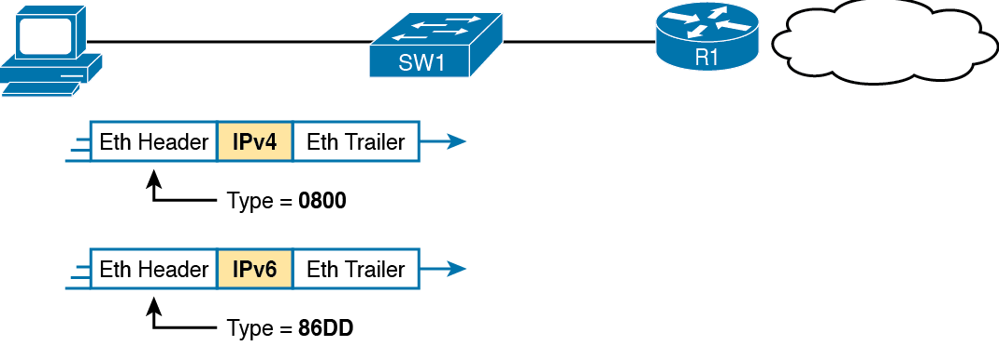
Use of Ethernet Type Field

Slide 29
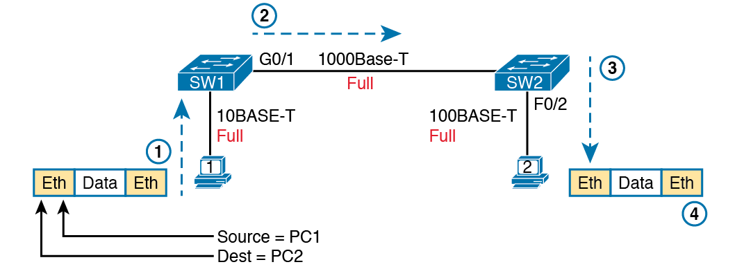
Example of Sending Data in a Modern Ethernet LAN

Slide 30
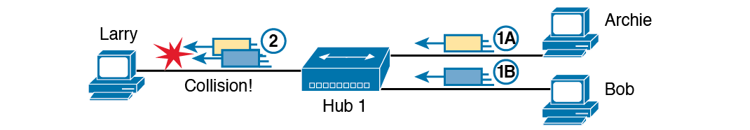
A Collision Occurring Because of LAN Hub Behavior

Slide 31
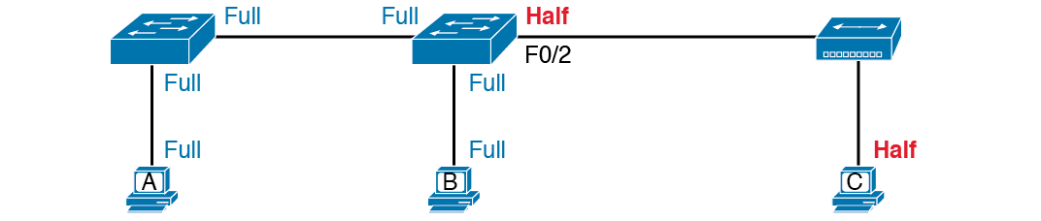
Full and Half Duplex in an Ethernet LAN

