Slide 1
CCNA 200-301, Volume I
Chapter 22
Fundamentals of IP Version 6

Slide 2
Objectives
Introduction to IPv6
IPv6 Addressing Formats and Conventions

Slide 3
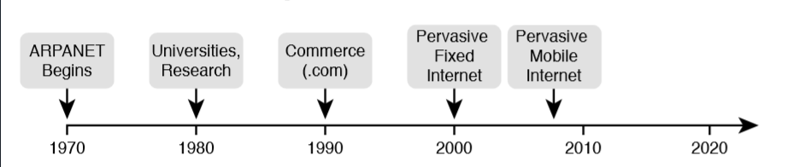
Some Major Events in the Growth of the Internet

Slide 4
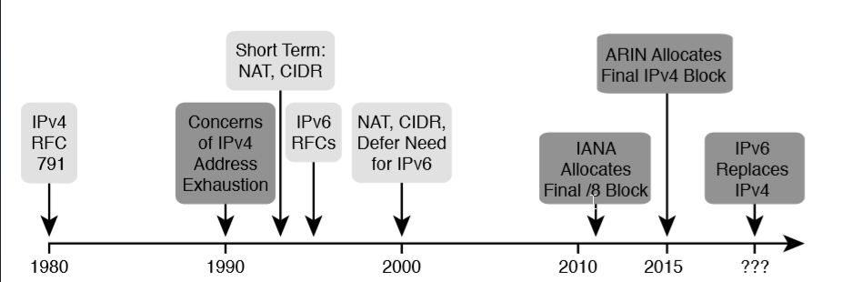
Timeline for IPv4 Address Exhaustion and Short/Long Term Solutions

Slide 5
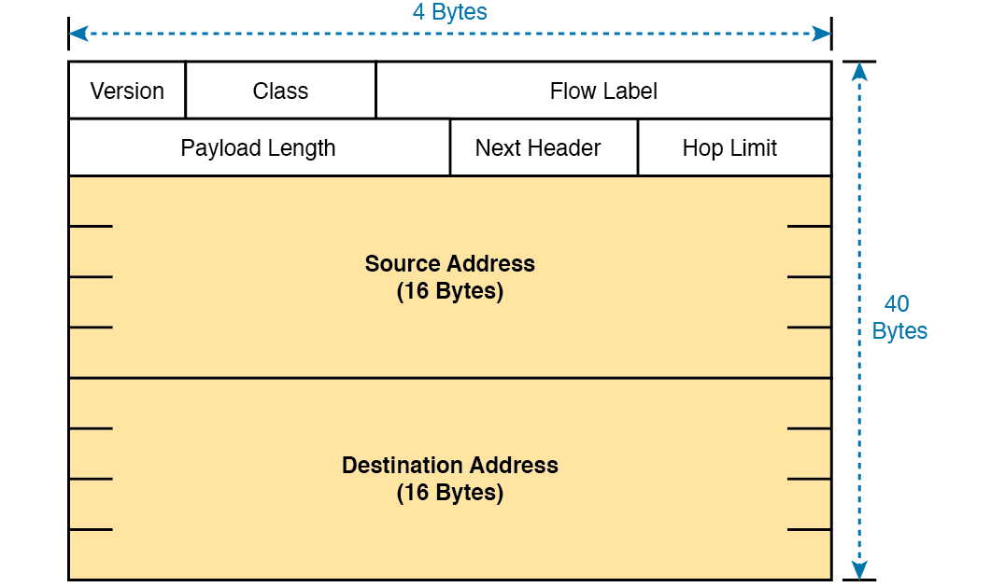
IPv6 Header

Slide 6
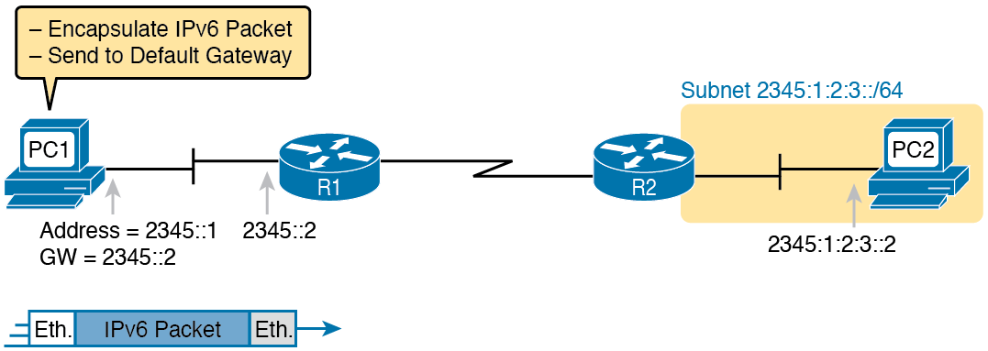
IPv6 Host Building and Sending an IPv6 Packet

Slide 7
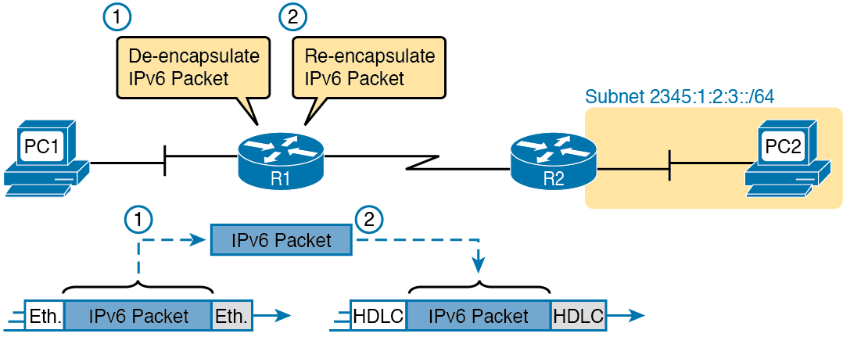
IPv6 Router Performing Routine Encapsulation Tasks when Routing Ipv6

Slide 8
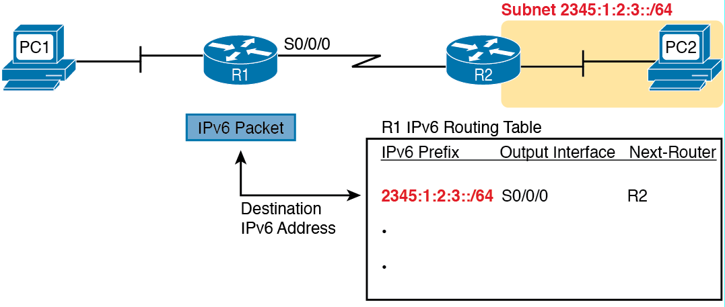
IPv6 Router Performing Routine Encapsulation Tasks when Routing IPv6

Slide 9
IPv6 Routing Protocols
Routing Protocol | Defined by | Description
RIPng (RIP Next Generation) | RFC | The “Next Generation” is a reference to a TV series, “Star Trek: the Next Generation”
OSPFv3 (OSPF Version 3) | RFC | The OSPF you have worked with for IPv4 is actually OSPF Version 2, as defined in RFC 2427
EIGRPv6 (EIGRP for IPv6) | Cisco | Cisco owns the rights to the EIGRP protocol; they just named it EIGRPv6 to look similar to “IPv6”
MP BGP-4 (Multiprotocol BGP Version 4) | RFC | BGP Version 4 was created to be highly extendable; IPv6 support was added to BGP Version 4 through one such enhancement, MP BGP-4.

Slide 10
Hexadecimal/Binary Conversion Chart
Hex | Binary | Hex | Binary
0 | 0000 | 8 | 1000
1 | 0001 | 9 | 1001
2 | 0010 | A | 1010
3 | 0011 | B | 1011
4 | 0100 | C | 1100
5 | 0101 | D | 1101
6 | 0110 | E | 1110
7 | 0111 | F | 1111

Slide 11
IPv6 Address Abbreviation and Expansion Practice
Full | Abbreviation
2340:0000:0010:0100:1000:ABCD:0101:1010
 | 30A0:ABCD:EF12:3456:ABC:B0B0:9999:9009
2222:3333:4444:5555:0000:0000:6060:0707
 | 3210::
210F:0000:0000:0000:CCCC:0000:0000:000D
 | 34BA:B:B::20
FE80:0000:0000:0000:DEAD:BEFF:FEEF:CAFE
 | FE80::FACE:BAFF:FEBE:CAFE
FE80:000F:00E0:0D00:FACE:BAFF:FE00:0000
 | FE80:800:0:40:CAFE:FF:FE00:1

Slide 12
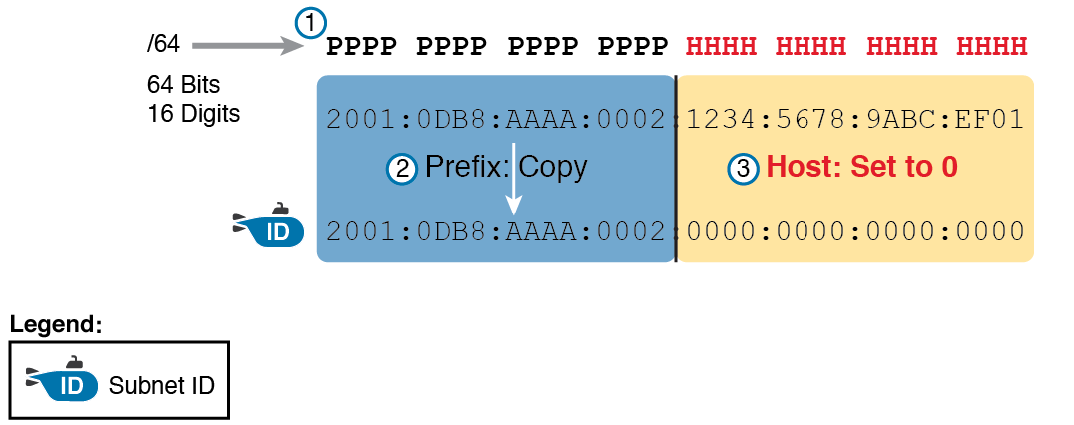
Creating the IPv6 Prefix from an Address/Length

Slide 13
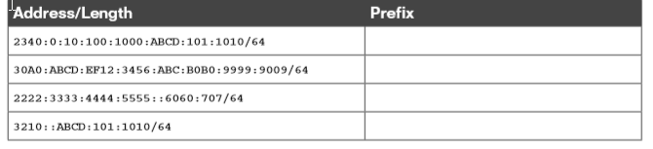
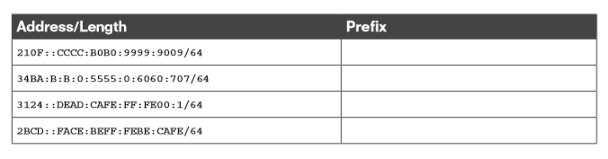
Finding the IPv6 Prefix from an Address/Length Value

Slide 14
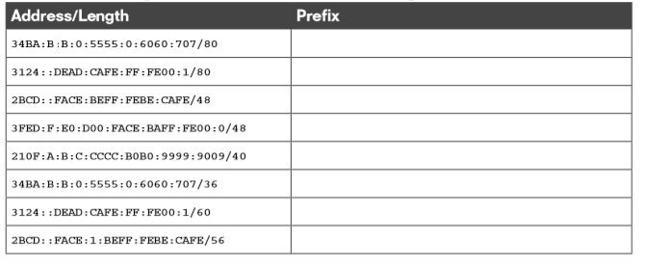
Working with More-Difficult IPv6 Prefix Lengths

