Slide 1
CCNA 200-301, Volume I
Chapter 23
IPv6 Addressing and Subnetting

Slide 2
Objectives
Global Unicast Addressing Concepts
Unique Local Unicast Addresses

Slide 3
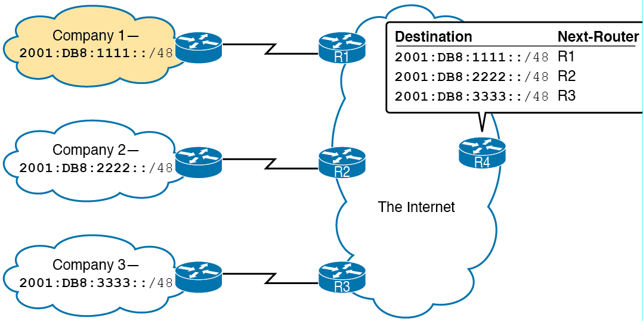
Three Global Routing Prefixes, with One Route per Prefix

Slide 4
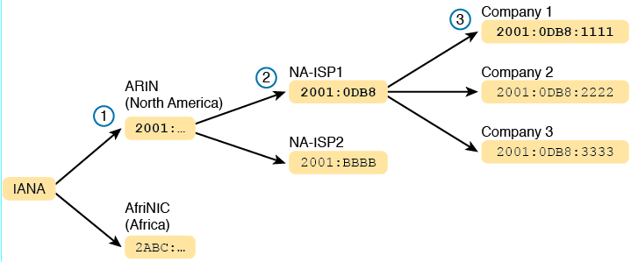
Prefix Assignment with IANA, RIRs, and ISPs

Slide 5
Some Types of IPv6 Addresses and Their First Hex Digit(s)
Address Type | First Hex Digits
Global unicast | 2 or 3 (originally); all not otherwise reserved (today)
Unique local | FD
Multicast | FF
Link local | FE80

Slide 6
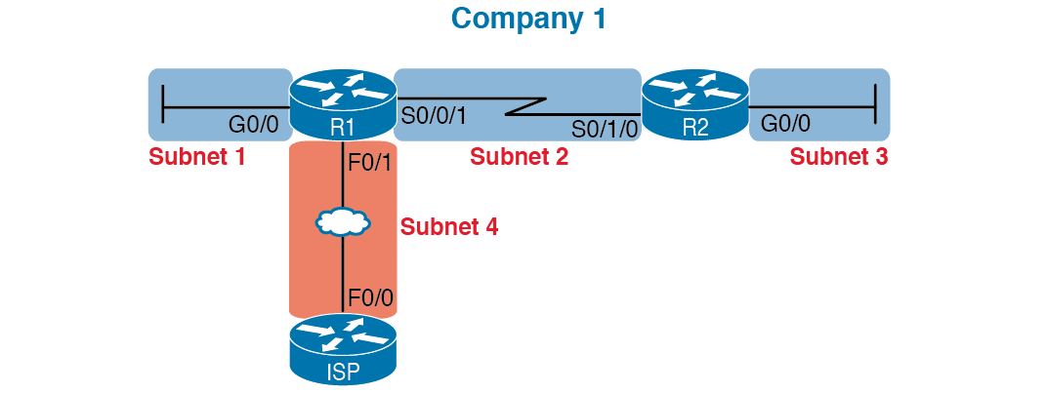
Locations for IPv6 Subnets

Slide 7
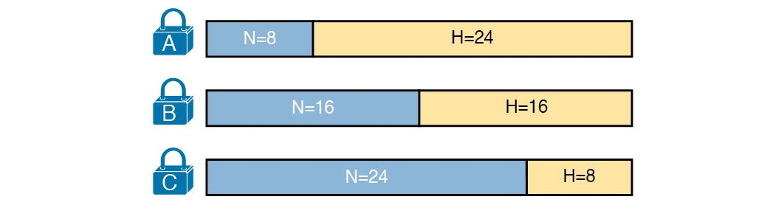
Classful View of Unsubnetted IPv4 Networks

Slide 8
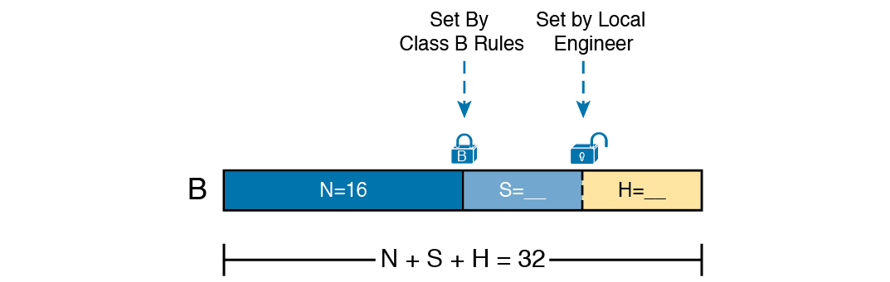
Classful View of Subnetted IPv4 Networks

Slide 9
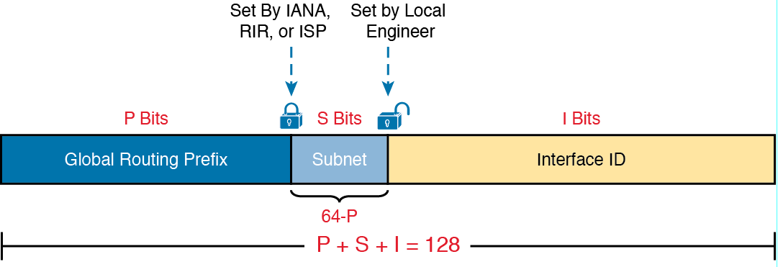
Structure of Subnetted IPv6 Global Unicast Addresses

Slide 10
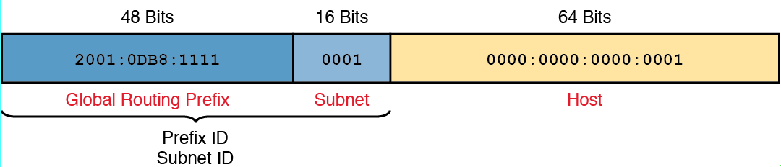
Address Structure for Company1 Example

Slide 11
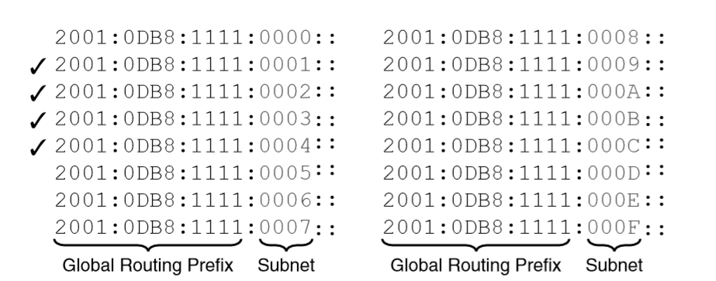
First 16 Possible Subnets With a 16-bit Subnet Field in this Example

Slide 12
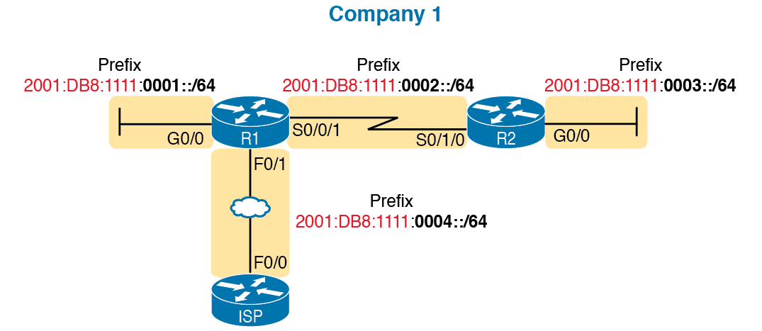
Subnets in Company1, with Global Routing Prefix of 2001:0DB8:1111::/48

Slide 13
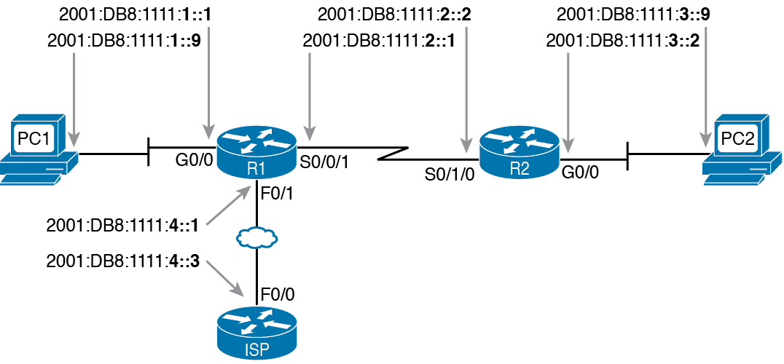
Example Static IPv6 Addresses Based on the Subnet Design

Slide 14
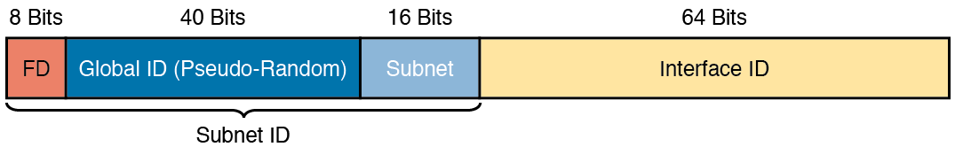
IPv6 Unique Local Unicast Address Format

Slide 15
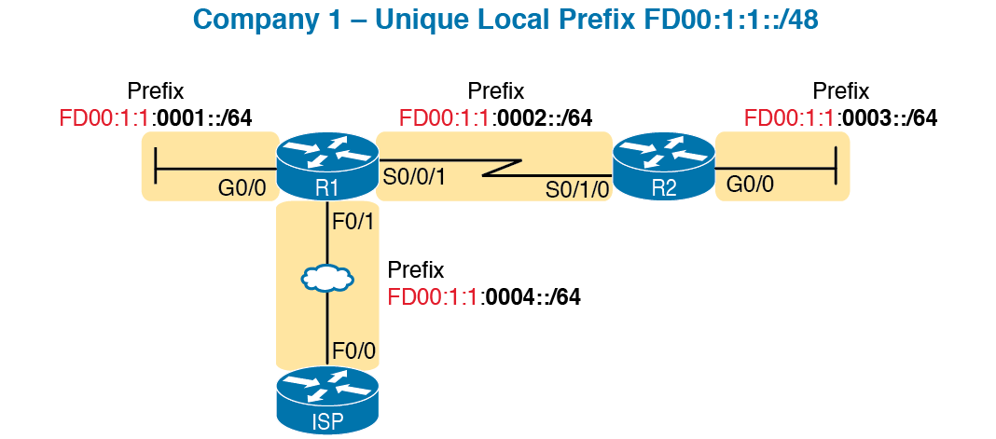
Subnetting Using Unique Local Addresses

