Slide 1
CCNA 200-301, Volume I
Chapter 24
Implementing IPv6 Addressing on Routers

Slide 2
Objectives
Implementing Unicast IPv6 Addresses on Routers
Special Addresses Used by Routers

Slide 3
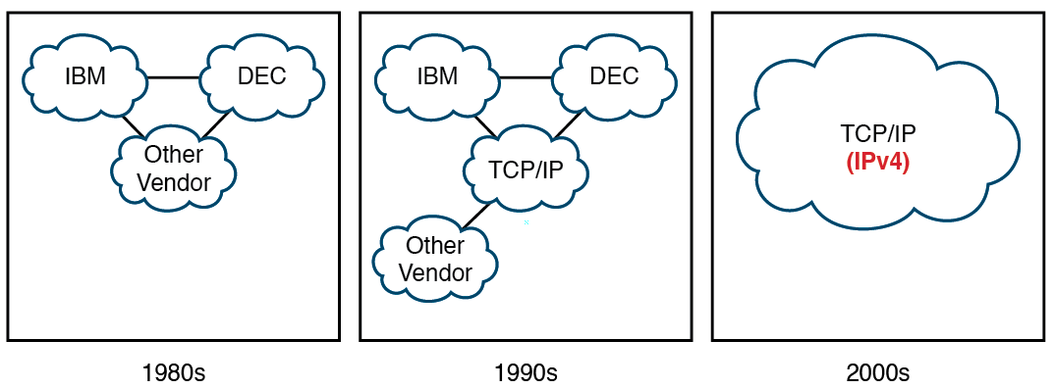
Migration of Enterprise Networks to use TCP/IP Stack Only, IPv4

Slide 4
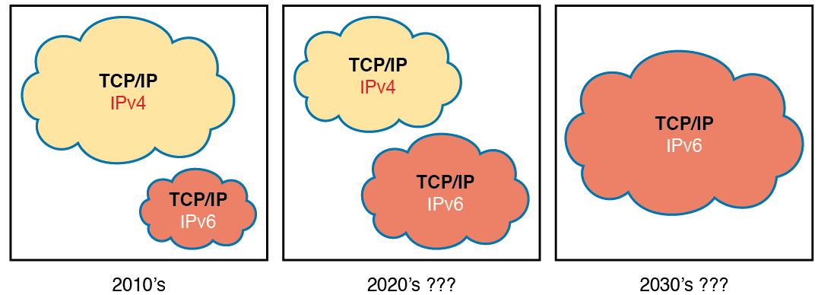
Likely Path Through Dual-Stack (IPv4 and IPv6) over a Long Period

Slide 5
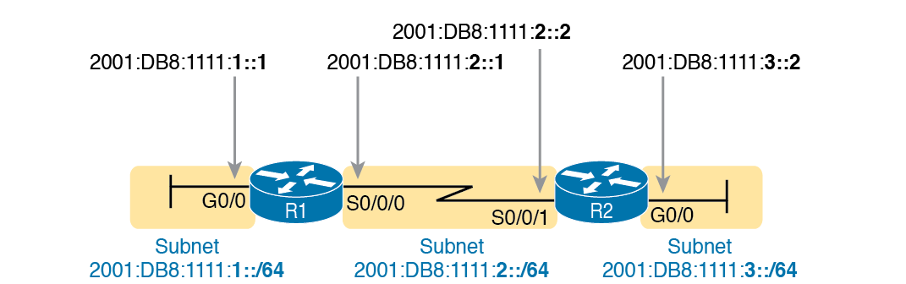
128-bit IPv6 Addresses to be Configured on Cisco Router Interfaces

Slide 6
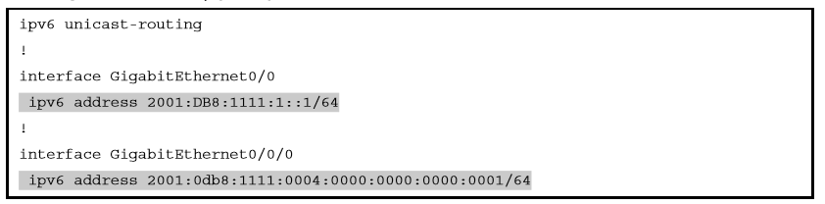
Configuring Static IPv6 Addresses on R1

Slide 7
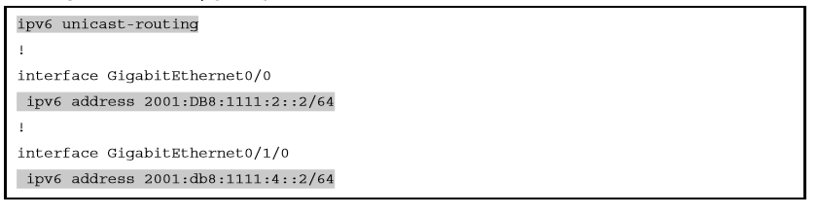
Configuring Static IPv6 Addresses on R2

Slide 8
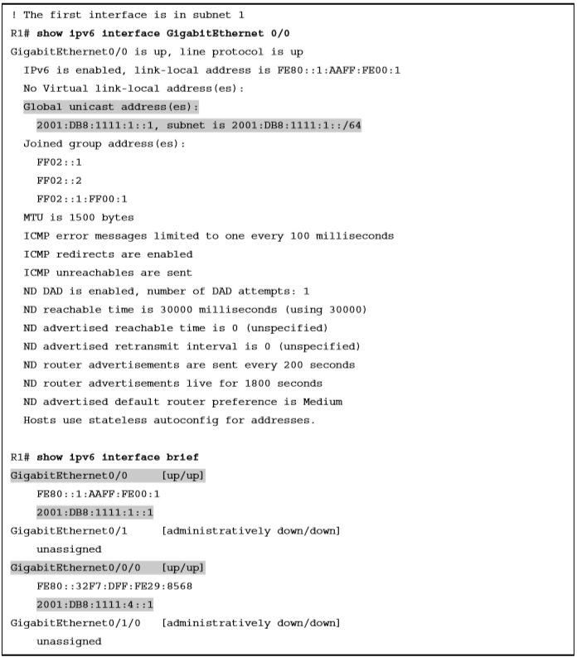
Verifying Static IPv6 Addresses on Router R1

Slide 9
Verifying Static IPv6 Addresses on Router R1 (Continued)
R1#show ipv6 interface S0/0/0
Serial0/0/0 is up, line protocol is up
IPv6 is enabled, link-local address is FE80::1FF:FE01:101
No Virtual link-local address(es):
Description: link to R2
Global unicast address(es):
2001:DB8:1111:2::1, subnet is 2001:DB8:1111:2::/64
Joined group address(es):
FF02::1
FF02::2
FF02::A
FF02::1:FF00:1
FF02::1:FF01:101
MTU is 1500 bytes
! Lines omitted for brevity
R1#show ipv6 interface brief
GigabitEthernet0/0 [up/up]
FE80::1FF:FE01:101
2001:DB8:1111:1::1
GigabitEthernet0/1 [administratively down/down]
unassigned
Serial0/0/0 [up/up]
FE80::1FF:FE01:101
2001:DB8:1111:2::1
Serial0/0/1 [administratively down/down]
unassigned

Slide 10
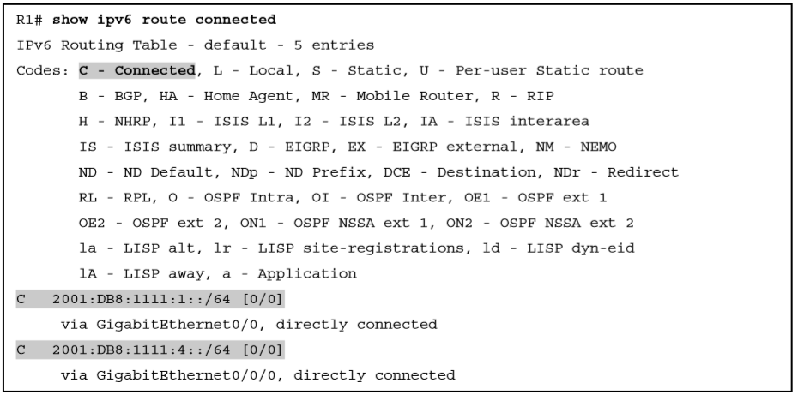
Displaying Connected IPv6 Routes on Router R1

Slide 11
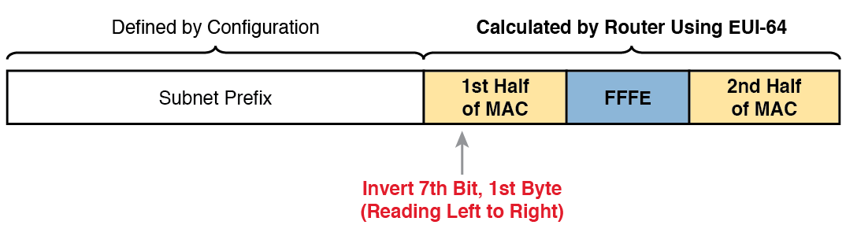
IPv6 Address Format with Interface ID and EUI-64

Slide 12
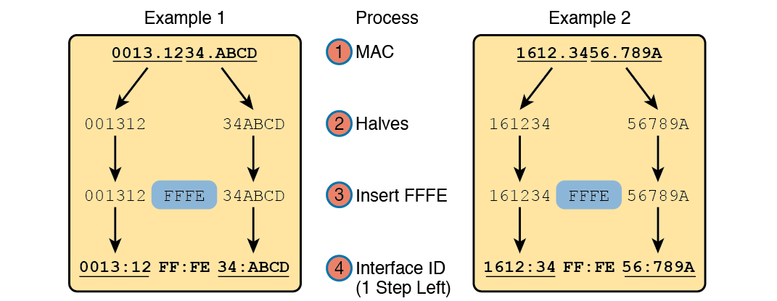
Two Examples of Most of the EUI-64 Interface ID Process

Slide 13
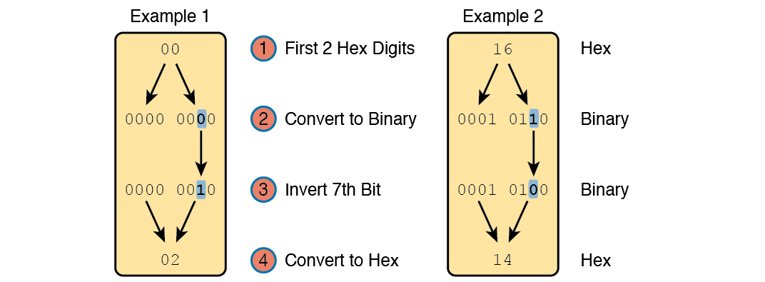
Inverting the 7th Bit of an EUI-64 Interface ID Field

Slide 14
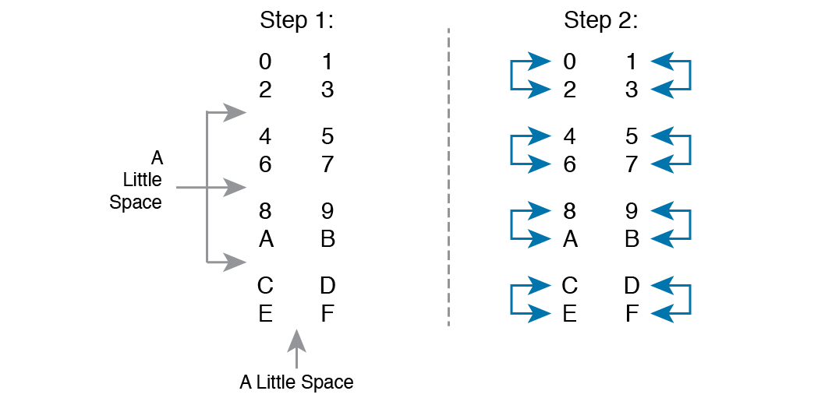
A Mnemonic Device to Help Memorize Hex Digits before and after 3rd Bit Inversion

Slide 15
IPv6 EUI-64 Address Creation Practice
Prefix | MAC Address | Unabbreviated IPv6 Address
2001:DB8:1:1::/64 | 0013.ABAB.1001
2001:DB8:1:1::/64 | AA13.ABAB.1001
2001:DB8:1:1::/64 | 000C.BEEF.CAFE
2001:DB8:1:1::/64 | B80C.BEEF.CAFE
2001:DB8:FE:FE::/64 | 0C0C.ABAC.CABA
2001:DB8:FE:FE::/64 | 0A0C.ABAC.CABA

Slide 16
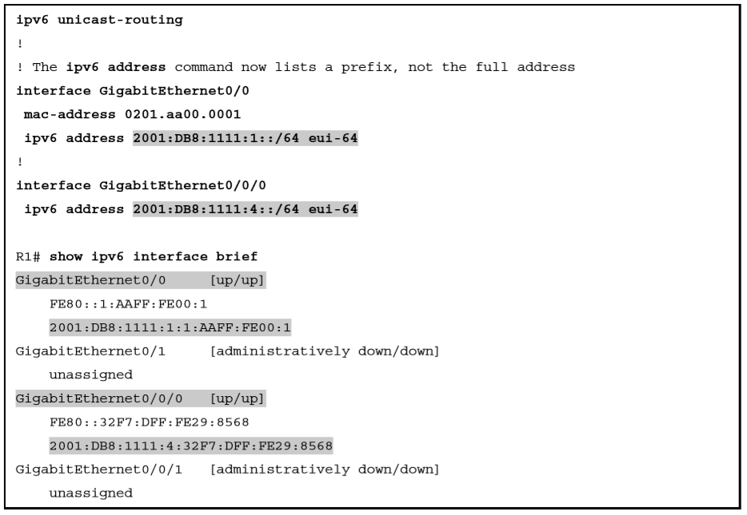
Configuring R1’s IPv6 Interfaces using EUI-64

Slide 17
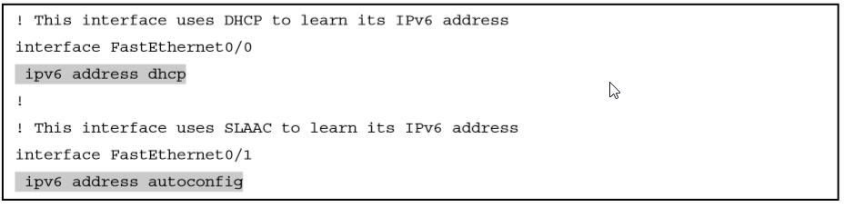
Router Configuration to Learn IPv6 Addresses with DHCP And SLAAC

Slide 18
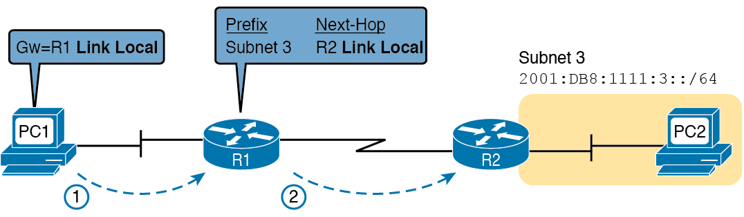
IPv6 Using Link-local Addresses as the Next-Hop Address

Slide 19

Link-local Address Format

Slide 20
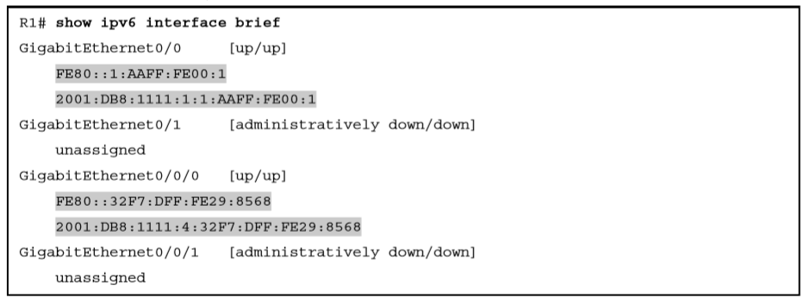
Comparing Link-local Addresses with EUI-generated Unicast Addresses

Slide 21
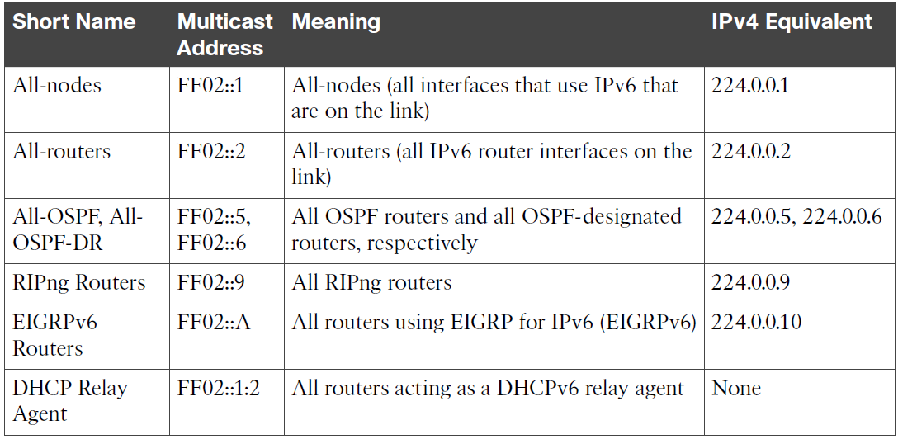
Key IPv6 Local-Scope Multicast Addresses

Slide 22
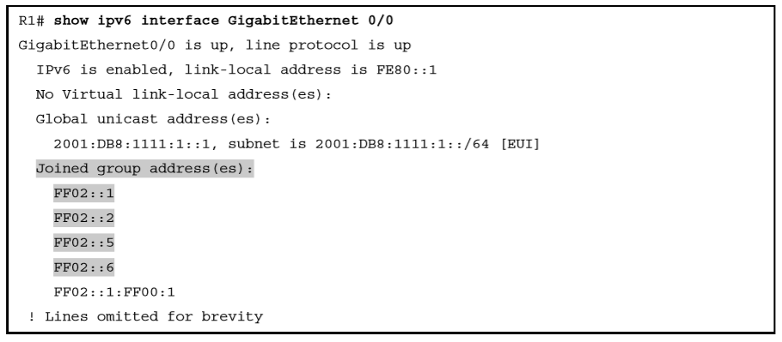
Verifying Static IPv6 Addresses on Router R1

Slide 23
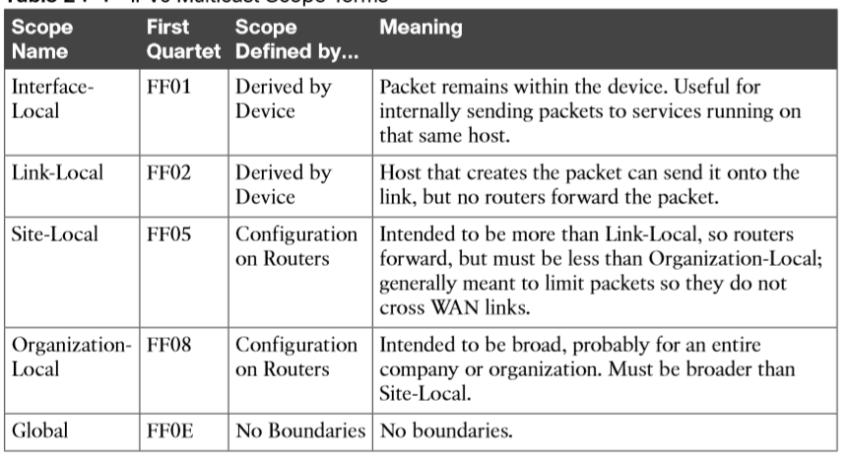
IPv6 Multicast Scope Terms

Slide 24
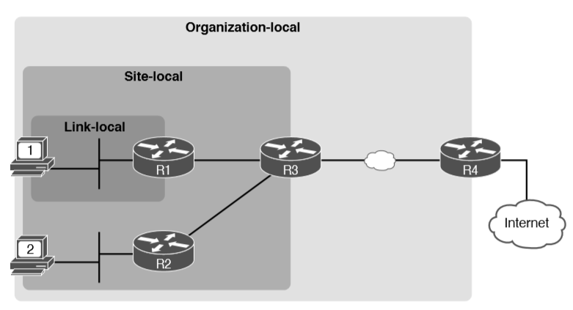
IPv6 Multicast Scopes

Slide 25
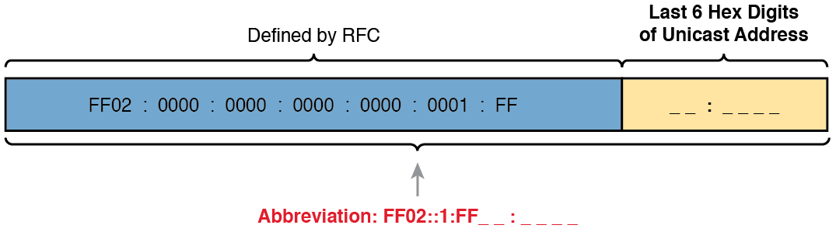
Solicited-node Multicast Address Format

Slide 26
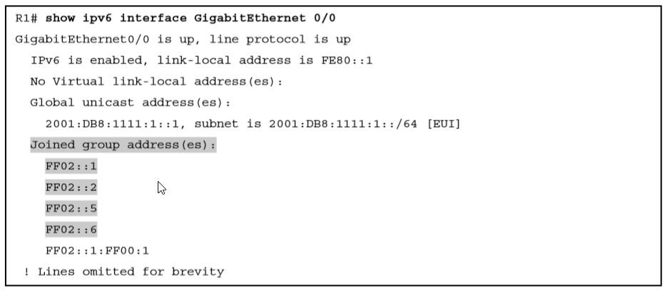
Verifying Static IPv6 Addresses on Router R1

Slide 27
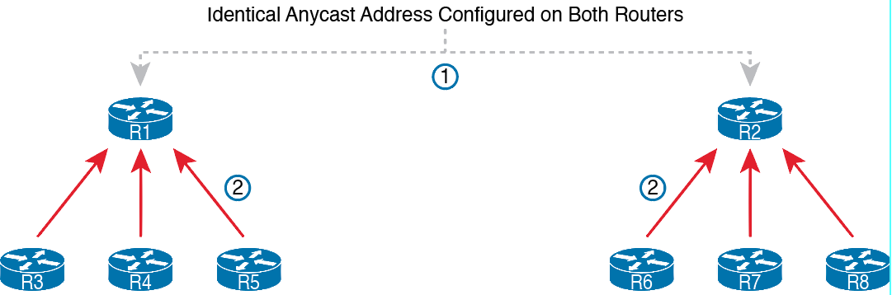
IPv6 Anycast Addresses

Slide 28
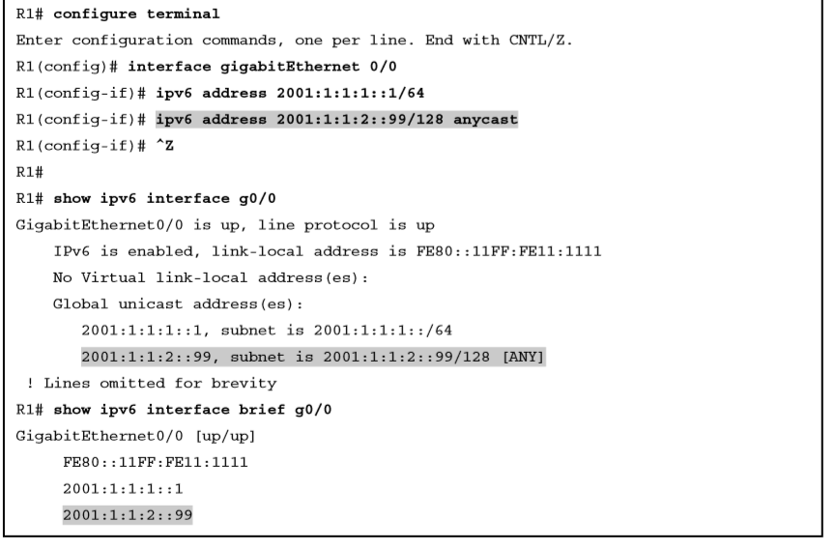
Configuring and Verifying IPv6 Anycast Addresses

Slide 29
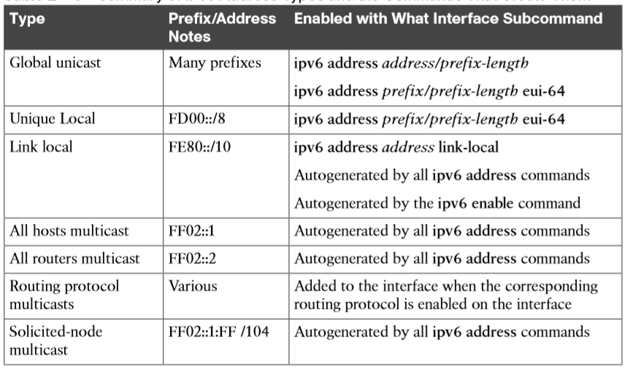
Summary of IPv6 Address Types and the Commands That Create Them Type Prefix/Address

