Slide 1
CCNA 200-301, Volume I
Chapter 35
Implementing IPv6 Routing

Slide 2
Objectives
Connected and Local IPv6 Routes
Static IPv6 Routes
The Neighbor Discovery Protocol

Slide 3
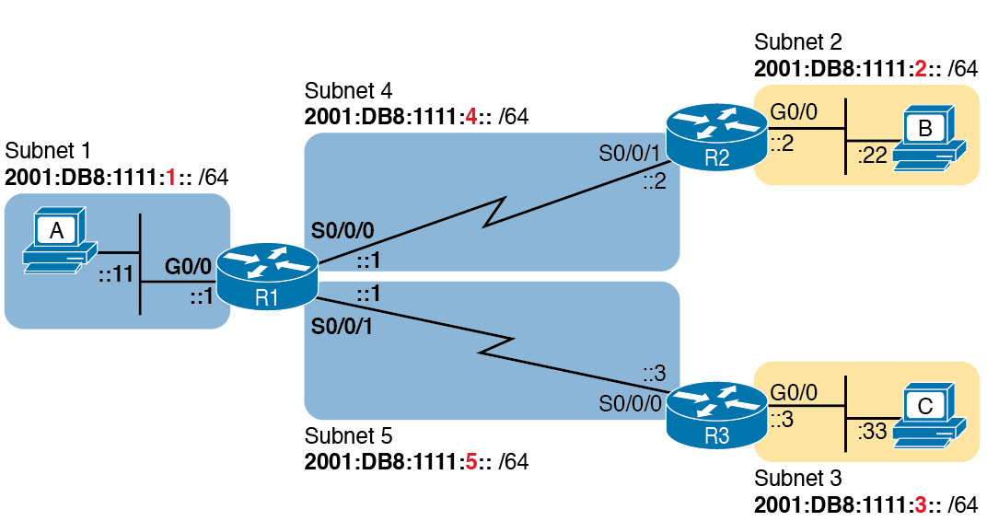
Sample Network Used to Show Connected and Local Routes

Slide 4
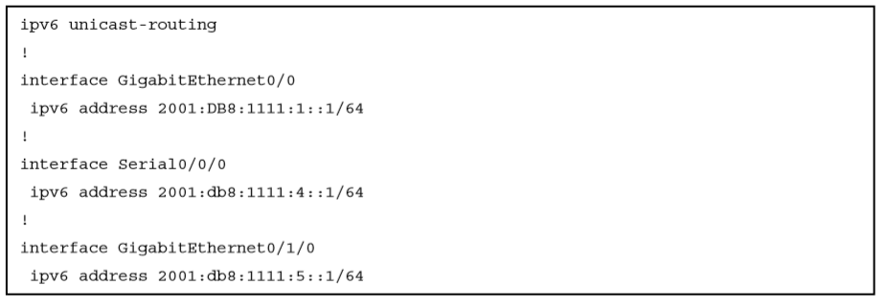
IPv6 Addressing Configuration on Router R1

Slide 5
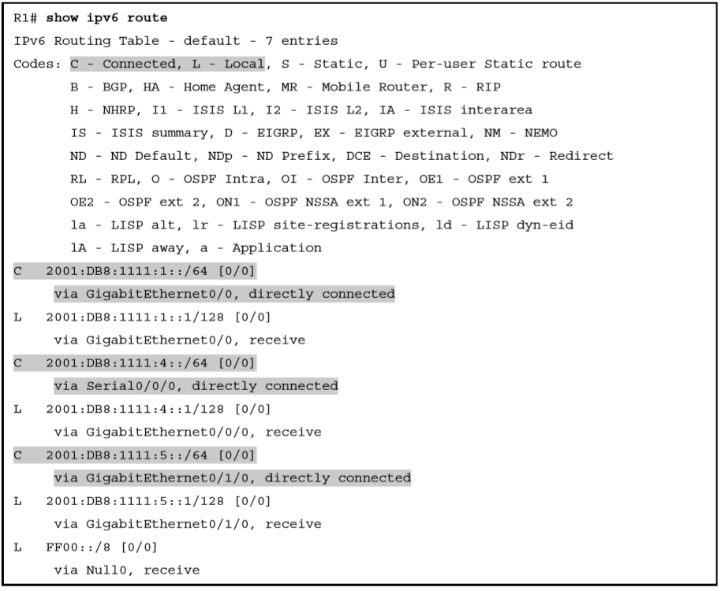
Routes on Router R1 before Adding Static or Routing Protocols

Slide 6
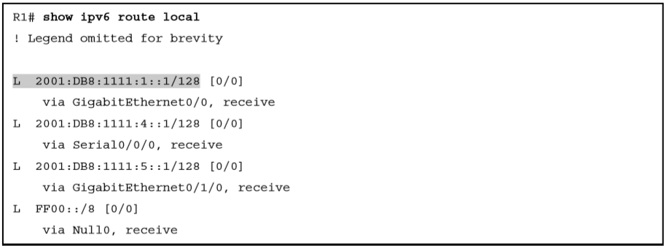
Local IPv6 Routes on Router R1

Slide 7
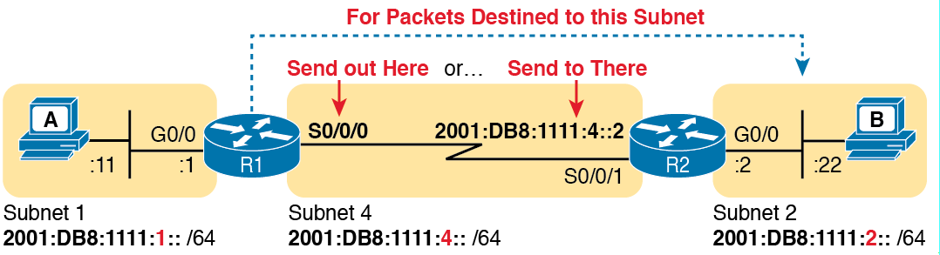
Logic Behind IPv6 Static Route Commands (IPv6 Route)

Slide 8
Static IPv6 Routes on Router R1

Slide 9
Static IPv6 Routes on Router R2

Slide 10
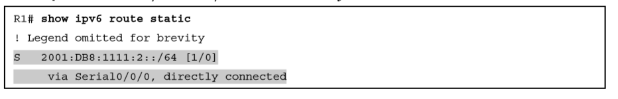
Verification of Static Routes Only on R1

Slide 11
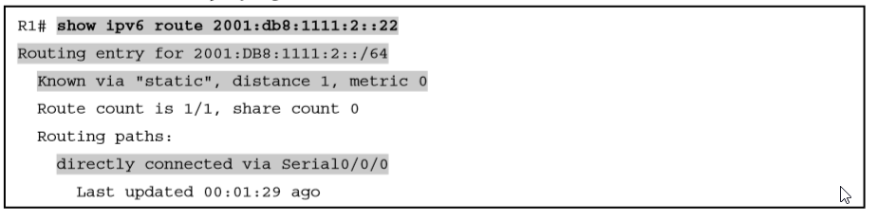
Displaying the Router R1 Uses to Forward to Host B

Slide 12
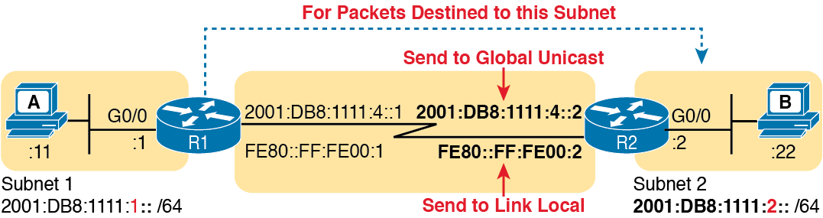
Using Unicast or Link-Local as Next-Hop Address for Static Routes

Slide 13
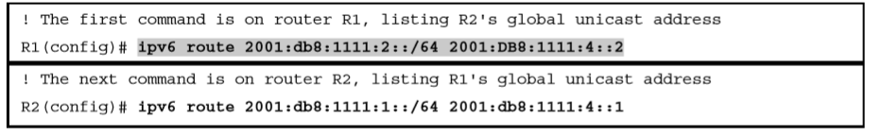
Static IPv6 Routes Using Global Unicast Addresses

Slide 14
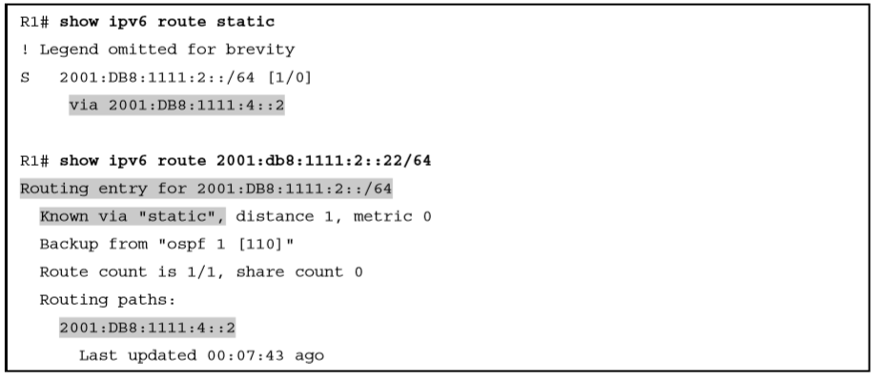
Verification of Static Routes to a Next-hop Global Unicast Address

Slide 15
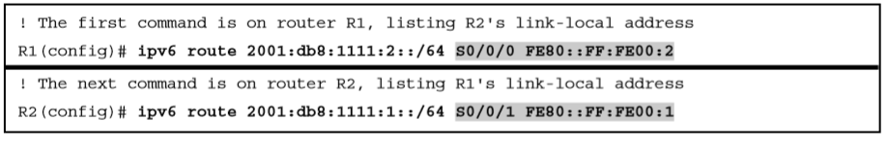
Static IPv6 Routes Using Link-Local Neighbor Addresses

Slide 16
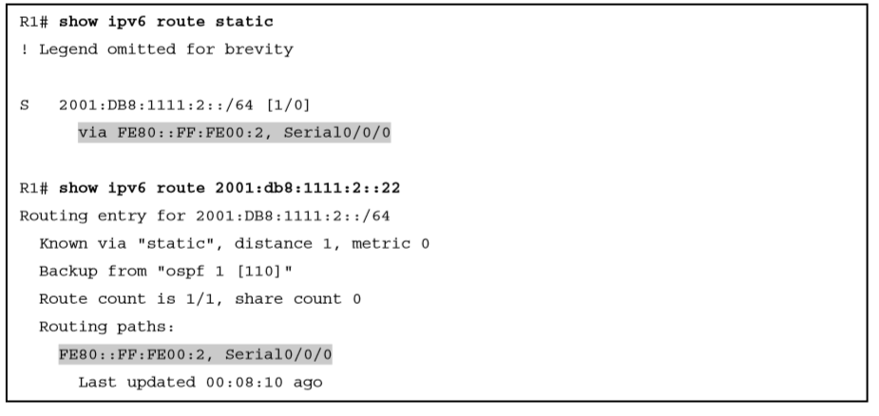
Verification of Static Routes to a Next-Hop Link-local Address

Slide 17
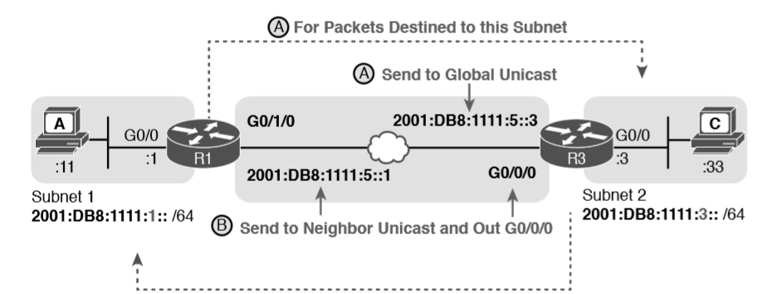
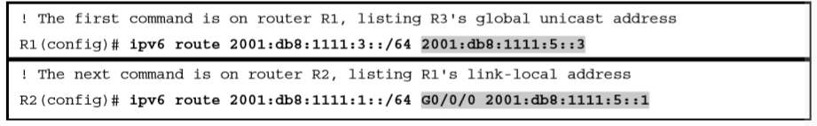
Network Details for IPv6 Static Routes on an Ethernet Interface

Slide 18
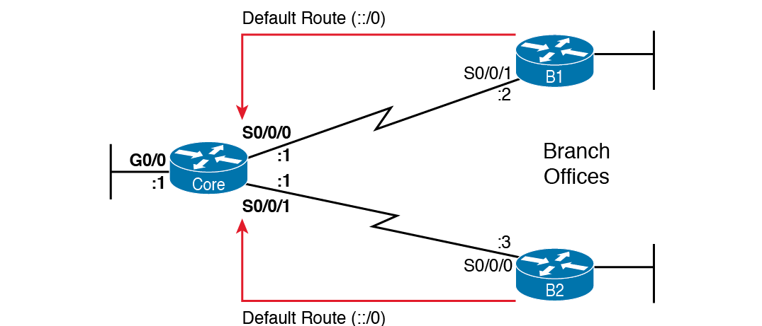
Using Static Default Routes at Branches to Forward Back to the Core

Slide 19
Static Default Route for Branch Router B1

Slide 20
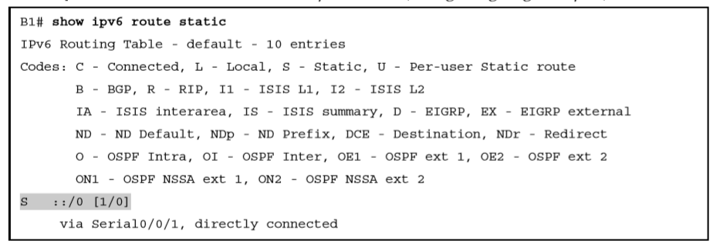
Router B1’s Static Default Route (Using Outgoing Interface)

Slide 21
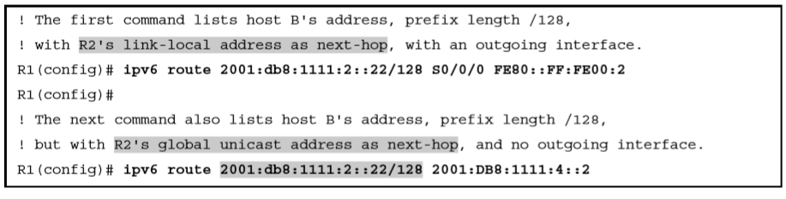
Static Host IPv6 Routes on R1, for Host B

Slide 22
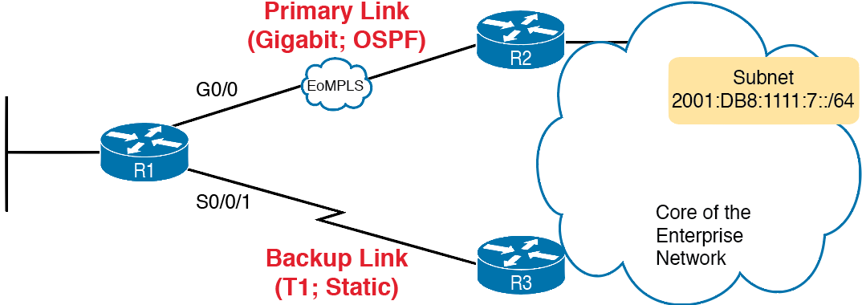
Using a Floating Static Route to Key Subnet 172.16.2.0/24

Slide 23
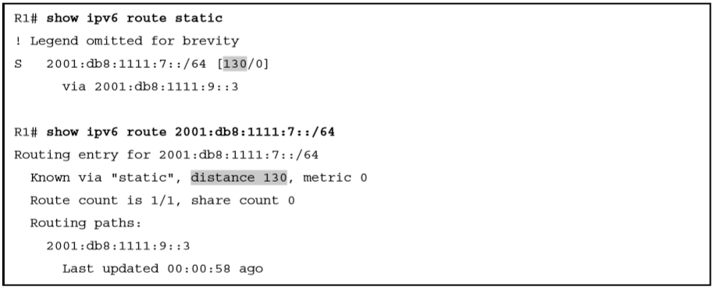
Displaying the Administrative Distance of the Static Route

Slide 24
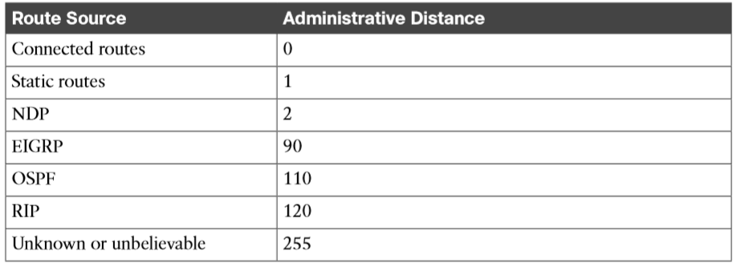
IOS Defaults for Administrative Distance

Slide 25
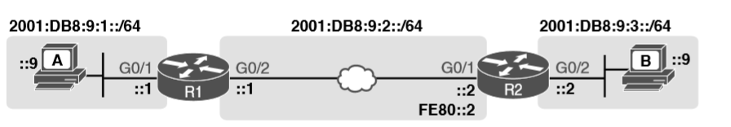
Sample Topology for Incorrect IPv6 Route Examples

Slide 26
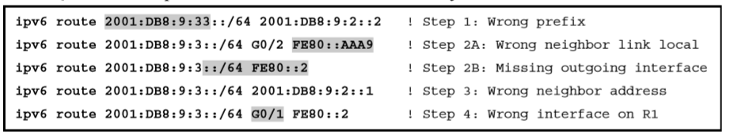
ipv6 route Commands with Correct Syntax but Incorrect Ideas

Slide 27
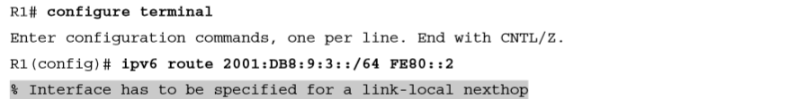
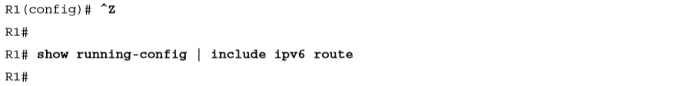
IOS Rejects the ipv6 route Command with Link-Local and No Outgoing Interface

Slide 28
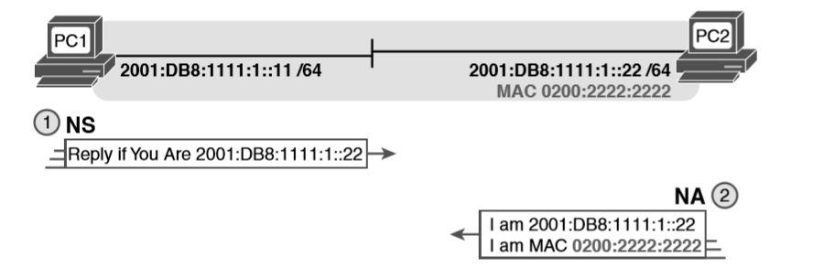
Example NDP NS/NA Process to Find the Neighbor’s Link Addresses

Slide 29
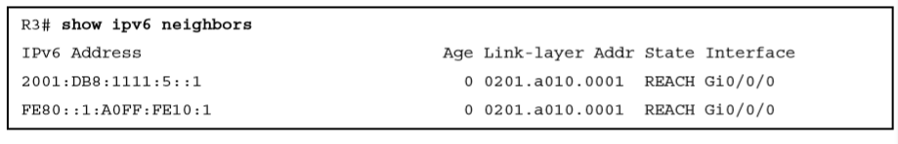
IPv6 Neighbor Table on Router R3

Slide 30
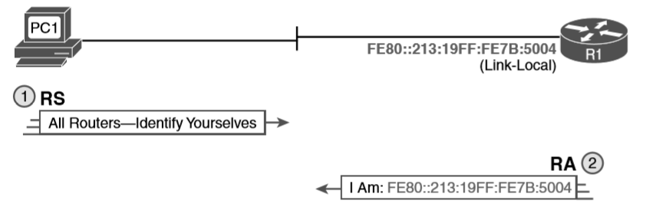
Example NDP RS/RA Process to Find the Default Routers

Slide 31
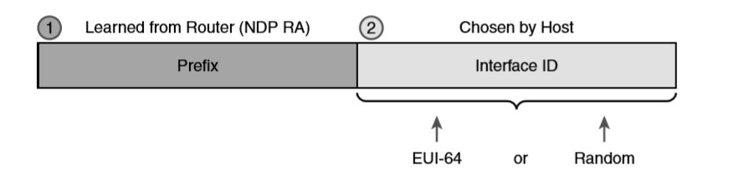
Host IPv6 Address Formation Using SLAAC

Slide 32
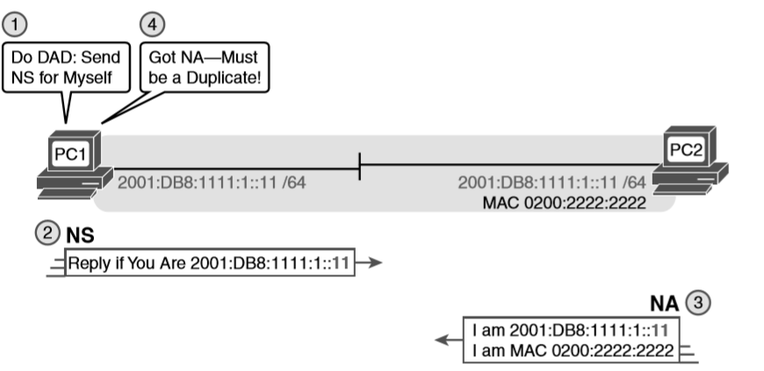
Example Duplicate Address Detection (DAD) with NDP NS/NA

Slide 33
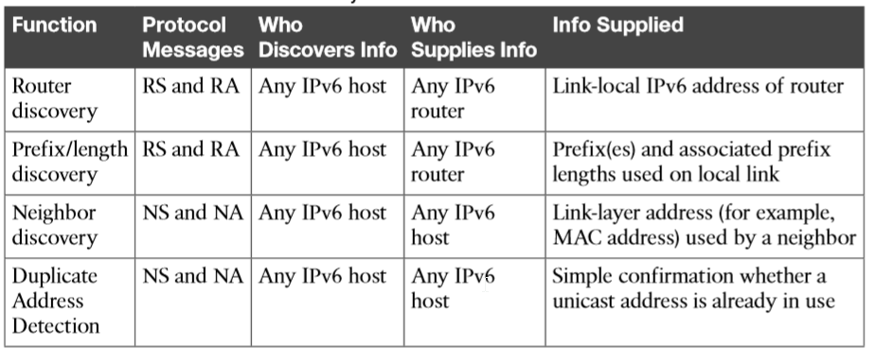
NDP Function Summary

