Slide 1
CCNA 200-301, Volume I
Chapter 26
Fundamentals of Wireless Networks

Slide 2
Objectives
Comparing Wired and Wireless Networks
Wireless LAN Topologies
Other Wireless Topologies
Wireless Bands and Channels

Slide 3
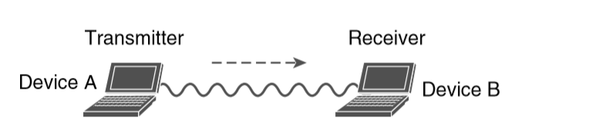
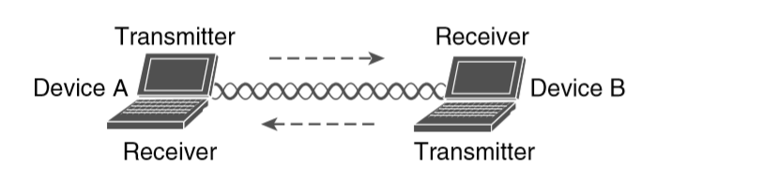
Unidirectional vs. Bidirectional Communication

Slide 4
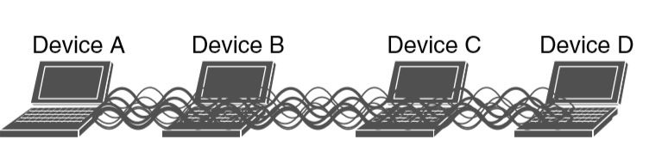
Interference from Simultaneous Transmissions

Slide 5
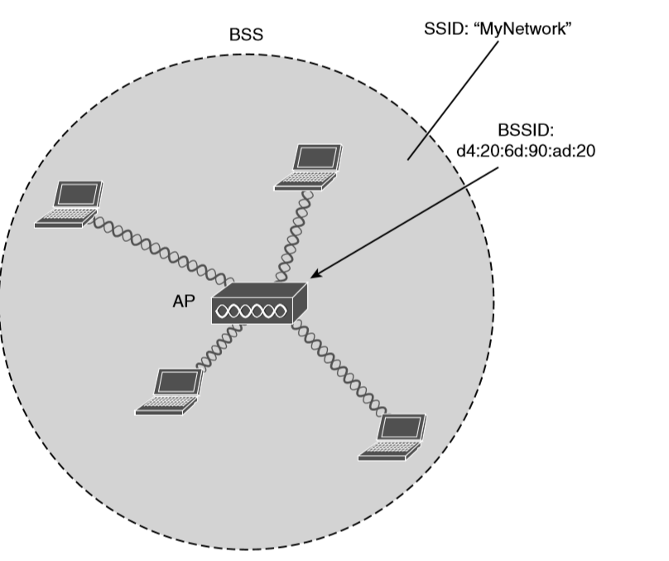
802.11 Basic Service Set

Slide 6
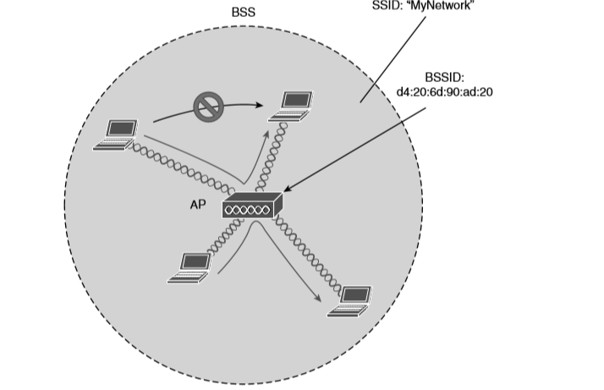
Traffic Flows Within a BSS

Slide 7
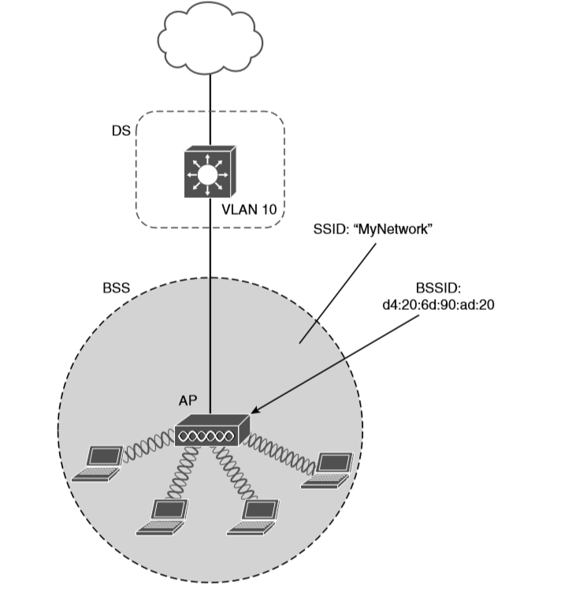
Distribution System Supporting a BSS

Slide 8
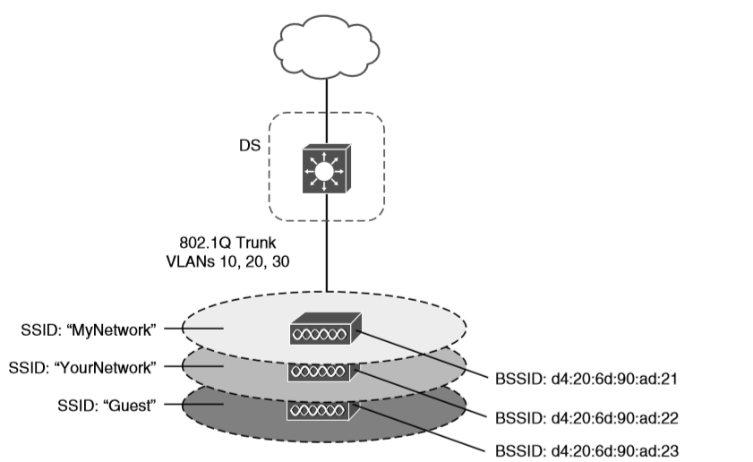
Supporting Multiple SSIDs on One AP

Slide 9
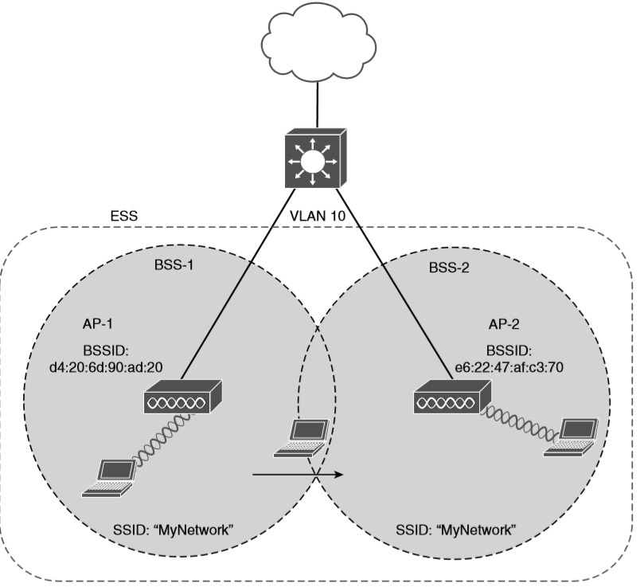
Scaling Wireless Coverage with an 802.11 Extended Service Set

Slide 10
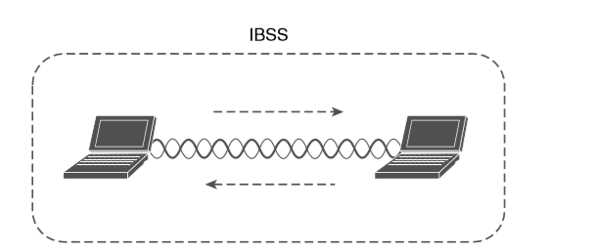
802.11 Independent Basic Service Set

Slide 11
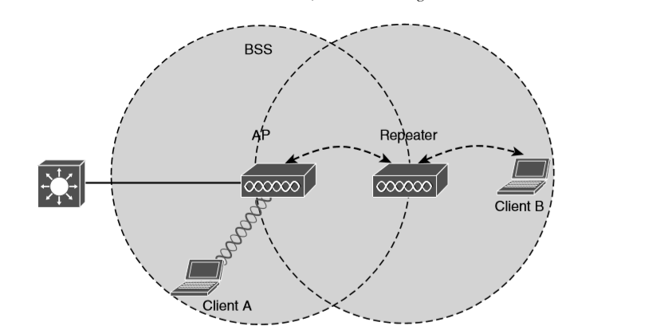
Extending the Range of an AP with a Wireless Repeater

Slide 12
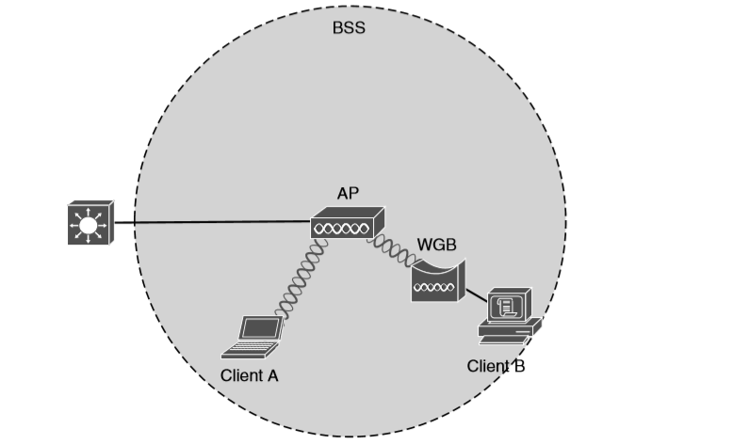
Nonwireless Device Connecting Through a Workgroup Bridge
You might encounter two types of workgroup bridges:
Universal workgroup bridge (uWGB): A single wired device can be bridged to a wireless network.
Workgroup bridge (WGB): A Cisco-proprietary implementation that allows multiple wired devices to be bridged to a wireless network

Slide 13
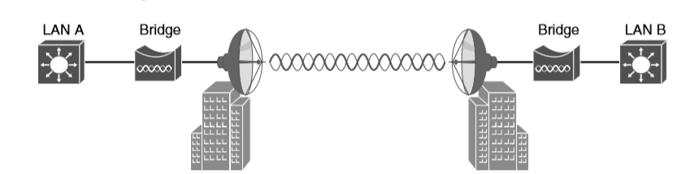
Point-to-Point Outdoor Bridge
If the LANs at two locations need to be bridged, a point-to-point bridged link can be used. One AP configured in bridge mode is needed on each end of the wireless link. Special purpose antennas are normally used with the bridges to focus their signals in one direction—toward the antenna of the AP at the far end of the link. This maximizes the link distance.

Slide 14
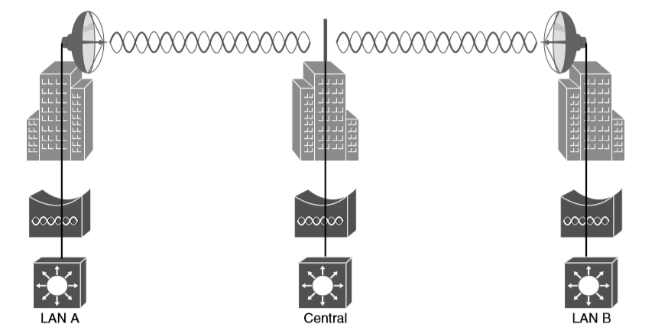
Point-to-Multipoint Outdoor Bridge
A point-to-multipoint bridged link allows a central site to be bridged to several other sites. The central site bridge is connected to an omnidirectional antenna, such that its signal is transmitted equally in all directions so that it can reach the other sites simultaneously. The bridges at each of the other sites can be connected to a directional antenna aimed at the central site.

Slide 15
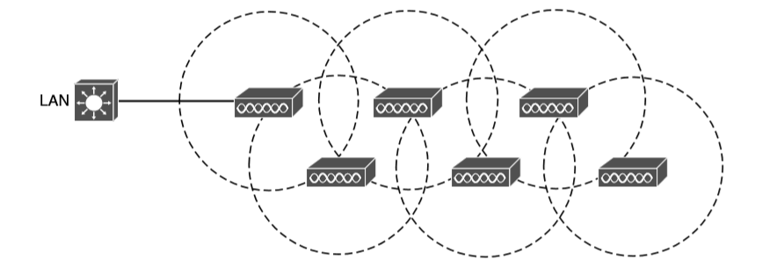
Typical Wireless Mesh Network

Slide 16
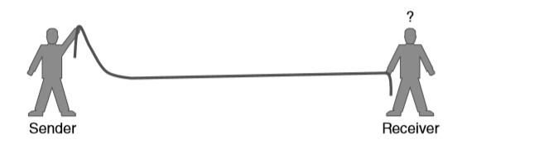
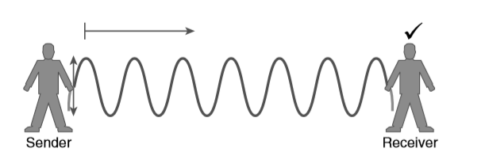
RF Overview
Failed attempt to pass a message down a rope
Sending a continuous wave down a rope

Slide 17
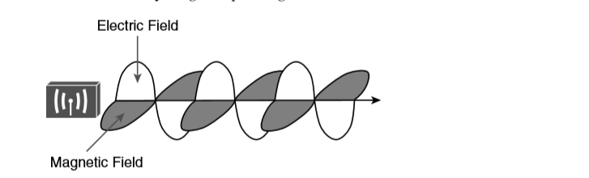
Traveling Electric and Magnetic Waves

Slide 18
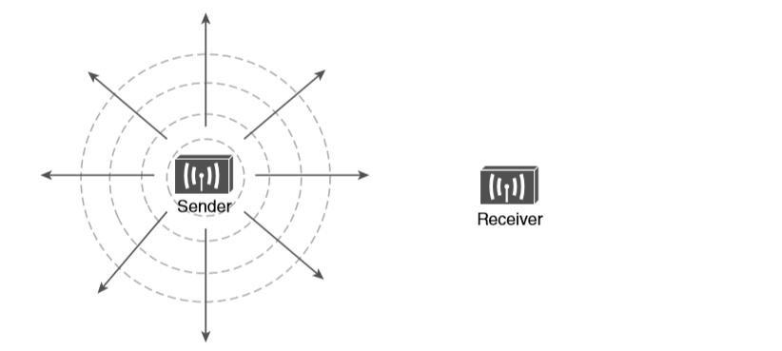
Wave Propagation with an Idealistic Antenna

Slide 19
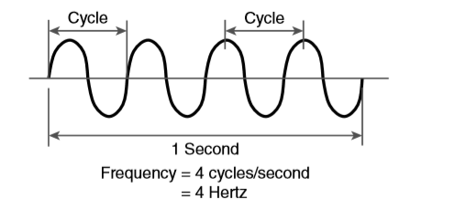
Cycles Within a Wave

Slide 20
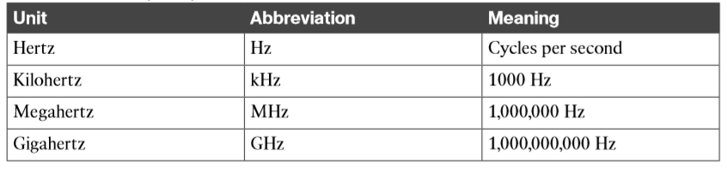
Frequency Unit Names

Slide 21
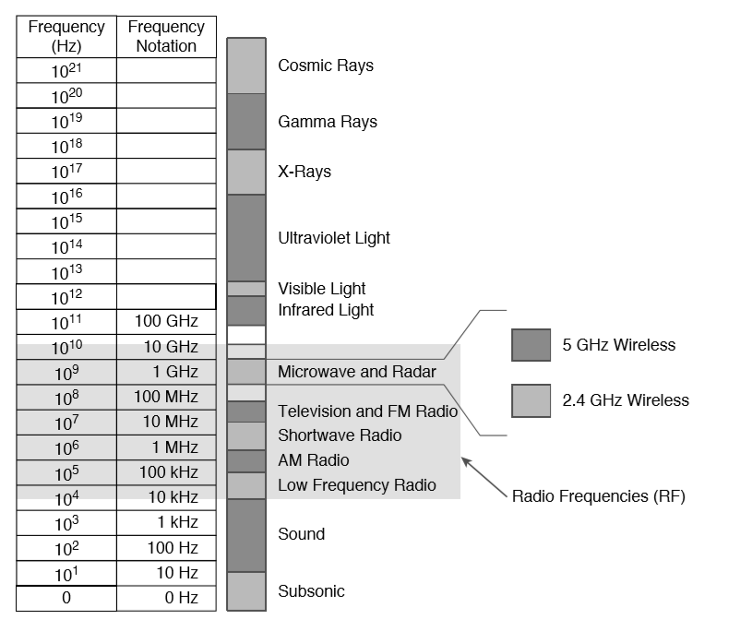
Continuous Frequency Spectrum

Slide 22
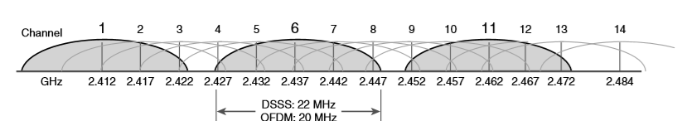
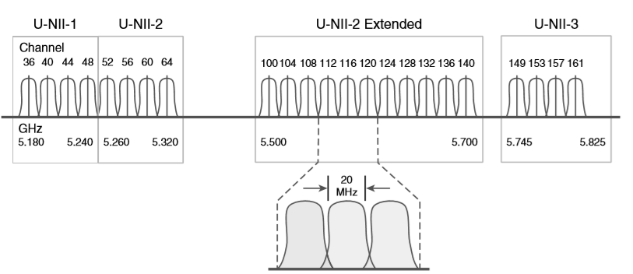
Wireless Bands and Channels
Channel Layout in the 2.4-GHz Band
Channel Layout in the 5-GHz Band

Slide 23
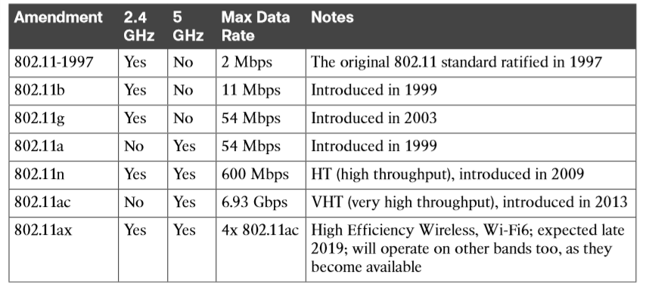
Basic Characteristics of Some IEEE 802.11 Amendments

