Slide 1
CCNA 200-301, Volume I
Chapter 27
Analyzing Cisco Wireless Architectures

Slide 2
Objectives
Autonomous AP Architectures
Cloud-based AP Architecture
Split-MAC Architectures
Comparing Wireless LAN Controller Deployments
Comparing Wireless LAN Controller Deployments

Slide 3
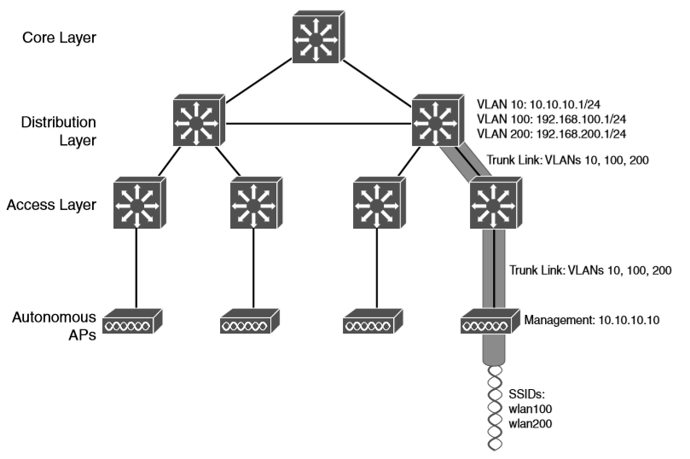
Wireless Network Architecture with Autonomous APs

Slide 4
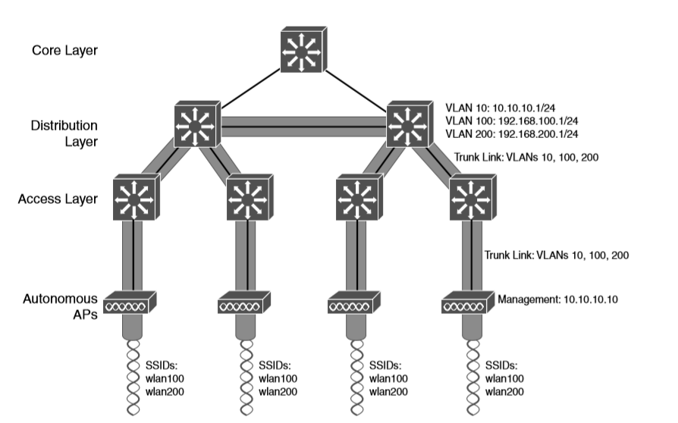
Extent of a Data VLAN in a Network of Autonomous APs

Slide 5
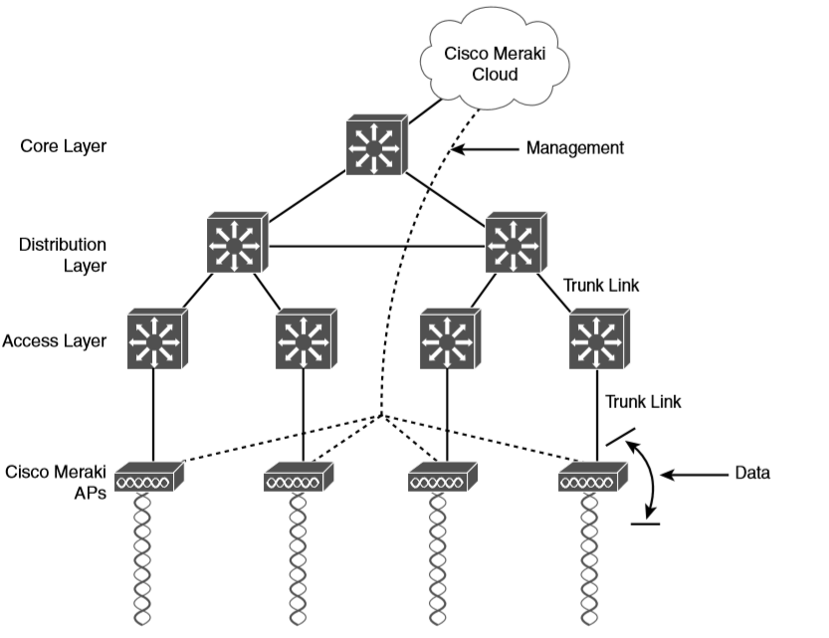
Cisco Meraki Cloud-Based Wireless Network Architecture
Notice that this network example consist of two distinct paths – one for data and one for management, corresponding to the following two functions:
A control plane: Traffic used to control, configure, manage, and monitor the AP itself.
A data plane: End-user traffic passing through the AP.

Slide 6
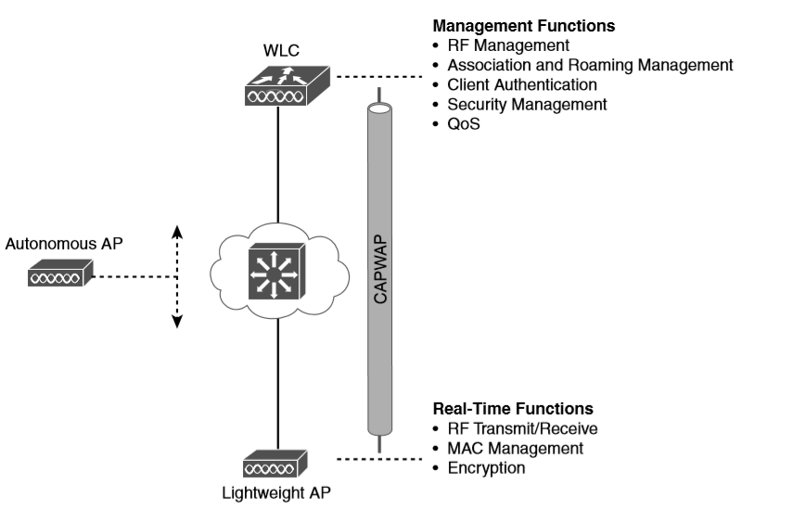
Autonomous Versus Lightweight Access Point

Slide 7
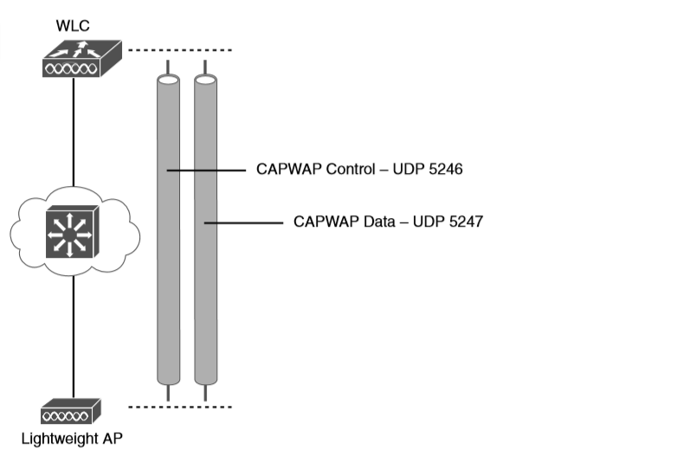
Linking a Lightweight AP and WLC with CAPWAP

Slide 8
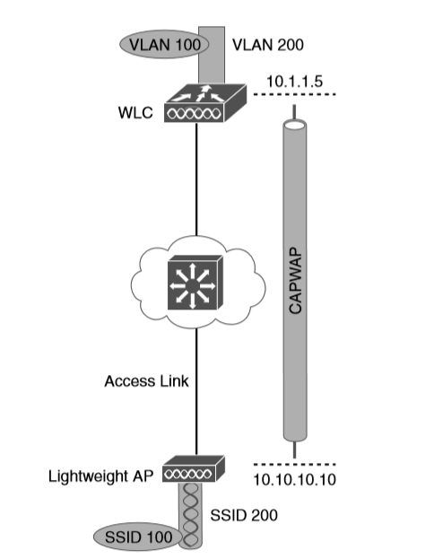
Extent of VLAN 100 in a Cisco Wireless Network

Slide 9
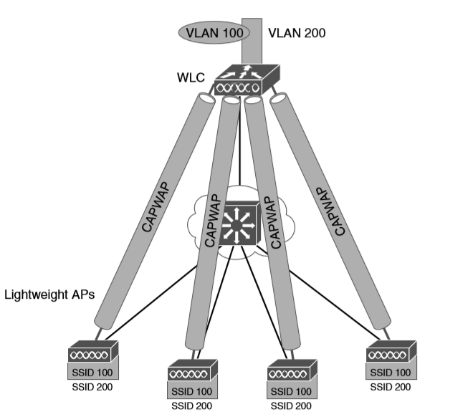
Using CAPWAP Tunnels to Connect APs to One Central WLC

Slide 10
WLC Functions
Dynamic channel assignment: The WLC can automatically choose and configure the RF channel used by each AP, based on other active access points in the area.
Transmit power optimization: The WLC can automatically set the transmit power of each AP based on the coverage area needed.
Self-healing wireless coverage: If an AP radio dies, the coverage hole can be “healed” by turning up the transmit power of surrounding APs automatically.
Flexible client roaming: Clients can roam between APs with very fast roaming times.
Dynamic client load balancing: If two or more APs are positioned to cover the same geographic area, the WLC can associate clients with the least used AP. This distributes the client load across the APs.
RF monitoring: The WLC manages each AP so that it scans channels to monitor the RF usage. By listening to a channel, the WLC can remotely gather information about RF interference, noise, signals from neighboring APs, and signals from rogue APs or ad hoc clients.
Security management: The WLC can authenticate clients from a central service and can require wireless clients to obtain an IP address from a trusted DHCP server before allowing them to associate and access the WLAN.
Wireless intrusion protection system: Leveraging its central location, the WLC can monitor client data to detect and prevent malicious activity.

Slide 11
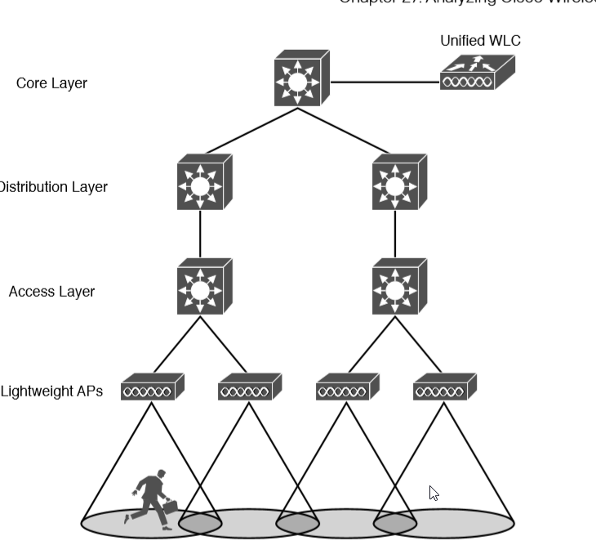
WLC Location in a Unified Deployment

Slide 12
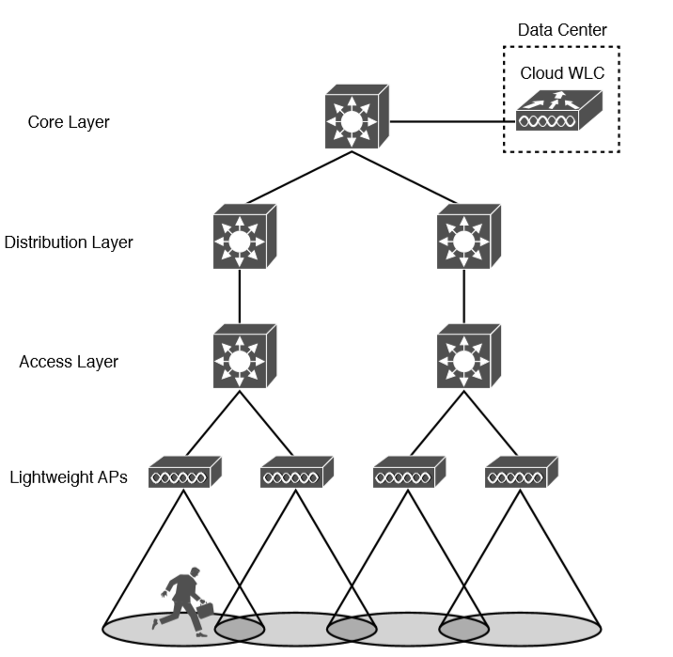
WLC Location in a Cloud-based Deployment

Slide 13
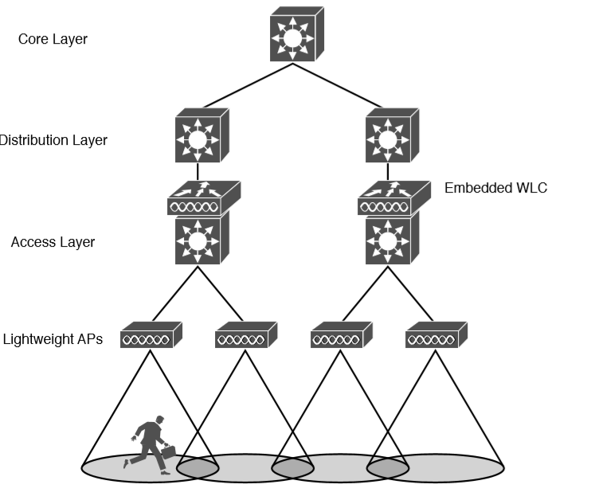
WLC Location in an Embedded Deployment

Slide 14
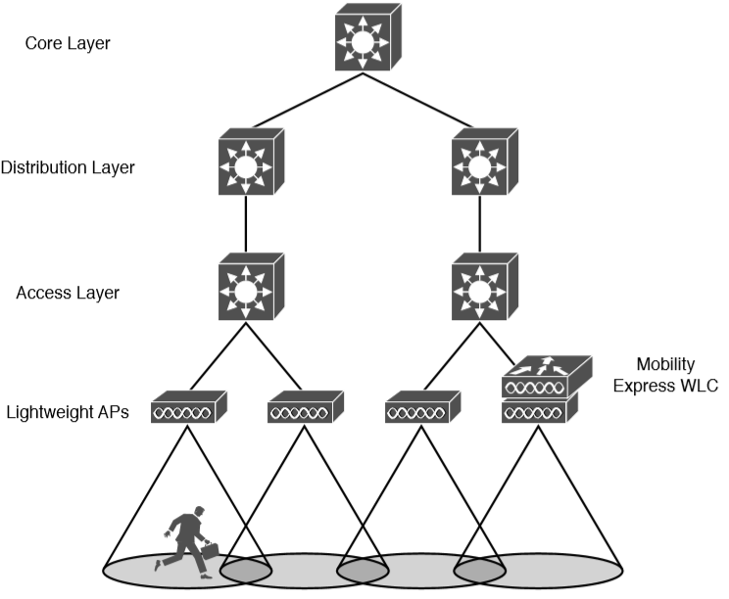
WLC Location in a Mobility Express Deployment

Slide 15
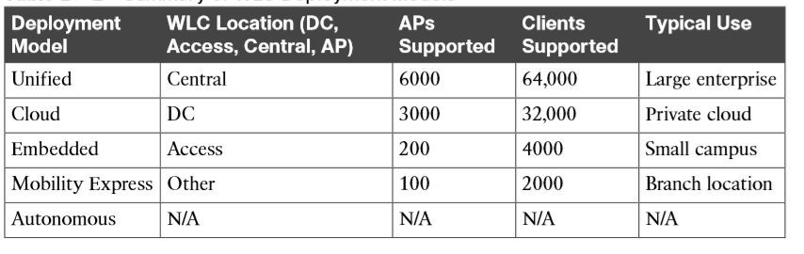
Summary of WLC Deployment Models

Slide 16
Cisco AP Modes
Local: The default lightweight mode that offers one or more functioning BSSs on a specific channel. During times that it is not transmitting, the AP will scan the other channels to measure the level of noise, measure interference, discover rogue devices, and match against intrusion detection system (IDS) events.
Monitor: The AP does not transmit at all, but its receiver is enabled to act as a dedicated sensor. The AP checks for IDS events, detects rogue access points, and determines the position of stations through location-based services.
FlexConnect: An AP at a remote site can locally switch traffic between an SSID and a VLAN if its CAPWAP tunnel to the WLC is down and if it is configured to do so.
Sniffer: An AP dedicates its radios to receiving 802.11 traffic from other sources, much like a sniffer or packet capture device. The captured traffic is then forwarded to a PC running network analyzer software such as Wildpackets OmniPeek or WireShark, where it can be analyzed further.

Slide 17
Cisco AP Modes (Continued)
Rogue detector: An AP dedicates itself to detecting rogue devices by correlating MAC addresses heard on the wired network with those heard over the air. Rogue devices are those that appear on both networks.
Bridge: An AP becomes a dedicated bridge (point-to-point or point-to-multipoint) between two networks. Two APs in bridge mode can be used to link two locations separated by a distance. Multiple APs in bridge mode can form an indoor or outdoor mesh network.
Flex+Bridge: FlexConnect operation is enabled on a mesh AP.
SE-Connect: The AP dedicates its radios to spectrum analysis on all wireless channels. You can remotely connect a PC running software such as MetaGeek Chanalyzer or Cisco Spectrum Expert to the AP to collect and analyze the spectrum analysis data to discover sources of interference.

