Slide 1
CCNA 200-301, Volume I
Chapter 28
Securing Wireless Networks

Slide 2
Objectives
Anatomy of a Secure Connection
Wireless Client Authentication Methods
Wireless Privacy and Integrity Methods
WPA, WPA2, and WPA3

Slide 3
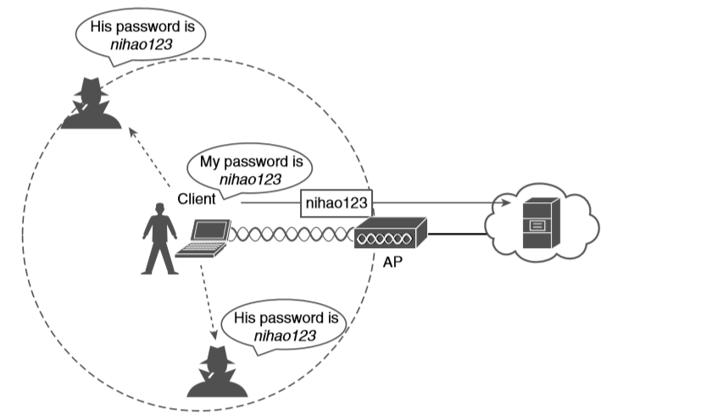
Wireless Transmissions Reaching Unintended Recipients

Slide 4
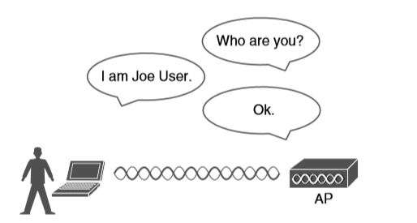
Authenticating a Wireless Client

Slide 5
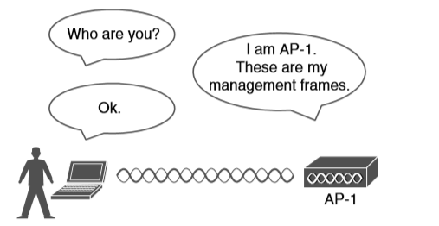
Authenticating a Wireless AP

Slide 6
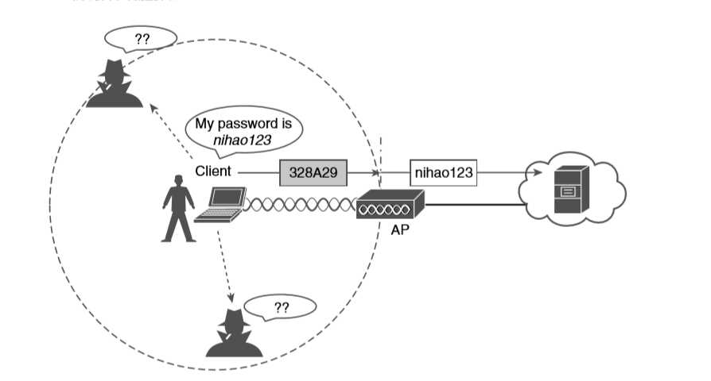
Encrypting Wireless Data to Protect Data Privacy

Slide 7
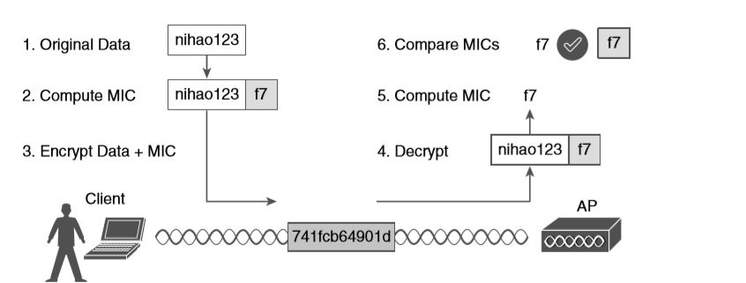
Checking Message Integrity over a Wireless Network

Slide 8
Open Authentication
Open authentication is true to its name; it offers open access to a WLAN.
The only requirement is that a client must use an 802.11 authentication request before it attempts to associate with an AP. No other credentials are needed.

Slide 9
WEP
WEP uses the RC4 cipher algorithm to make every wireless data frame private and hidden from eavesdroppers.
The algorithm uses a string of bits as a key, commonly called a WEP key, to derive other encryption keys—one per wireless frame.
WEP is known as a shared-key security method.

Slide 10
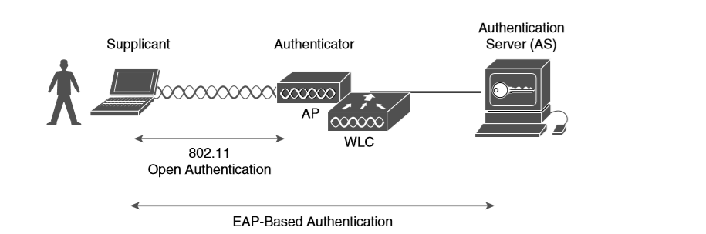
802.1x Client Authentication Roles

Slide 11
EAP-FAST
The PAC is a form of shared secret that is generated by the AS and used for mutual authentication. EAP-FAST is a sequence of three phases:
Phase 0: The PAC is generated or provisioned and installed on the client.
Phase 1: After the supplicant and AS have authenticated each other, they negotiate a Transport Layer Security (TLS) tunnel.
Phase 2: The end user can then be authenticated through the TLS tunnel for additional security.

Slide 12
TKIP
TKIP adds the following security features using legacy hardware and the underlying WEP encryption:
MIC: This efficient algorithm adds a hash value to each frame as a message integrity check to prevent tampering; commonly called “Michael” as an informal reference to MIC.
Time stamp: A time stamp is added into the MIC to prevent replay attacks that attempt to reuse or replay frames that have already been sent.
Sender’s MAC address: The MIC also includes the sender’s MAC address as evidence of the frame source.
TKIP sequence counter: This feature provides a record of frames sent by a unique MAC address, to prevent frames from being replayed as an attack.
Key mixing algorithm: This algorithm computes a unique 128-bit WEP key for each frame.
Longer initialization vector (IV): The IV size is doubled from 24 to 48 bits, making it virtually impossible to exhaust all WEP keys by brute-force calculation.

Slide 13
CCMP
The Counter/CBC-MAC Protocol (CCMP) is considered to be more secure than TKIP. CCMP consists of two algorithms:
AES counter mode encryption
Cipher Block Chaining Message Authentication Code (CBC-MAC) used as a message integrity check (MIC)

Slide 14
GCMP
The Galois/Counter Mode Protocol (GCMP) is a robust authenticated encryption suite that is more secure and more efficient than CCMP. GCMP consists of two algorithms:
AES counter mode encryption
Galois Message Authentication Code (GMAC) used as a message integrity check (MIC
GCMP is used in WPA3, which is described in the following section.

Slide 15
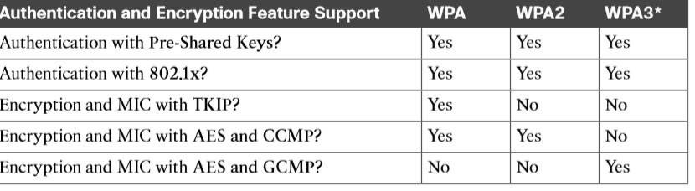
Comparing WPA, WPA2, and WPA3

