Slide 1
CCNA 200-301, Volume I
Chapter 29
Building a Wireless LAN

Slide 2
Objectives
Connecting a Cisco AP
Accessing a Cisco WLC
Connecting a Cisco WLC
Configuring a WLAN

Slide 3
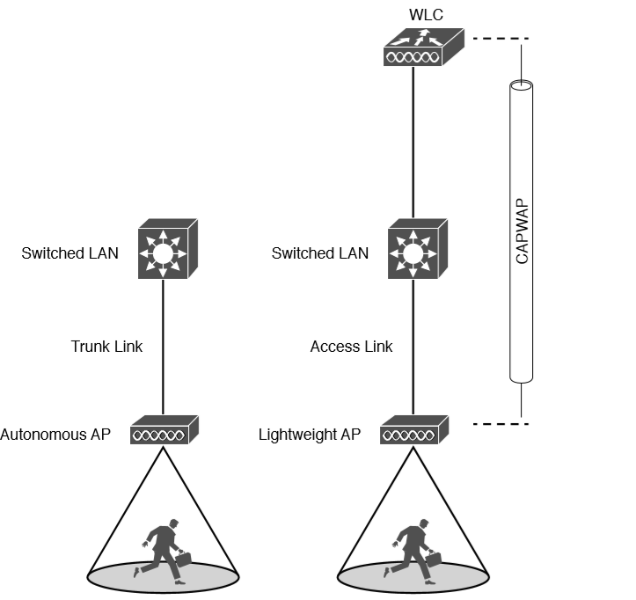
Comparing Connections to Autonomous and Lightweight APs

Slide 4
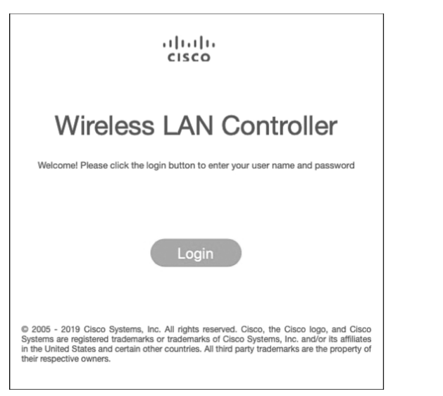
Accessing a WLC with a Web Browser

Slide 5
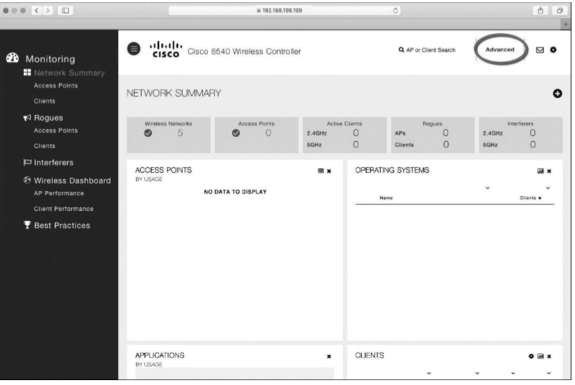
Accessing the Advanced Configuration Interface

Slide 6
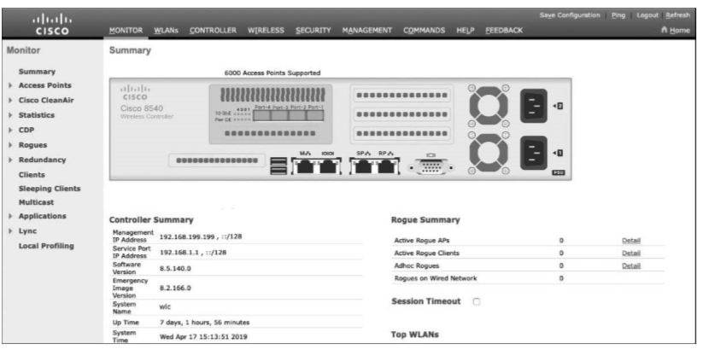
The Advanced WLC Configuration GUI

Slide 7
Using WLC Ports
You can connect several different types of controller ports to your network:
Service port: Used for out-of-band management, system recovery, and initial boot functions; always connects to a switch port in access mode.
Distribution system port: Used for all normal AP and management traffic; usually connects to a switch port in 802.1Q trunk mode.
Console port: Used for out-of-band management, system recovery, and initial boot functions; asynchronous connection to a terminal emulator (9600 baud, 8 data bits, 1 stop bit, by default).
Redundancy port: Used to connect to a peer controller for high availability (HA) operation.

Slide 8
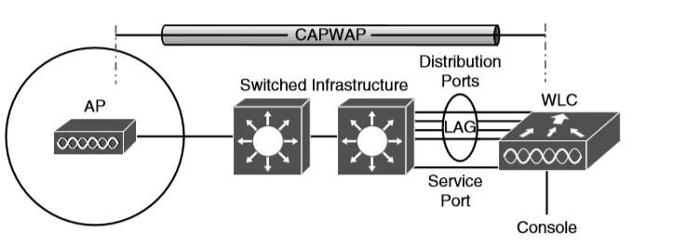
Cisco Wireless LAN Controller Ports

Slide 9
Using WLC Interfaces
Cisco controllers support the following interface types
Management interface: Used for normal management traffic, such as RADIUS user authentication, WLC-to-WLC communication, web-based and SSH sessions, SNMP, Network Time Protocol (NTP), syslog, and so on. The management interface is also used to terminate CAPWAP tunnels between the controller and its APs.
Redundancy management: The management IP address of a redundant WLC that is part of a high availability pair of controllers. The active WLC uses the management interface address, while the standby WLC uses the redundancy management address.
Virtual interface: IP address facing wireless clients when the controller is relaying client DHCP requests, performing client web authentication, and supporting client mobility.
Service port interface: Bound to the service port and used for out-of-band management.
Dynamic interface: Used to connect a VLAN to a WLAN.

Slide 10
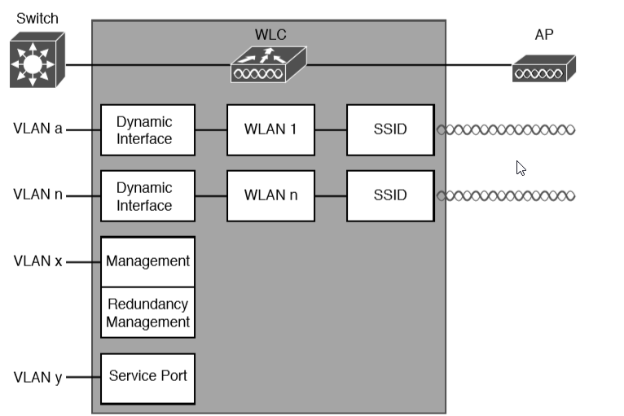
Cisco Wireless LAN Controller Interfaces

Slide 11
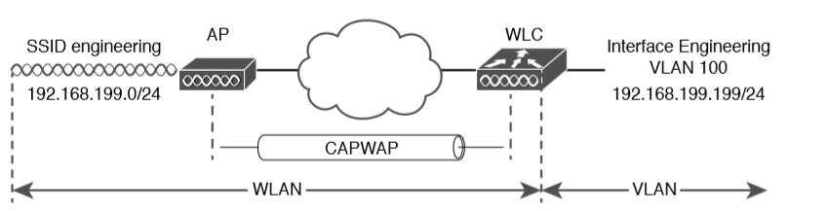
Connecting Wired and Wireless Networks with a WLAN

Slide 12
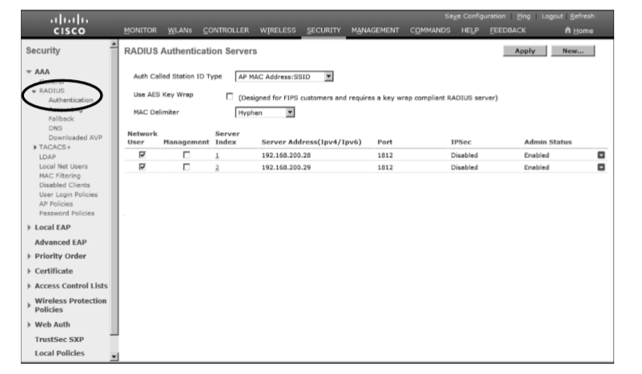
Displaying the List of RADIUS Authentication Servers

Slide 13
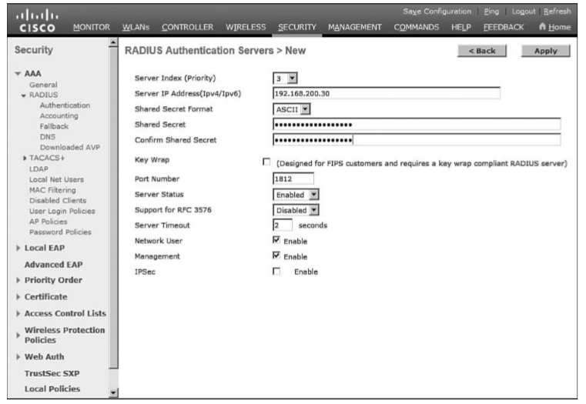
Configuring a New RADIUS Server

Slide 14
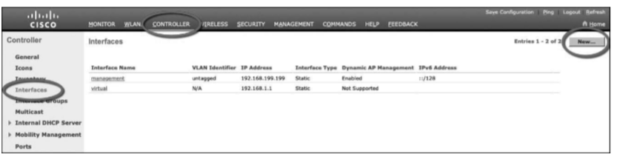
Displaying a List of Dynamic Interfaces

Slide 15
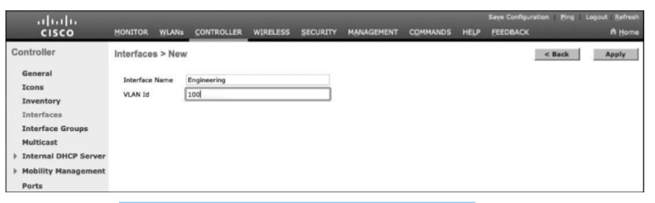
Defining a Dynamic Interface Name and VLAN ID

Slide 16
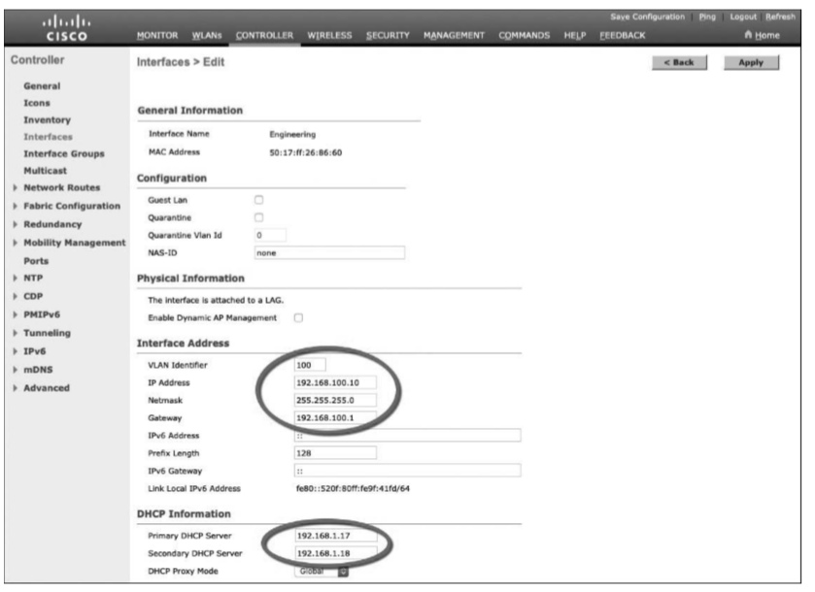
Editing the Dynamic Interface Parameters

Slide 17
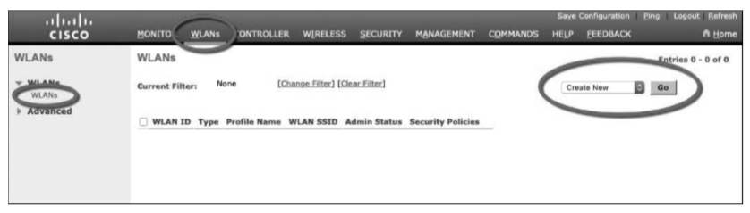
Displaying a List of WLANs

Slide 18
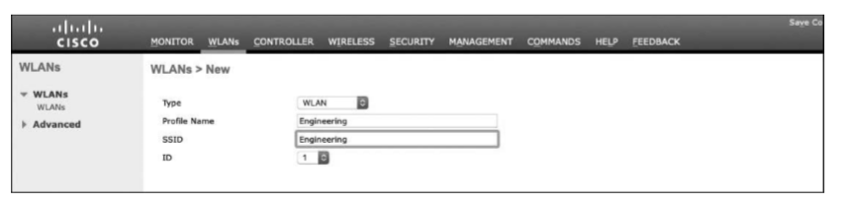
Creating a New WLAN

Slide 19
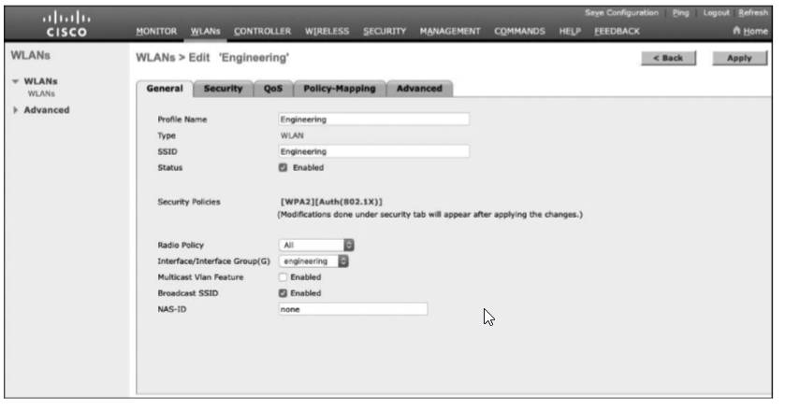
Configuring the General WLAN Parameters

Slide 20
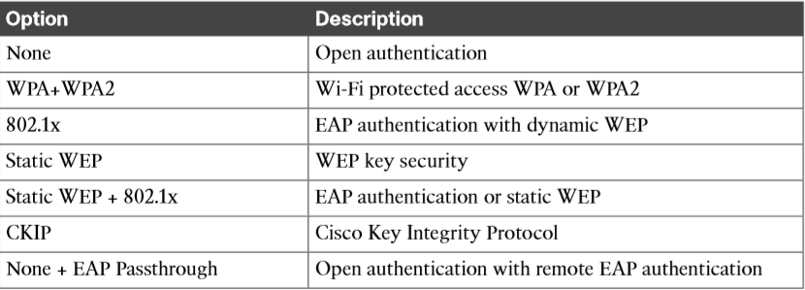
Layer 2 WLAN Security Type

Slide 21
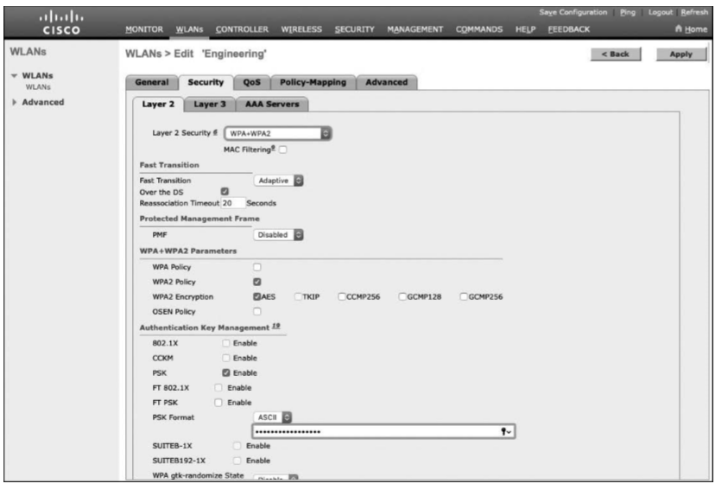
Configuring Layer 2 WLAN Security

Slide 22
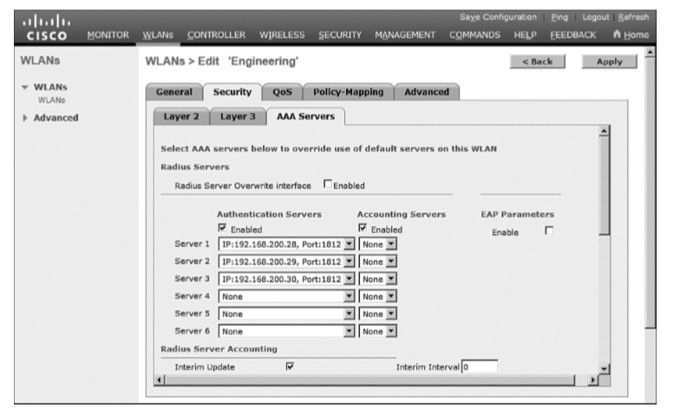
Selecting RADIUS Servers for WLAN Authentication

Slide 23
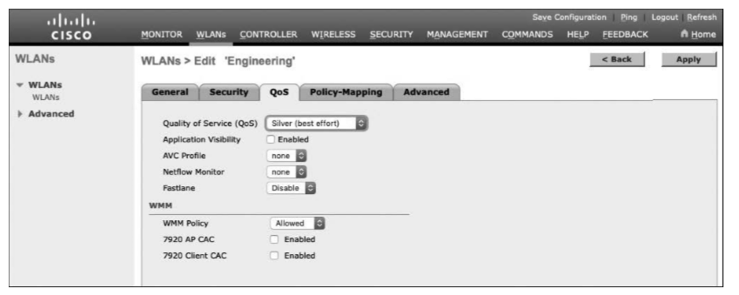
Configuring QoS Settings

Slide 24
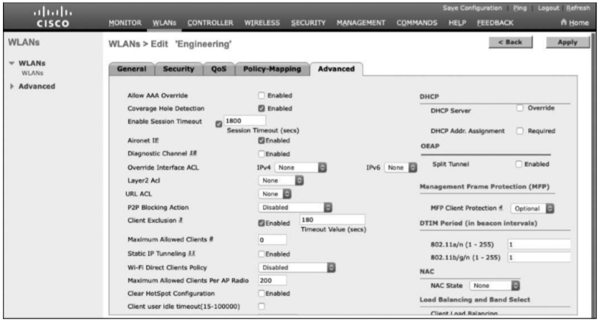
Configuring Advanced WLAN Settings

Slide 25
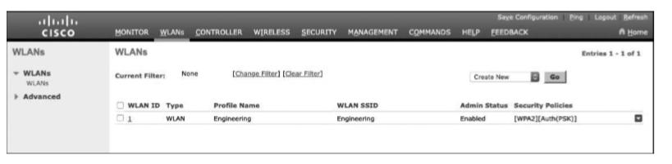
Displaying WLANs Configured on a Controller

Slide 26
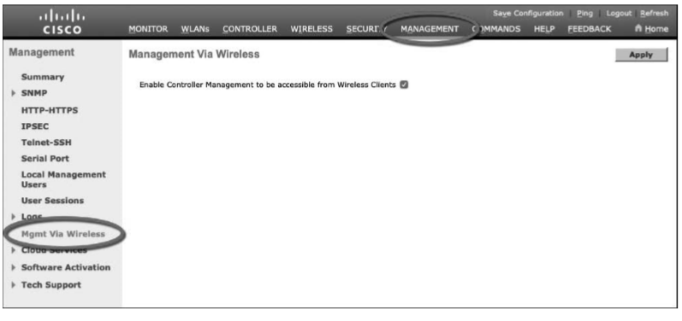
Configuring Management Access from Wireless Networks

