Slide 1
CCNA 200-301, Volume I
Chapter 3
Fundamentals of WANs and IP Routing

Slide 2
Objectives
Leased Line WANs
Ethernet as a WAN technology
Accessing the Internet

Slide 3
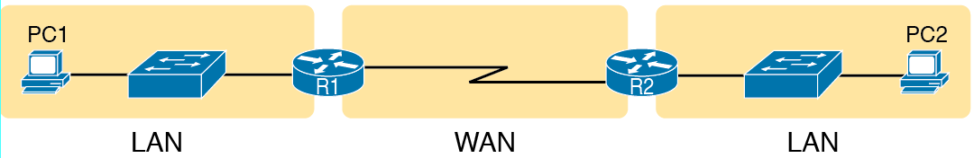
Small Enterprise Network with One Leased Line

Slide 4
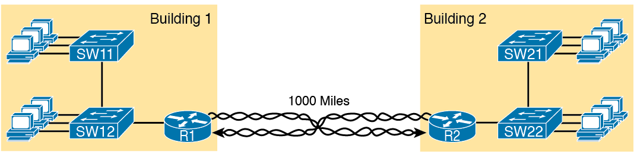
Conceptual View of the Leased-Line Service

Slide 5
Different Names for a Leased Line
Name | Meaning or Reference
Leased circuit, Circuit | The words “line” and “circuit” are often used as synonyms in Telco terminology; circuit makes reference to the electrical circuit between the two endpoints.
Serial link, Serial line | The words “link” and “line” are also often used as synonyms. “Serial” in this case refers to the fact that the bits flow serially, and that routers use serial interfaces.
Point-to-point link, Point-to-point line | These terms refer to the fact that the topology stretches between two points, and two points only. (Some older leased lines allowed more than two devices.)
T1 | A specific type of leased line that transmits data at 1.544 Megabits per second (1.544 Mbps).
WAN link, Link | Both these terms are very general, with no reference to any specific technology.
Private line | This term refers to the fact that the data sent over the line cannot be copied by other telco customers, so the data is private.

Slide 6
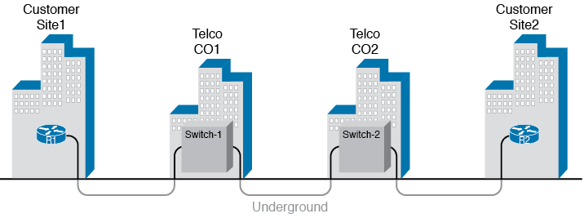
Possible Cabling Inside a Telco for a Short Leased Line

Slide 7

HDLC Framing

Slide 8
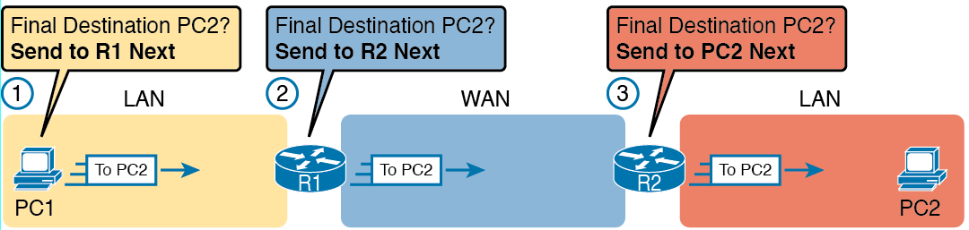
IP Routing Logic over LANs and WANs

Slide 9
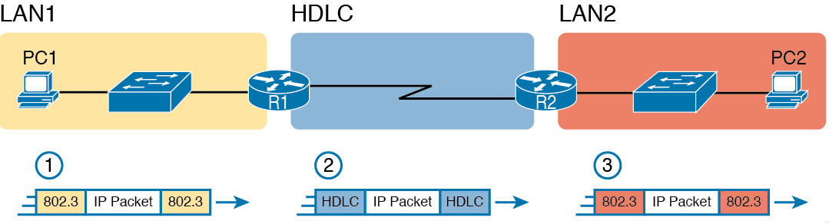
General Concept of Routers De-encapsulation and Re-encapsulating IP Packets

Slide 10
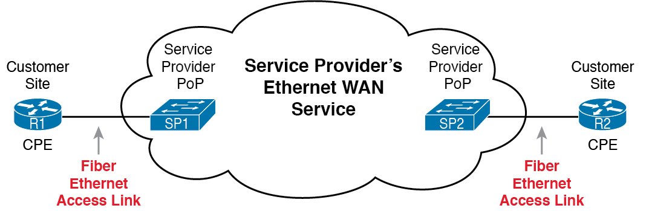
Fiber Ethernet Link to Connect CPE Router to a Service Provider’s WAN

Slide 11
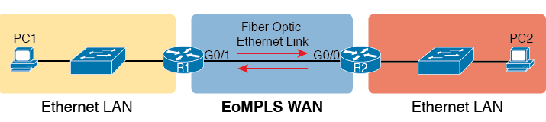
EoMPLS Acting like a Simple Ethernet Link Between Two Routers

Slide 12
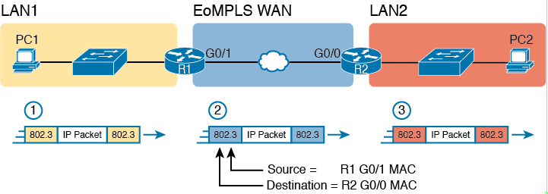
Routing over an EoMPLS Link

Slide 13
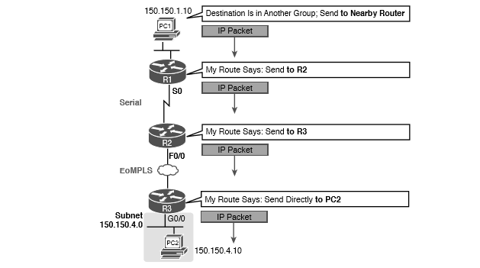
Routing Logic: PC1 Sending an IP Packet to PC2

Slide 14
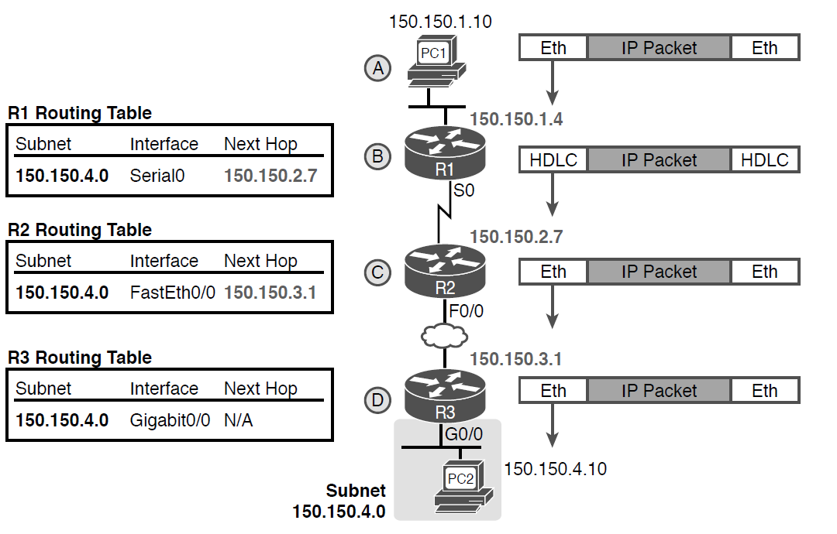
Network Layer and Data-Link Layer Encapsulation

Slide 15
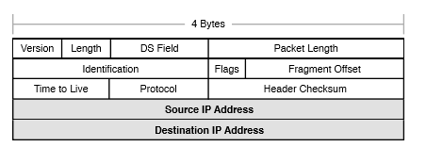
IPv4 Header, Organized as 4 Bytes Wide for a Total of 20 Bytes

Slide 16
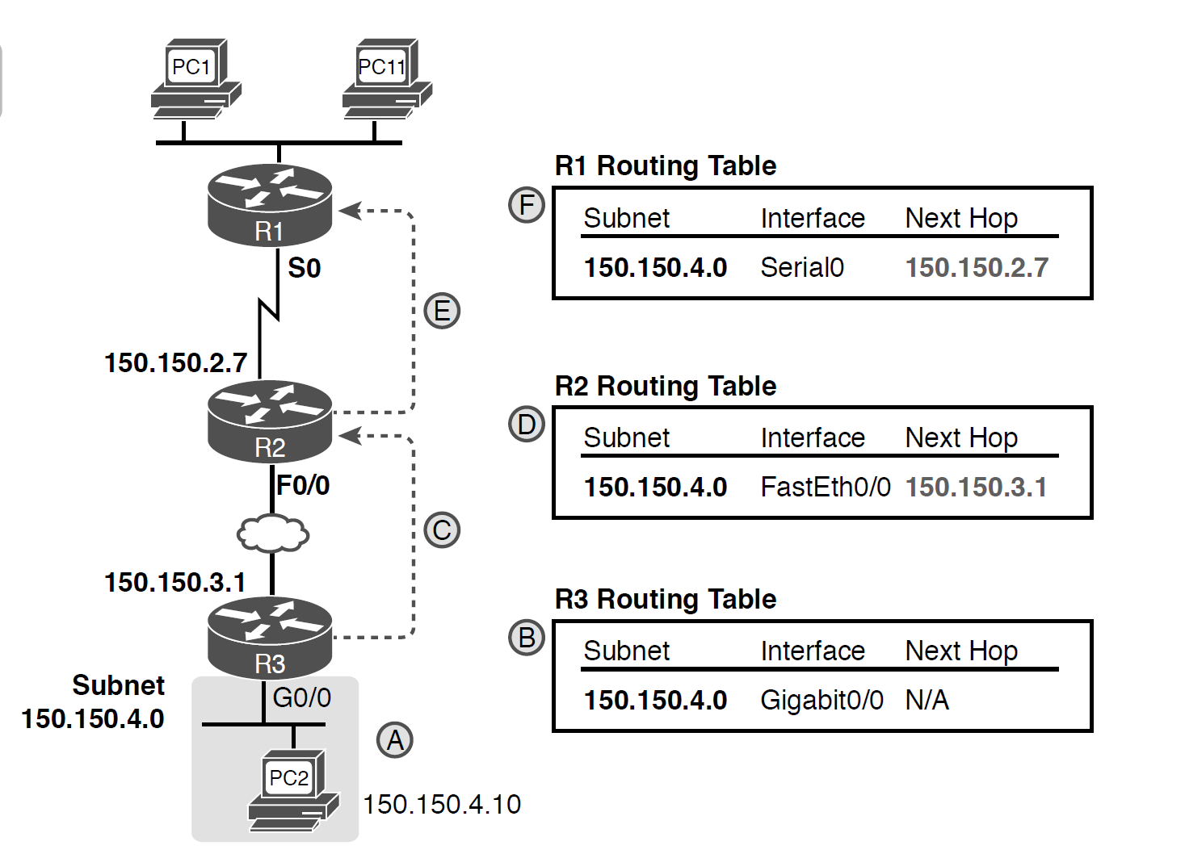
Example of How Routing Protocols Advertise About Networks and Subnets

Slide 17
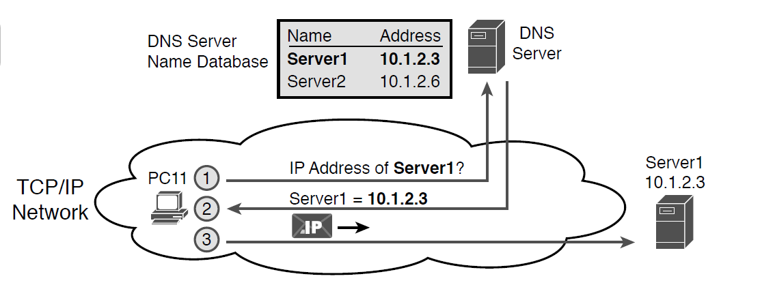
Basic DNS Name Resolution Request

Slide 18
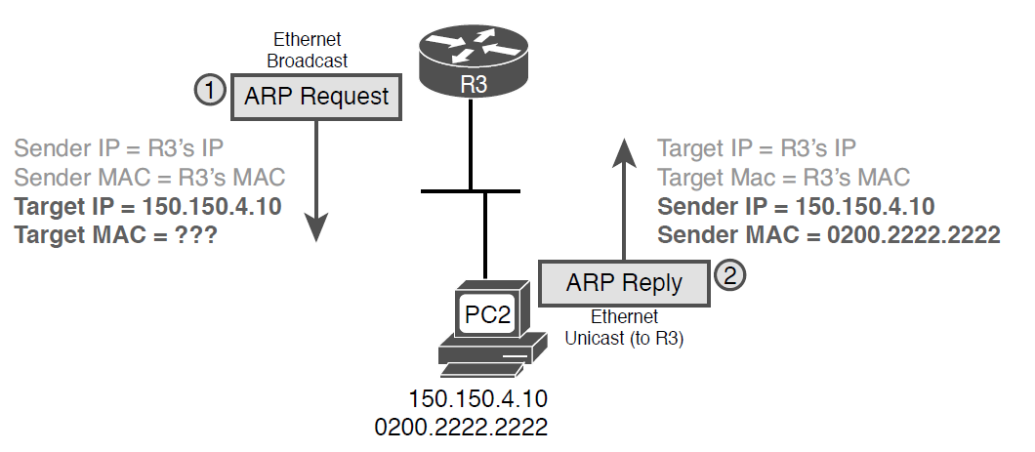
Sample ARP Process

Slide 19
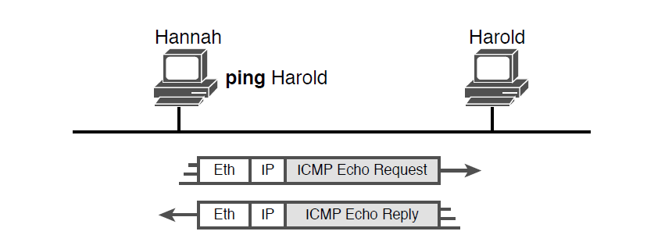
Sample Network, ping Command

