Slide 1
CCNA 200-301, Volume I
Chapter 4
Using the Command-Line Interface

Slide 2
Objectives
Accessing a Cisco Catalyst Switch CLI
Configuring Cisco IOS Software

Slide 3
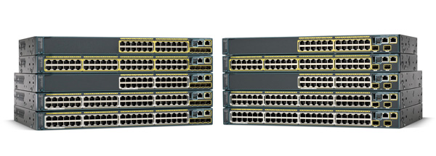
Cisco 2960-XR Catalyst Switch Series

Slide 4
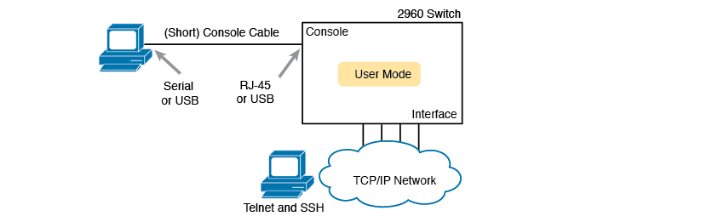
CLI Access Options

Slide 5
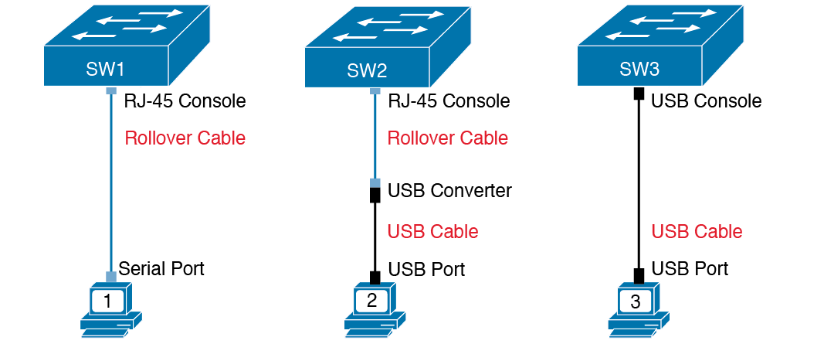
Console Connection to a Switch

Slide 6
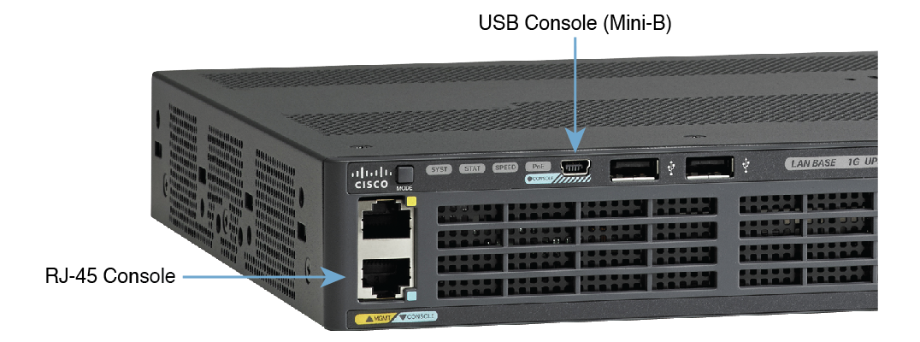
A Part of a 2960-XR Switch with Console Ports Shown

Slide 7
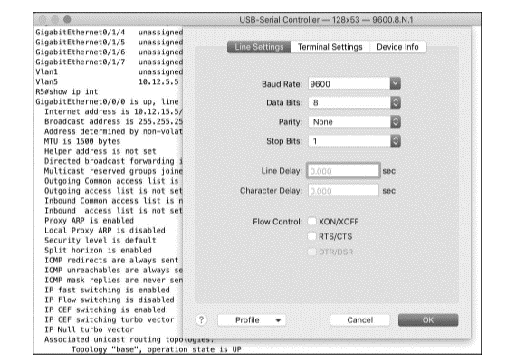
Terminal Settings for Console Access

Slide 8
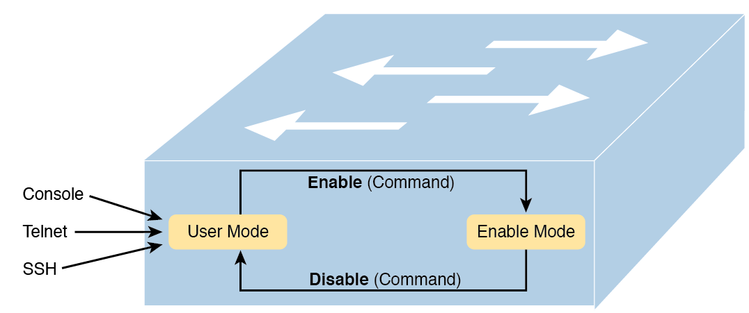
User and Enable (Privileged) Modes

Slide 9
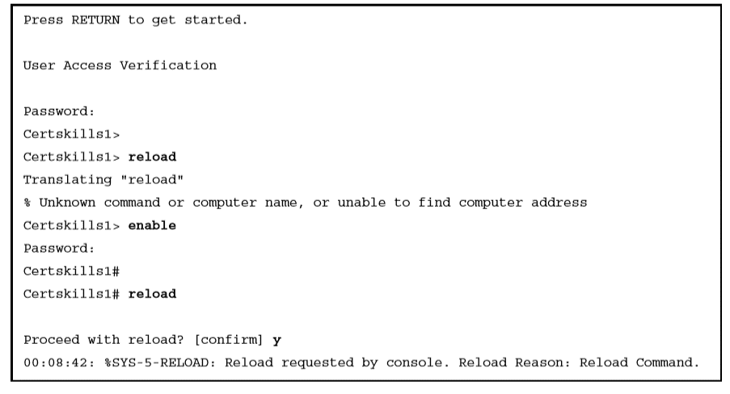
Example of Privileged Mode Commands Being Rejected in User Mode

Slide 10
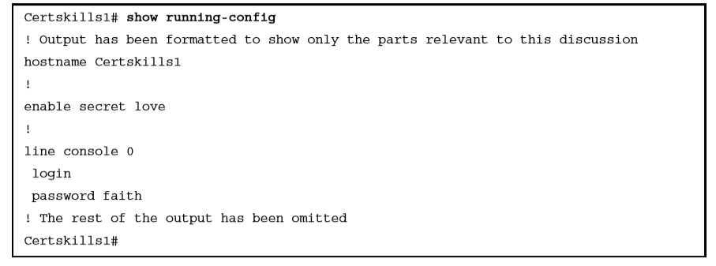
Nondefault Basic Configuration

Slide 11
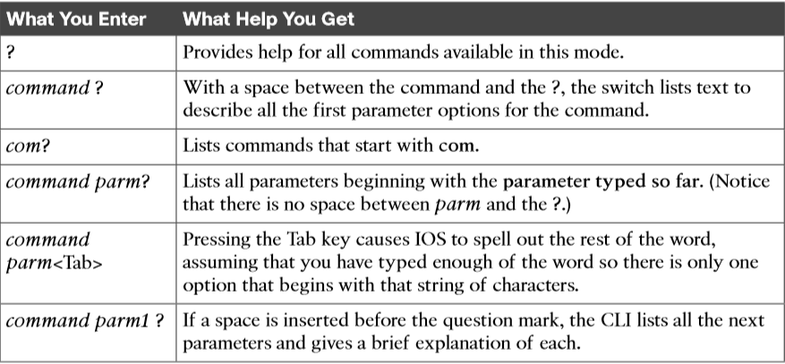
Cisco IOS Software Command Help

Slide 12
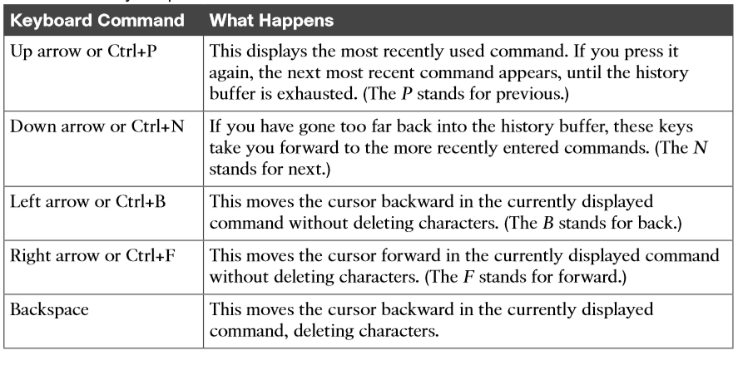
Key Sequences for Command Edit and Recall

Slide 13
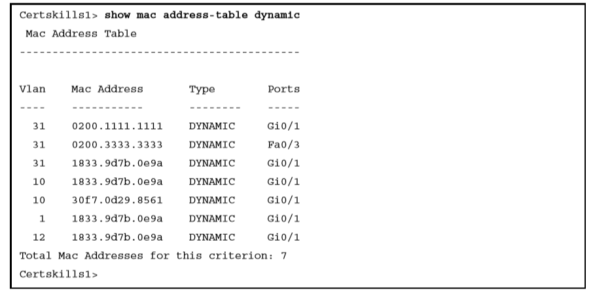
Nondefault Basic Configuration

Slide 14
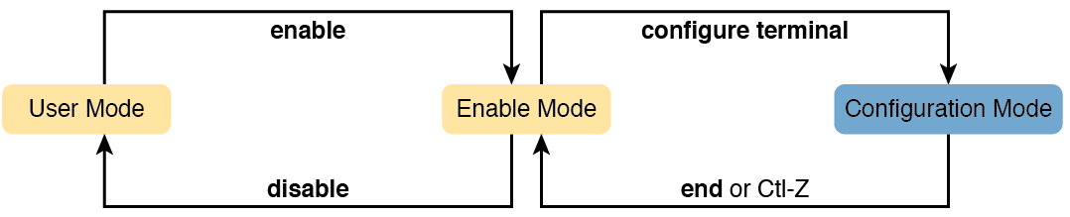
CLI Configuration Mode Versus Exec Modes

Slide 15
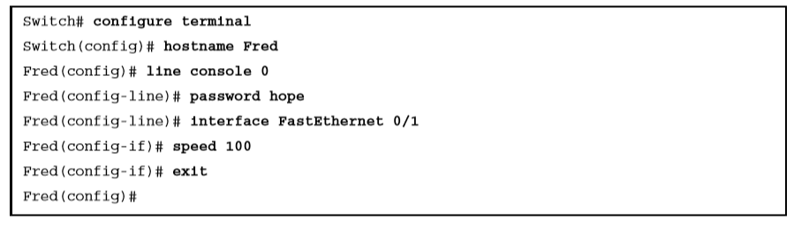
Navigating Between Different Configuration Modes

Slide 16
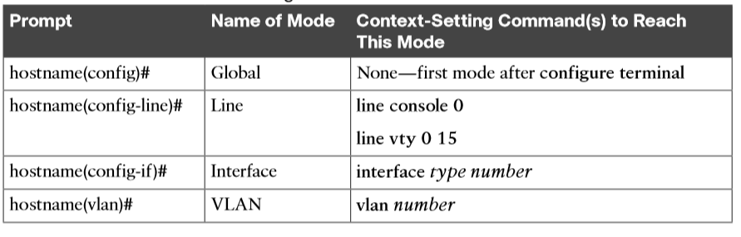
Common Switch Configuration Modes

Slide 17
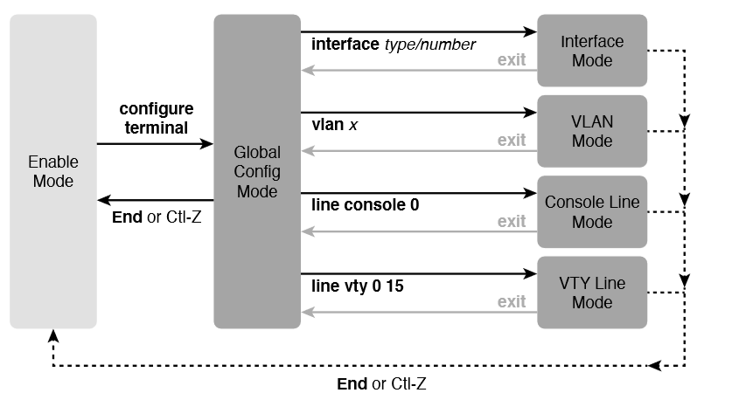
Navigation In and Out of Switch Configuration Modes

Slide 18
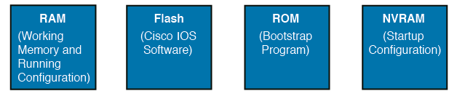
Cisco Switch Memory Types

Slide 19
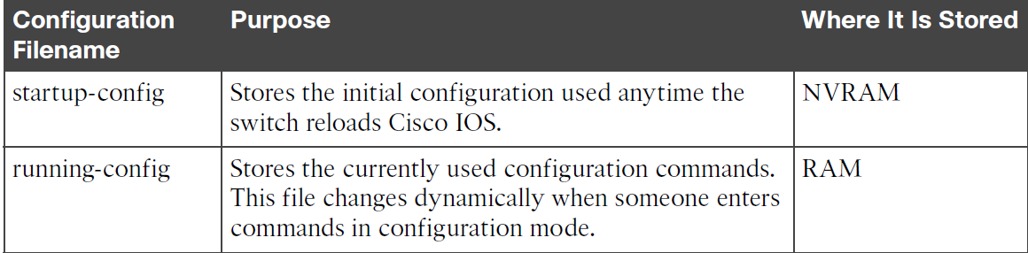
Two Main Cisco IOS Configuration Files

Slide 20
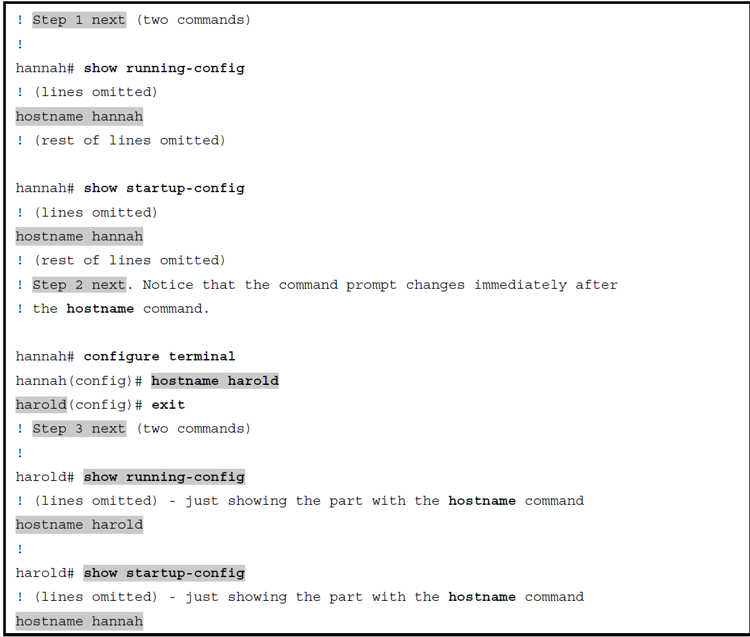
How Configuration Mode Commands Change the Running-Config File, Not the Startup-Config File

