Slide 1
CCNA 200-301, Volume I
Chapter 5
Analyzing Ethernet LAN Switching

Slide 2
Objectives
LAN Switching Concepts
Verifying and Analyzing Ethernet Switching

Slide 3
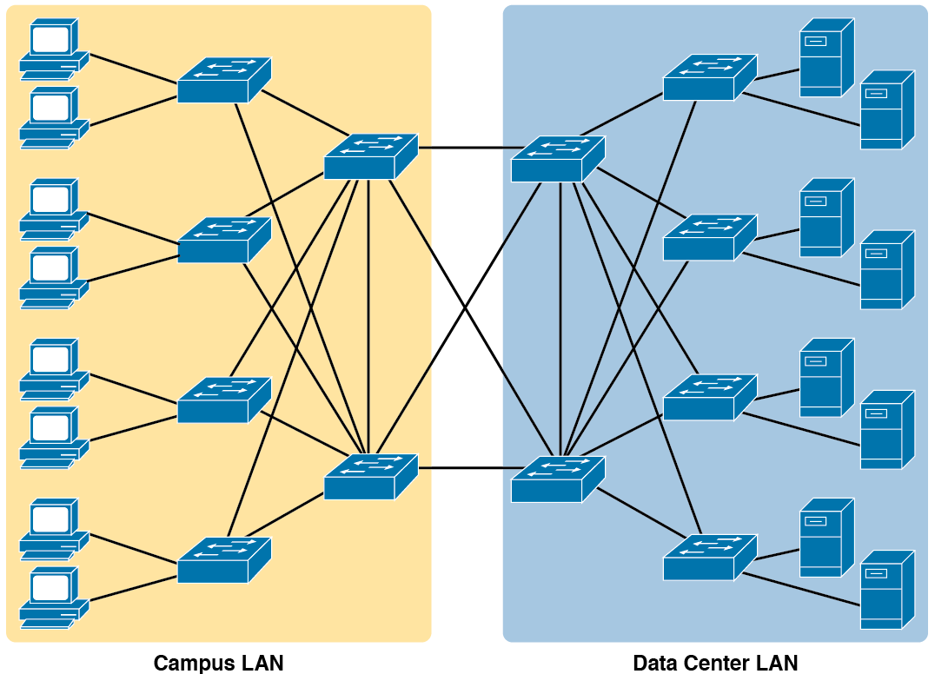
Campus LAN and Data Center LAN, Conceptual Drawing

Slide 4
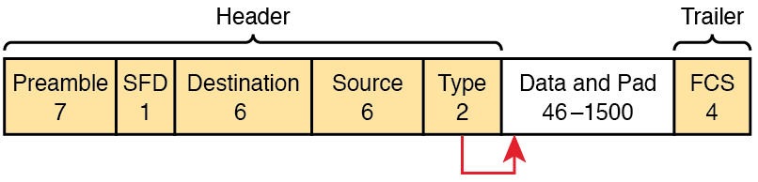
IEEE 802.3 Ethernet Frame
(One Variation)

Slide 5
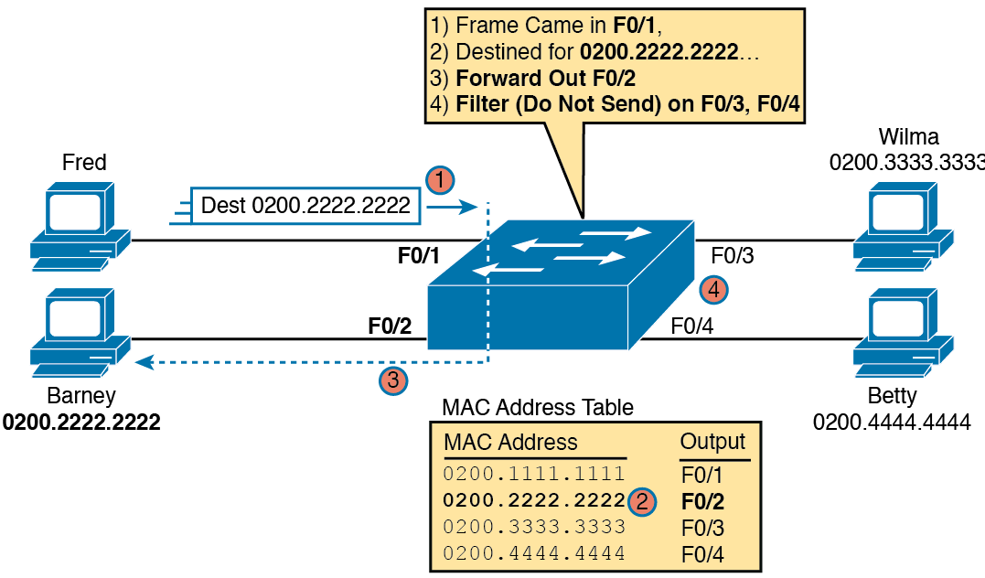
Sample Switch Forwarding and Filtering Decision

Slide 6
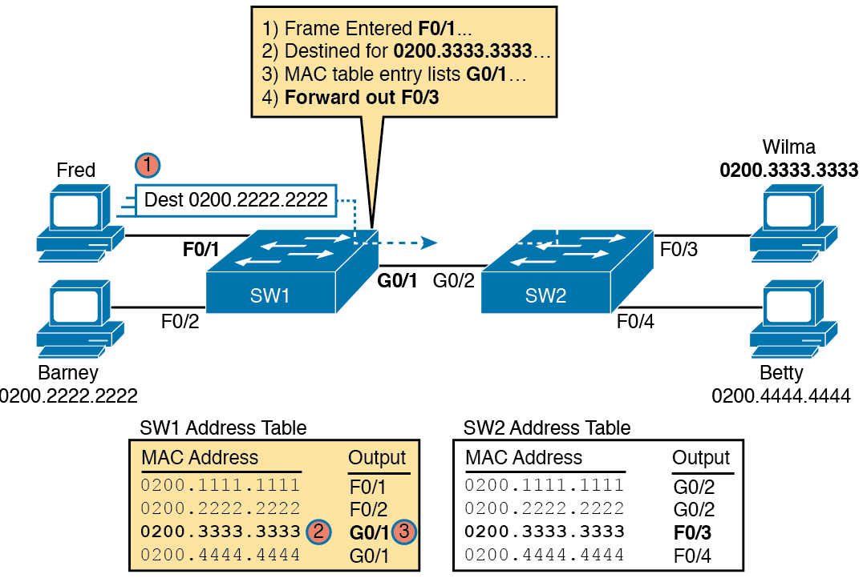
Forwarding Decision with Two Switches:
First Switch

Slide 7
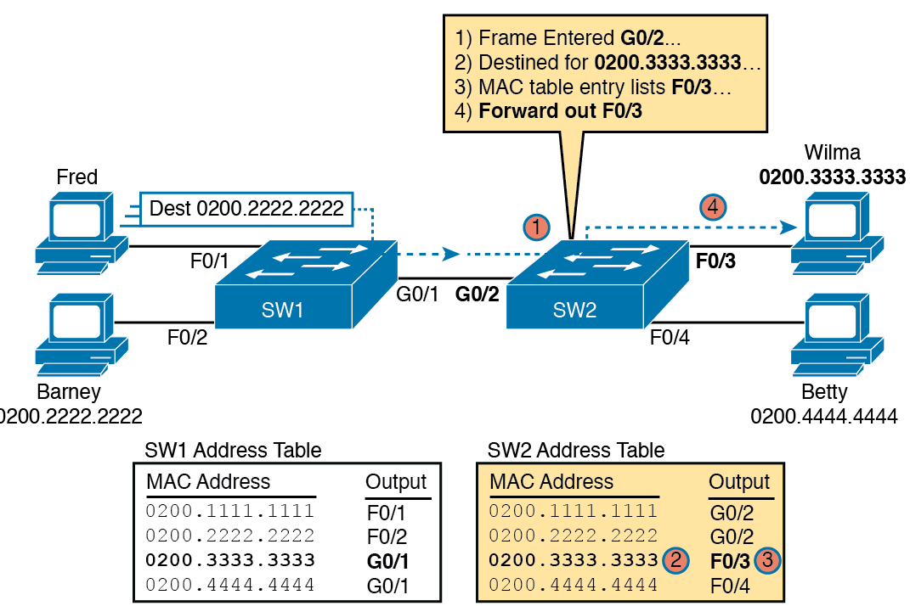
Forwarding Decision with Two Switches:
Second Switch

Slide 8
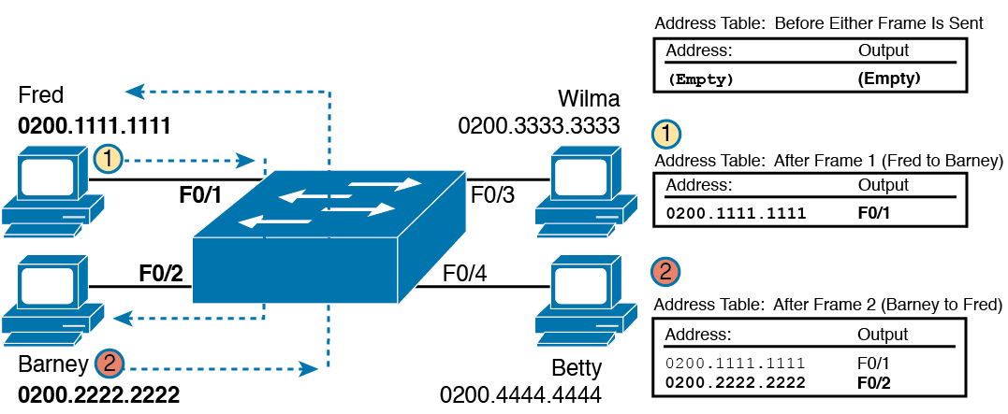
Switch Learning: Empty Table and Adding Two Entries

Slide 9
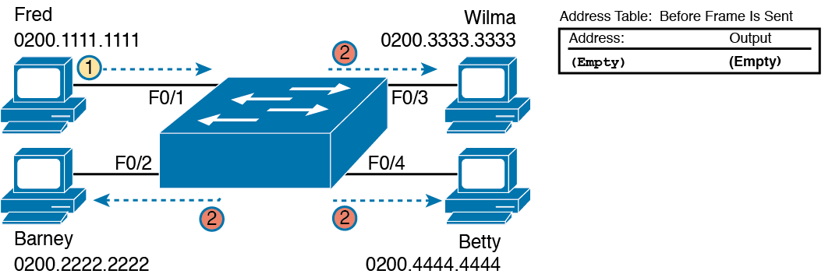
Switch Flooding: Unknown Unicast Arrives, Floods out Other Ports

Slide 10
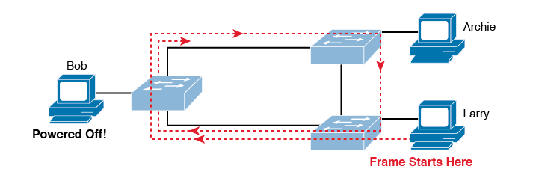
Network with Redundant Links But Without STP: The Frame Loops Forever

Slide 11
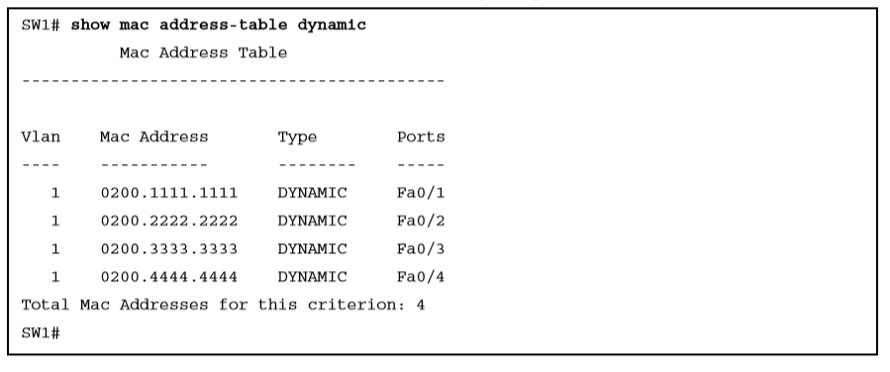
show mac address-table dynamic on switch SW1

Slide 12
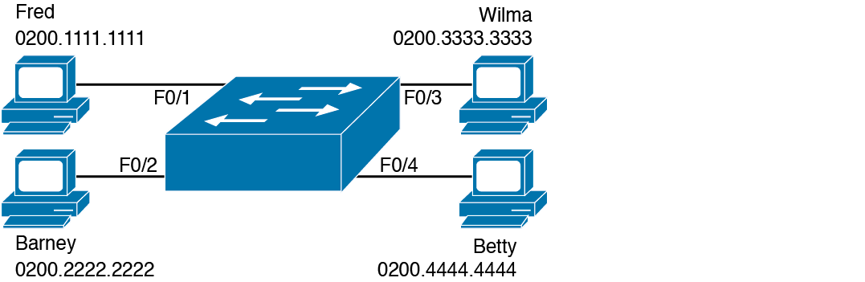
Single Switch Topology Used in Verification Section

Slide 13
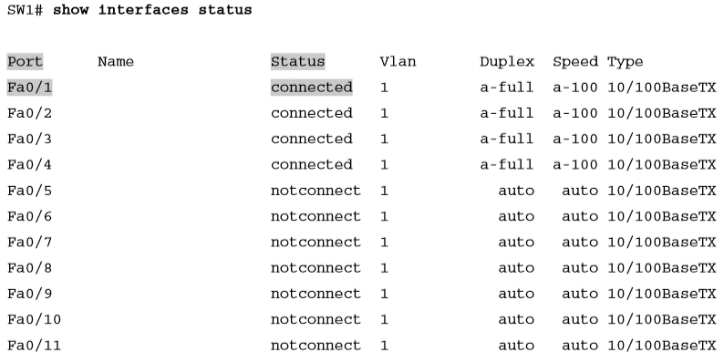
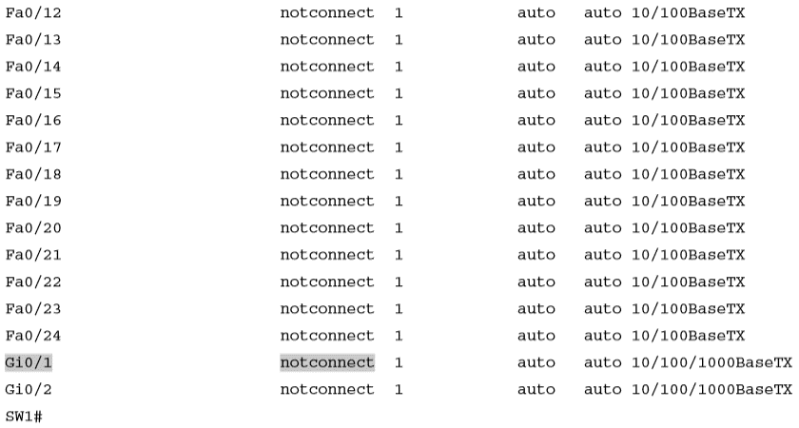
show interfaces status on Switch SW1

Slide 14
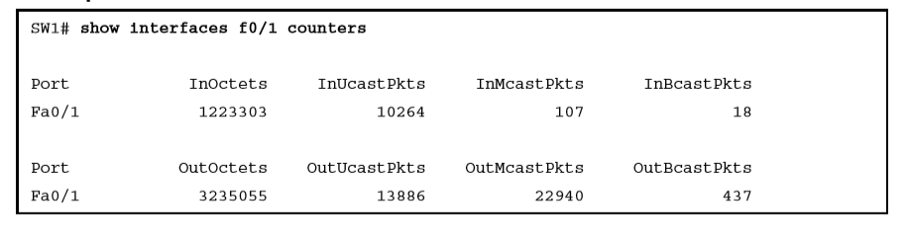
show interfaces f0/1 counters on Switch SW1

Slide 15
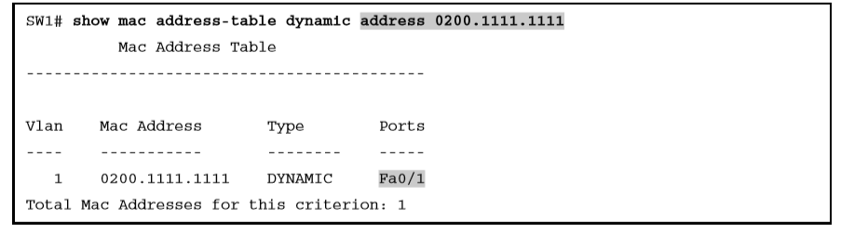
show mac address-table dynamic with the address Keyword

Slide 16
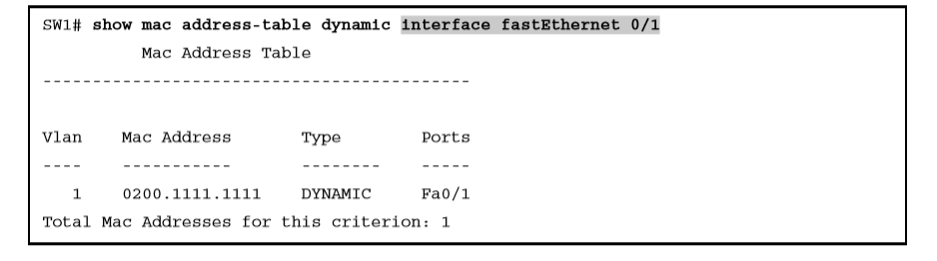
show mac address-table dynamic with the interface Keyword

Slide 17
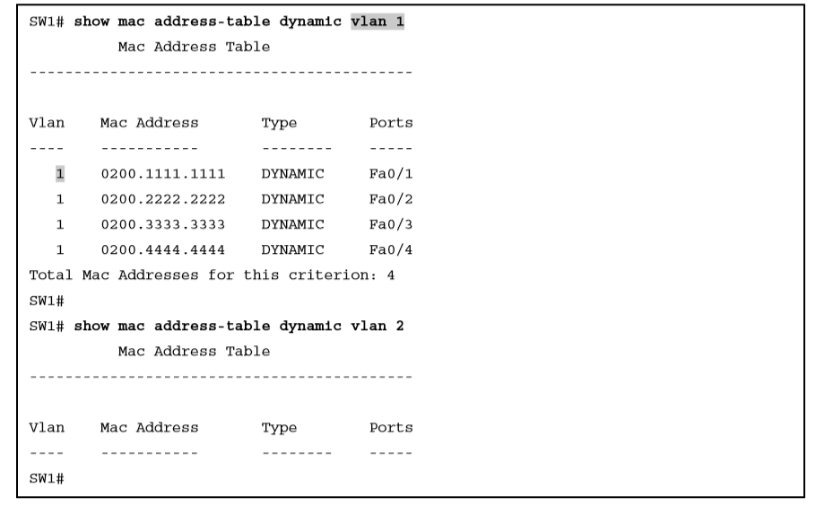
The show mac address-table vlan command

Slide 18
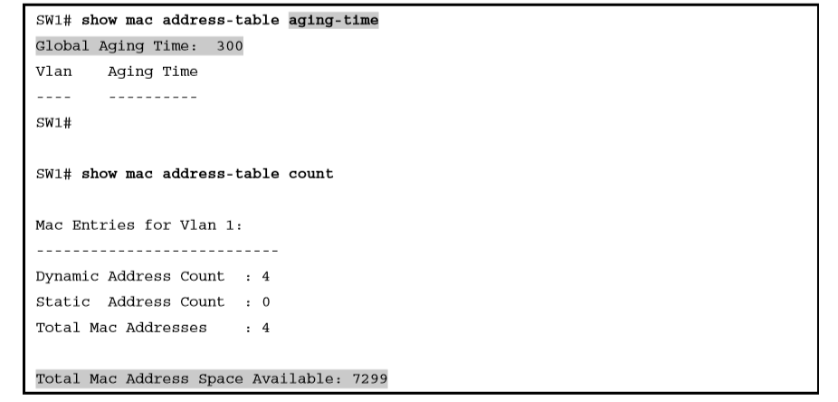
The MAC Address Default Aging Timer Displayed

Slide 19
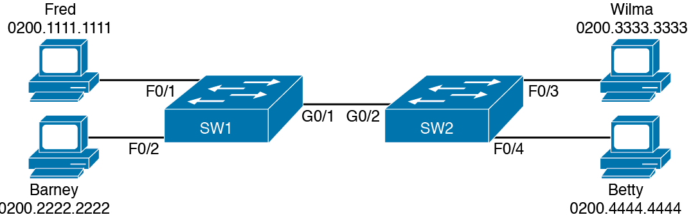
Two-Switch Topology Example

Slide 20
The MAC Address Table on Two Switches
SW1# show mac address-table dynamic
Mac Address Table
-------------------------------------------
Vlan Mac Address Type Ports
---- ----------- -------- -----
1 0200.1111.1111 DYNAMIC Fa0/1
1 0200.2222.2222 DYNAMIC Fa0/2
1 0200.3333.3333 DYNAMIC Gi0/1
1 0200.4444.4444 DYNAMIC Gi0/1
Total Mac Addresses for this criterion: 4
! The next output is from switch SW2
SW2# show mac address-table dynamic
1 0200.1111.1111 DYNAMIC Gi0/2
1 0200.2222.2222 DYNAMIC Gi0/2
1 0200.3333.3333 DYNAMIC Fa0/3
1 0200.4444.4444 DYNAMIC Fa0/4
Total Mac Addresses for this criterion: 4

