Slide 1
CCNA 200-301, Volume I
Chapter 6
Configuring Basic Switch
Management

Slide 2
Objectives
Securing the Switch CLI
Enabling IP for Remote Access
Miscellaneous Settings Useful in Lab

Slide 3
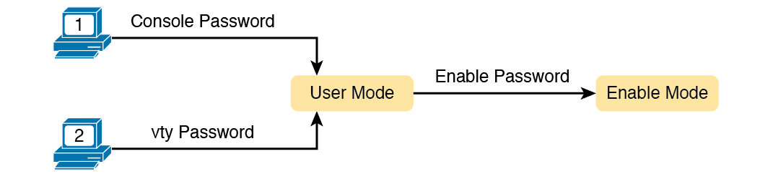
Simple Password Security Concepts

Slide 4
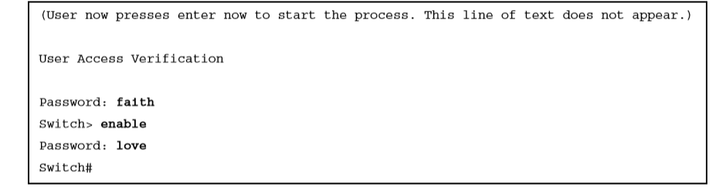
Console Login and Movement to Enable Mode

Slide 5
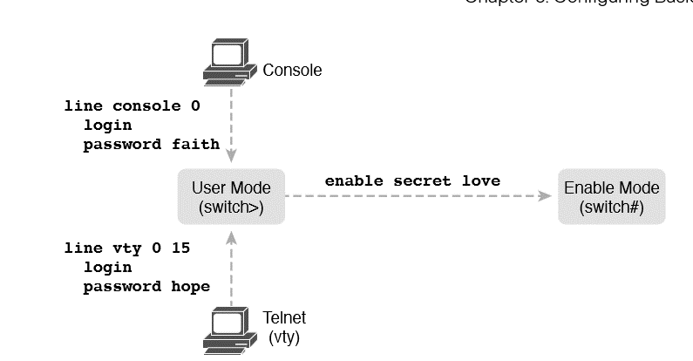
Simple Password Security Configuration

Slide 6
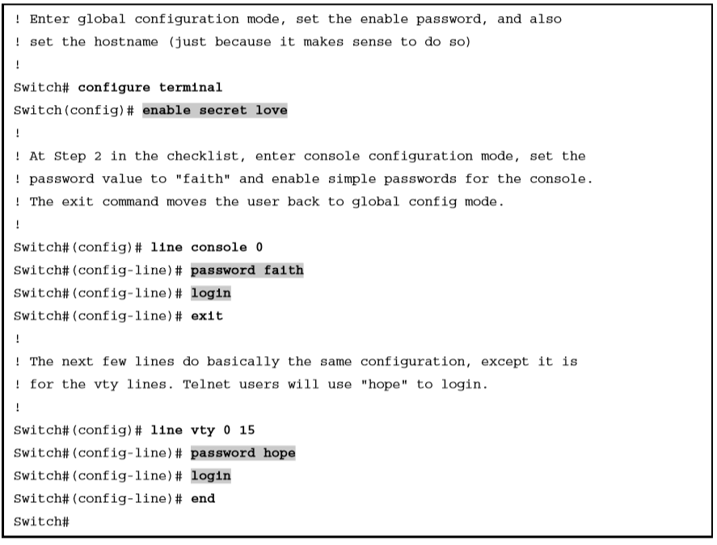
Configuring Basic Password

Slide 7
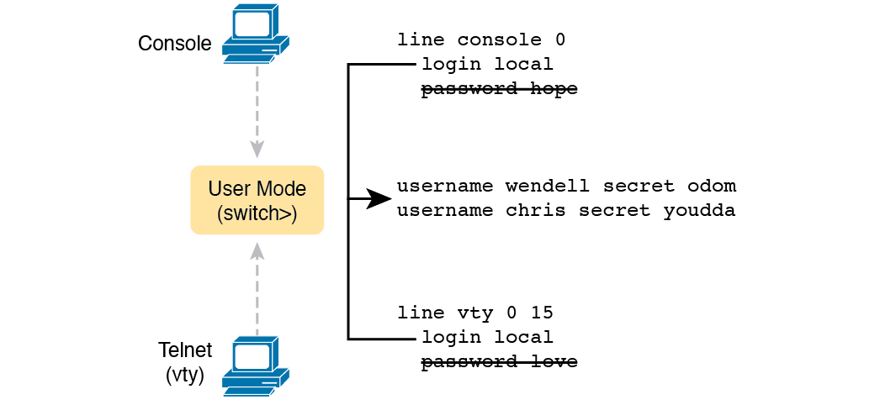
Configuring Switches to Use Local Username Login Authentication

Slide 8
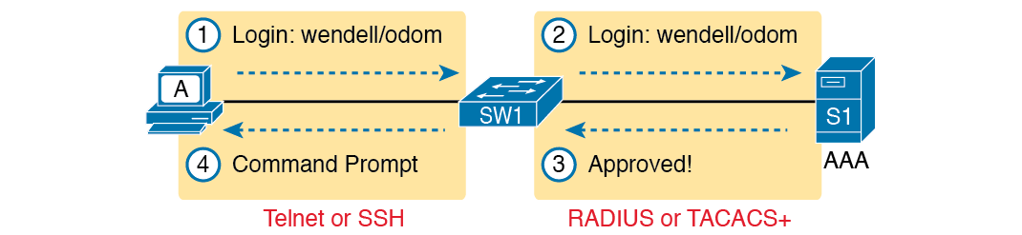
Basic Authentication Process with an External AAA Server

Slide 9
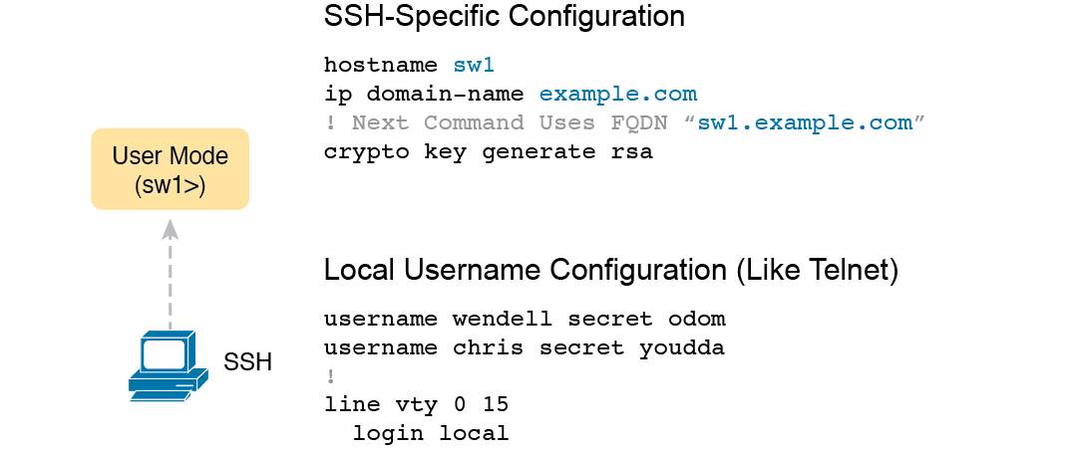
Adding SSH Configuration to Local Username Configuration

Slide 10
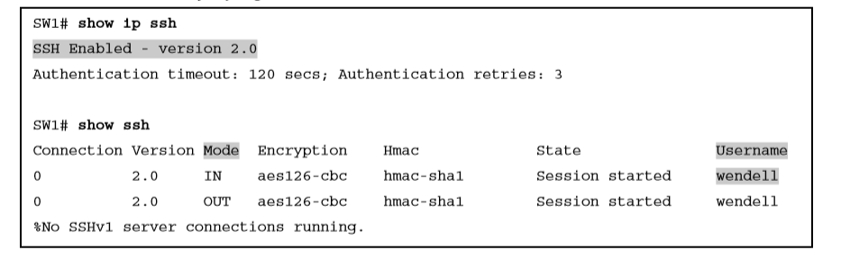
Displaying SSH Status

Slide 11
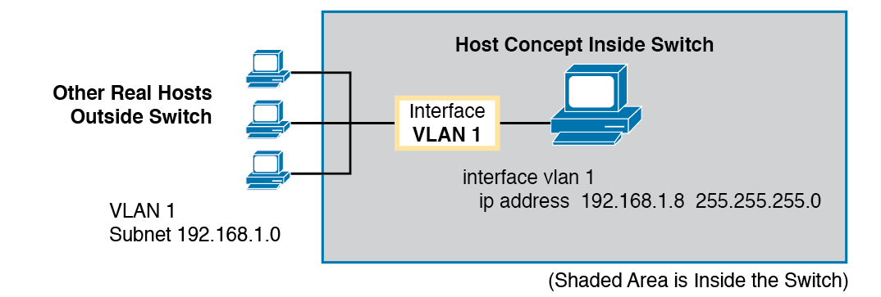
The Switch Virtual Interface (SVI) Concept Inside a Switch

Slide 12
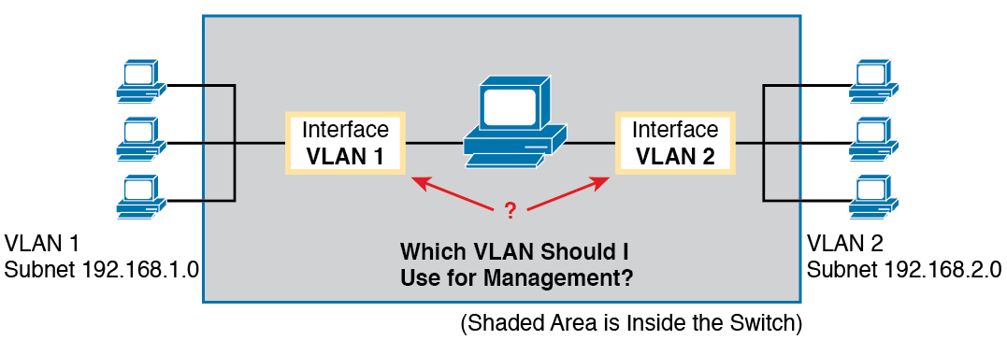
Choosing One VLAN on Which to Configure a Switch IP Address

Slide 13
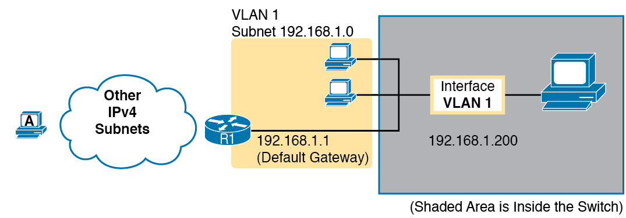
The Need for a Default Gateway

Slide 14
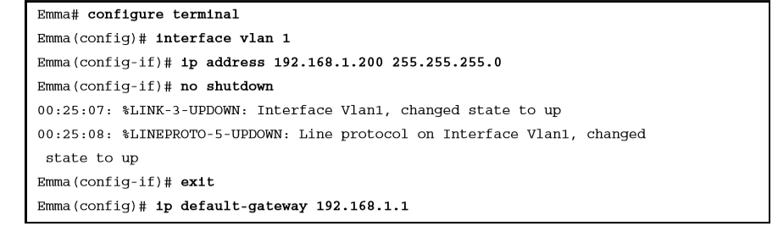
Switch Static IP Address Configuration

Slide 15
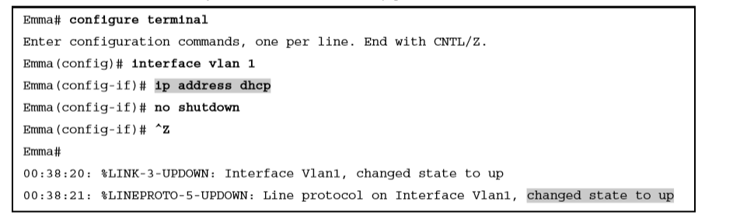
Switch Dynamic IP Address Configuration with DHCP

Slide 16
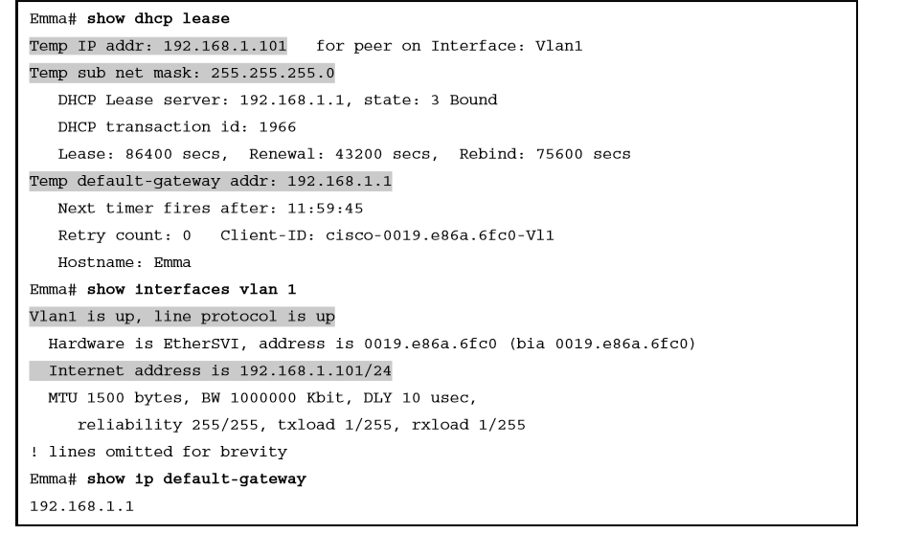
Verifying DHCP-Learned Information on a Switch

Slide 17
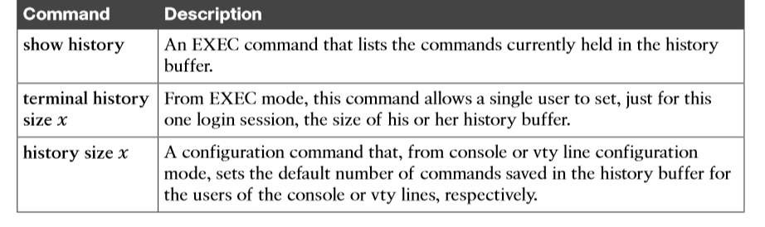
Commands Related to the History Buffer

Slide 18
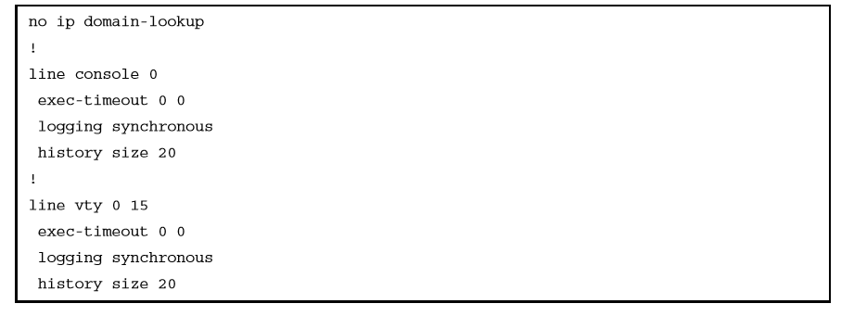
Commands Often Used in the Lab to Increase Productivity

