Slide 1
CCNA 200-301, Volume I
Chapter 7 Configuring and Verifying Switch Interfaces

Slide 2
Objectives
Configuring Switch Interfaces
Analyzing Switch Interface Status and Statistics

Slide 3
Configuring speed, duplex, and description on Switch Emma
Emma#configure terminal
Enter configuration commands, one per line. End with CNTL/Z.
Emma(config)#interface FastEthernet 0/1
Emma(config-if)#duplex full
Emma(config-if)#speed 100
Emma(config-if)#description Server1 connects here
Emma(config-if)#exit
Emma(config)#interface range FastEthernet 0/11 - 20
Emma(config-if-range)#description end-users connect_here
Emma(config-if-range)#^Z
Emma#

Slide 4
How IOS Expands the Subcommands Typed After interface range
Emma# show running-config
! Lines omitted for brevity
!
interface FastEthernet0/11
description end-users connect here
!
interface FastEthernet0/12
description end-users connect here
!
! Lines omitted for brevity

Slide 5
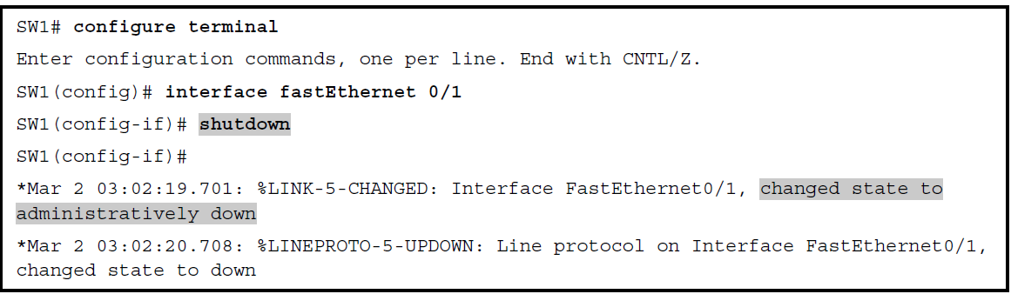
Administratively Disabling an Interface with shutdown

Slide 6
The Different Status Information about Shutdown in Two Different Show Commands
SW1# show interfaces f0/1 status
Port Name Status Vlan Duplex Speed Type
Fa0/1 disabled 1 auto 10/100BaseTX

Slide 7
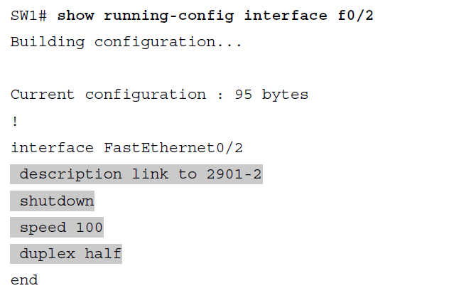
Removing Configuration with the no Command – Initial Configuration

Slide 8
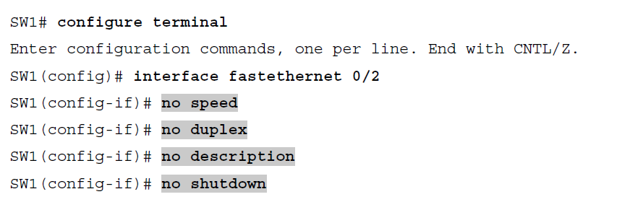
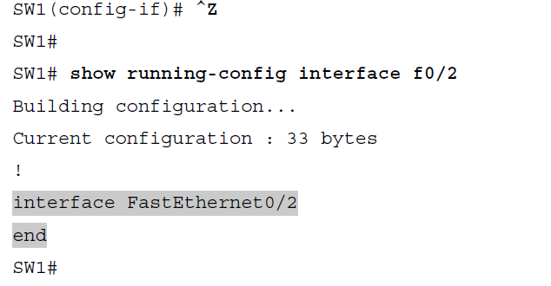
Removing Configuration with the no Command – After no Command

Slide 9
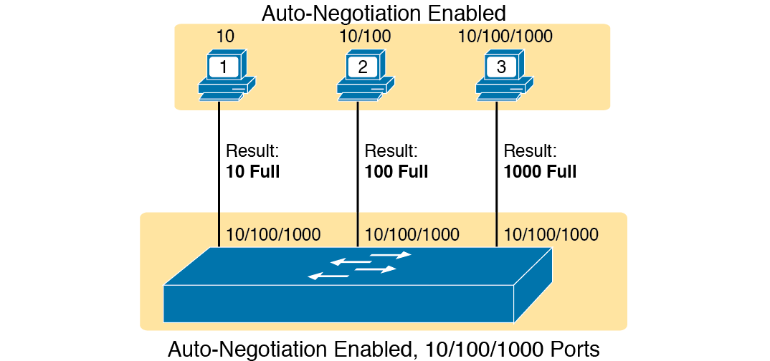
IEEE Autonegotiation Results with Both Nodes Working Correctly

Slide 10
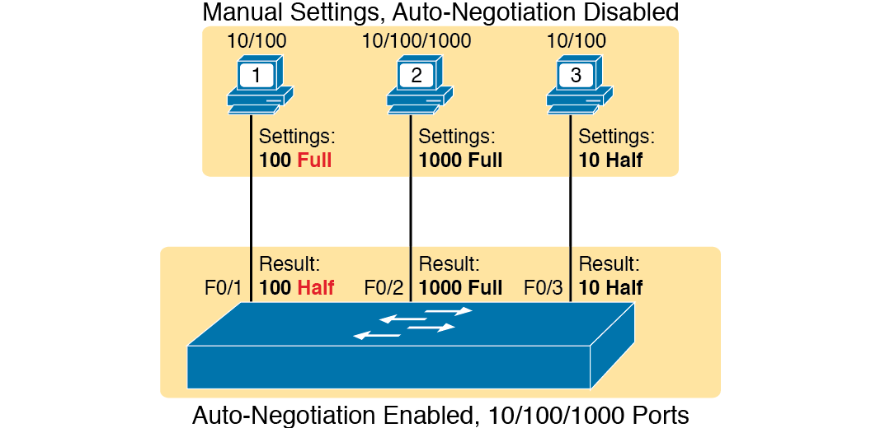
IEEE Autonegotiation Results with Autonegotiation Disabled on One Side

Slide 11
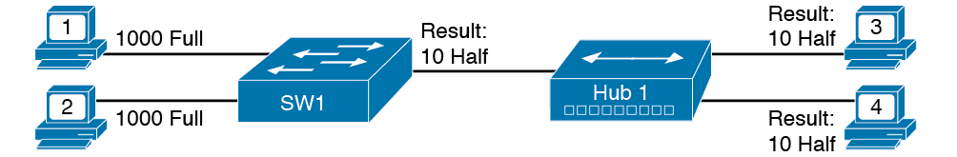
IEEE Autonegotiation with a LAN Hub

Slide 12
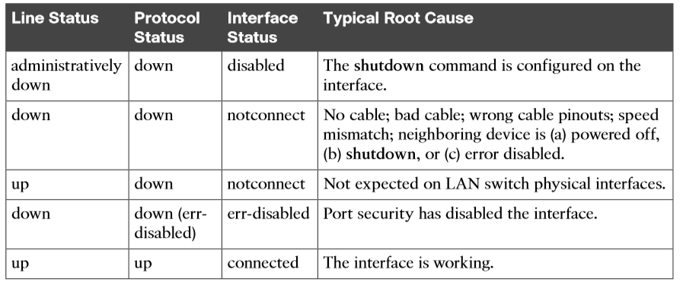
LAN Switch Interface Status Codes

Slide 13
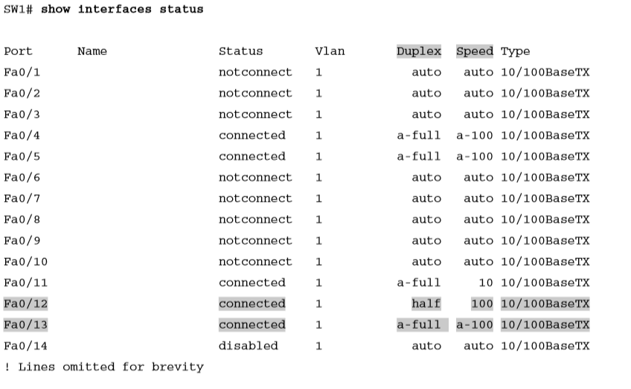
Displaying Speed and Duplex Settings on Switch Interfaces

Slide 14
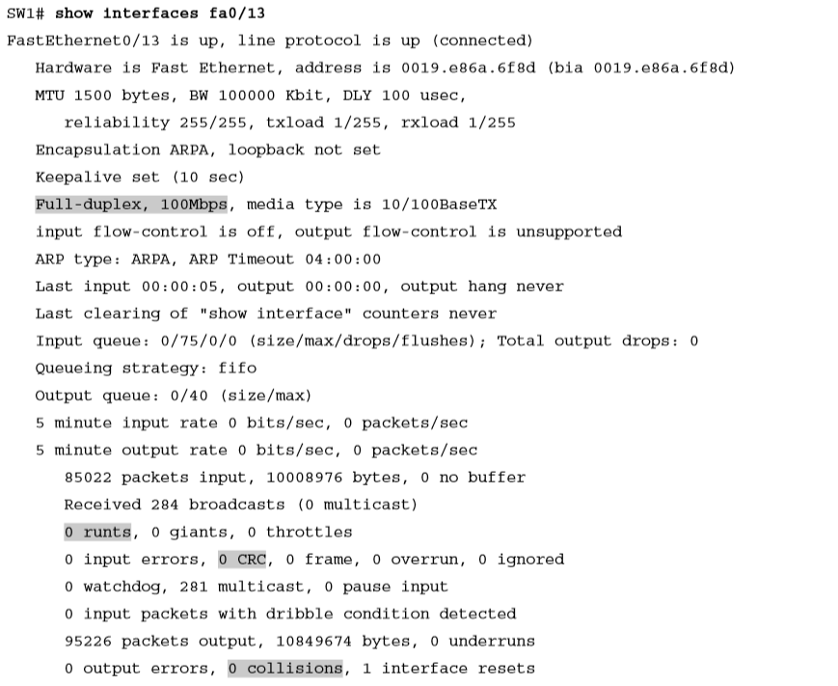
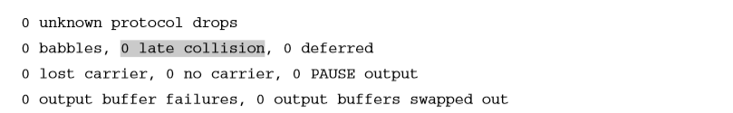
Displaying Speed and Duplex Settings on Switch Interfaces (Continued)

Slide 15
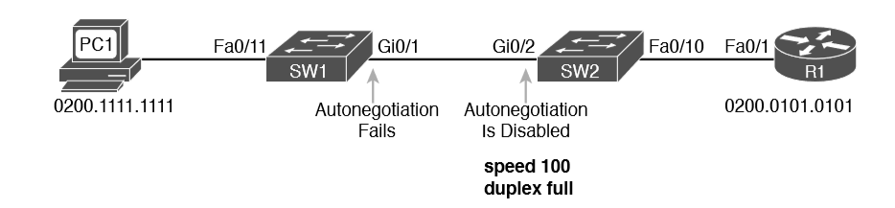
Conditions to Create a Duplex Mismatch Between SW1 and SW2

Slide 16
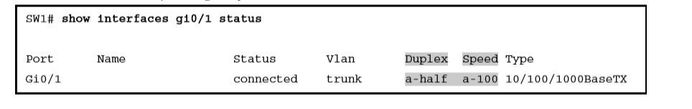
Confirming Duplex Mismatch

Slide 17
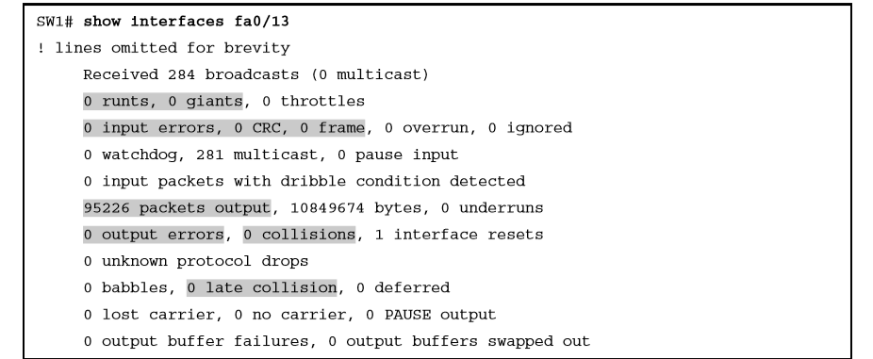
Interface Counters for Layer 1 Problems

