Slide 1
CCNA 200-301, Volume I
Chapter 8
Implementing Ethernet Virtual LANs

Slide 2
Objectives
Virtual LAN Concepts
VLAN and VLAN Trunking Configuration and Verification
Troubleshooting VLANs and VLAN Trunk

Slide 3
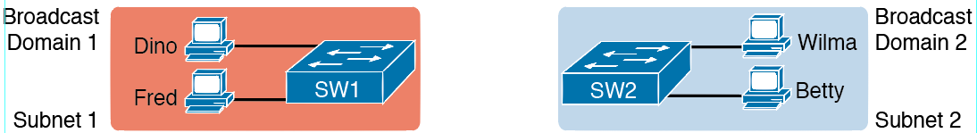
Creating Two Broadcast Domains with Two Physical Switches and No VLANs

Slide 4
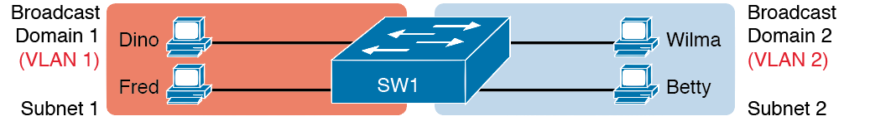
Creating Two Broadcast Domains Using One Switch and VLANs

Slide 5
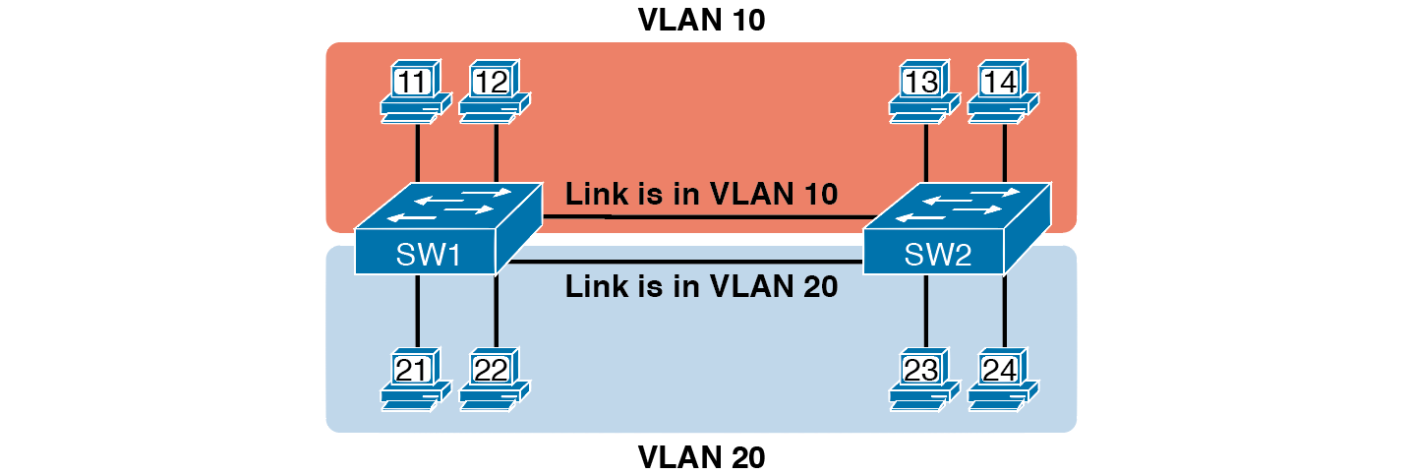
Multiswitch VLAN Without VLAN Trunking

Slide 6
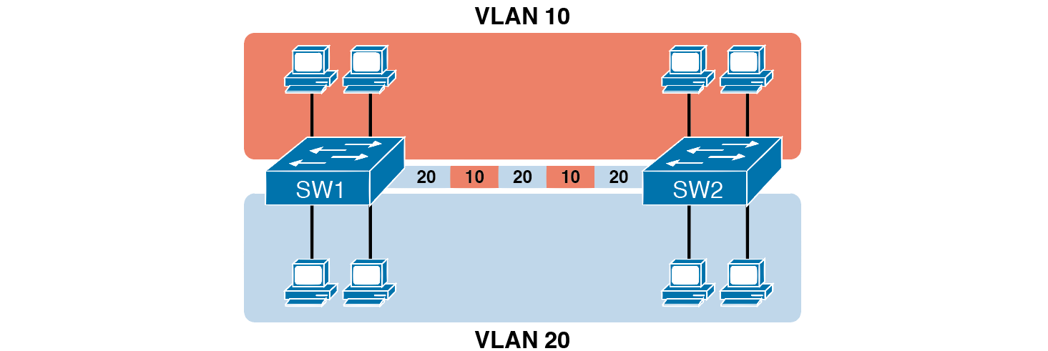
Multiswitch VLAN with Trunking

Slide 7
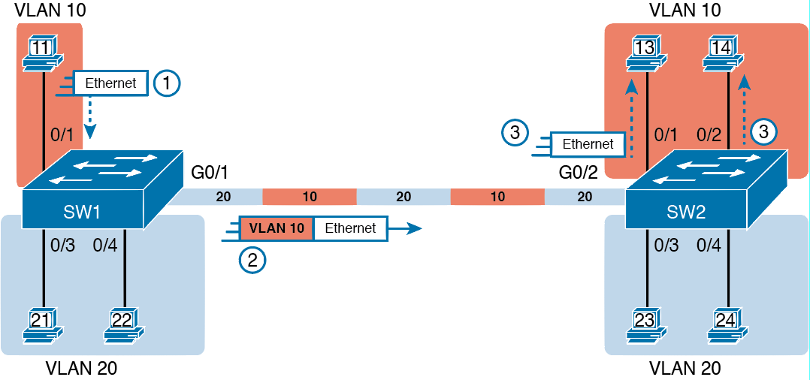
VLAN Trunking Between Two Switches

Slide 8
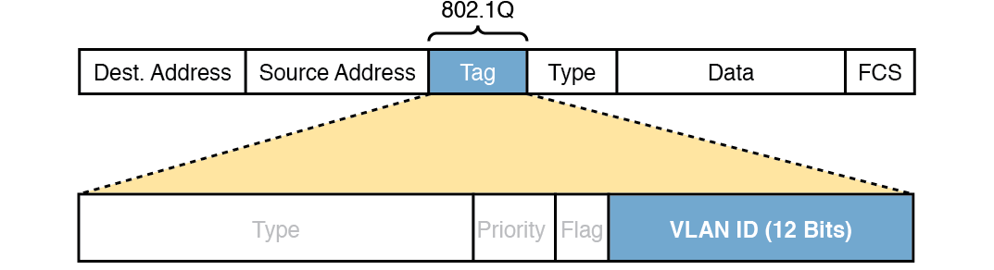
802.1Q Trunking

Slide 9
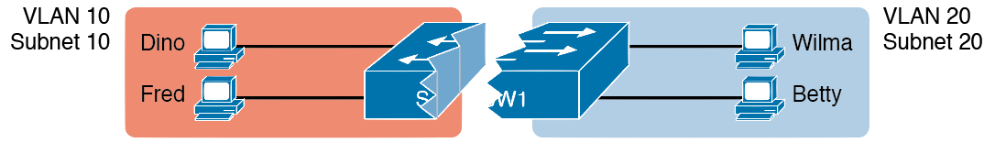
Layer 2 Switch Does Not Route Between the VLANs

Slide 10
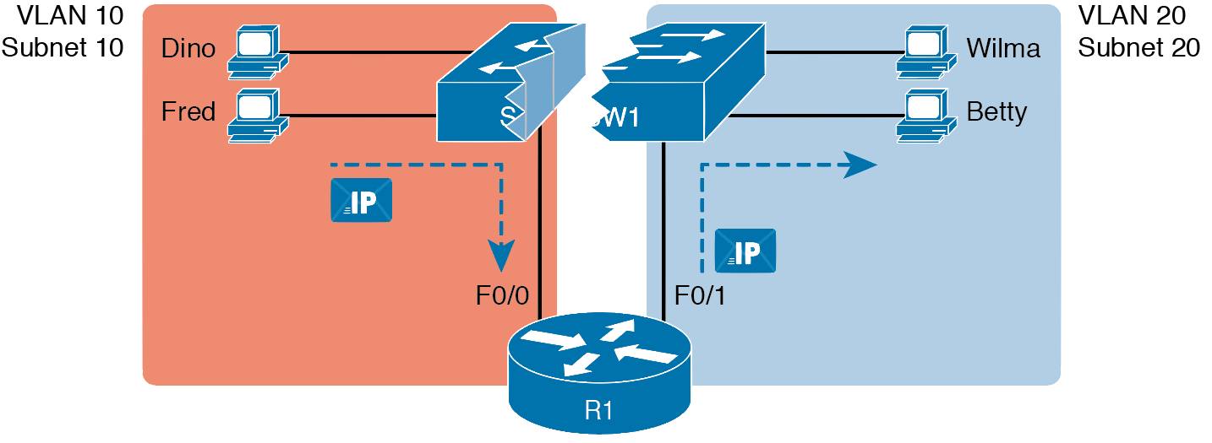
Routing Between Two VLANs on Two Physical Interfaces

Slide 11
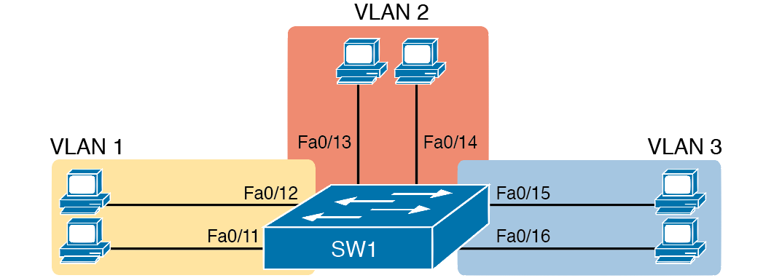
Network with One Switch and Three VLANs

Slide 12
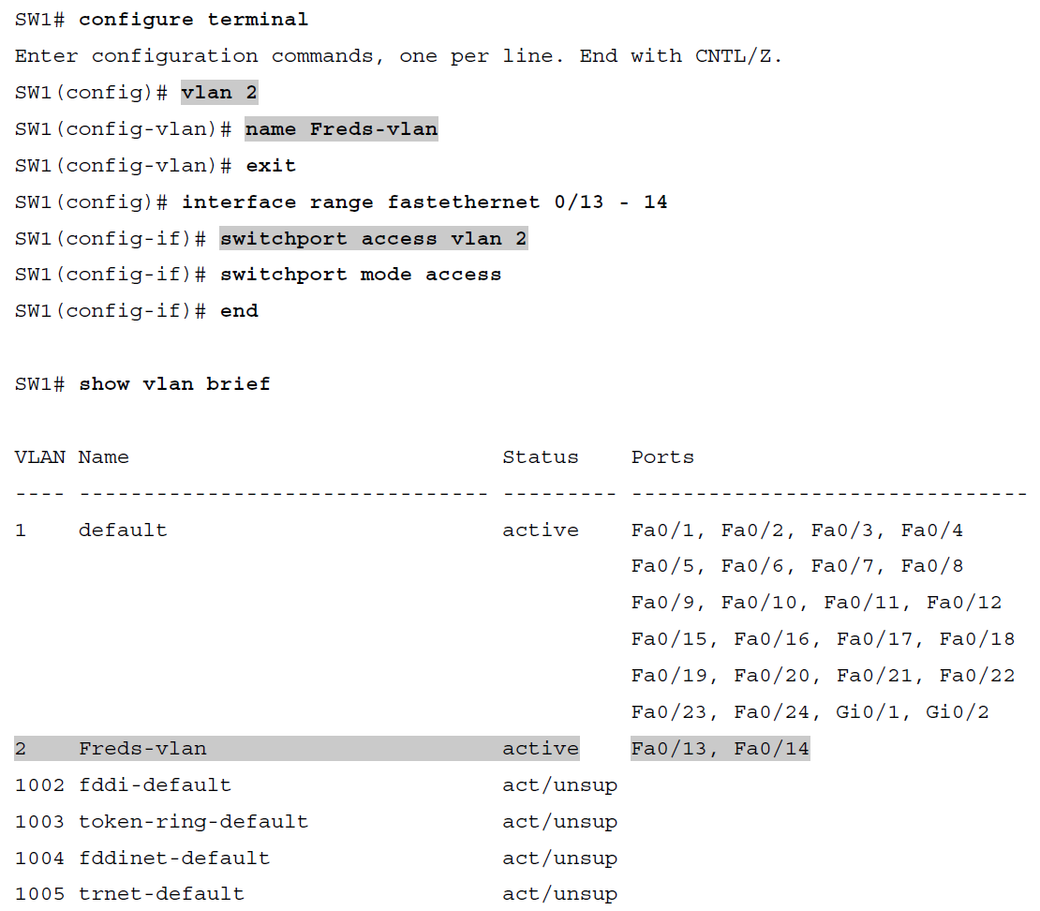
Configuring VLANs and Assigning VLANs to Interfaces

Slide 13
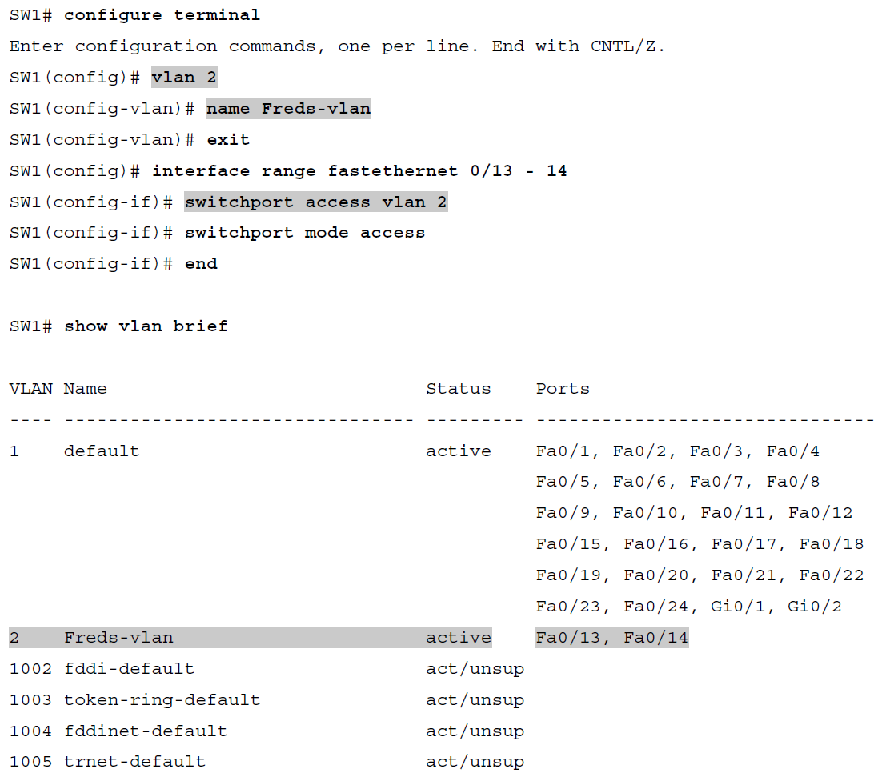
Configuring VLANs and Assigning VLANs to Interfaces (Continued)

Slide 14
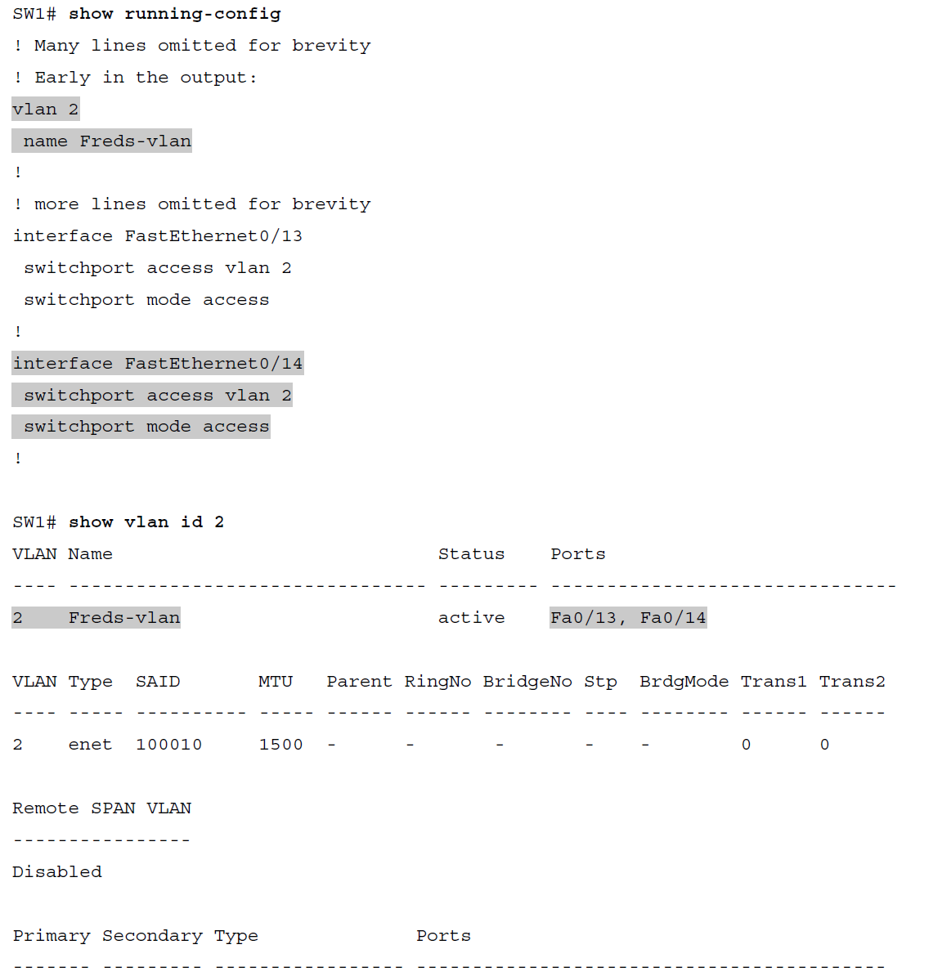
Configuring VLANs and Assigning VLANs to Interfaces (Continued)

Slide 15
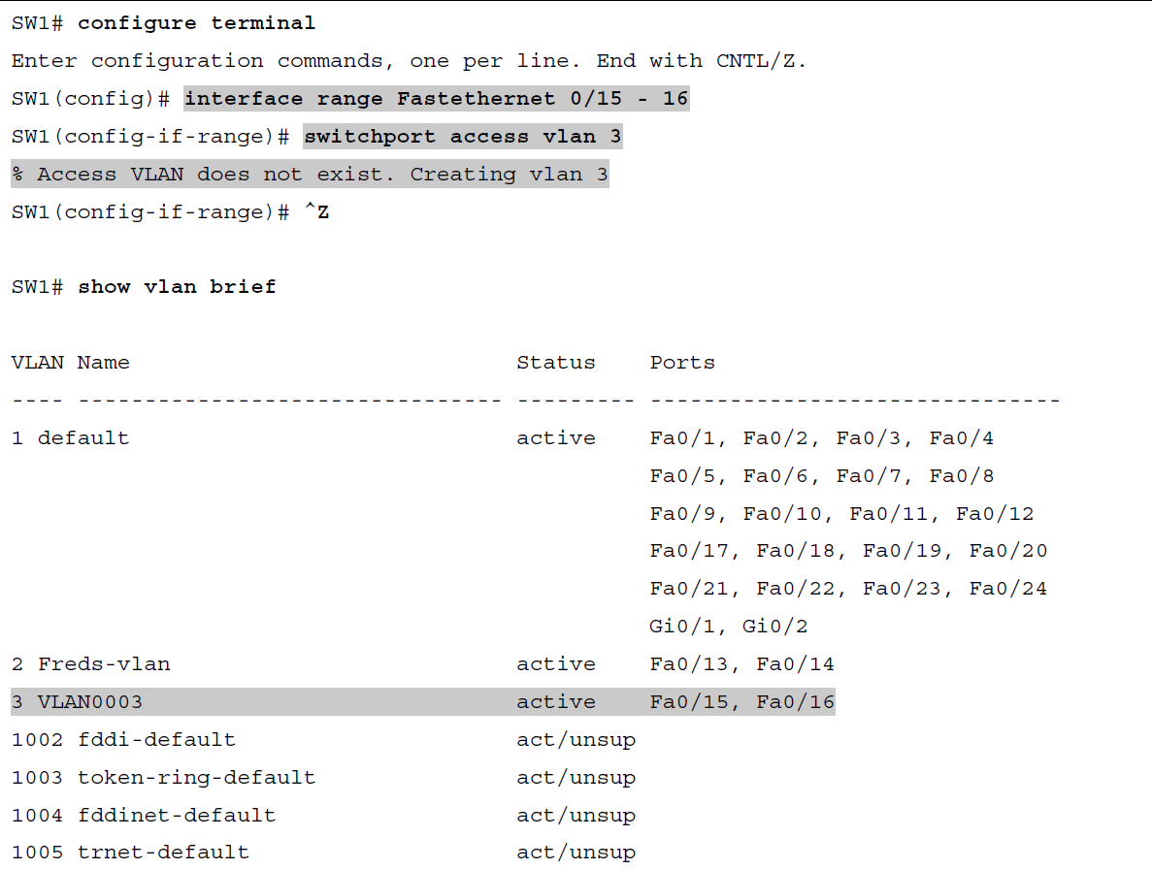
Shorter VLAN Configuration Example (VLAN 3)

Slide 16
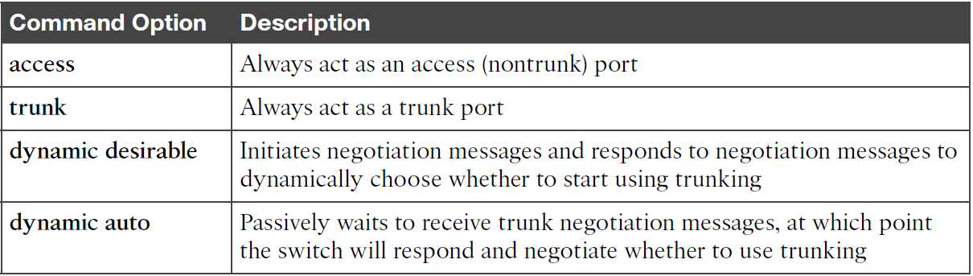
Trunking Administrative Mode Options with the switchport mode Command

Slide 17
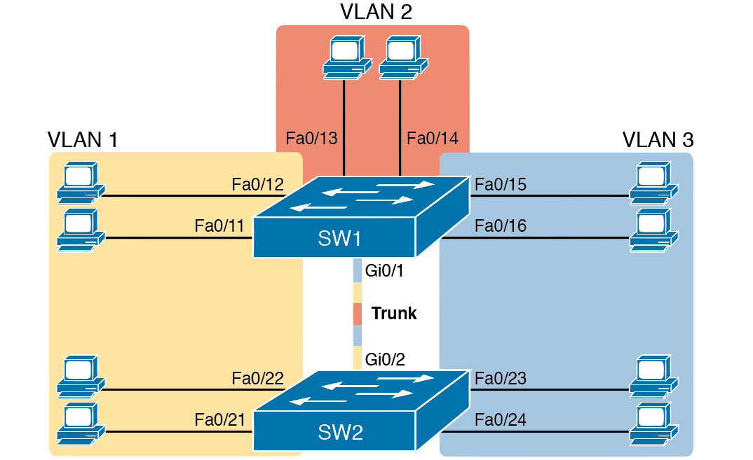
Network with Two Switches and Three VLANs

Slide 18
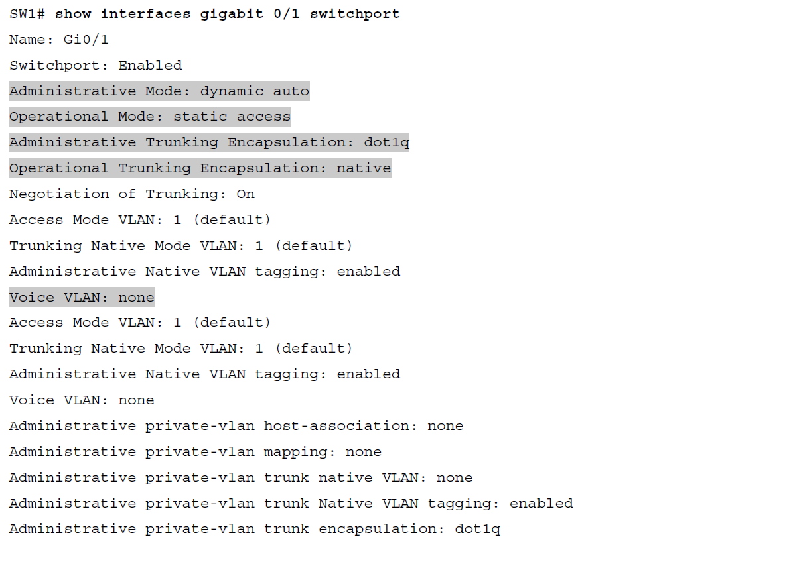
Initial (Default) State: Not Trunking Between SW1 and SW2

Slide 19
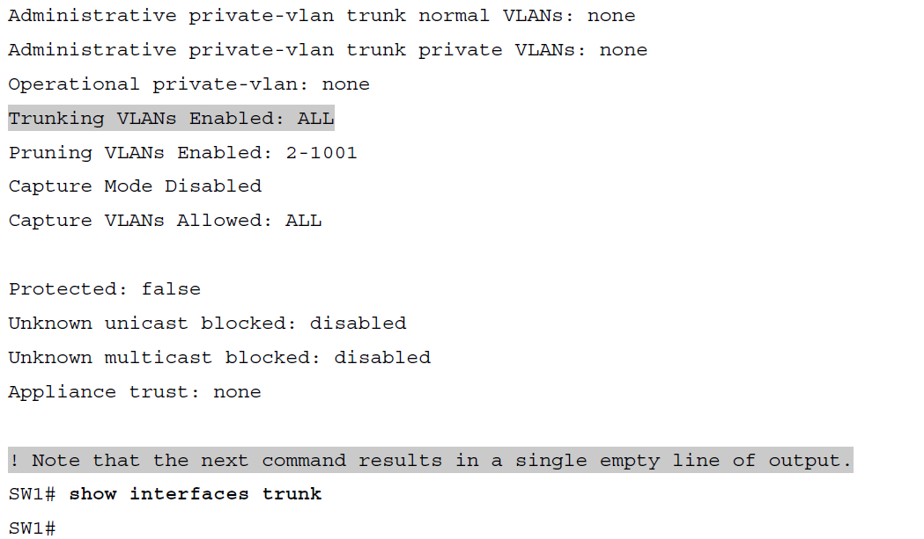
Initial (Default) State: Not Trunking Between SW1 and SW2 (Continued)

Slide 20
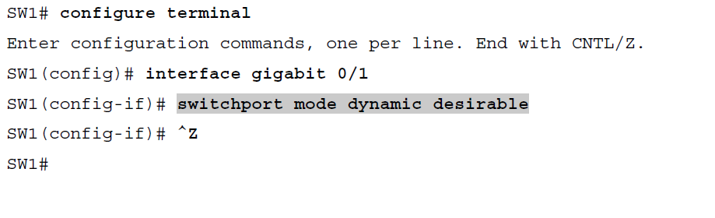
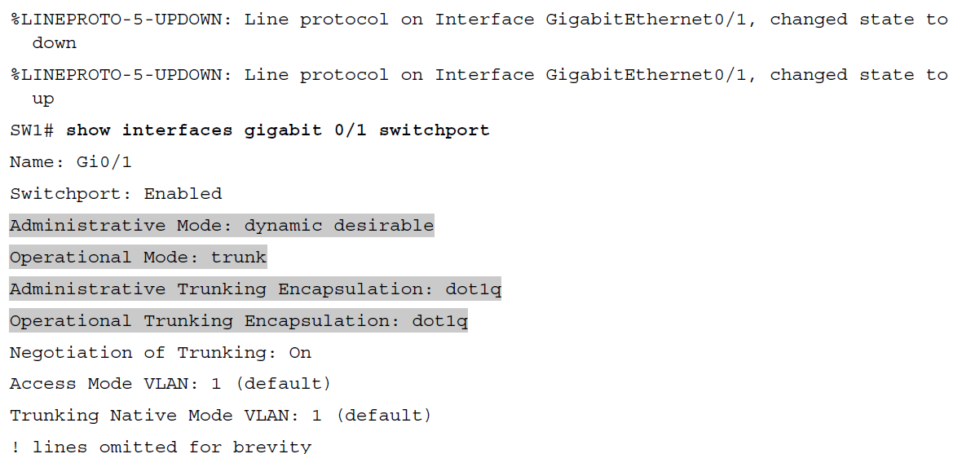
SW1 Changes from Dynamic Auto to Dynamic Desirable

Slide 21
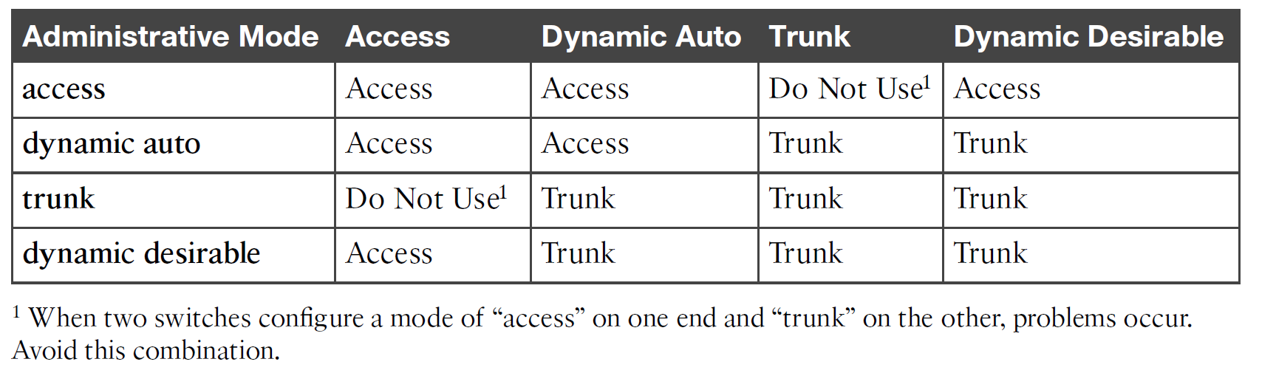
Expected Trunking Operational Mode Based on the Configured Administrative Modes

Slide 22
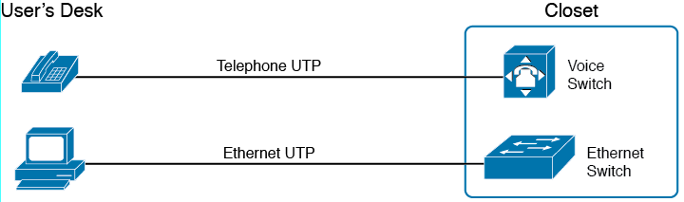
Before IP Telephony: PC and Phone, One Cable Each, Connect to Two Different Devices

Slide 23
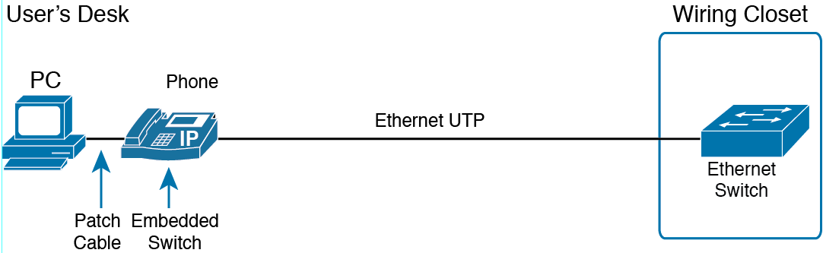
Cabling with an IP Phone, a Single Cable, and an Integrated Switch

Slide 24
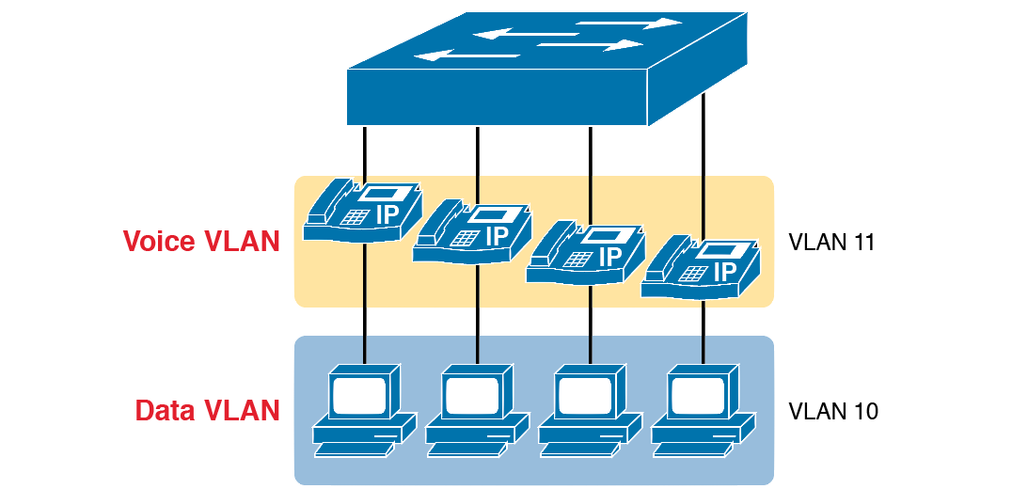
A LAN Design, with Data in VLAN 10 and Phones in VLAN 11

Slide 25
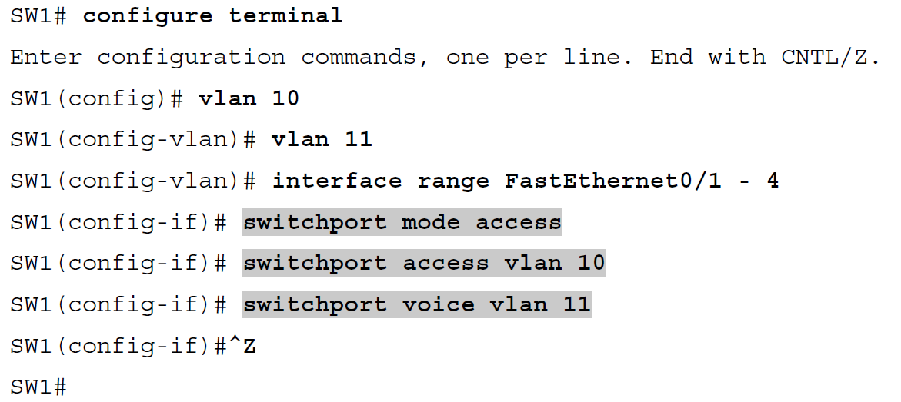
Configuring the Voice and Data VLAN on a Ports Connected to Phones

Slide 26
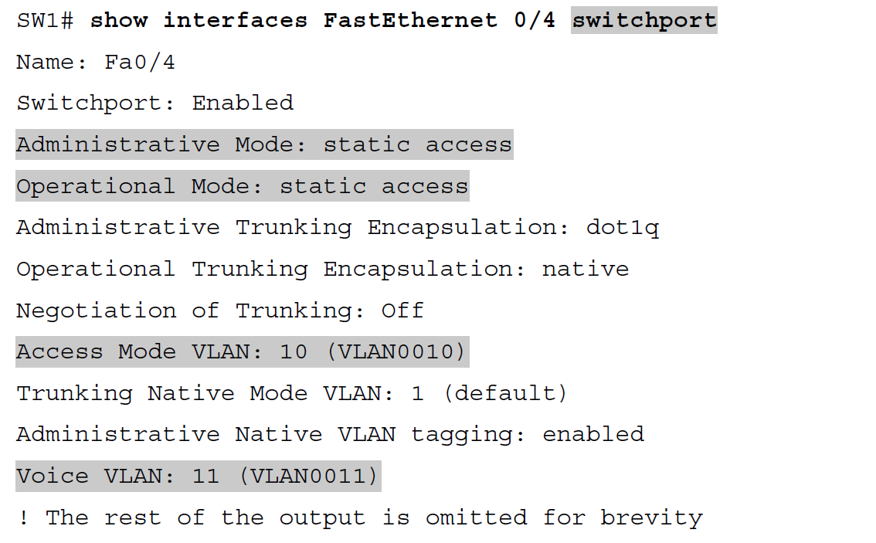
Verifying the Data VLAN (Access VLAN) and Voice VLAN

Slide 27
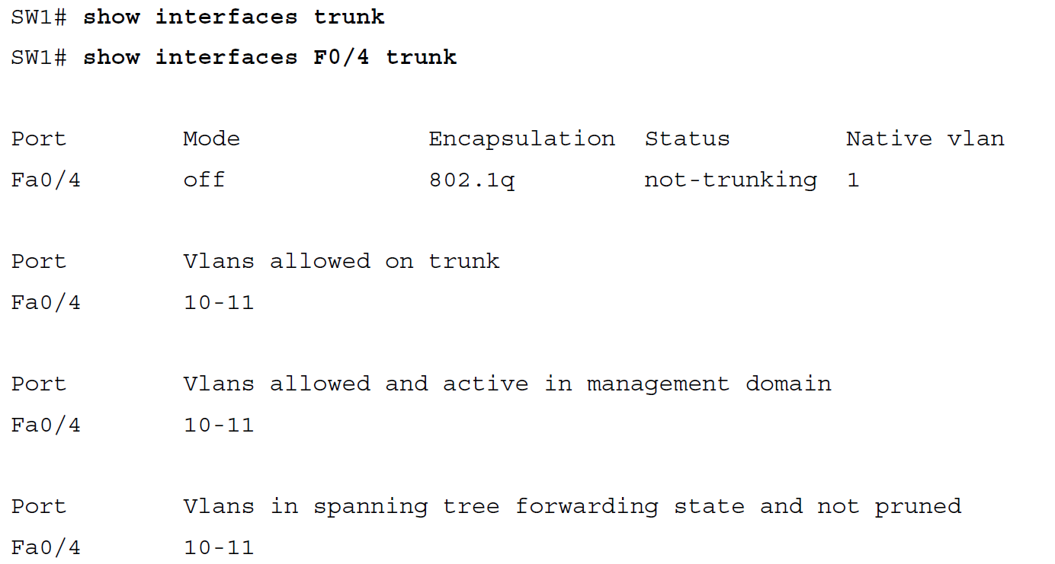
Allowed VLAN List and the List of Active VLANs

Slide 28
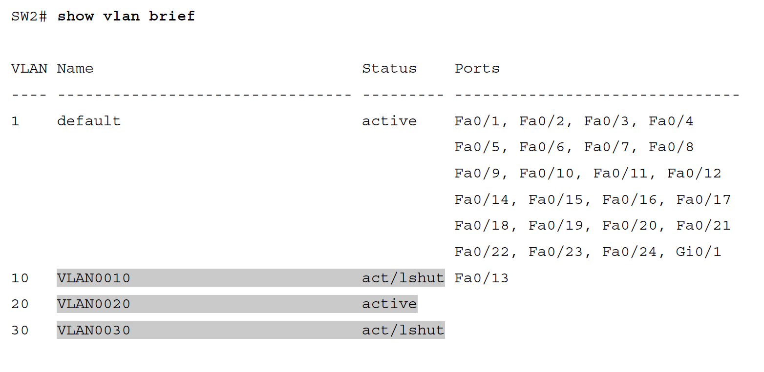
Enabling and Disabling VLANs on a Switch

Slide 29
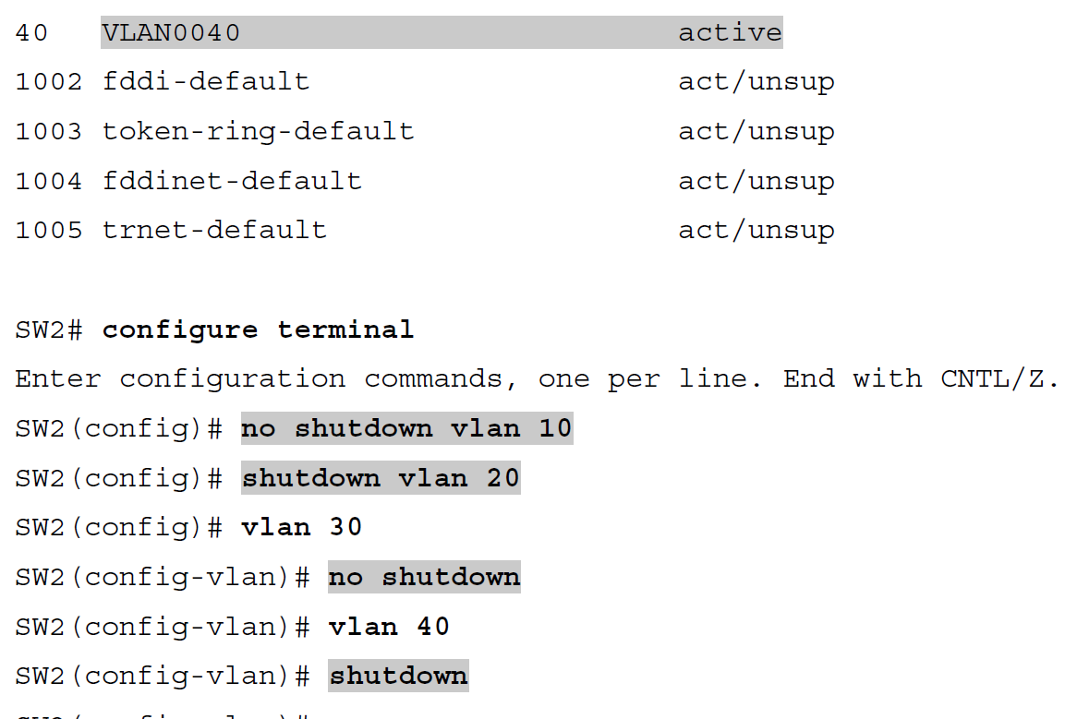
Enabling and Disabling VLANs on a Switch (Continued)

Slide 30
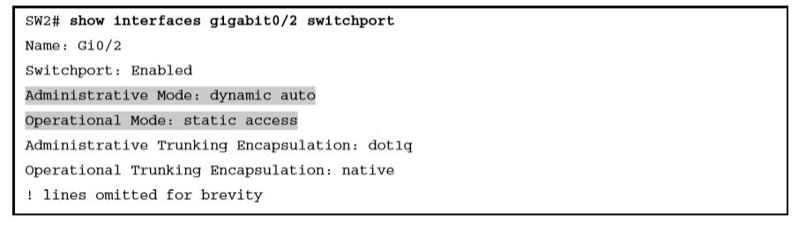
Operational Trunking State

Slide 31
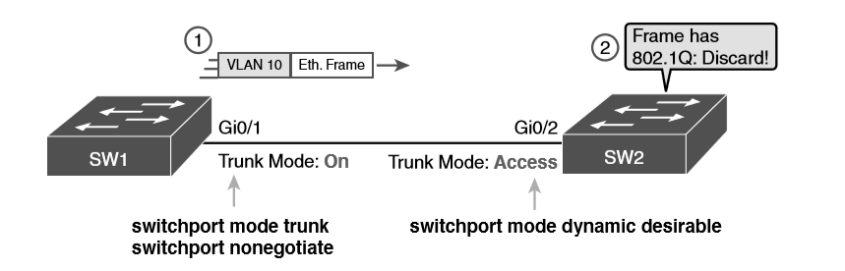
Mismatched Trunking Operational States

