Slide 1
CCNA 200-301, Volume I
Chapter 9
Spanning Tree Protocol Concepts

Slide 2
Objectives
STP and RSTP Basics
Details Specific to STP (and Not RSTP)
Rapid STP Concepts

Slide 3
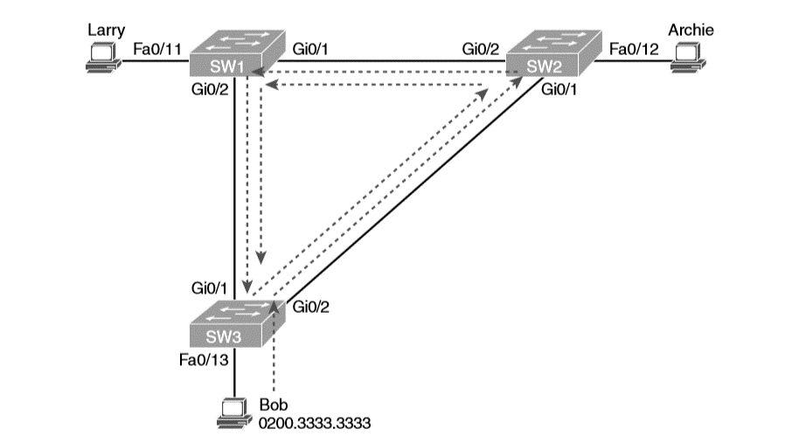
Broadcast Storm

Slide 4
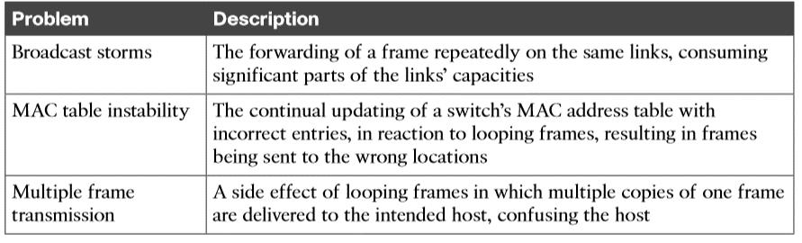
Three Classes of Problems Caused by Not Using STP in Redundant LANs

Slide 5
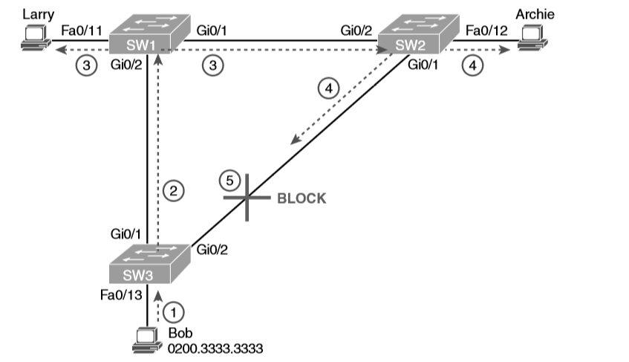
STP/RSTP Blocks a Port to Break the Loop

Slide 6
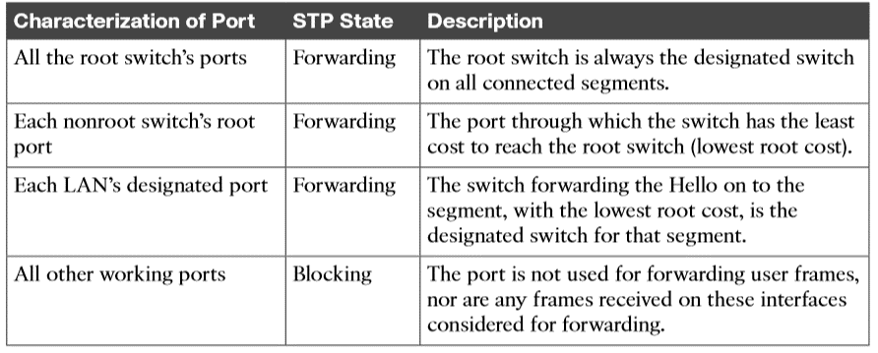
STP/RSTP: Reasons for Forwarding or Blocking

Slide 7
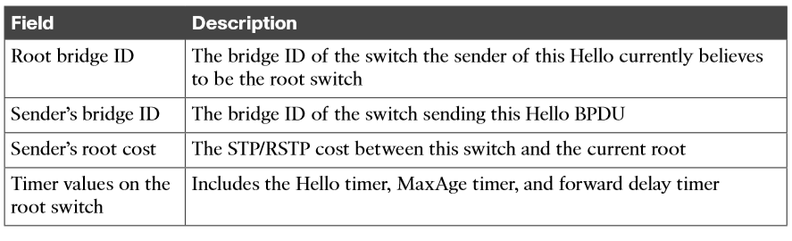
Fields in the STP Hello BPDU

Slide 8
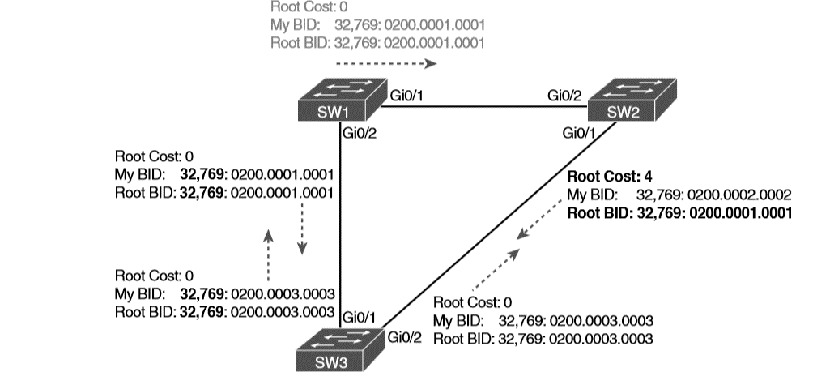
Beginnings of the Root Election Process

Slide 9
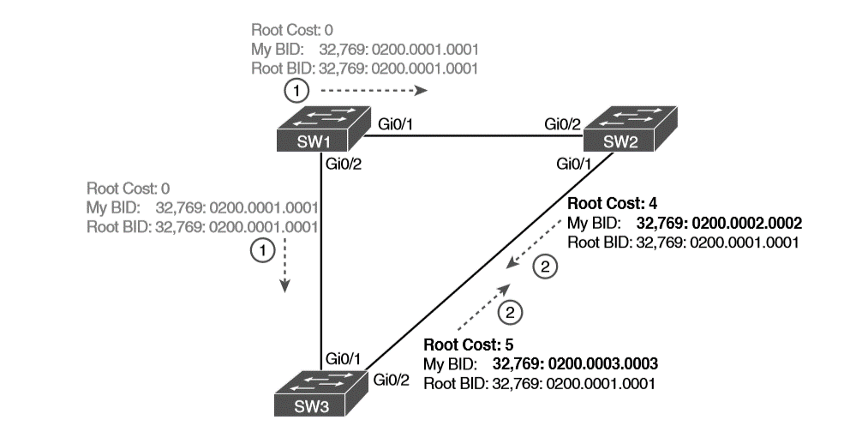
SW1 Wins the Election

Slide 10
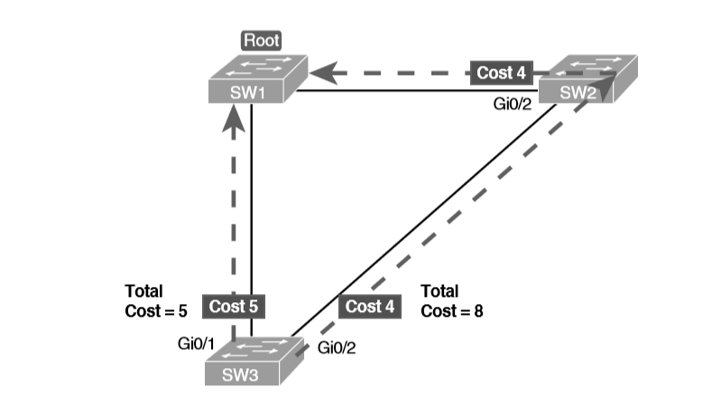
How a Human Might Calculate STP/RSTP Cost from SW3 to the Root (SW1)

Slide 11
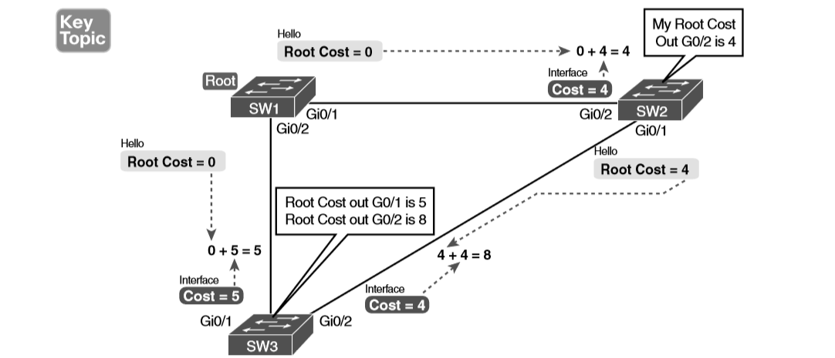
How STP/RSTP Actually Calculates the Cost from SW3 to the Root

Slide 12
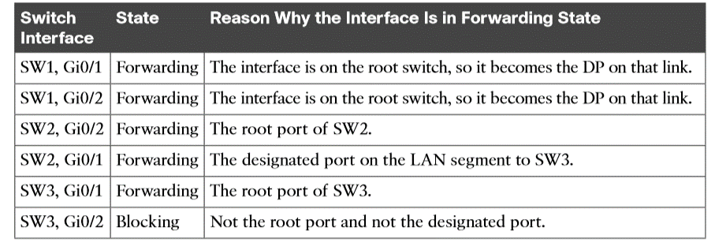
State of Each Interface

Slide 13
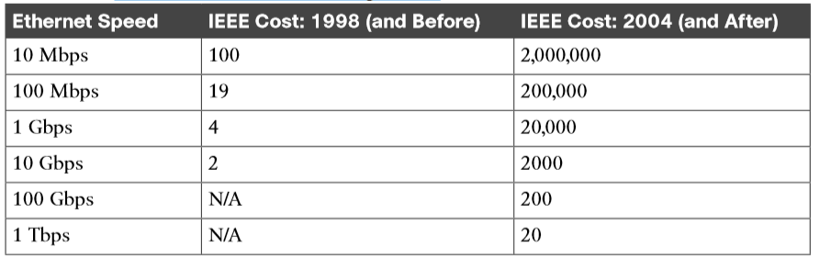
Default Port Costs According to IEEE

Slide 14
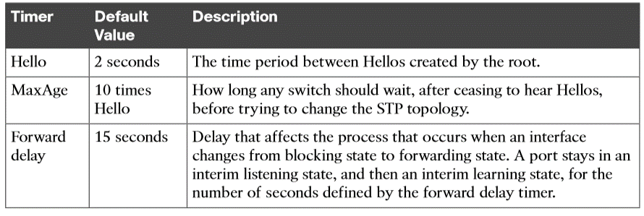
STP Timers

Slide 15
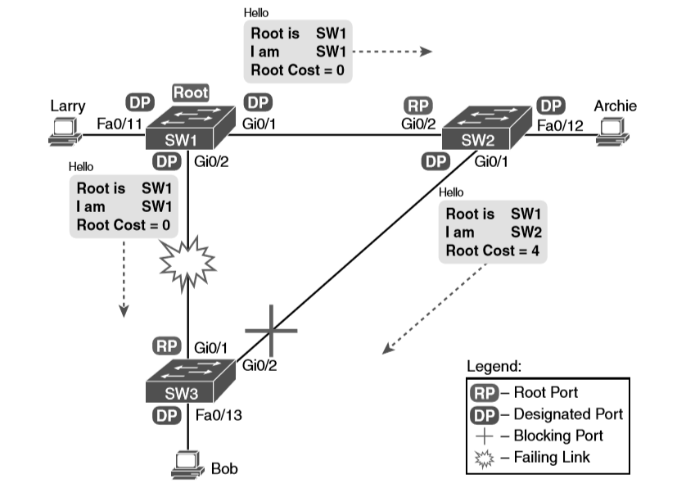
Initial STP State Before SW1-SW3 Link Fails

Slide 16
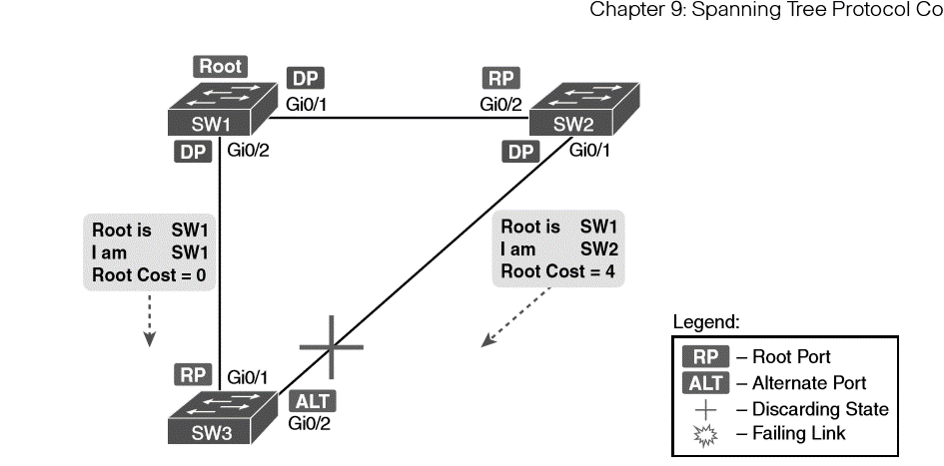
Example of SW3 Making G0/2 Become an Alternate Port

Slide 17
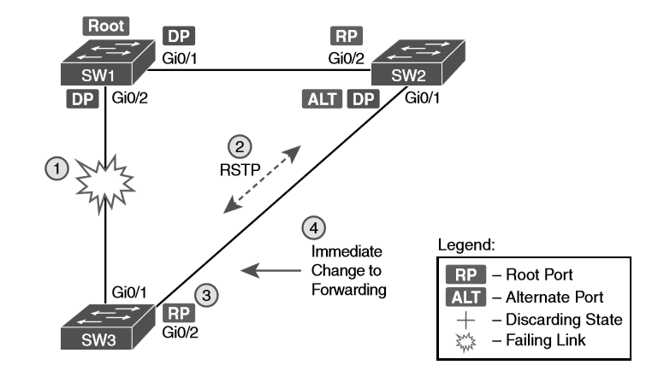
Convergence Events with SW3 G0/1 Failure

Slide 18
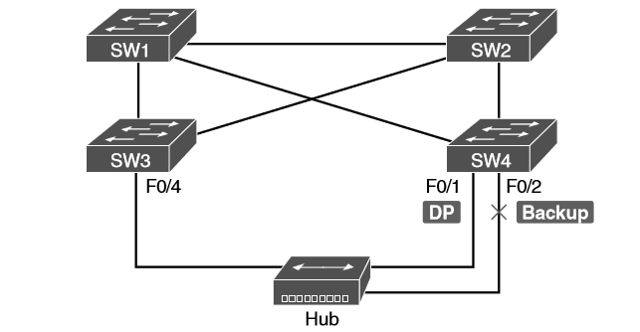
RSTP Backup Port Example

Slide 19
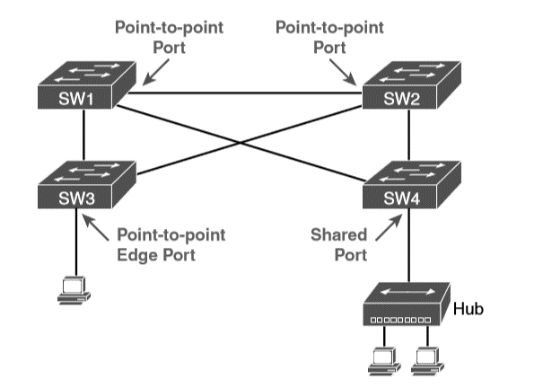
RSTP Link Types

Slide 20
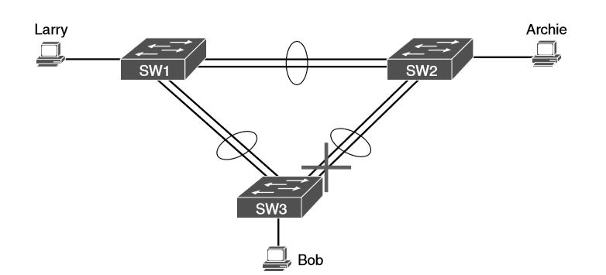
Two-Segment EtherChannels Between Switches

