Slide 1
CCNA 200-301, Volume 2
Chapter 1
Introduction to TCP/IP Transport and Applications

Slide 2
Objectives
Compare TCP to UDP
Explain the role of DHCP and DNS in the network

Slide 3
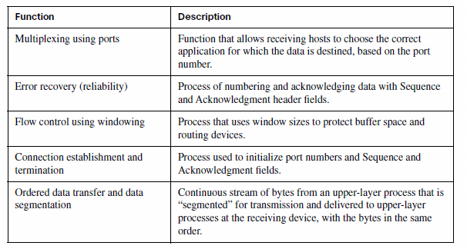
TCP/IP Transport Layer

Slide 4
TCP Header Fields

Slide 5
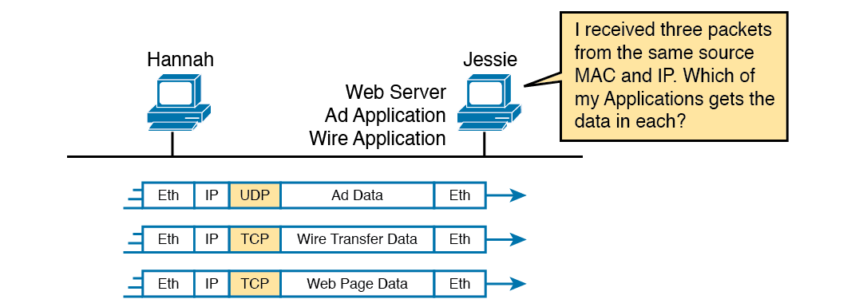
Hannah Sending Packets to Jessie, with Three Applications

Slide 6
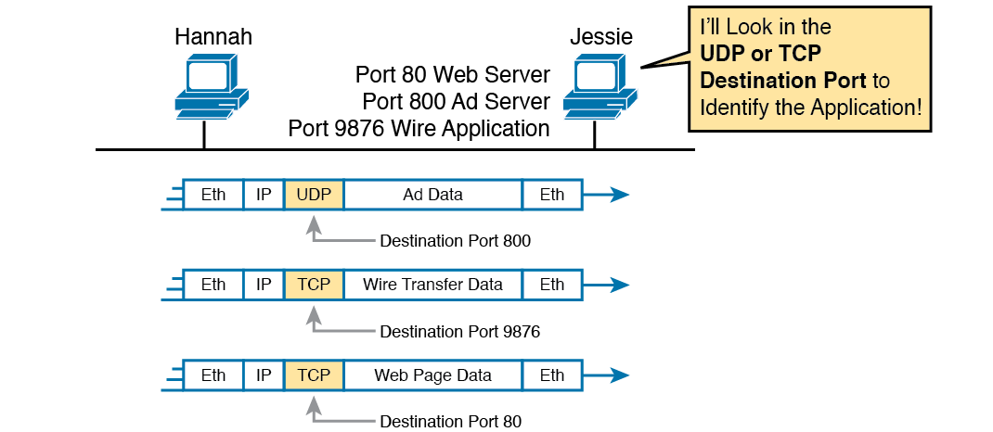
Hannah Sending Packets to Jessie, with Three Applications Using Port Numbers to Multiplex

Slide 7
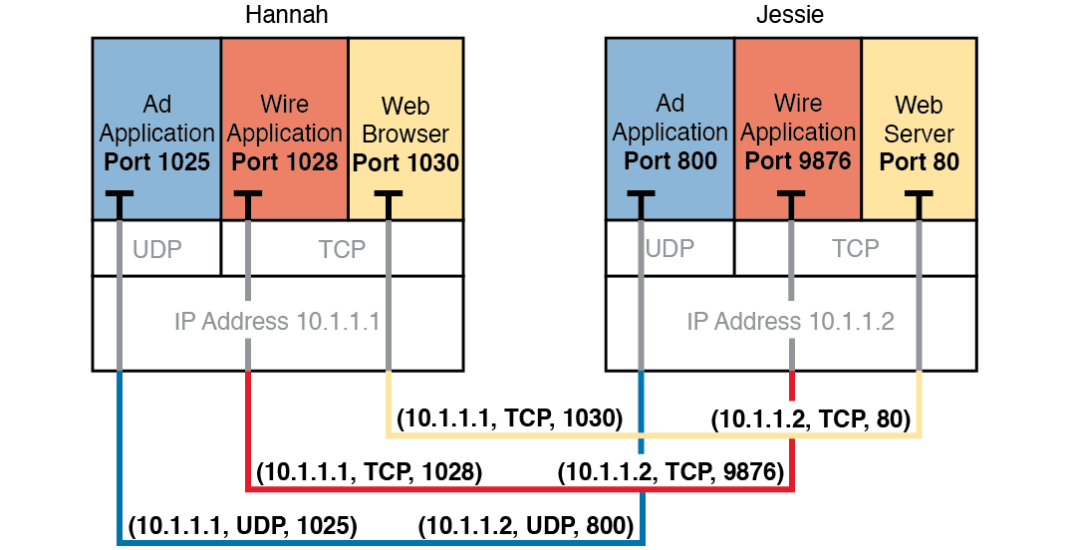
Connections Between Sockets

Slide 8
Popular Applications and Their Well-Known Port Numbers
Port Number | Protocol | Application
20 | TCP | FTP Data
21 | TCP | FTP Control
22 | TCP | SSH
23 | TCP | Telnet
25 | TCP | SMTP
53 | UDP, TCP | DNS
67,68 | UDP | DHCP (Server, Client)
69 | UDP | TFTP
80 | TCP | HTTP (WWW)
110 | TCP | POP3
161 | UDP | SNMP
443 | TCP | SSL
514 | UDP | Syslog

Slide 9
TCP Connection Establishment

Slide 10
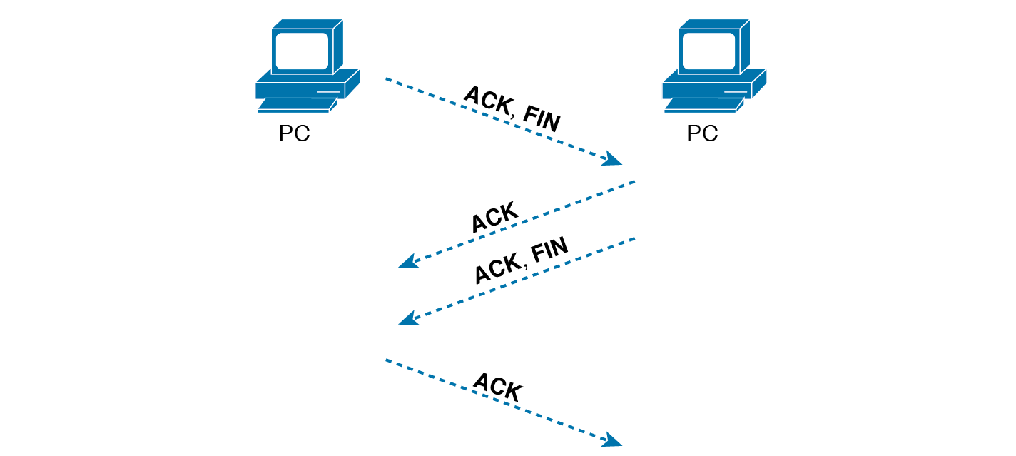
TCP Connection Termination

Slide 11
TCP Acknowledgement Without Errors

Slide 12
TCP Acknowledgment with Errors

Slide 13
TCP Windowing

Slide 14
UDP Header

Slide 15
Structure of a URI Used to Retrieve a Web Page

Slide 16
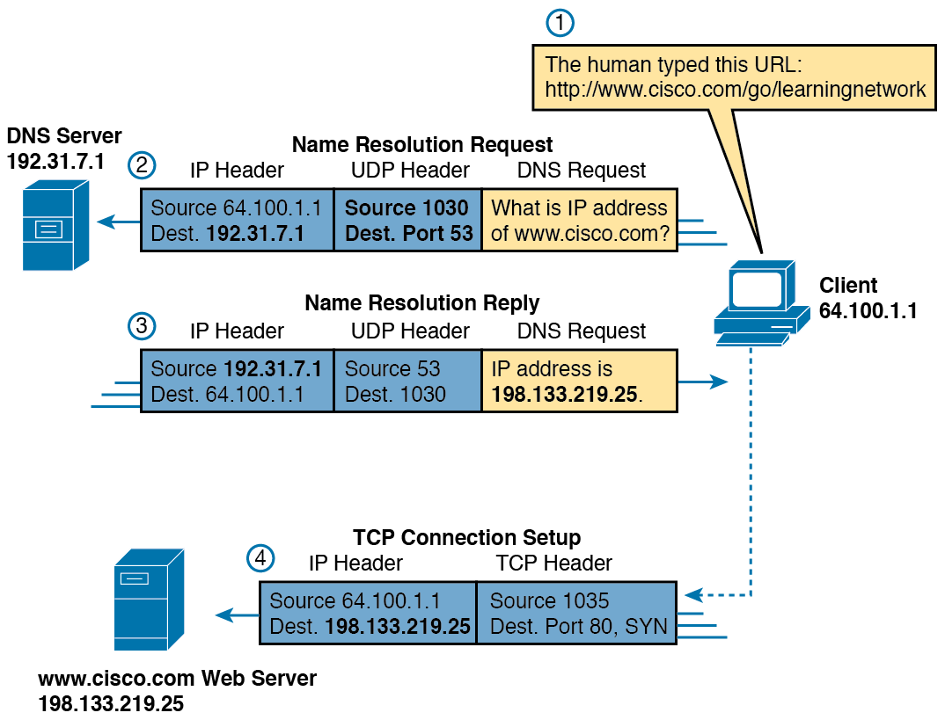
DNS Resolution and Requesting a Web Page

Slide 17
Recursive DNS Lookup

Slide 18
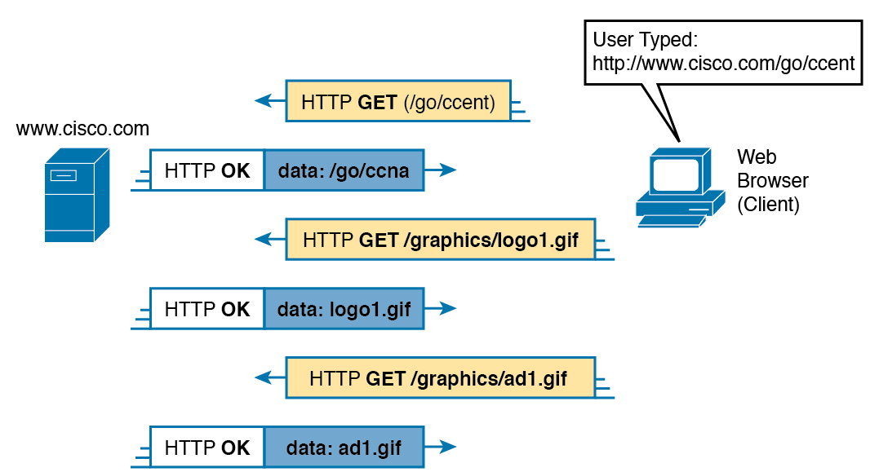
Multiple HTTP Get Requests/Responses

Slide 19
Dilemma: How Host A Chooses the App That Should Receive This Data

Slide 20
Three Key Fields with Which to Identify the Next Header

