Slide 1
CCNA 200-301, Volume 2
Chapter 2
Basic IPv4 Access Control Lists

Slide 2
Objectives
Configure and verify access control lists

Slide 3
IPv4 Access Control List Basics
IPv4 access control lists give network engineers a way to identify different types of packets.
ACL configurations list values that the router can see in the IP, ICMP, TCP, and UDP (and other) headers.
IPv4 ACLs perform many functions in Cisco routers, including packet filtering and QoS.

Slide 4
Locations to Filter Packets from Hosts A and B Going Toward Server S1

Slide 5
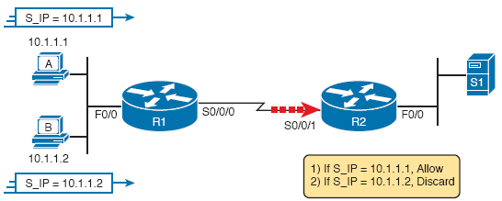
Pseudocode to Demonstrate ACL Command-Matching Logic

Slide 6
Comparisons of IP ACL Types

Slide 7
Backdrop for Discussion of List Process with IP ACLs

Slide 8
ACL Items Compared for Packets from Hosts A, B, and C on Previous Slide

Slide 9
Logic for WC Masks 0.0.0.255, 0.0.255.255, and 0.255.255.255

Slide 10
Syntactically Correct ACL Replaces Pseudocode

Slide 11
Binary Wildcard Mask Example
For subnet 172.16.8.0 255.255.252.0, use the subnet number as the address parameter and do the following math to find the wildcard mask:

Slide 12
Matching Any/All Addresses
In some cases, one ACL command can be used to match any and all packets that reach that point in the ACL using the any keyword.
Example: access-list 1 permit any.
All Cisco IP ACLs end with an implicit deny any.

Slide 13
Implementing Standard IP ACLs
Step 1: Plan the location and direction on that interface
Step 2: Configuration one or more access-list global configuration commands to create the ACL
Step 3: Enable the ACL on the chosen router interface, in the correct direction, using the ip access-group number {in | out} interface subcommand.

Slide 14
Standard Numbered ACL Example 1 Configuration

Slide 15
ACL show Commands on R2

Slide 16
Standard Numbered ACL Example 2

Slide 17
Creating Log Messages for ACL Statistics

Slide 18
Example of Checking the Interface and Direction for an ACL

Slide 19
Building One-Line Standard ACLs: Practice
Problem | Criteria
1 | Packets from 172.16.5.4
2 | Packets from hosts with 192.168.6 as the first three octets
3 | Packets from hosts with 192.168 as the first two octets
4 | Packets from any host
5 | Packets from subnet 10.1.200.0/21
6 | Packets from subnet 10.1.200.0/27
7 | Packets from subnet 172.20.112.0/23
8 | Packets from subnet 172.20.112.0/26
9 | Packets from subnet 192.168.9.64/28
10 | Packets from subnet 192.168.9.64/30

Slide 20
Reverse Engineering from ACL to Address Range
With the command access-list 1 permit 172.16.200.0 0.0.7.255, the low end of the range is 172.16.200.0.
To find the high end of the range, add this number to the WC mask, as shown here:

Slide 21
Finding IP Addresses/Ranges Matching by Existing ACLs
Problem | Criteria
1 | access-list 1 permit 10.7.6.5
2 | access-list 2 permit 192.168.4.0 0.0.0.127
3 | access-list 3 permit 192.168.6.0 0.0.0.31
4 | access-list 4 permit 172.30.96.0 0.0.3.255
5 | access-list 5 permit 172.30.96.0 0.0.0.63
6 | access-list 6 permit 10.1.192.0 0.0.0.31
7 | access-list 7 permit 10.1.192.0 0.0.1.255
8 | access-list 8 permit 10.1.192.0 0.0.63.255

Slide 22
IOS Changing the Address Field in an access-list Command

