Slide 1
CCNA 200-301, Volume 2
Chapter 4
Security Architectures

Slide 2
Objectives
Define key security concepts (threats, vulnerabilities, exploits, and mitigation techniques)
Describe security program elements (user awareness, training, and physical access control)
Describe security password policies elements, such as management, complexity, and password alternatives (multifactor authentication, certificates, and biometrics)
Differentiate authentication, authorization, and accounting concepts

Slide 3
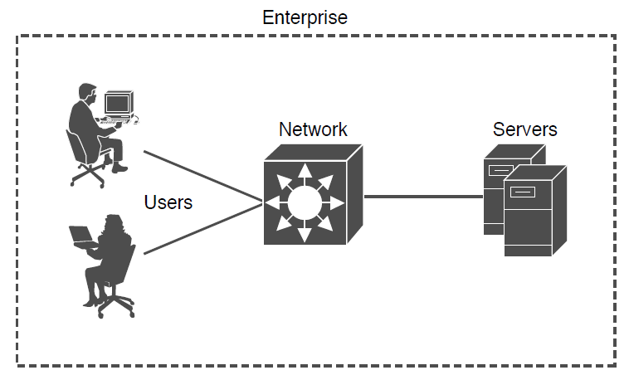
Example of an Enterprise Closed System

Slide 4
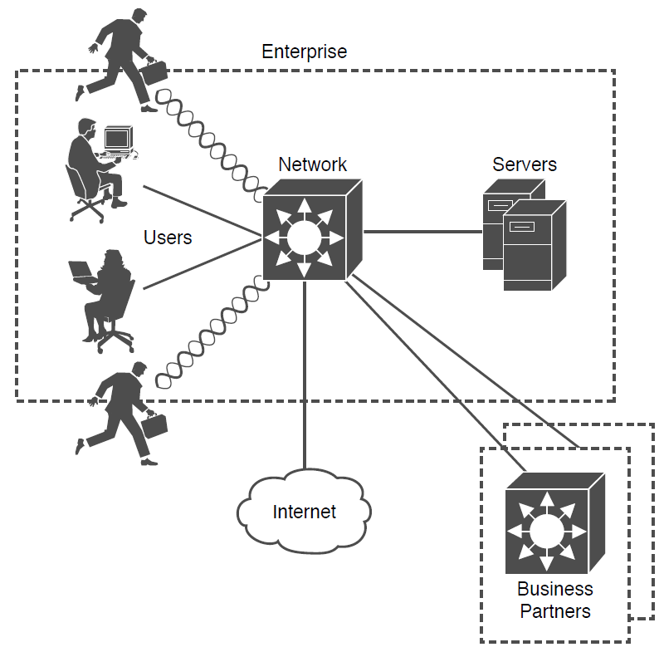
Example Enterprise Extends Beyond Its Own Boundary

Slide 5
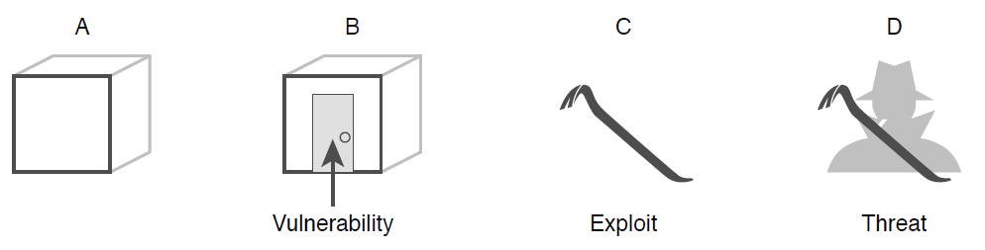
Security Terminology Illustrated

Slide 6
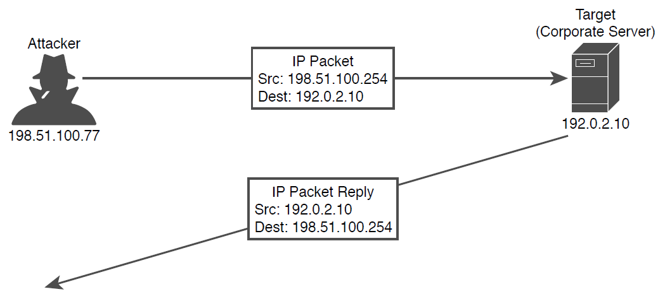
Sample Spoofing Attack

Slide 7
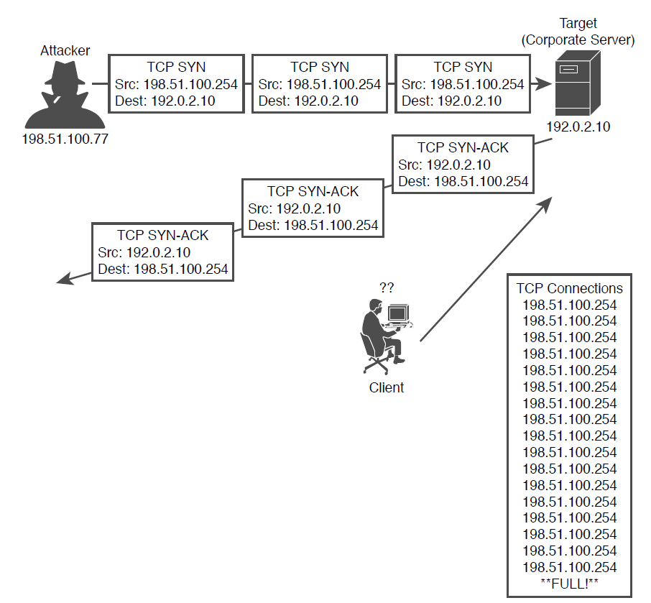
Sample Denial-of-Service Attack

Slide 8
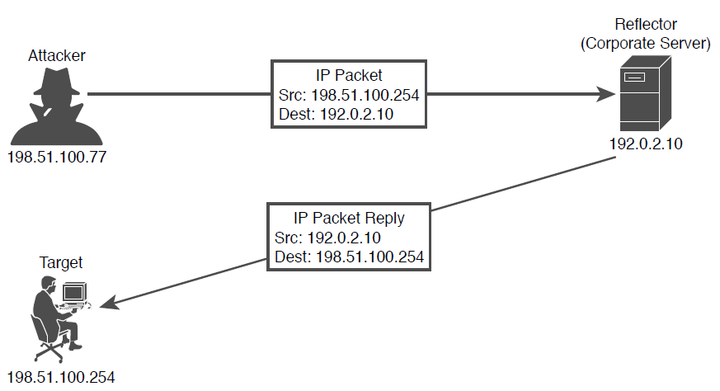
A Sample Reflection Attack

Slide 9
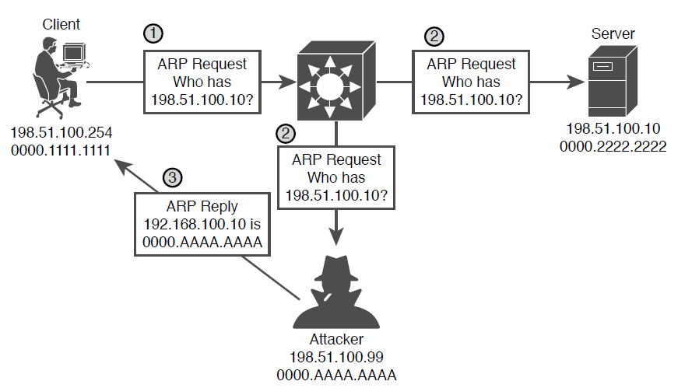
A Man-in-the-Middle Attack Begins

Slide 10
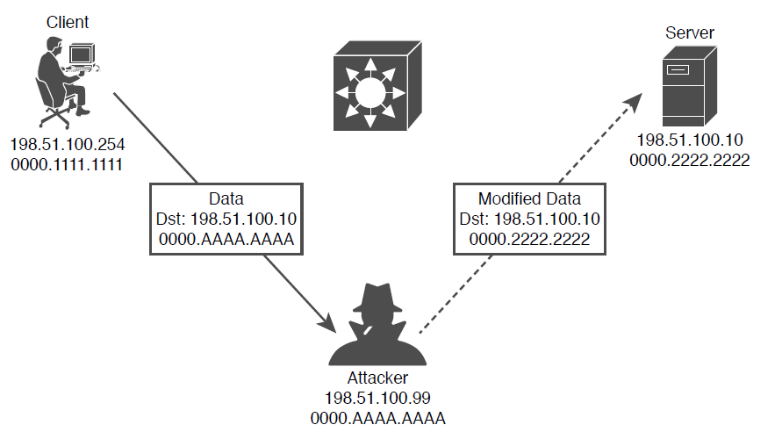
A Man-in-the-Middle Attack Succeeds

Slide 11
Summary of Address Spoofing Attacks
Goal | DoS/DDoS | Reflection | Amplification | Man-in-the-Middle
Exhaust a system service or resource; crash the target system | Yes | No | No | No
Trick an unwitting accomplice host to send traffic to target | No | Yes | Yes | No
Eavesdrop on traffic | No | No | No | Yes
Modify traffic passing through | No | No | No | Yes

Slide 12
Summary of Malware Types
Characteristic | Trojan Horse | Virus | Worm
Packaged inside other software | Yes | No | No
Self-injected into other software | No | Yes | No
Propagates automatically | No | No | Yes

Slide 13
Summary of Human Security Vulnerabilities
Attack Type | Goal
Social engineering | Exploits human trust and social behavior
Phishing | Disguises a malicious invitation as something legitimate
Spear phishing | Targets group of similar users
Whaling | Targets high-profile individuals
Vishing | Uses voice calls
Smishing | Uses SMS text messages
Pharming | Uses legitimate services to send users to a compromised site
Watering hole | Targets specific victims who visit a compromised site

Slide 14
Summary of Password Authentication and Alternatives
Characteristic | Password Only | Two-Factor | Digital Certificates | Biometric
Something you know | Yes | Yes
Something you have |  | Yes | Yes
Something you are |  |  |  | Yes

Slide 15
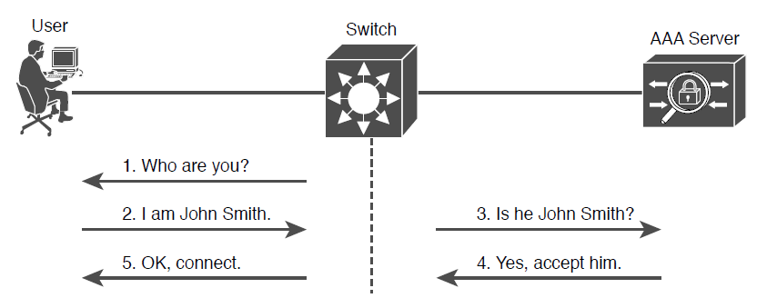
Simplified View of AAA

