Slide 1
CCNA 200-301, Volume 2
Chapter 5
Securing Network Devices

Slide 2
Objectives
Explain the Role of Network Components
Next-generation firewalls and IPS
Configure network devices for remote access using SSH
Configure device access control using local passwords

Slide 3
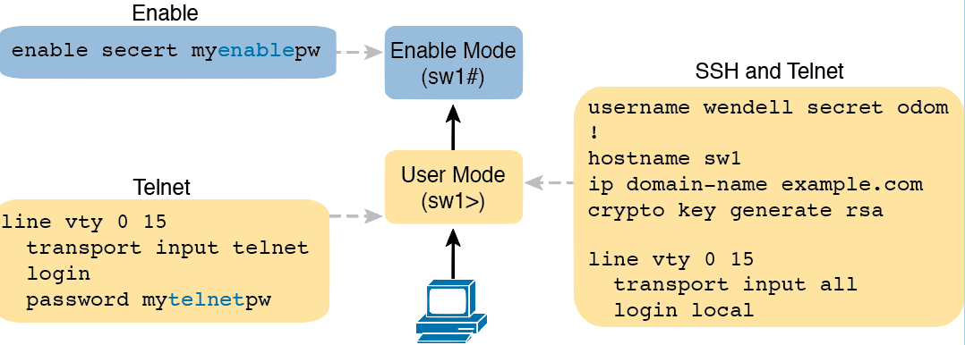
Example Login Security Configuration

Slide 4
Encryption and the service password-encryption Command

Slide 5
Encryption Is Immediate; Decryption Awaits Next Password Change

Slide 6
One-Way Nature of MD5 Hash to Create Secret

Slide 7
Creation of the enable secret Command
Notes:
Switch3(config)# enable secret fred
Switch3(config)# ^Z
Switch3# show running-config | include enable secret
enable secret 5 $1$ZGMA$e8cmvkz4UjiJhVp7.maLE1
Switch3# configure terminal
Enter configuration commands, one per line. End with CNTL/Z.
Switch3(config)# no enable secret
Switch3(config)# ^Z

Slide 8
Timeline of Encryptions/Hashes of Cisco IOS Passwords

Slide 9
Commands and Encoding Types for the enable secret Command
Command | Type | Algorithm
enable [algorithm-type md5] secret password | 5 | MD5
enable algorithm-type sha256 secret password | 8 | SHA-256
enable algorithm-type scrypt secret password | 9 | SHA-256

Slide 10
Cisco IOS Encoding Password “mypass1” as Type 9 (SHA-256)

Slide 11
Commands and Encoding Types for the username secret Command
Command | Type | Algorithm
username name [algorithm-type md5] secret password | 5 | MD5
username name algorithm-type sha256 secret password | 8 | SHA-256
username name algorithm-type scrypt secret password | 9 | SHA-256

Slide 12
vty Access Control Using the access-class Command

Slide 13
Firewall as Positioned in the Packet Forwarding Path

Slide 14
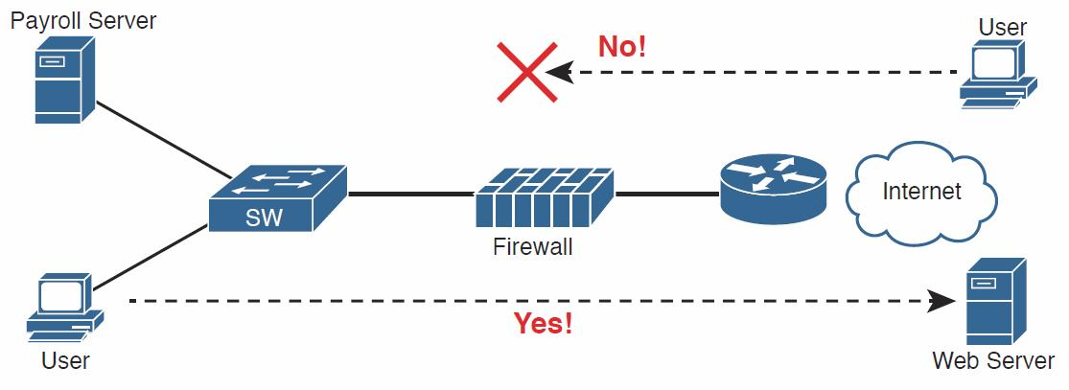
Allowing Outbound Connections and Preventing Inbound Connections

Slide 15
Using Security Zones with Firewalls

Slide 16
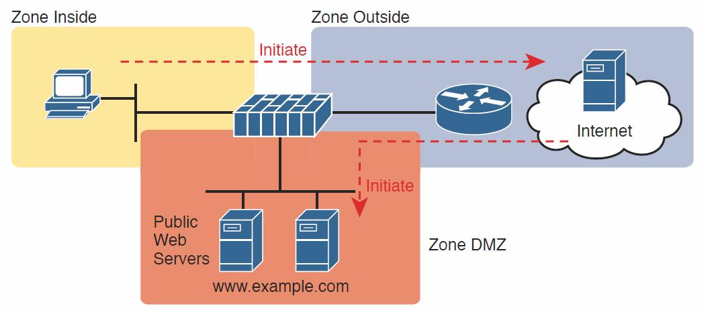
Using a DMZ for Enterprise Servers That Need to Be Accessible from the Internet

Slide 17
IPS and Signature Database

Slide 18
Next-Generation Firewall with Next-Generation IPS Module

