Slide 1
CCNA 200-301, Volume 2
Chapter 6
Implementing Switch Port Security

Slide 2
Objectives
Configure Layer 2 security features (DHCP snooping, dynamic ARP inspection, and port security)

Slide 3
Source MAC Addresses in Frames as They Enter a Switch

Slide 4
Port Security Configuration Steps
Use the switchport mode access or the switchport mode trunk interface subcommand to make the switch interface either a static access or trunk interface.
Use the switchport port-security interface subcommand to enable port security on the interface.
(Optional) Use the switchport port-security maximum number interface subcommand to override the default maximum number of allowed MAC addresses associated with the interface (1).
(Optional) Use the switchport port-security violation {protect | restrict | shutdown} interface subcommand to override the default action to take upon a security violation (shutdown).
(Optional) Use the switchport port-security mac-address mac-address interface subcommand to predefine any allowed source MAC addresses for this interface. Use the command multiple times to define more than one MAC address.
(Optional) Use the switchport port-security mac-address sticky interface subcommand to tell the switch to “sticky learn” dynamically learned MAC addresses.

Slide 5
Port Security Configuration Example

Slide 6
Variations on Port Security Configuration

Slide 7
Configuration Added by the Port Security Sticky Feature

Slide 8
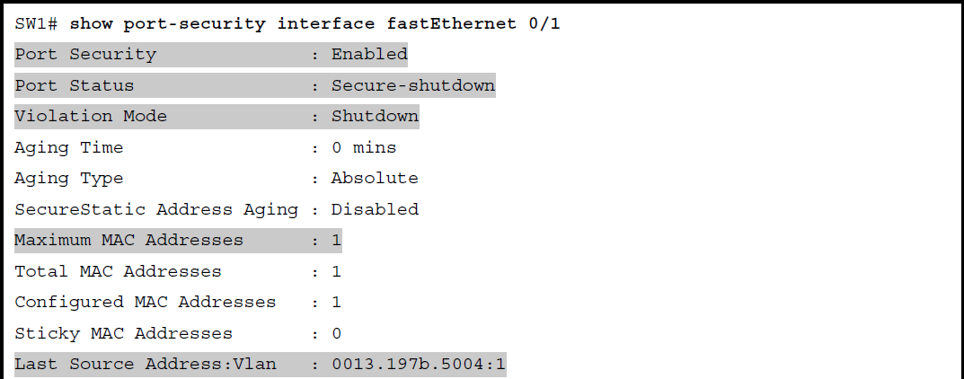
Using Port Security to Define Correct MAC Addresses of Particular Interfaces

Slide 9
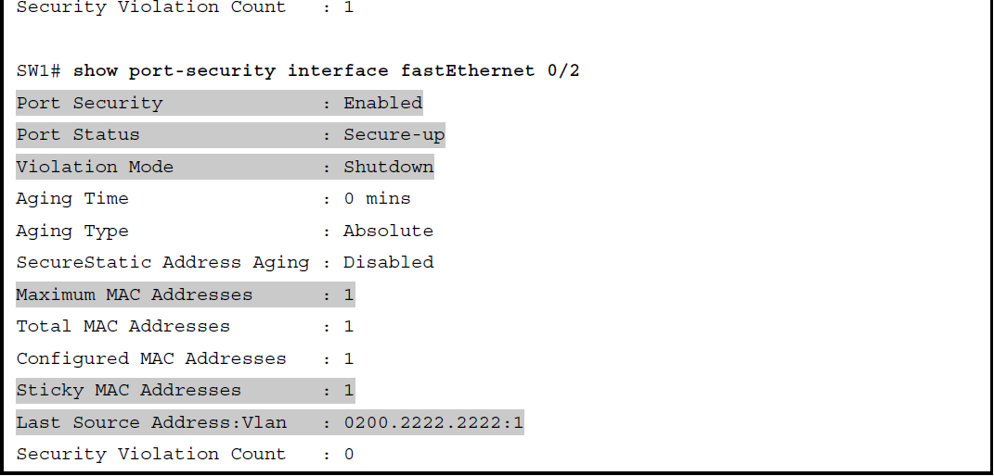
Using Port Security to Define Correct MAC Addresses of Particular Interfaces (continued)

Slide 10
Using the secure Keyword to See MAC Table Entries When Using Port Security

Slide 11
Actions When Port Security Violation Occurs
Option on the switchport port-security violation Command | Protect | Restrict | Shutdown
Discards offending traffic | Yes | Yes | Yes
Sends log and SNMP messages | No | Yes | Yes
Disables the interface by putting it in an err-disabled state, discarding all traffic | No | No | Yes

Slide 12
Confirming the Port Security Violation Mode

Slide 13
Port Security Status in Shutdown Mode After a Violation

Slide 14
Summary of Actions: Port Security Violation Mode Shutdown

Slide 15
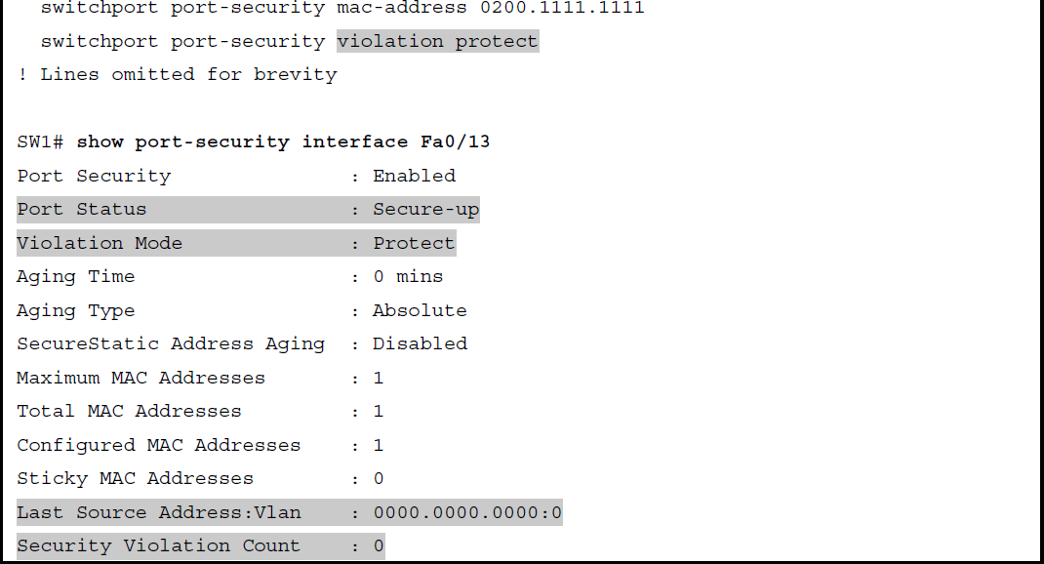
Port Security Using Protect Mode

Slide 16
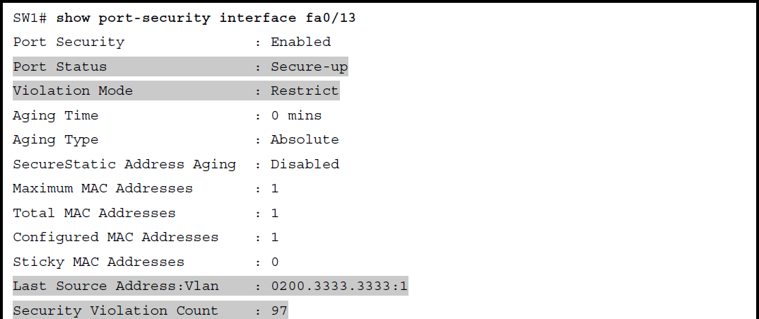
Port Security Using Violation Mode Restrict

Slide 17
Summary of Actions: Port Security Violation Mode Restrict

