Slide 1
CCNA 200-301, Volume 2
Chapter 7
Implementing DHCP

Slide 2
Objectives
Identify IP parameters for Client OS (Windows, macOS, Linux)
Explain the role of DHCP and DNS within the network
Configure and verify DHCP client and relay

Slide 3
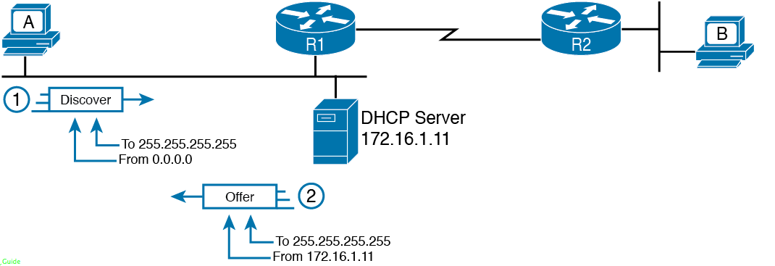
DHCP Discover and Offer

Slide 4
IP Helper Address Effect

Slide 5
IP Helper Address for the Offer Message Returned from the DHCP Server

Slide 6
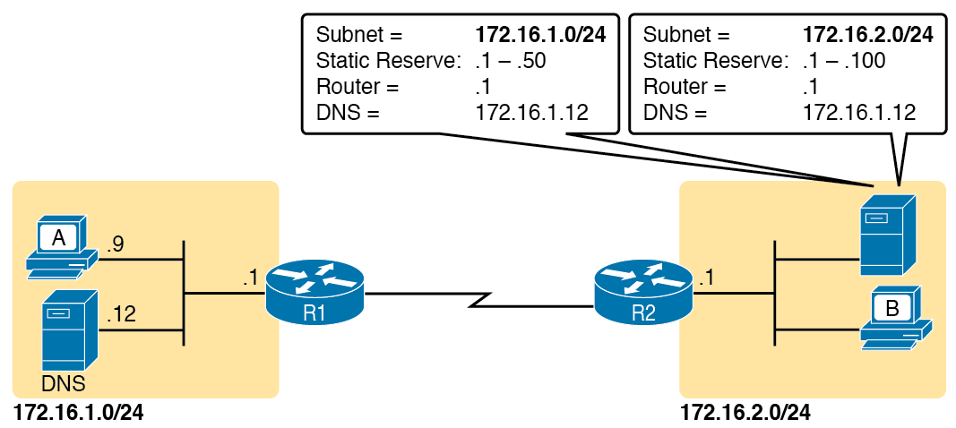
Preconfiguration on a DHCP Server

Slide 7
Listing the Current Helper Address Setting with show ip interface

Slide 8
Switch Dynamic IP Address Configuration with DHCP

Slide 9
Verifying DHCP-Learned IP Address on a Switch

Slide 10
Verifying DHCP-Learned Information on a Switch

Slide 11
Enterprise Router Building and Advertising Default Routes with DHCP Client

Slide 12
Learning an Address and Default Static Route with DHCP

Slide 13
Host A Needs to Know the IP Address of the DNS Servers

Slide 14
Host Default Router Setting Should Equal Router Interface Address

Slide 15
The Need for Subnet Agreement Between Host and Default Router

Slide 16
IP Address, Mask, and Default Router Settings on Windows

Slide 17
ipconfig (Windows)

Slide 18
ipconfig /all (Windows)

Slide 19
netstat -rn Command (Windows)

Slide 20
IP Address, Mask, and Default Router Settings on macOS

Slide 21
ifconfig (macOS)

Slide 22
networksetup -getinfo and networksetup -getdnsservers (macOS)

Slide 23
netstat -rn (macOS)

Slide 24
IP Address, Mask, and Default Router Settings on Linux

Slide 25
ifconfig and ip address Commands (Linux)

Slide 26
netstat -rn and ip route Commands (Linux)

