Slide 1
CCNA 200-301, Volume 2
Chapter 9
Device Management Protocols

Slide 2
Objectives
Configure and verify Layer 2 discovery protocols (Cisco Discovery Protocol and LLDP)
Configure and verify NTP operating in a client and server mode
Describe the use of syslog features including facilities and levels

Slide 3
IOS Processing for Log Messages to Current Users

Slide 4
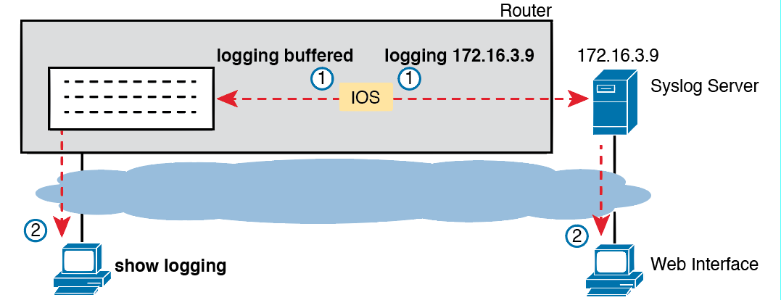
IOS Storing Log Messages for Later View: Buffered and Syslog Server

Slide 5
Disabling Timestamps and Enabling Sequence Numbers in Log Messages

Slide 6
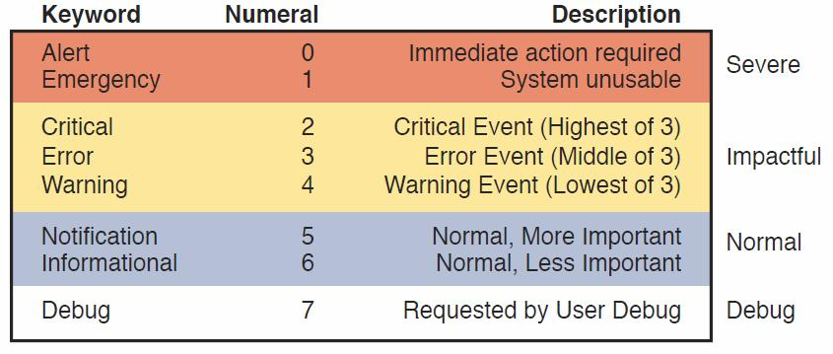
Syslog Message Severity Levels by Keyword and Numeral

Slide 7
How to Configure Logging Message Levels for Each Log Service
Service | To Enable Logging | To Set Message Levels
Console | logging console | logging console level-name|level-number
Monitor | logging monitor | logging monitor level-name|level-number
Buffered | logging buffered | logging buffered level-name|level-number
Syslog | logging host address|hostname | logging trap level-name|level-number

Slide 8
Sample Network Used in Logging Examples

Slide 9
Syslog Configuration on R1

Slide 10
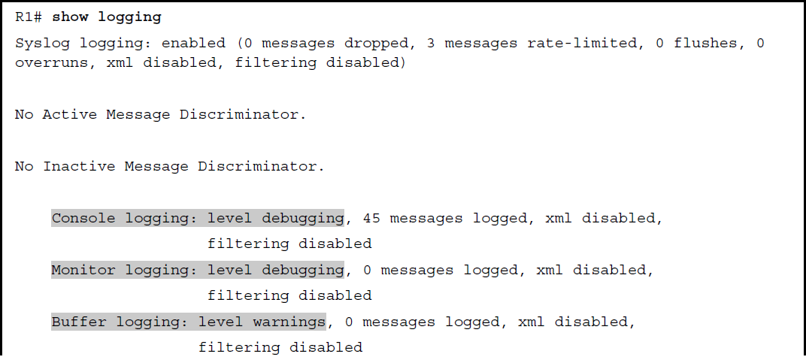
Viewing the Configured Log Settings of the Earlier Example

Slide 11
Viewing the Configured Log Settings of the Earlier Example (continued)

Slide 12
Seeing Severity 3 and 5 Messages at the Console, and Severity 3 Only in the Buffer

Slide 13
Seeing Severity 3 and 5 Messages at the Console, and Severity 3 Only in the Buffer (continued)

Slide 14
Using debug ip ospf hello from R1’s Console

Slide 15
Log Messages from Routers R1 and R2, Compared

Slide 16
Setting the Date/Time with clock set, Plus Timezone/DST

Slide 17
R1 as NTP Client, R2 as Client/Server, R3 as Server

Slide 18
NTP Client/Server Configuration

Slide 19
Verifying NTP Client Status on R1

Slide 20
Verifying NTP Client Status on R1 and R2

Slide 21
Examining NTP Server, Reference Clock, and Stratum Data

Slide 22
Stratum Levels When Using an Internet-based Stratum 1 NTP Server

Slide 23
NTP Configuration on R1, R2 per Graphic on Previous Slide

Slide 24
NTP Configuration on R1 and R2 to Protect Against Internet Failures

Slide 25
The Availability Issue of Referencing an NTP Server’s Physical Interface IP Address

Slide 26
NTP Client/Server Configuration on R1 and R2 Using a Loopback Interface

Slide 27
show cdp Commands That List Information About Neighbors
Command | Description
show cdp neighbors [type number] | Lists one summary line of information about each neighbor, or just the neighbor found on a specific interface if an interface was listed.
show cdp neighbors detail | Lists one large set (approximately 15 lines) of information, one set for every neighbor.
show cdp entry name | Lists the same information as the show cdp neighbors detail command, but only for the named neighbor (case sensitive).

Slide 28
Small Network Used in CDP Examples

Slide 29
show cdp neighbors Command Examples: SW2

Slide 30
show cdp neighbors detail Command on SW2

Slide 31
show cdp neighbors detail Command on SW2 (continued)

Slide 32
show cdp neighbors detail Command on SW2 (continued)

Slide 33
Commands Used to Verify CDP Operations
Command | Description
show cdp | States whether CDP is enabled globally, and lists the default update and holdtime timers.
show cdp interface [type number] | States whether CDP is enabled on each interface, or a single interface if the interface is listed, and states update and holdtime timers on those interfaces.
show cdp traffic | Lists global statistics for the number of CDP advertisements sent and received.

Slide 34
show cdp Commands That Show CDP Status

Slide 35
show lldp neighbors on SW2 with Similarities to CDP Highlighted

Slide 36
show lldp entry r2 Command on SW2

Slide 37
Enabling LLDP on All Ports, Disabling on a Few Ports

Slide 38
Enabling LLDP on Limited Ports, Leaving Disabled on Most

Slide 39
show lldp Commands That Show LLDP Status

