Slide 1
CCNA 200-301, Volume 2
Chapter 12
Miscellaneous IP Services

Slide 2
Objectives
Describe the purpose of First Hop Redundancy Protocol
Explain the function of SNMP in network operations
Describe the capabilities and function of TFTP/FTP in the network

Slide 3
R1 and the One WAN Link as Single Points of Failure

Slide 4
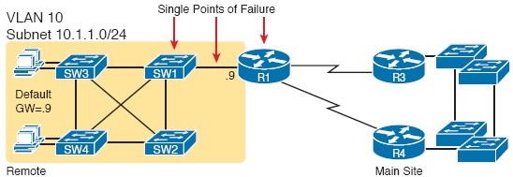
Higher Availability but with R1 Still as a Single Point of Failure

Slide 5
Removing All Single Points of Failure from the Network Design

Slide 6
Balancing Traffic by Assigning Different Default Routers to Different Clients

Slide 7
Three FHRP Options
Acronym | Full Name | Origin | Redundancy Approach | Load Balancing Per . . .
HSRP | Hot Standby Router Protocol | Cisco | active/standby | subnet
VRRP | Virtual Router Redundancy Protocol | RFC 5798 | active/standby | subnet
GLBP | Gateway Load Balancing Protocol | Cisco | active/active | host

Slide 8
All Traffic Goes to .1 (R1, Which is Active); R2 is Standby

Slide 9
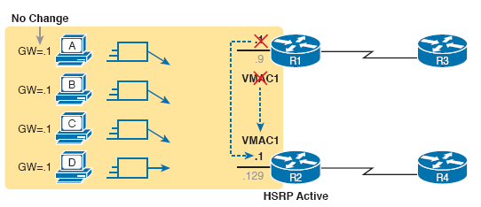
Packets Sent Through R2 (New Active) Once It Takes Over for Failed R1

Slide 10
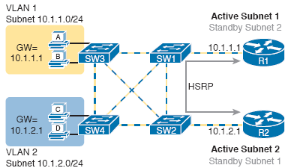
Loading Balancing with HSRP by Using Different Active Routers per Subnet

Slide 11
Elements of Simple Network Management Protocol

Slide 12
SNMP Get Request and Get Response Message Flow

Slide 13
SNMP Trap Notification Process

Slide 14
Management Information Base (MIB)

Slide 15
RO and RW Communities with the Get and Set Commands

Slide 16
Cisco IOS File Systems on a Router

Slide 17
Copying an IOS Image as Part of the Cisco IOS Software Upgrade Process

Slide 18
copy tftp flash Command Copies the IOS Image to Flash Memory

Slide 19
Command Copies the IOS Image to Flash Memory

Slide 20
Command Copies the IOS Image to Flash Memory (continued)

Slide 21
MD5 Verification of IOS Images— Concepts

Slide 22
Verifying Flash Memory Contents with the show flash Command

Slide 23
Common Methods to Copy Files Outside a Router
Method | Method (Full Name) | Encrypted?
TFTP | Trivial File Transfer Protocol | No
FTP | File Transfer Protocol | No
SCP | Secure Copy Protocol | Yes

Slide 24
Installing a New IOS with FTP

Slide 25
Major Concepts with FTP Clients and Servers

Slide 26
FTP Client Example with Filezilla

Slide 27
FTP Client Creates an FTP Control Connection

Slide 28
FTP Active Mode Process to Create the Data Connection

Slide 29
FTP Passive Mode Process to Create the Data Connection

Slide 30
FTPS Explicit Mode Control and Data Connection Establishment

