Slide 1
CCNA 200-301, Volume 2
Chapter 13
LAN Architecture

Slide 2
Objectives
Describe characteristics of network topology architectures
  2 tier
  3 tier
  Small office/home office (SOHO)
Compare physical interface and cabling types
  Concepts of PoE

Slide 3
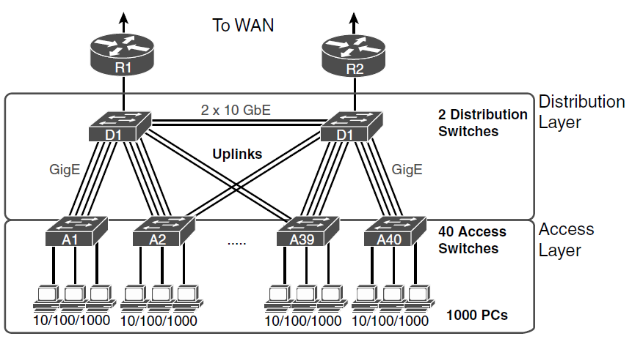
Campus LAN with Design Terminology Listed

Slide 4
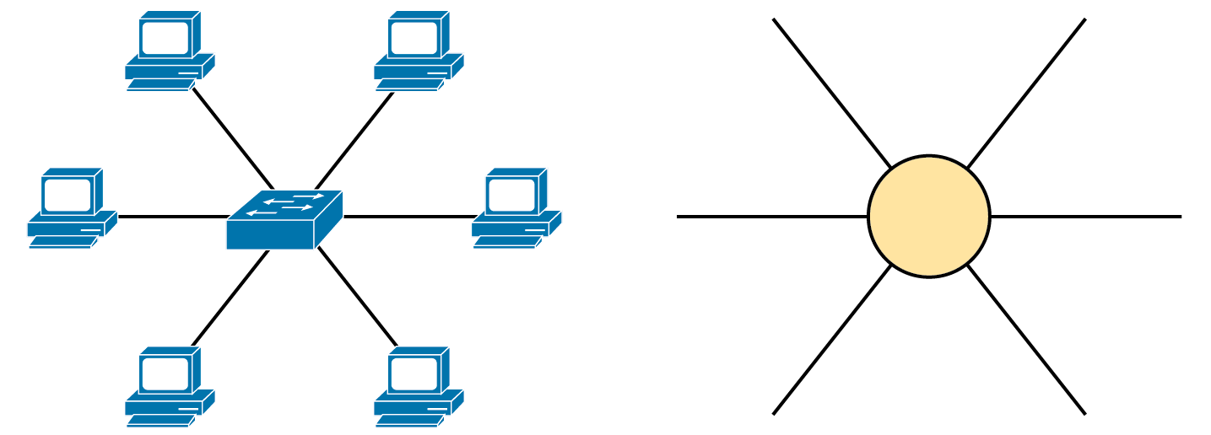
The Star Topology Design Concept in Networking

Slide 5
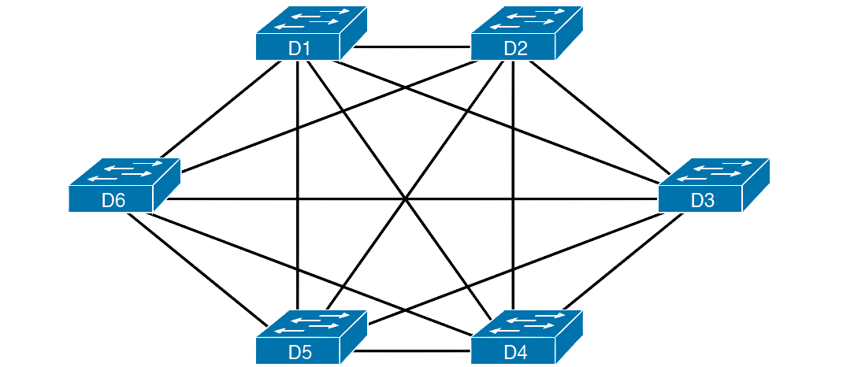
Using a Full Mesh at the Distribution Layer, 6 Switches, 15 Links

Slide 6
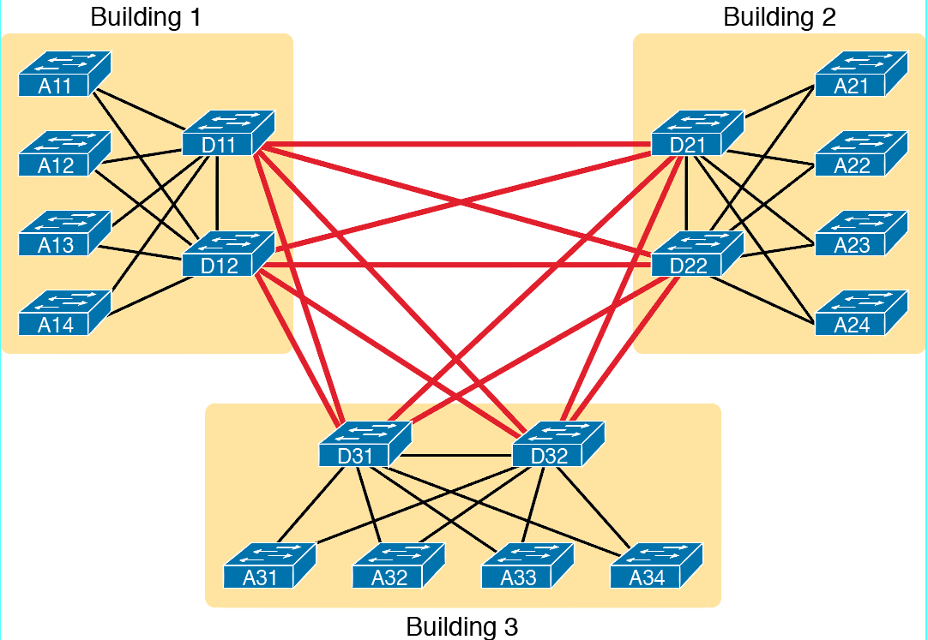
Two Tier Building Design, No Core, Three Buildings

Slide 7
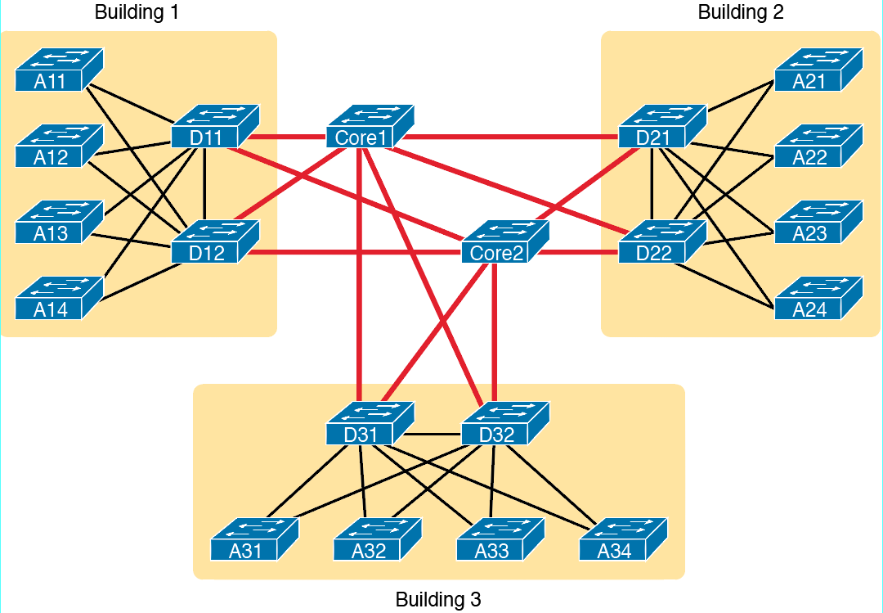
Three-Tier Building Design (Core Design), Three Buildings

Slide 8
Campus Switches Summary
Access: Provides a connection point for end-user devices
Distribution: Provides an aggregation point for access switches
Core: Aggregates distribution switches in very large campus LANs

Slide 9
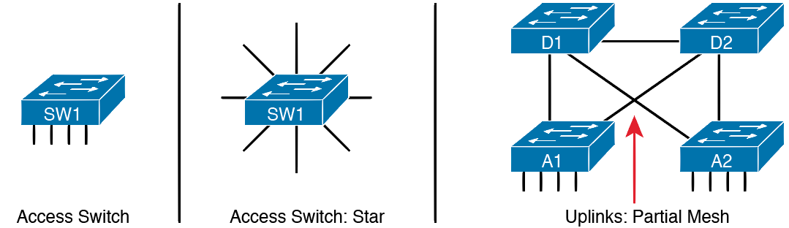
LAN Design Terminology

Slide 10
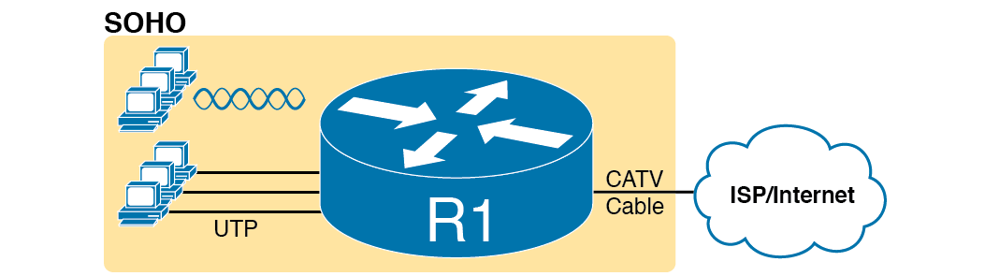
A Typical Home Wired and Wireless LAN

Slide 11
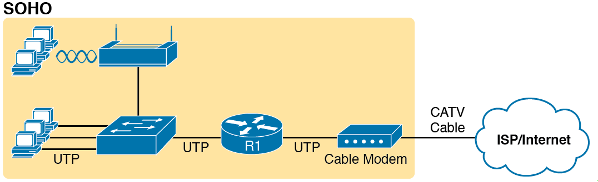
A Representation of the Functions Inside a Consumer Wireless Routing Product

Slide 12
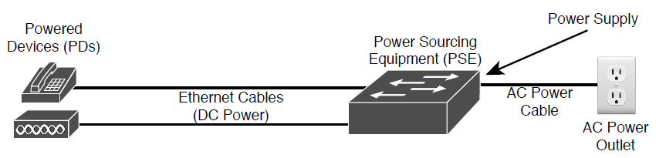
Power over Ethernet Terminology

Slide 13
Power over Ethernet Standards
Name | Standard | Watts at PSE | Powered Wire Pairs
Cisco Inline Power | Cisco | 7 | 2
PoE | 802.3af | 15 | 2
PoE+ | 902.3at | 30 | 2
UPoE | 802.3bt | 60 | 4
UPoE+ | 802.3bt | 100 | 4

Slide 14
Key Points When Planning a LAN Design with PoE
Powered Devices
Power Requirements
Switch Ports
Switch Power Supplies
PoE Standards vs. Actual

