Slide 1
CCNA 200-301, Volume 2
Chapter 14
WAN Architecture

Slide 2
Objectives
Describe characteristics of network topology architectures
WAN
Describe remote access and site-to-site VPNs

Slide 3
Metro Ethernet Concept as a Large Ethernet Network

Slide 4
Ethernet Access Links into a Metro Ethernet Service

Slide 5
IEEE Ethernet Standards Useful for Metro Ethernet Access
Name | Speed | Distance
100Base-LX10 | 100 Mbps | 10 Km
1000Base-LX | 1 Gbps | 5 Km
1000Base-LX10 | 1 Gbps | 10 Km
1000Base-ZX | 1 Gbps | 100 Km
10GBase-LR | 10 Gbps | 10 Km
10GBase-ER | 10 Gbps | 40 Km

Slide 6
Three MEF Service Types and Their Topologies
MEF Service Name | MEF Short Name | Topology Terms | Description
Ethernet Line Service | E-Line | point-to-point | Two customer premise equipment (CPE) devices can exchange Ethernet frames, similar to concept of leased line.
Ethernet LAN Service | E-LAN | Full Mesh | Acts like a LAN, in that all devices can send frames to all other devices.
Ethernet Tree Service | E-Tree | Hub-and-spoke; partial mesh; point-to-multipoint | A central site can communicate to a defined set of remote sites, but the remote sites cannot communicate directly.

Slide 7
Point-to-Point Topology in Metro Ethernet E-Line Service Between Routers

Slide 8
Using Multiple E-Lines, One for Each Remote Site

Slide 9
MetroE Ethernet LAN Service—Any-to-Any Forwarding over the Service

Slide 10
E-Tree Service Creates a Hub-and-Spoke Topology

Slide 11
Routing Protocol Neighbor Relationships over Metro Ethernet E-Line

Slide 12
Layer 3 Forwarding Between Remote Sites—Through Central Site

Slide 13
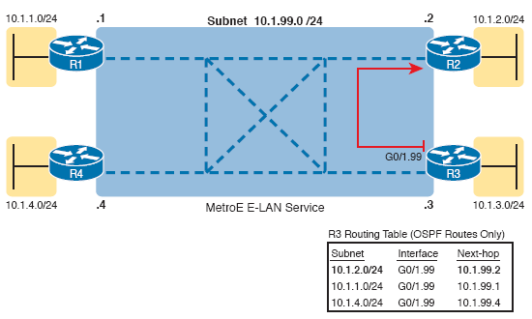
Layer 3 Forwarding Between Sites with E-LAN Service

Slide 14
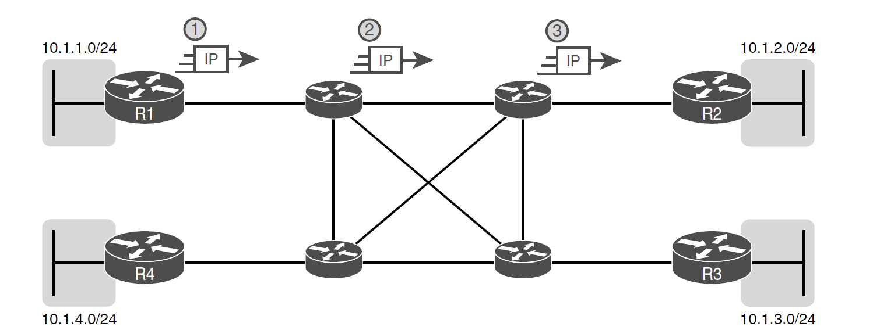
Basic IP Routing of IP Packets

Slide 15
MPLS Layer 3 Design, with PE and CE Routers

Slide 16
Popular MPLS Access Link Technologies

Slide 17
MPLS VPN QoS Marking and Reaction in the MPLS WAN

Slide 18
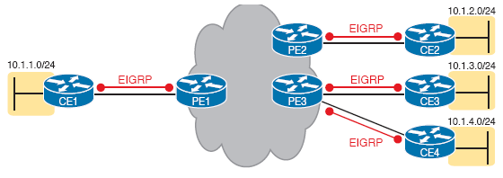
Routing Protocol Neighbor Relationships with MPLS Customer Edge

Slide 19
MPLS VPN Using Redistribution with MPBGP at PE Router

Slide 20
Three Examples of Internet Access Links for Companies

Slide 21
Wiring and Devices for a Home DSL Link

Slide 22
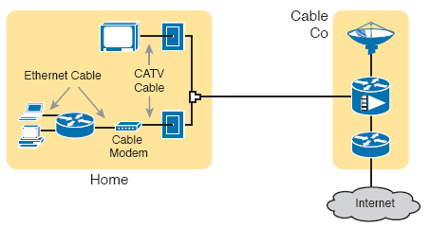
Wiring and Devices for a Home Cable Internet Link

Slide 23
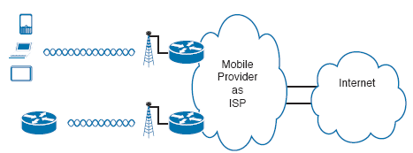
Wireless Internet Access Using 3G/4G/5G Technology

Slide 24
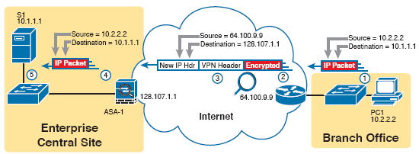
VPN Tunnel Concepts for a Site-to-Site Intranet VPN

Slide 25
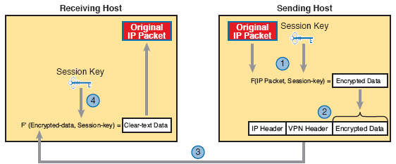
Basic IPsec Encryption Process

Slide 26
Site-to-Site VPN Tunnels with GRE and IPsec

Slide 27
Remote Access VPN Options (TLS)

Slide 28
Comparisons of Site-to-Site and Remote Access VPNs
 | Remote Access | Site-to-Site
Typical security protocol | TLS | IPsec
Devices supported by one VPN (one or many) | One | Many
Typical use: on-demand or permanent | On-demand | Permanent

