Slide 1
CCNA 200-301, Volume 2
Chapter 15
Cloud Architecture

Slide 2
Objectives
Explain the role and function of network components
Servers
Describe the characteristics of network topology architectures
On-premises and cloud
Explain virtualization fundamentals (virtual machines)

Slide 3
Cisco UCS Servers: B-Series (Blade)

Slide 4
Physical Server Model: Physical Hardware, One OS, and Applications

Slide 5
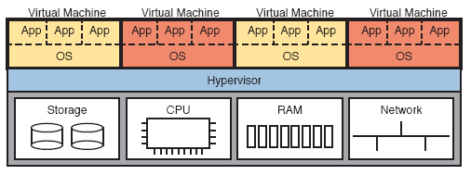
Four VMs Running on One Host; Hypervisor Manages the Hardware

Slide 6
Basic Networking in a Virtualized Host with a Virtual Switch

Slide 7
Traditional Data Center Top-of-Rack and End-of-Row Physical Switch Topology

Slide 8
Traditional Workflow: Customer (Human) Asks Virtualization (Human) for Service

Slide 9
Cloud Computing Criteria
On-demand self-service
Broad network access
Resource pooling
Rapid elasticity
Measured service

Slide 10
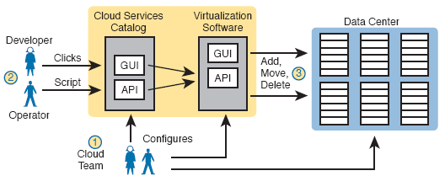
Basic Private Cloud Workflow to Create One VM

Slide 11
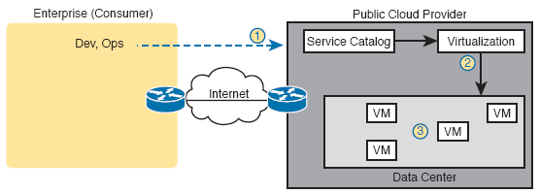
Public Cloud Provider in the Internet

Slide 12
IaaS Concept

Slide 13
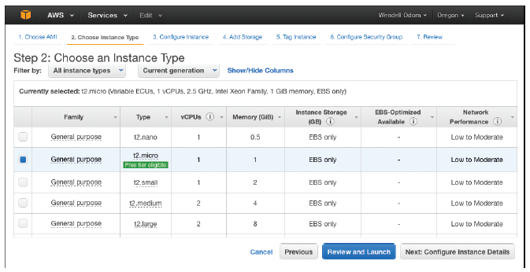
AWS Screenshot—Set Up VM with Different CPU/RAM/OS

Slide 14
SaaS Concept

Slide 15
PaaS Concept

Slide 16
Accessing a Public Cloud Service Using the Internet

Slide 17
Using Private WAN to a Public Cloud: Security, QoS, Capacity, Reporting

Slide 18
Permanent Private WAN Connection to an Intercloud Exchange

Slide 19
Comparison of Public Cloud WAN Options

Slide 20
Traffic Flow: Private WAN, Enterprise Implements Email Services

Slide 21
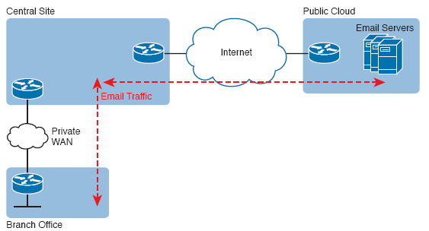
Traffic Flow: Private WAN, Enterprise Implements Email Services

Slide 22
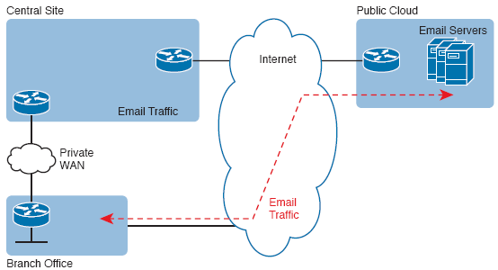
Connecting Branches Directly to the Internet for Public Cloud Traffic

