Slide 1
CCNA 200-301, Volume 2
Chapter 17
Cisco Software-Defined Access (SDA)

Slide 2
Objectives
Explain the role and function of network components
  Controllers (Cisco DNA Center and WLC)
Explain how automation impacts network management
Compare traditional networks with controller-based networking
Describe controller-based and software defined architectures (overlay, underlay, and fabric)
  Separation of control plane and data plane
  Northbound and southbound APIs
Compare traditional campus device management with Cisco DNA Center enabled device management

Slide 3
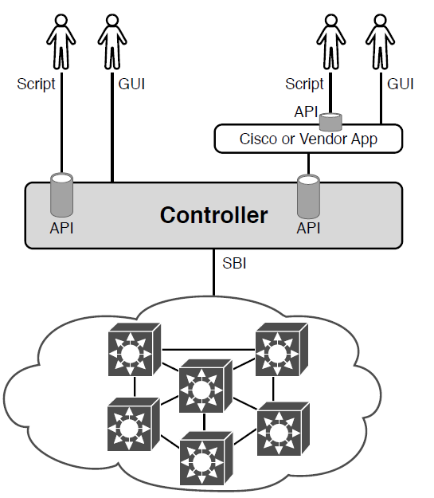
SDA Architectural Model with DNA Center

Slide 4
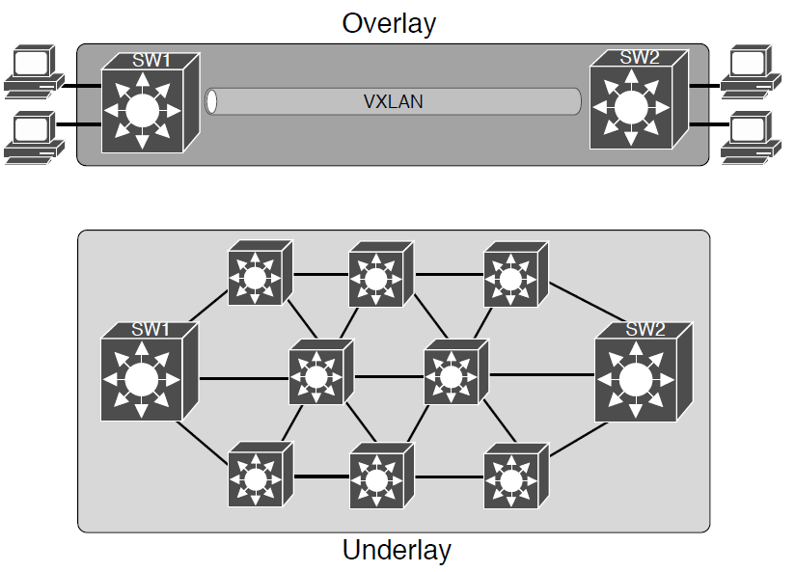
Fabric, Underlay, and Overlay Concepts

Slide 5
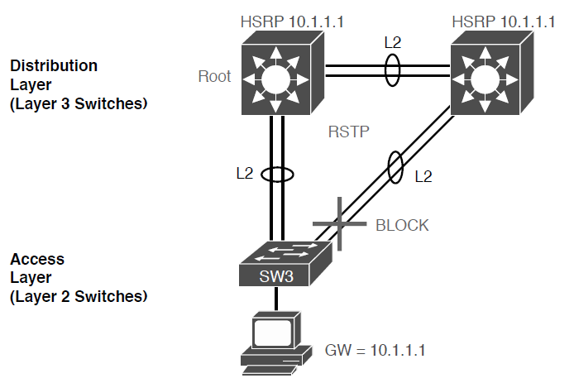
Traditional Access Layer Design: Three Switches in STP Triangle

Slide 6
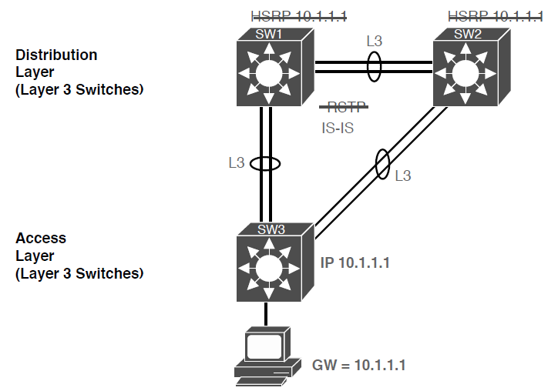
SDA Fabric Layer 3 Access Benefits

Slide 7
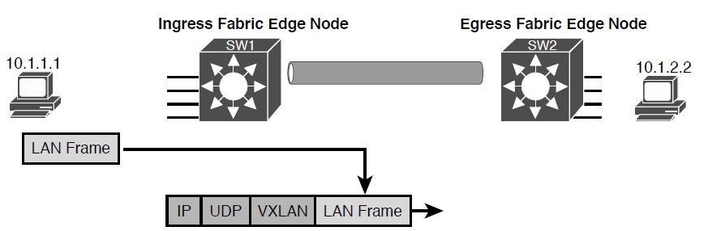
Fundamentals of VXLAN Encapsulation in SDA

Slide 8
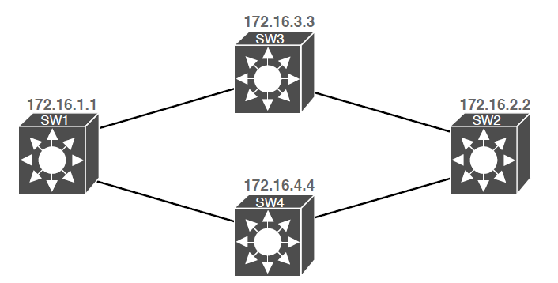
SDA Underlay Using 172.16.0.0

Slide 9
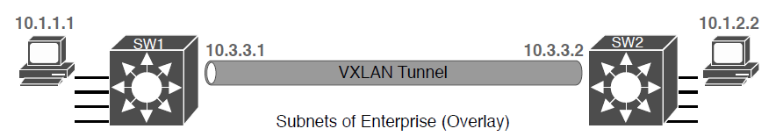
VXLAN Tunnel and Endpoints with IPv4 Addresses in the Same IPv4 Space

Slide 10
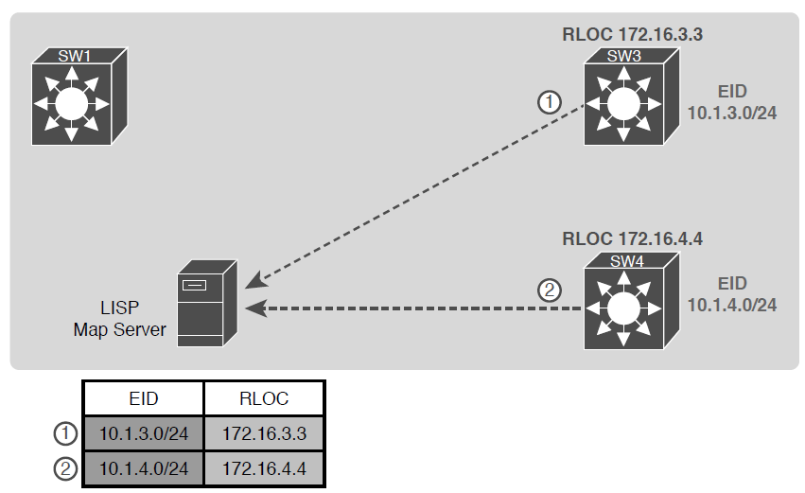
Edge Nodes Register IPv4 Prefixes (Endpoint IDs) with LISP Map Server

Slide 11
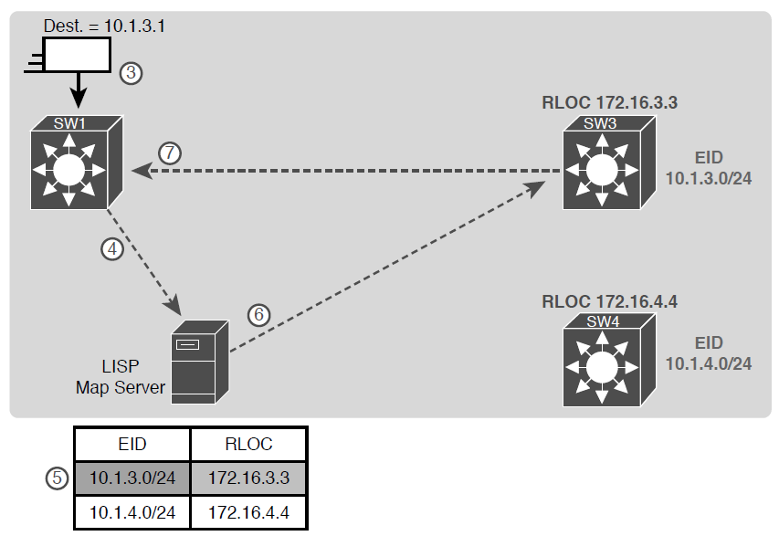
Ingress Tunnel Router SW1 Discovers Egress Tunnel Router SW3 Using LISP

Slide 12
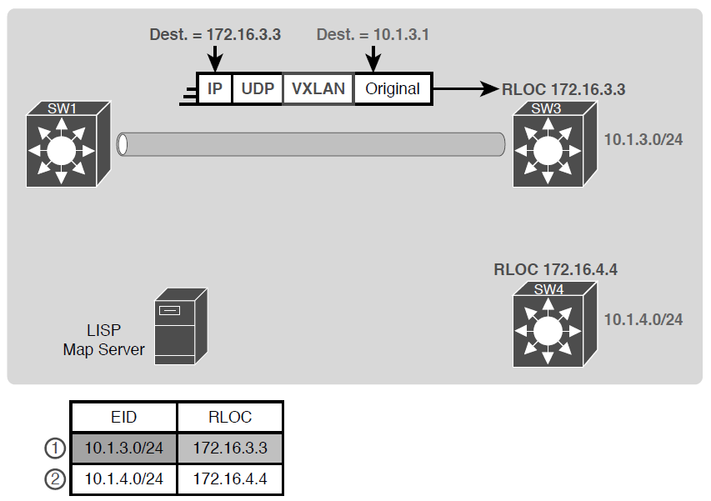
Ingress Tunnel Router (ITR) SW1 Forwards Based on LISP Mapping to SW3

Slide 13
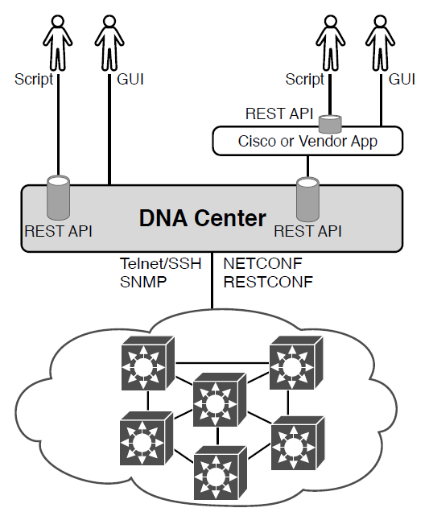
Cisco DNA Center with Northbound and Southbound Interfaces

Slide 14
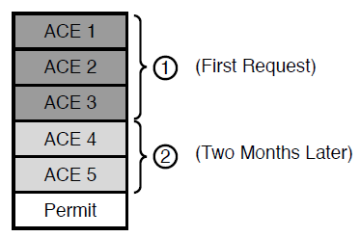
Lines (ACEs) in an ACL after Two Changes

Slide 15
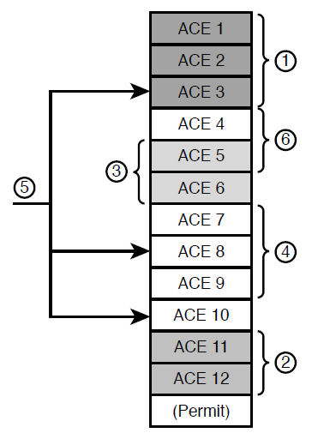
Lines (ACEs) in an ACL after Six Changes

Slide 16
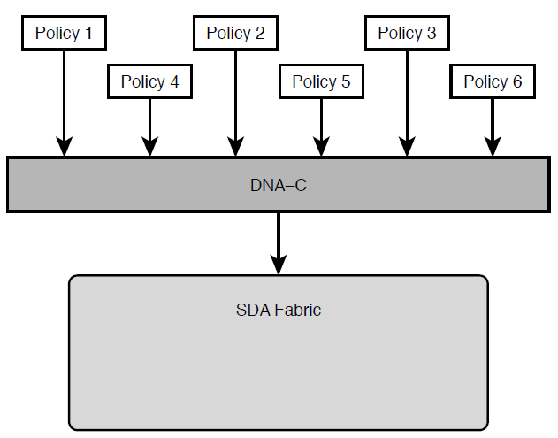
DNA-C IP Security Policies (Northbound) to Simplify Operations

Slide 17
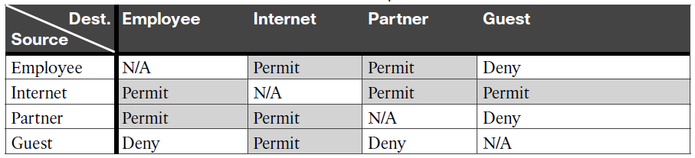
Access Table for SDA Scalable Group Access

Slide 18
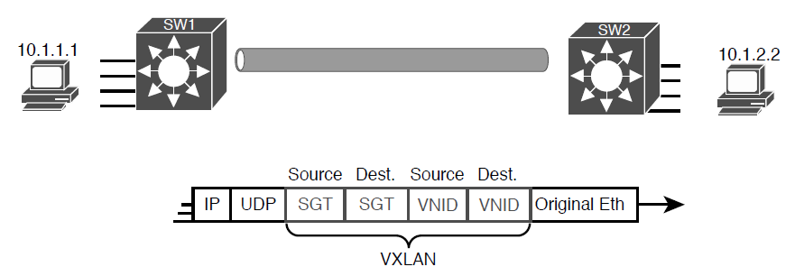
VXLAN Header with Source and Destination SGTs and VNIDs Revealed

Slide 19
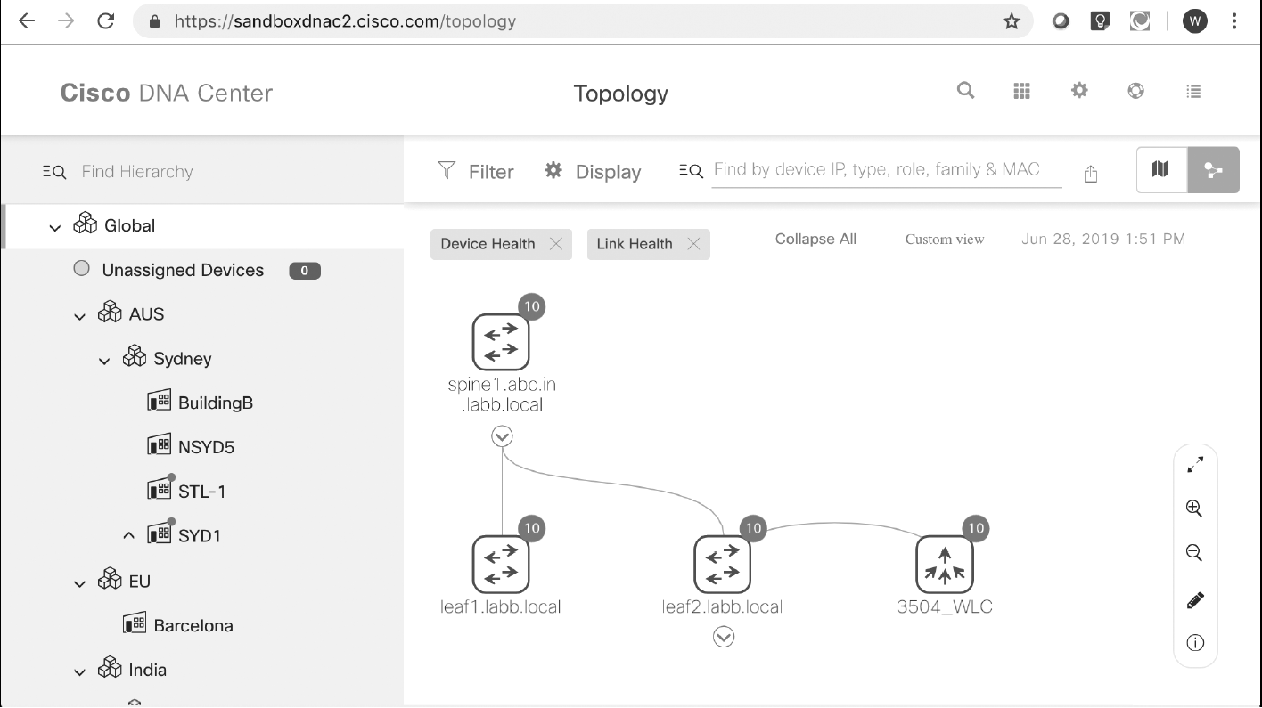
DNA Center Topology Map

Slide 20
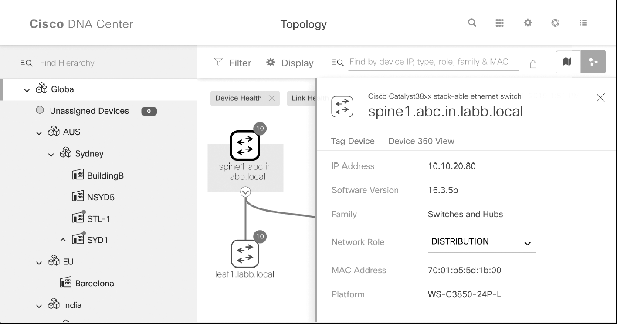
Hover and Click Details About One Cisco 9300 Switch from DNA Center

