Slide 1
CCNA 200-301, Volume 2
Chapter 18
Understanding REST and JSON

Slide 2
Objectives
Describe characteristics of REST-based APIs (CRUD, HTTP verbs, and data encoding)
Interpret JSON encoded data

Slide 3
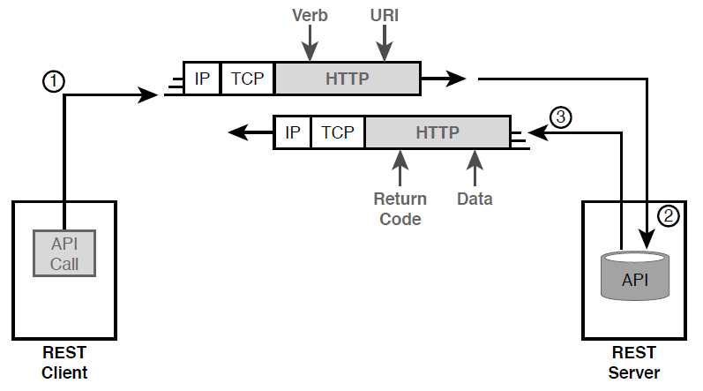
Client/Server Operation with REST

Slide 4
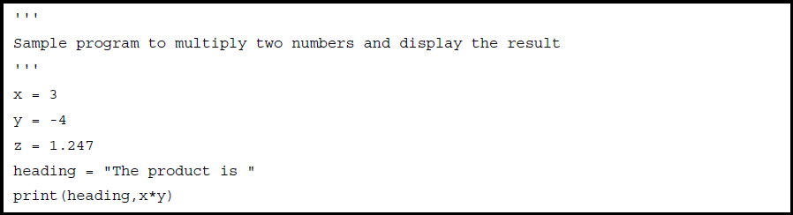
Simple Python Program That Shows a Product

Slide 5
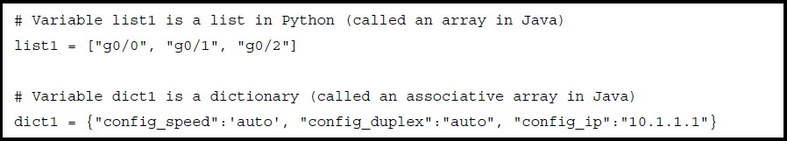
Sample List and Dictionary Variables in Python

Slide 6
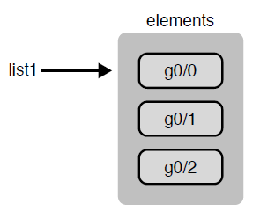
The List Data Structure in Python

Slide 7
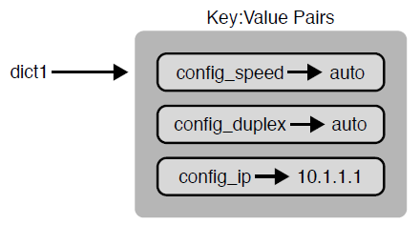
Dictionary Data Structures in Python

Slide 8
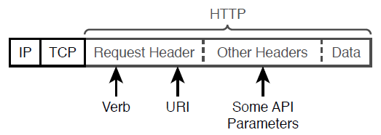
HTTP Verb and URI in an HTTP Request Header

Slide 9
Comparing CRUD Actions to REST Verbs
Action | CRUD Term | REST (HTTP) Verb
Create new data structures and variables | Create | POST
Read (retrieve) variable names, structures, and values | Read | GET
Update or replace values of some variable | Update | PATCH, PUT
Delete some variables and data structures | Delete | DELETE

Slide 10
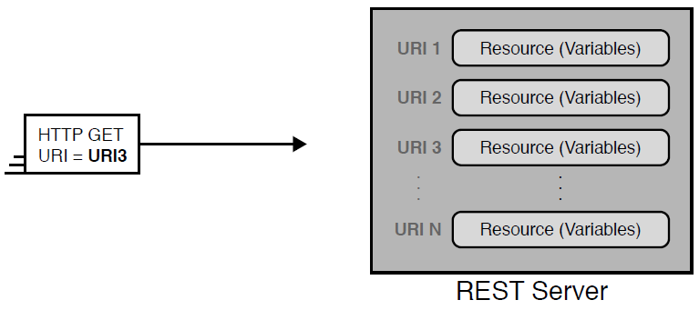
One URI for Each API Resource— Conceptual View

Slide 11
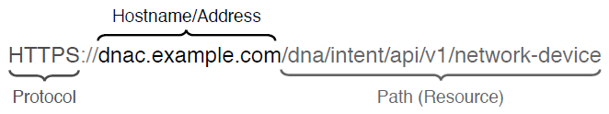
URI Structure for REST GET Request

Slide 12
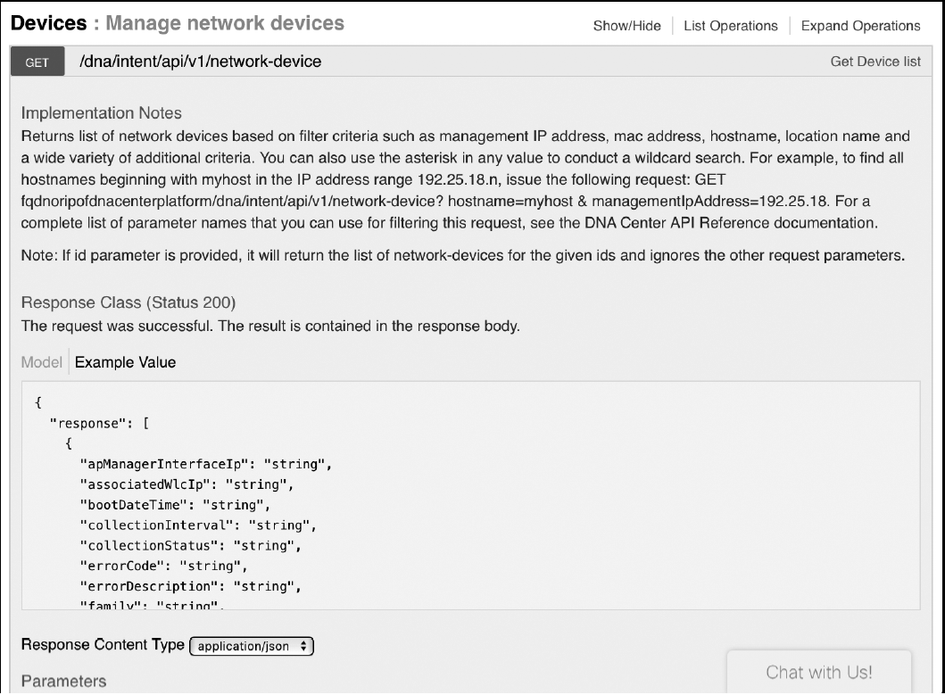
DNA Center API Doc Page for the Network Device (List) Resource

Slide 13
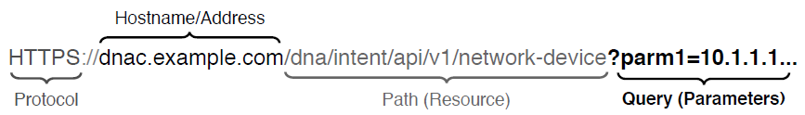
Example Components of a URI Used in a REST API Call

Slide 14
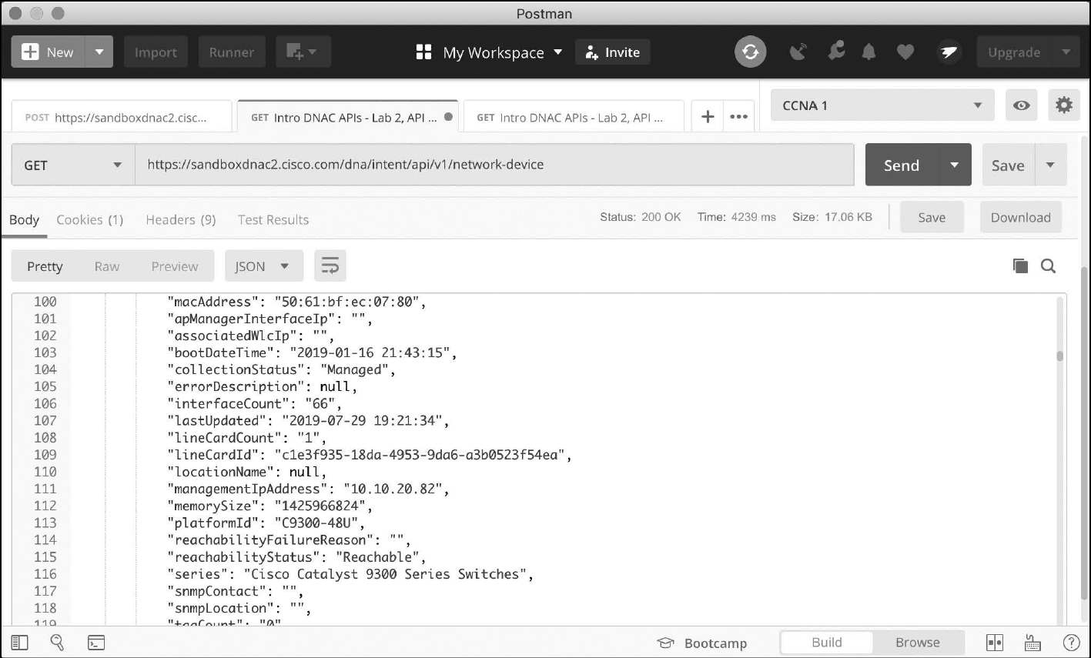
URI Structure for REST GET Request

Slide 15
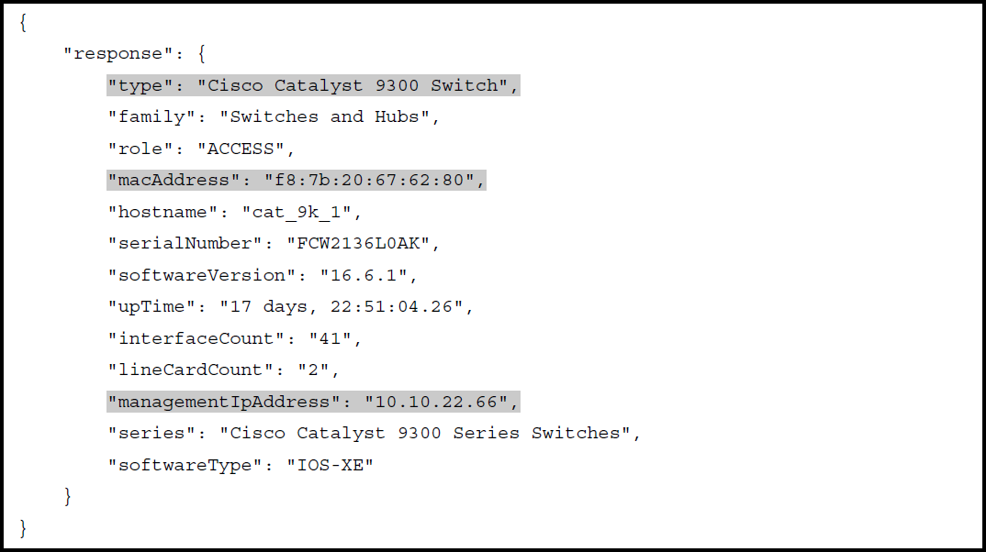
JSON Output from a REST API Call

Slide 16
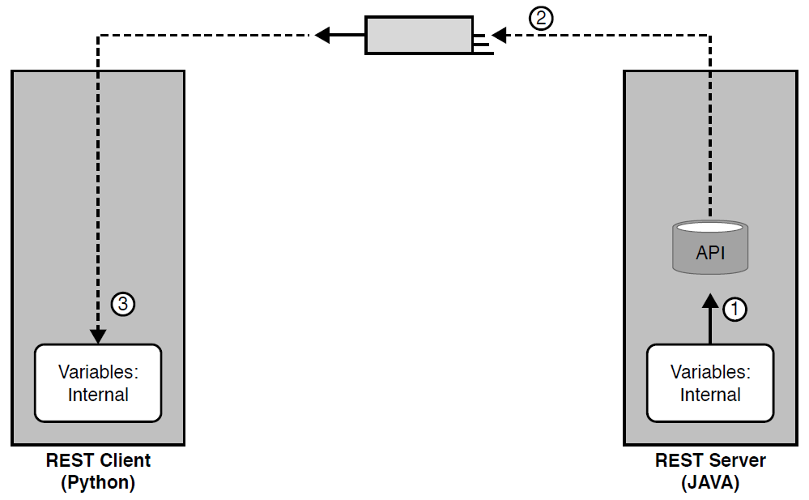
Broken Concept: Exchanging Internal Representations of Variables

Slide 17
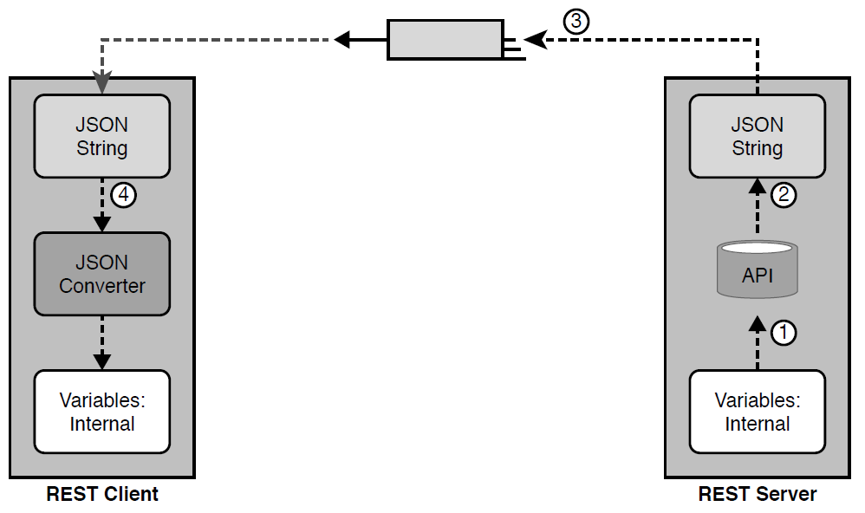
Correct Concept: Exchanging Internal Representations of Variables

Slide 18
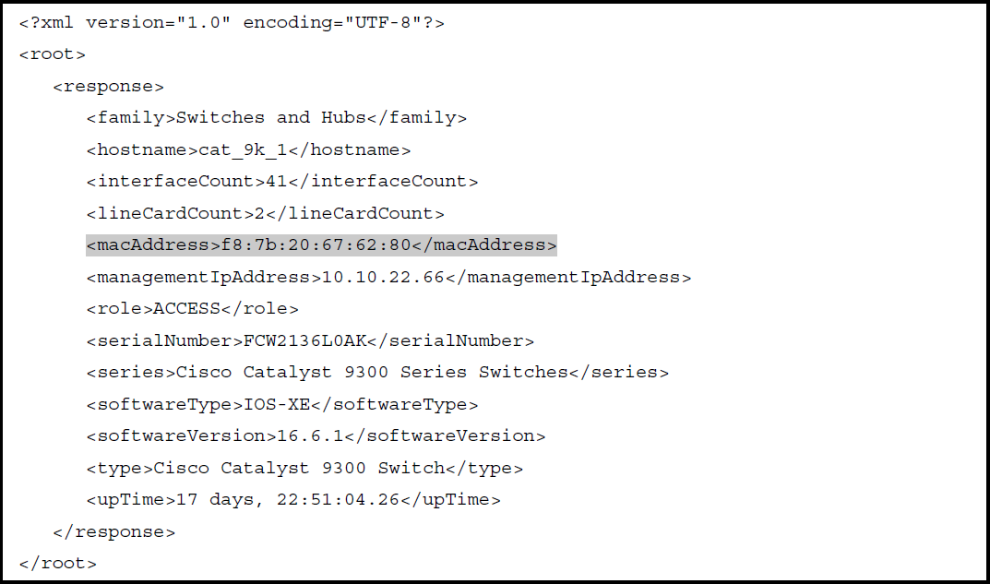
JSON Output from a REST API Call

Slide 19
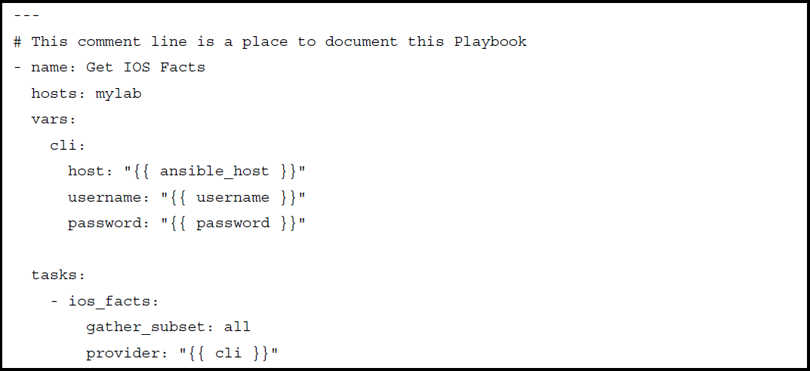
YML File Used by Ansible

Slide 20
Comparing Data Modeling Languages
Acronym | Name | Origin/ Definition | Central Purpose | Common Use
JSON | JavaScript Object Notation | JavaScript (JS) language; RFC 8259 | General data modeling and serialization | REST APIs
XML | eXtensible Markup Language | World Wide Web Consortium (W3C.org) | Data-focused text markup that allows data modeling | REST APIs, Web pages
YAML | YAML Ain’t Markup Language | YAML.org | General data modeling | Ansible

Slide 21
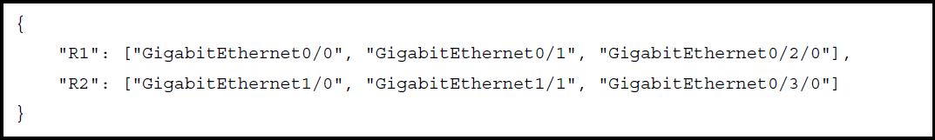
Simple JSON That Lists a Router’s Interfaces

Slide 22
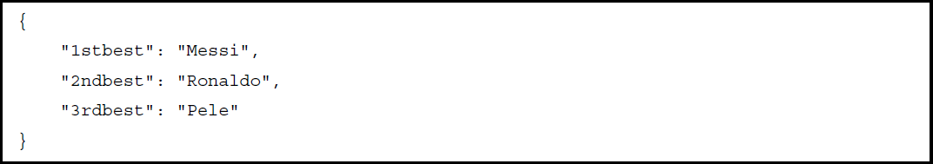
One JSON Object (Dictionary) with Three Key:Value Pairs

Slide 23
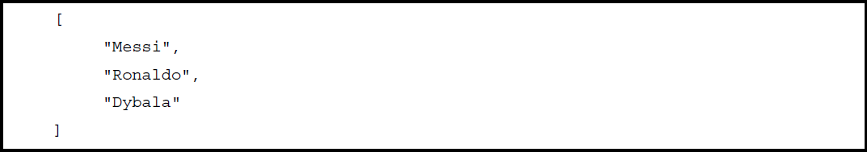
A JSON Snippet Showing a Single JSON Array (List)

Slide 24
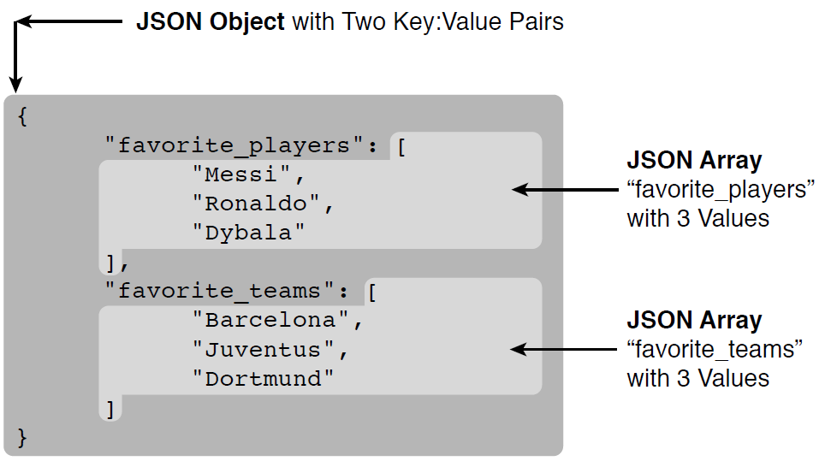
Accurate/Compete JSON Data with One Object, Two Keys, Two JSON List Values

Slide 25
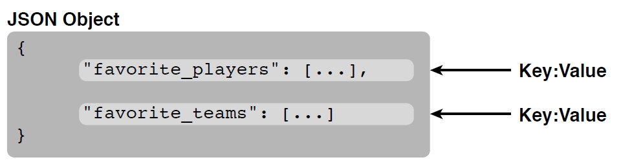
Structural Representation of Previous Slide’s Primary Object and Two Key:Value Pairs

Slide 26
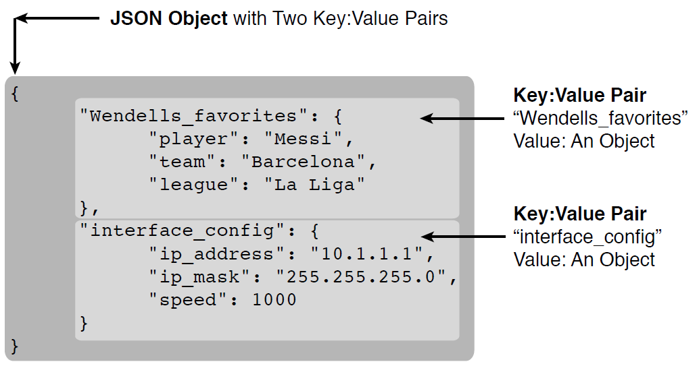
A JSON Object, with Two Key:Value Pairs, Each Value Another Object

