Slide 1
CCNA 200-301, Volume 2
Chapter 19
Understanding Ansible, Puppet, and Chef

Slide 2
Objectives
Recognize the capabilities of configuration mechanisms Puppet, Chef, and Ansible

Slide 3
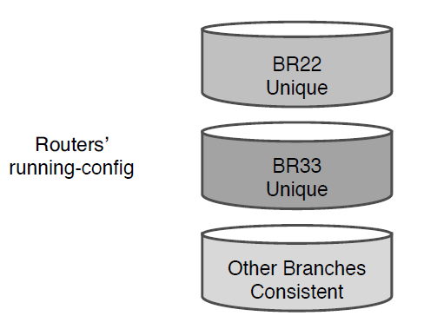
Configuration Drift in Branch Routers BR22 and BR33

Slide 4
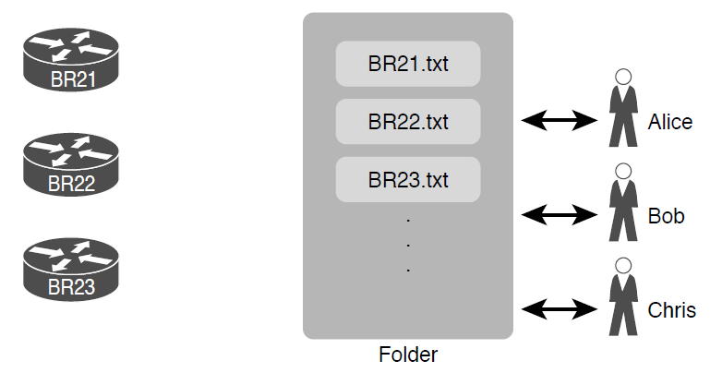
Copying Device Configurations to a Central Location

Slide 5
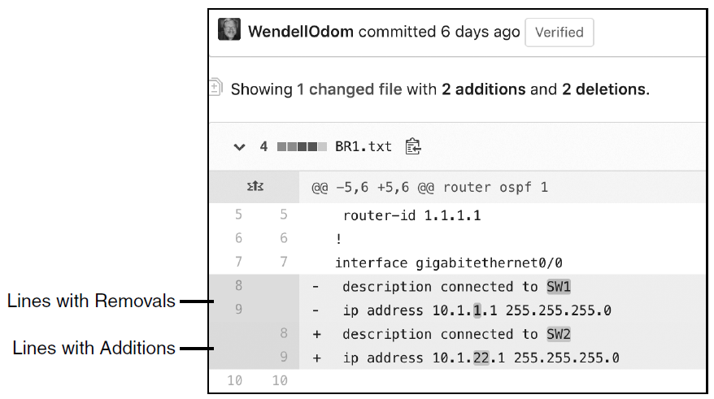
Showing File Differences in GitHub

Slide 6
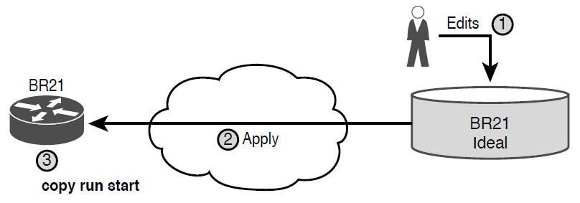
Pushing Centralized Configuration to a Remote Device

Slide 7
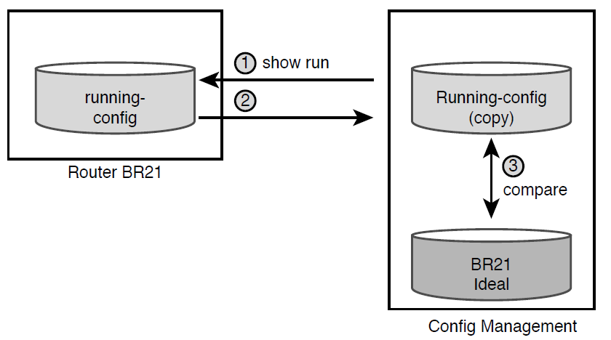
Configuration Monitoring

Slide 8
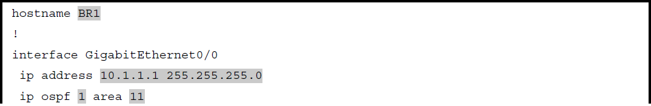
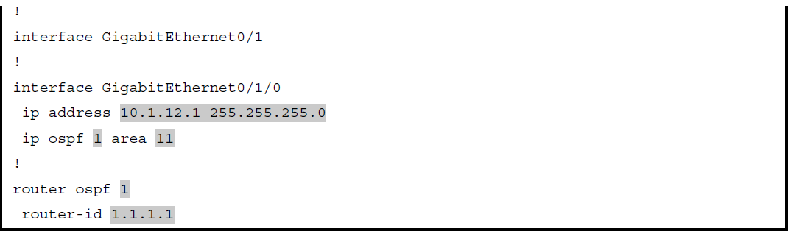
Router BR1 Configuration, with Unique Values Highlighted

Slide 9
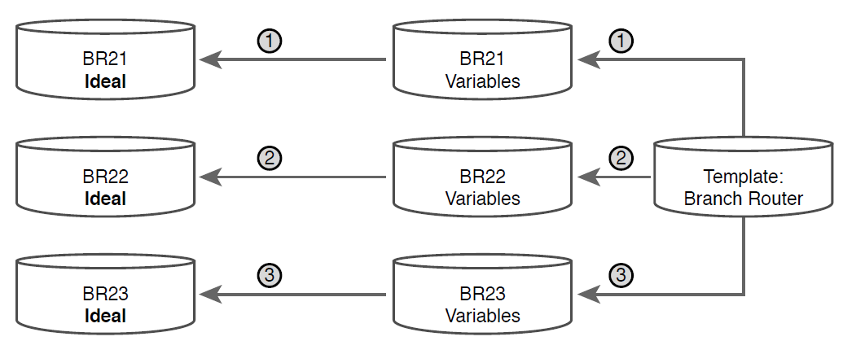
Concept: Configuration Templates and Variables

Slide 10
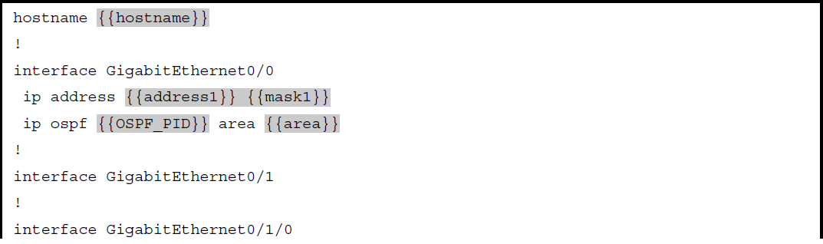
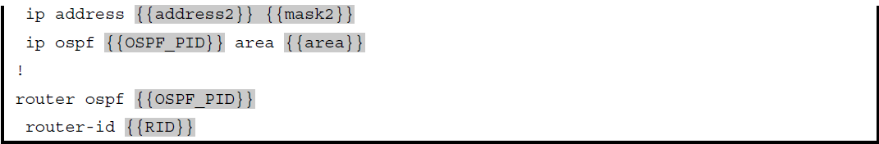
Jinja2 Template with Variables Based on Previous Example

Slide 11
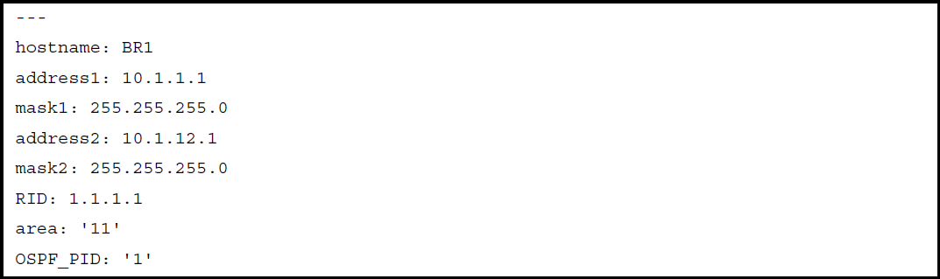
YAML Variables File Based on Previous Example

Slide 12
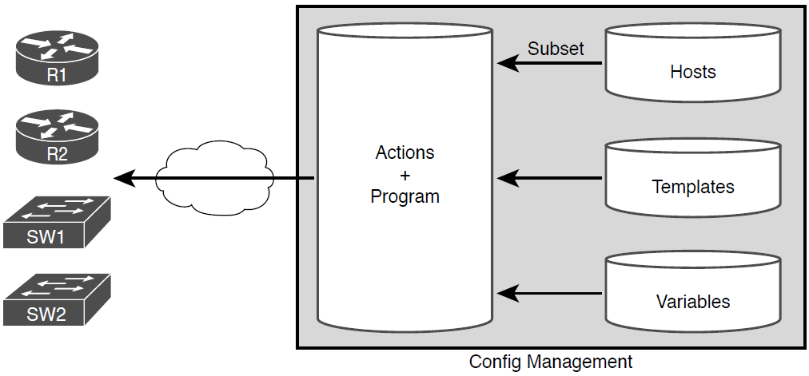
Important Files Used by Configuration Management Tools

Slide 13
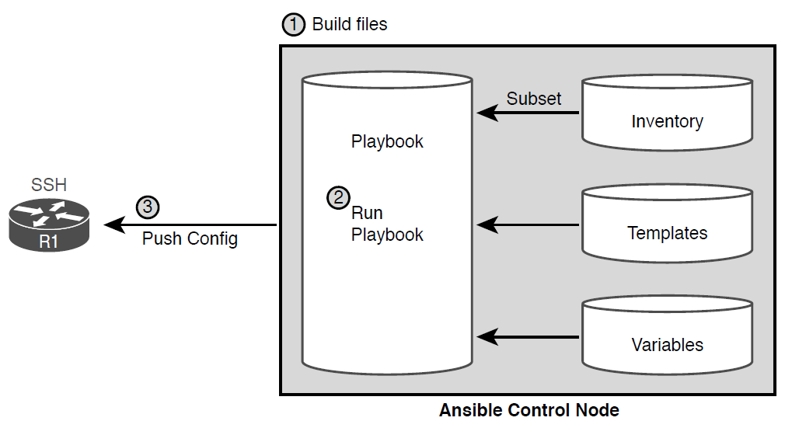
Ansible Push Model

Slide 14
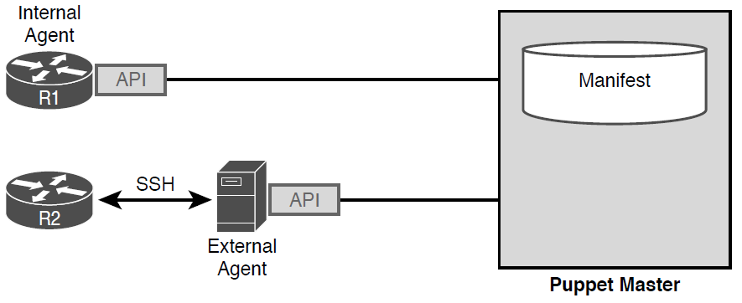
Agent-based and Agentless Operation for Puppet

Slide 15
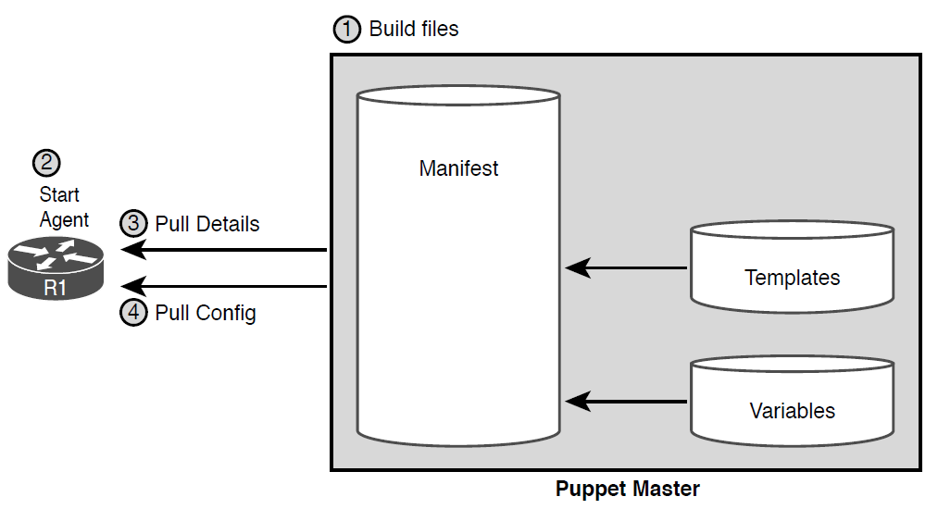
Pull Model with Puppet

Slide 16
Comparing Ansible, Puppet, and Chef
Action | Ansible | Puppet | Chef
Term for the file that lists actions | Playbook | Manifest | Recipe, Runlist
Protocol to network device | SSH, NETCONF | HTTP (REST) | HTTP (REST)
Uses agent or agentless model | Agentless | Agent* | Agent
Push or pull model | Push | Pull | Pull
* Puppet can use an in-device agent or an external proxy agent for network devices

